Slide 1

Ibrar Ahmed Principal Software Developer Percona

Slide 2

Who am I?
Software Career
Software industries since 1998.
PostgreSQL Career
Working on PostgreSQL Since 2006.
EnterpriseDB (Associate Software Architect core Database Engine) 2006-2009
EnterpriseDB (Software Architect core Database Engine) 2011 - 2016
EnterpriseDB (Senior Software Architect core Database Engine) 2016 – 2018
Percona (Senior Software Developer core Database Engine) 2018 – Present
@ibrar_ahmad
IBRAR AHMED
Senior Software Architect
https://www.facebook.com/ibrar.ahmed
Percona LLC
PostgreSQL Books
https://www.linkedin.com/in/ibrarahmed74/
PostgreSQL Developer's Guide
PostgreSQL 9.6 High Performance

Slide 3
Agenda
01
Database Performance
02
PostgreSQL Modules
03
PostgreSQL Performance Tuning
04
Linux Kernel Tuning
05
Questions and Answers

Slide 4





Timeline
Database Performance
PostgreSQL Performance Tuning
Tips
5 Minutes
5 Minutes
20 Minutes
20 Minutes
5 Minutes
5 Minutes
PostgreSQL Modules
Linux Kernel Tuning
Question Answers

Slide 5
Database Performance

Slide 6




Database Performance
Hardware
Database
Choose better Hardware
Tune your database (PostgreSQL)
Operating System
Application
Operating System Selection and Tuning
Tune client application
Workload
Query
SELECT * FROM foo
Choose Database Depend based on Workload
Tune your query properly.

Slide 7
PostgreSQL Modules

Slide 8
PostgreSQL Modules
Clients
PostgreSQL Memory
work_mem
Client - psql
Client - JDBC
Client - ODBC
Shared Buffers
Default = 128MB
Processes
Postmaster
Port = 5432
Postgres
Postgres
WAL Buffers
Default = 16MB
maintancework_mem
WAL Writer
Archiver
Checkpointer
Background Writer
Logger
Kernel Memory
Disk Management
4K
2MB/1GB Huge Pages
THP
$PGDATA
Table Spaces
base/ Datafiles
global
pg_wal/ WAL files
Configuration Files
/dev/sda
/dev/sdb

Slide 9
PostgreSQL Performance Tuning

Slide 10
PostgreSQL Tuning Parameters
PostgreSQL’ configuration file (postgresql.conf)
Memory Related Parameter
shared_buffers
wal_buffers
effective_cache_size
work_mem
maintenance_work_mem
I/O Based Parameters
checkpoint_timeout
checkpoint_completion_target
synchronous_commit

Slide 11

PostgreSQL Tuning / shared_buffer
PostgreSQL uses its own buffer along with kernel buffered I/O.
PostgreSQL does not change the information on disk directly then how?
Writes the data to shared buffer cache.
The backend process write that these blocks kernel buffer.
postgresql=# SHOW shared_buffers;
shared_buffers
----------------
128MB
(1 row)
The proper size for the POSTGRESQL shared buffer cache is the largest useful size that does not adversely affect other activity.
—Bruce Momjian

Slide 12
PostgreSQL Tuning / shared_buffer
Shared_buffer vs TPS
Shared_buffer vs TPS
Shared_buffer
TPS
35%
128 Megabyte
500
128 Megabyte
3023
128 Megabyte
6801
1 Gigabyte
12898
2 Gigabyte
30987
4 Gigabyte
54536
8 Gigabyte
55352
16 Gigabyte
55364

Slide 13
PostgreSQL Tuning / wal_buffer
Do you have Transaction? Obviously
WAL – (Write Ahead LOG) Log your transactions
Size of WAL files 16MB with 8K Block size (can be changed at compile time)
PostgreSQL writes WAL into the buffers(wal_buffer ) and then these buffers are flushed to disk.
Bigger value for wal_buffer in case of lot of concurrent connection gives better performance.

Slide 14
PostgreSQL Tuning effective_cache_size
This used by the optimizer to estimate the size of the kernel's disk buffer cache.
The effective_cache_size provides an estimate of the memory available for disk caching.
It is just a guideline, not the exact allocated memory or cache size.

Slide 15
PostgreSQL Tuning / work_mem
This configuration is used for complex sorting.
It allows PostgreSQL to do larger in-memory sorts.
Each value is per session based, that means if you set that value to 10MB and 10 users issue sort queries then 100MB will be allocated.
In case of merge sort, if x number of tables are involved in the sort then x * work_mem will be used.
It will allocate when required.
Line in EXPLAIN ANALYZE “Sort Method: external merge Disk: 70208kB”

Slide 16

PostgreSQL Tuning / work_mem
postgres=# SET work_mem ='2MB';
postgres=# EXPLAIN ANALYZE SELECT * FROM foo ORDER BY id;
QUERY PLAN
---------------------------------------------------------------------------------------------------------------------------------------------
Gather Merge (cost=848382.53..1917901.57 rows=9166666 width=9) (actual time=5646.575..12567.495 rows=11000000 loops=1)
Workers Planned: 2
Workers Launched: 2
-> Sort (cost=847382.51..858840.84 rows=4583333 width=9) (actual time=5568.049..7110.789 rows=3666667 loops=3)
Sort Key: id
Sort Method: external merge Disk: 74304kB
Worker 0: Sort Method: external merge Disk: 70208kB
Worker 1: Sort Method: external merge Disk: 70208kB
-> Parallel Seq Scan on foo (cost=0.00..105293.33 rows=4583333 width=9) (actual time=0.018..985.524 rows=3666667 loops=3)
Planning Time: 0.055 ms
Execution Time: 13724.353 ms
(11 rows)
postgres=# SET work_mem ='1GB';
postgres=# EXPLAIN ANALYZE SELECT * FROM foo ORDER BY id;
QUERY PLAN
--------------------------------------------------------------------------------------------------------------------------------------------
Sort (cost=1455965.01..1483465.01 rows=11000000 width=9) (actual time=5346.423..6554.609 rows=11000000 loops=1)
Sort Key: id
Sort Method: quicksort Memory: 916136kB
-> Seq Scan on foo (cost=0.00..169460.00 rows=11000000 width=9) (actual time=0.011..1794.912 rows=11000000 loops=1)
Planning Time: 0.049 ms
Execution Time: 7756.950 ms
(6 rows)
Time: 7757.595 ms (00:07.758)

Slide 17
maintenance_work_mem
maintenance_work_mem is a memory setting used for maintenance tasks.
The default value is 64MB.
Setting a large value helps in tasks like
VACUUM
RESTORE
CREATE INDEX
ADD FOREIGN KEY
ALTER TABLE.

Slide 18
maintenance_work_mem
postgres=# CHECKPOINT;
postgres=# SET maintenance_work_mem='10MB';
postgres=# SHOW maintenance_work_mem;
maintenance_work_mem
----------------------
10MB
(1 row)
postgres=# CREATE INDEX idx_foo ON foo(id);
Time: 12374.931 ms (00:12.375)
postgres=# CHECKPOINT;
postgres=# SET maintenance_work_mem='1GB';
postgres=# SHOW maintenance_work_mem;
maintenance_work_mem
----------------------
1GB
(1 row)
postgres=# CREATE INDEX idx_foo ON foo(id);
Time: 9550.766 ms (00:09.551)

Slide 19
synchronous_commit
This is used to enforce that commit will wait for WAL to be written on disk before returning a success status to the client.
This is a trade-off between performance and reliability.
Increasing reliability decreases performance and vice versa.
Synchronous commit doesn't introduce the risk of corruption, which is really bad, just some risk of data loss.
https://wiki.postgresql.org/wiki/Tuning_Your_PostgreSQL_Server

Slide 20
checkpoint_timeout
PostgreSQL writes changes into WAL. The checkpoint process flushes the data into the data files.
More checkpoints have a negative impact on performance.
Frequent checkpoint reduce the recovery time

Slide 21
Linux Tuning for PostgreSQL

Slide 22
Input Output Handling
Direct IO, Buffered IO and Double buffering
PostgreSQL believes that the Operating system (Kernel) knows much better about storage and IO scheduling.
PostgreSQL has its own buffering; and also needs the pages cache. Double Buffering
It Increase the use of memory.
And different kernel and setting behave differently.

Slide 23
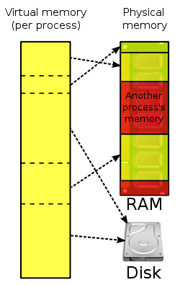
Virtual Memory
Every process is given the impression that it is working with large, contiguous sections of memory
Each process runs in its own dedicated address space
Pages Table are used to translate the virtual addresses seen by the application into Physical Address
https://en.wikipedia.org/wiki/Virtual_memory
https://en.wikipedia.org/wiki/Page_table

Slide 24
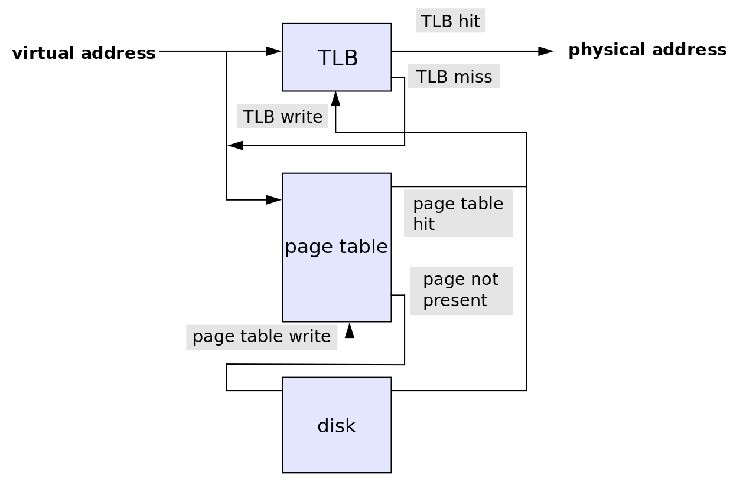
Translation Lookaside Buffer (TLB)
Translation Lookaside Buffer is a memory cache
It reduce the time to access a user memory location
If a match is found the physical address of the page is returned → TLB hit
If match not found scan the page table (walk)
looking for the address mapping (entry) → TLB miss
Small page size bigger TLB size → expensive

Slide 25
Memory Pages
PostgreSQL uses its own buffer along with kernel buffered I/O.
PostgreSQL does not change the information on disk directly then how?
Writes the data to shared buffer cache.
The backend process write that these blocks kernel buffer.

Slide 26
Linux Page sizes
Linux Page size is 4K
Many modern processors support other page sizes
If we consider a server with 256G of RAM:
4K | 67108864
2M | 131072
1G | 256
large/huge pages
Notes:
The address translation logic is also known as page table walking
The page table walk is expensive because it may require multiple memory accesses
Using large pages to improve the effectiveness of the TLB
by increasing the page size we'll have less pages to map

Slide 27
Classic Huge Pages
# cat /proc/meminfo
MemTotal: 264041660 kB
...
Hugepagesize: 2048 kB
DirectMap4k: 128116 kB
DirectMap2M: 3956736 kB
DirectMap1G: 266338304 kB
sysctl -w vm.nr_hugepages=256
Notes:
"Default" huge page size
DirectMap here is related to TLB use, I'm unsure if accurate though

Slide 28
Classic Huge Pages
# vi /etc/default/grub
GRUB_CMDLINE_LINUX_DEFAULT="hugepagesz=1GB default_hugepagesz=1G”
# update-grub
Generating grub configuration file ...
Found linux image: /boot/vmlinuz-4.4.0-75-generic
Found initrd image: /boot/initrd.img-4.4.0-75-generic
Found memtest86+ image: /memtest86+.elf
Found memtest86+ image: /memtest86+.bin
Done
# shutdown -r now
Notes:
huge page size can only be changed at boot time

Slide 29
Classic Huge Pages
# vim /etc/postgresql/10/main/postgresql.conf
huge_pages=ON # default is try
# service postgresql restart

Slide 30
Transparent Huge pages
The kernel works in the background (khugepaged) trying to:
"create" huge pages.
Find enough contiguous blocks of memory
Convert them into a huge page
Transparently allocate them to processes when there is a "fit"
Notes:
Transparent Hugepage Support is an alternative means of using huge pages for the backing of virtual memory with huge pages that supports the automatic promotion and demotion of page sizes

Slide 31
Disabling Transparent Huge pages
# cat /proc/meminfo | grep AnonHuge
AnonHugePages: 2048 kB
# ps aux | grep huge
root 42 0.0 0.0 0 0 ? SN Jan17 0:00 [khugepaged]
To disable it:
at runtime:
# echo never > /sys/kernel/mm/transparent_hugepage/enabled
# echo never > /sys/kernel/mm/transparent_hugepage/defrag
at boot time:
GRUB_CMDLINE_LINUX_DEFAULT="(...) transparent_hugepage=never"

Slide 32
vm.swappines
This is another kernel parameter that can affect the performance of the database.
Used to control the swappiness (swapping pages to swap memory into RAM) behavior on a Linux system.
The parameter can take anything from “0” to “100”.
The default value is 60.
Higher value means more aggressively swap.

Slide 33
vm.overcommit_memory and vm.overcommit_ratio
Applications acquire memory and free that memory when it is no longer needed.
But in some cases an application acquires too much memory and does not release it. This can invoke the OOM killer.
This is used to control the memory over-commit.
It has three options
Heuristic overcommit, Do it intelligently (default); based kernel heuristics
Allow overcommit anyway
Don’t over commit beyond the overcommit ratio.

Slide 34
vm.dirty_background_ratio and vm.dirty_background_bytes
The vm.dirty_background_ratio is the percentage of memory filled with dirty pages that need to be flushed to disk.
Flushing is done in the background.
The value of this parameter ranges from 0 to 100;

Slide 35
vm.dirty_ratio / vm.dirty_bytes
The vm.dirty_background_ratio is the percentage of memory filled with dirty pages that need to be flushed to disk.
Flushing is done in the foreground.
The value of this parameter ranges from 0 to 100;

Slide 36
Blogs
Tuning PostgreSQL Database Parameters to Optimize Performance.
https://www.percona.com/blog/2018/08/31/tuning-postgresql-database-parameters-to-optimize-performance/
Tune Linux Kernel Parameters For PostgreSQL Optimization
https://www.percona.com/blog/2018/08/29/tune-linux-kernel-parameters-for-postgresql-optimization/

Slide 37
THANK YOU
PostgreSQL Performance Tunning

