Slide 1
Percona Distribution For PostgreSQL
Ibrar Ahmed (Senior Database Architect)
Percona LLC

Slide 2
PostgreSQL
The world’s most advanced open source relational database
(https://www.postgresql.org/)
Open-source
(git://git.postgresql.org/git/postgresql.git)
Very open license called PostgreSQL License similar to BSD and MIT
(https://www.postgresql.org/about/licence/)
Community-based development
(https://www.postgresql.org/community/)
Many companies have PostgreSQL Forks
Open-source
Close-source

Slide 3
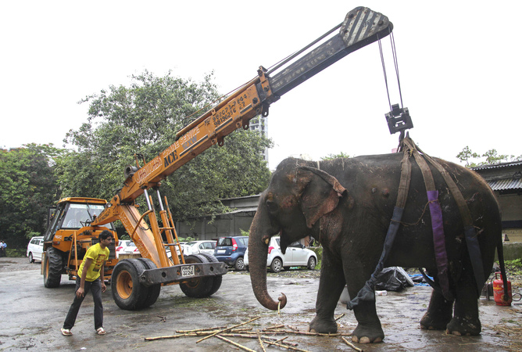
PostgreSQL Distributions (Help PostgreSQL)

Slide 4

PostgreSQL Distributions (Too Many Nodes)

Slide 5

PostgreSQL Distributions (Auditing)

Slide 6
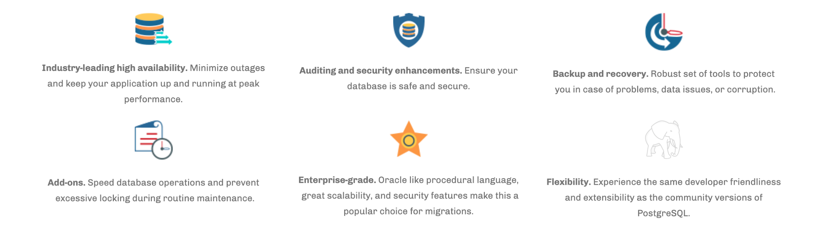
Percona Distribution for PostgreSQL

Slide 7
Percona Distribution for PostgreSQL
PostgreSQL (Version 11)
pg_repack
pgAudit
pgBackRest
Patroni

Slide 8
pg_repack
Heavily-used tool for rebuilding tables and indexes online (minimal locks).
Several advanced features such as parallelism, online table move to a new tablespace, and repack all the tables of a schema.

Slide 9
pgaudit (An Audition Solution)
Capability to produce audit logs required to pass certain government, financial, or ISO certification audits.
Not only the statement passed by the user, but also the sub statement executed in the database is logged.
Useful when statements passed to database are intentionally obfuscated or to identify SQL injections.

Slide 10
pgaudit (Example)
DO
$$
BEGIN
EXECUTE 'CREATE TABLE import' || 'ant_table (id INT)’;
END
$$;
DO
$$
BEGIN
EXECUTE 'CREATE TABLE import' || 'ant_table (id INT)’;
END
$$;
AUDIT: SESSION,33,1,FUNCTION,DO,,,
“DO $$
BEGIN
EXECUTE 'CREATE TABLE import' || 'ant_table (id INT)’;
END
$$;"
AUDIT: SESSION,33,2,DDL,CREATE TABLE,
TABLE, public.important_table,CREATE TABLE important_table (id INT)

Slide 11

pgBackrest (A Cluster Backup Solution)
Backup tool for a few gigabytes to multi-terabyte database clusters
Backups
Full Cluster Level Backup
Incremental Backup
Differential Backup
Storage
Local Backup
Remote Backup
Cloud Storage
Speed
Compression
Parallelism
Why if PostgreSQL has pg_basebackup and pg_dump?

Slide 12
Patroni (A High Availability Solution)
Template for PostgreSQL HA that helps achieve several nines of availability.
Supports automatic and manual failover/switchover and switchback.
Integrated with pg_rewind for rejoining a demoted node to a cluster.
Protection from split-brain using watchdog.

Slide 13
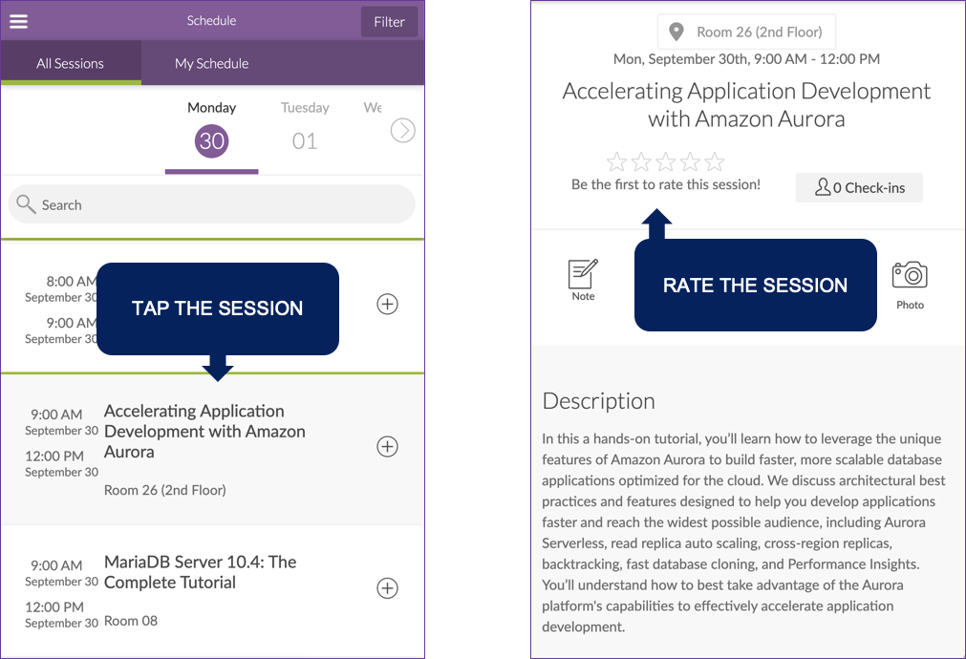
Rate My Session

Slide 14

We’re Hiring
Percona’s open source database
experts are true superheroes, improving database performance for customers across the globe.
Our staff live in nearly 30 different countries around the world, and most
work remotely from home.
Discover what it means to have a Percona career with the smartest people in the database performance industries, solving the most challenging problems our customers come across.

Slide 15

?
“Poor leaders rarely ask questions of themselves or others. Good leaders, on the other hand, ask many questions. Great leaders ask the great questions.”
Michael Marquardt, author of Leading with Questions

