Slide 1


PostgreSQL And Artificial Intelligence Slides: https://github.com/ibrarahmad/PostgreSQLTalks/tree/main/Conferences/2022-Austin-Percona-Live
Ibrar Ahmed – Principal Engineer
Notes:
Storyline
Current state
Massive market trends
How we’ve met them? Percona history up to today. All the DB tech, etc. Timeline view?
Sense of urgency. Companies won’t survive, etc. Examples of those who got with it, and those who didn’t.
Gap between current state and ideal state. Value/significance of problems
Our future: Percona Platform
How each area helps customers achieve their future-state vision
Demo of value: Advisors
Where we’re headed: Strategic roadmap themes

Slide 2
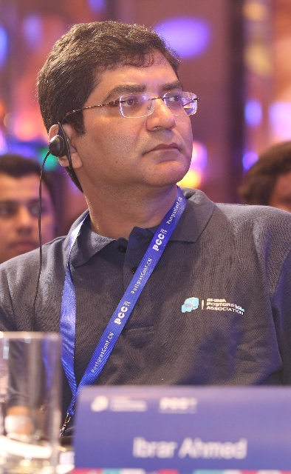
Who am I?
Software Career
Software industries since 1998.
PostgreSQL Career
Working on PostgreSQL Since 2006.
EnterpriseDB (Associate Software Architect core Database Engine) 2006-2009
EnterpriseDB (Software Architect core Database Engine) 2011 - 2016
EnterpriseDB (Senior Software Architect core Database Engine) 2016 – 2018
Percona (Senior Software Architect core Database Engine) 2018 – Present
@ibrar_ahmad
IBRAR AHMED
Principal Engineer
https://www.facebook.com/ibrar.ahmed
Percona LLC
PostgreSQL Books
https://www.linkedin.com/in/ibrarahmed74/
PostgreSQL Developer's Guide
PostgreSQL 9.6 High Performance

Slide 3
PostgreSQL And Artificial Intelegence
Artificial Intelligence
Machine Learning
Deep Learning
What is artificial intelligence?
Basic Concepts of Machine Learning
Introduction to Deep Learning
Demonstration
Database
Demonstration Using Postgres
Why use a database?

Slide 4
01
Artificial Intelligence

Slide 5
What is Artificial Intelligence?
Machines that mimic "cognitive" functions that humans associate with the human mind, such as "learning" and "problem solving”*.
https://en.wikipedia.org/wiki/Artificial_intelligence

Slide 6
Artificial Intelligence
“Artificial Intelligence is no match for natural stupidity”
Albert Einstein
“A machine with strong A.I. is able to think and act just like a human. It is able to learn from experiences”
Albert Einstein
“I think the development of full artificial intelligence could spell the end of the human race”
Stephen Hawking
“The one who becomes the leader in this sphere will be the ruler of the world”
Vladimir Putin

Slide 7
Types of Artificial Intelligence
ANI - Artificial narrow intelligence
ANI has a narrow range of ability to perform specific tasks.
AGI - Artificial general intelligence
AGI can perform different tasks that humans can do.
ASI - Artificial superintelligence
ASI is more capable than a human, learning from past experience and from new data to do a variety of tasks.

Slide 8
Sub-Fields of Artificial Intelegence
Machine Learning
Deep Learning
Neural Network
NLP and Computer Vision
Cognitive Computing

Slide 9
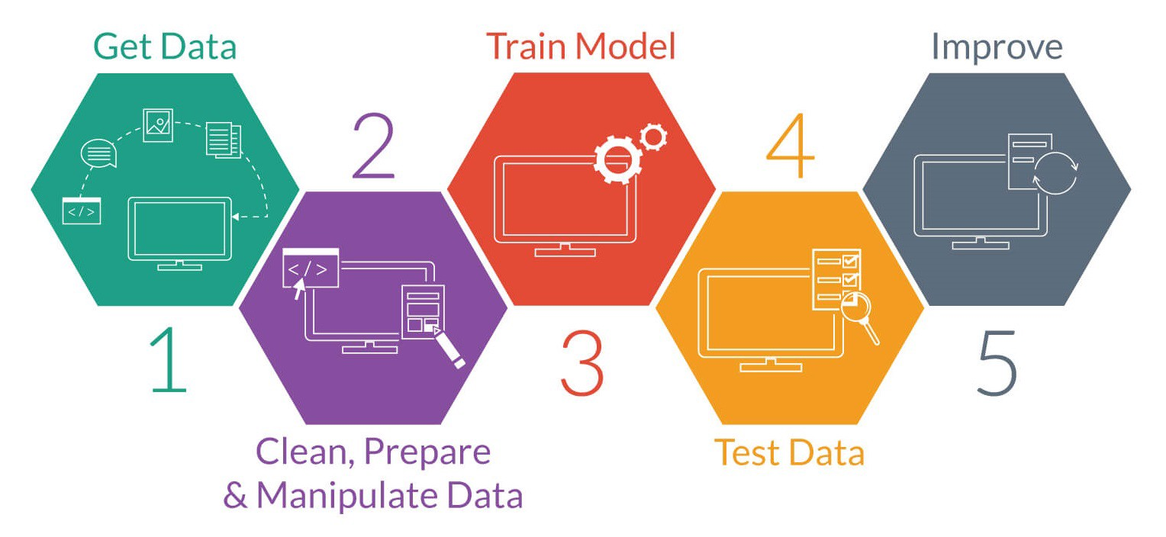
Licensed under CC BY-SA-NC

Slide 10
02
Machine Learning

Slide 11
Machine Learning
Make a big impact with our professional slides and charts
Supervised Learning
Regression and Classification
Unsupervised Learning
Association and Clustering
Reinforcement Learning
Learn From Environment

Slide 12
04
Deep Learning

Slide 13
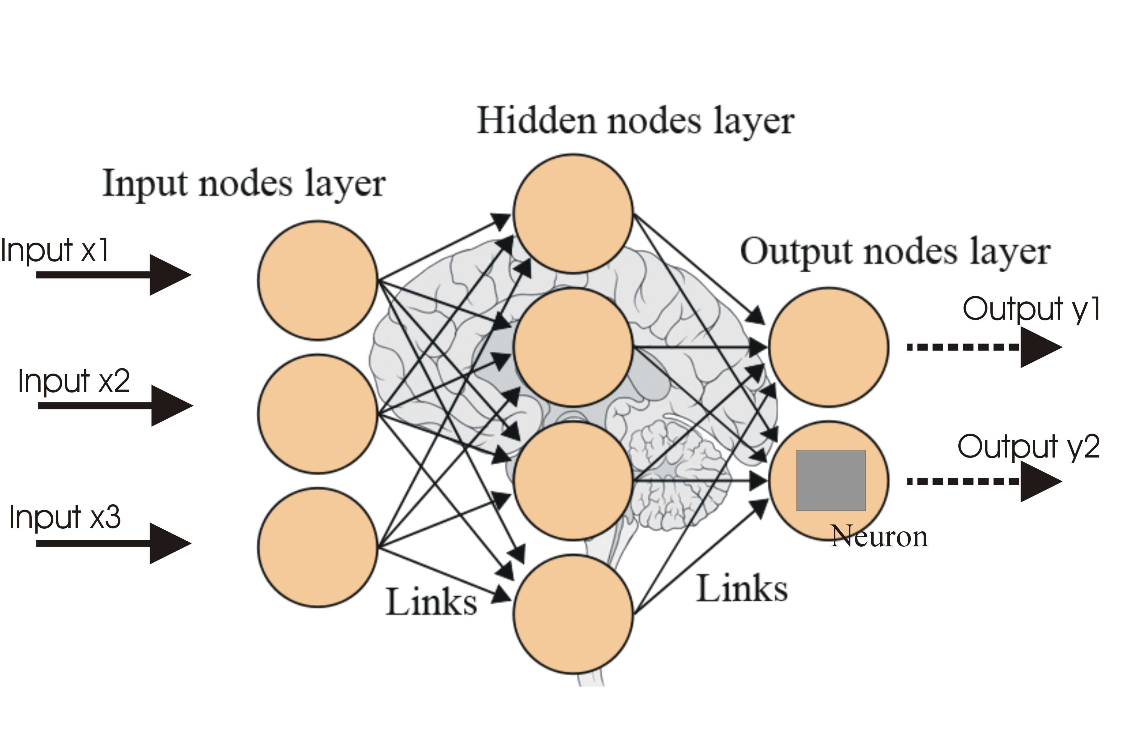
Deep Learning
Neural Networks, with more layers and modules
It has a model which can take any input/output type and size
Nural Network
Licensed under CC BY-SA

Slide 14
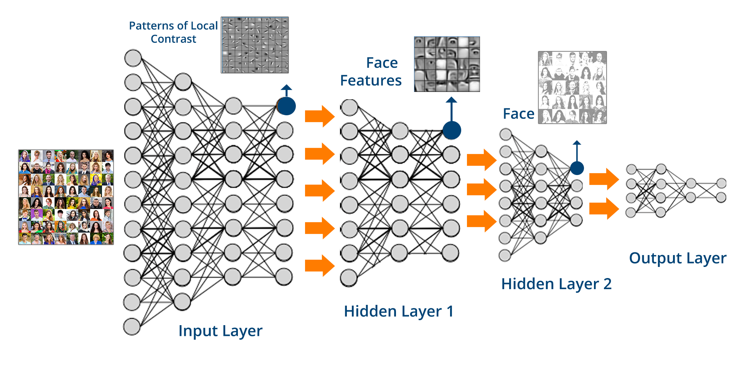
Deep Learning

Slide 15
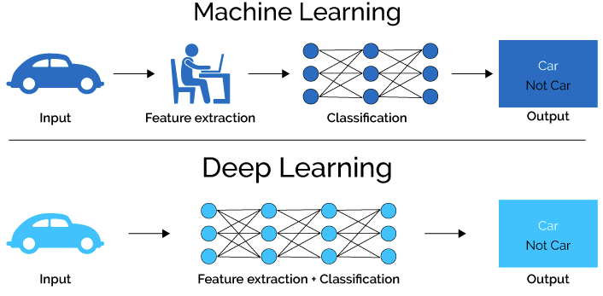
This Photo by Unknown Author is licensed under CC BY

Slide 16
05
Demonstration

Slide 17
Demonstration Using Postgres
Does an Integer Have Non-Leading Zeros?
31903 is true
82392 is false

Slide 18
Install PL/Perl
CREATE EXTENSION IF NOT EXISTS plperl;
All queries in this presentation can be downloaded from https://momjian.us/main/writings/ pgsql/AI.sql.

Slide 19
Generate Tensor
CREATE OR REPLACE FUNCTION generate_tensor(value INTEGER) RETURNS BOOLEAN[] AS $$
my $value = shift;
my @tensor = (
# this many digits or more?
(map { length($value) >= $_ } 1..10),
# divisible by zero? $value % 10 == 0, );
# map to t/f
grep { $_ = ($_ ? ’t’ : �f’) } @tensor; return encode_typed_literal(\@tensor, ’boolean[]’); $$ LANGUAGE plperl STRICT;

Slide 20
Create and Populate Input Layer
CREATE TABLE training_set(value INTEGER, training_output BOOLEAN, tensor BOOLEAN[]);
WITH randint (value) AS ( SELECT (random() * (10 ^ (random() * 8 + 1)::integer))::integer
FROM generate_series(1, 10000) ) INSERT INTO training_set
SELECT value, value::text LIKE ’%0%’, generate_tensor(value) FROM randint;

Slide 21
Input Layer
SELECT * FROM training_set LIMIT 10;
Value. | training_output
------------+-----------------
28762748 | f
44550313 | t
72 | f
4891026 | t
3413 | f
62 | f
86517976 | f
967 | f
636667644 | f
36419 | f
| tensor
+----------------------
| {t,t,t,t,t,t,t,t,f,f,f}
| {t,t,t,t,t,t,t,t,f,f,f}
| {t,t,f,f,f,f,f,f,f,f,f}
| {t,t,t,t,t,t,t,f,f,f,f}
| {t,t,t,t,f,f,f,f,f,f,f}
| {t,t,f,f,f,f,f,f,f,f,f}
| {t,t,t,t,t,t,t,t,f,f,f}
| {t,t,t,f,f,f,f,f,f,f,f}
| {t,t,t,t,t,t,t,t,t,f,f}
| {t,t,t,t,t,f,f,f,f,f,f}

Slide 22
Generate Weights for Tensor (Cont…)
CREATE OR REPLACE FUNCTION generate_weight
(query TEXT, desired_output BOOLEAN)
RETURNS REAL[]
AS
$$
my $rv = spi_exec_query(shift);
my $status = $rv->{status};
my $nrows = $rv->{processed};
my $desired_output = shift;
my @success_neurons = ();
my @desired_neurons = ();
my $desired_input = 0;

Slide 23
Generate Weights for Tensor (Cont…)
foreach my $rn (0 .. $nrows - 1) {
my $row = $rv->{rows}[$rn];
my $tensor = $row->{(sort keys %$row)[0]}; my $training_output = $row-> {
(sort keys %$row)[1]};
# only process training rows that match our desired output
foreach my $neuron (0 .. $#$tensor) {
$success_neurons[$neuron] //= 0;
$desired_neurons[$neuron] //= 0;
# Neuron value matches desired output value;
# does the value match the desired output?
if ($tensor->[$neuron] eq $desired_output) {
# Prediction success/failures that match our desired output.
$success_neurons[$neuron]++
if ($training_output eq $desired_output);
$desired_neurons[$neuron]++;
}
}
$desired_input++
if ($training_output eq $desired_output);
}

Slide 24
Generate Weights for Tensor
my @weight = ();
my $sum = 0;
# compute percentage of tests that matched requested outcome
foreach my $neuron (0 .. $#success_neurons) {
$weight[$neuron] = $desired_neurons[$neuron] != 0 ? $success_neurons[$neuron] / $desired_neurons[$neuron] : 0;
$sum += $weight[$neuron];}
# balance weights so they total the observed probability;
# this prevents an overly-predictive output value from skewing
# the results.
foreach my $neuron (0 .. $#weight) {
$weight[$neuron] = ($weight[$neuron] / $sum) *($desired_input / $nrows);
}
return encode_typed_literal(\@weight, ’real[]’);
$$ LANGUAGE plperl STRICT;

Slide 25
Create Tensor_Mask
-- Return weights where our neuron value matches the desired output
CREATE OR REPLACE FUNCTION tensor_mask(tensor BOOLEAN[], weight REAL[], desired_output BOOLEAN)
RETURNS REAL[] AS $$
my $tensor = shift;
my $weight = shift;
my $desired_output = shift;
my @result = ();
elog(ERROR, ’tensor and weight lengths differ’)
if ($#$tensor != $#$weight);
foreach my $i (0 .. $#$tensor) {
push(@result, ($tensor->[$i] eq $desired_output) ? $weight->[$i] : 0);
}
return encode_typed_literal(\@result, ’real[]’);
$$ LANGUAGE plperl STRICT;

Slide 26
Create Sum_Weight
CREATE OR REPLACE FUNCTION sum_weight(weight REAL[]) RETURNS REAL AS $$
my $weight = shift;
my $sum = 0; # sum weights
foreach my $i (0 .. $#$weight) {
$sum += $weight->[$i];
}
return encode_typed_literal($sum, ’real’);
$$ LANGUAGE plperl STRICT;

Slide 27
Create Soft_Max
--Normalize the values so the probabilities total one
CREATE OR REPLACE FUNCTION softmax(val1 REAL, val2 REAL)
RETURNS REAL[] AS $$
my $val1 = shift;
my $val2 = shift;
my $sum = $val1 + $val2;
# What percentage is each of the total?
my @result = ( $val1 / $sum, $val2 / $sum, );
return encode_typed_literal(\@result, ’real[]’);
$$ LANGUAGE plperl STRICT;

Slide 28
Store Weights
CREATE TABLE tensor_weight_true
AS SELECT generate_weight(’SELECT tensor AS x1, training_output AS x2 FROM training_set’, true) AS weight;
CREATE TABLE tensor_weight_false AS SELECT generate_weight(’SELECT tensor AS x1, training_output AS x2 FROM training_set’, false) AS weight;

Slide 29
Stored Weights
SELECT * FROM tensor_weight_true;
weight
{0.020473005,0.021917565,0.024002228,0.026247077,0.028482921, \
0.030471962,0.032726202,0.034238704,0.036621932,0,0.0641184}
SELECT * FROM tensor_weight_false;
weight
{0,0.0820682,0.07662672,0.074060954,0.07129263,0.068018064, \
0.06497674,0.061864104,0.059269458,0.058057636,0.06446551}

Slide 30
Test 100
WITH test_set (checkval) AS
( SELECT 100 )
SELECT softmax(
sum_weight(
tensor_mask( generate_tensor(checkval),
tensor_weight_true.weight, true)),
sum_weight(
tensor_mask( generate_tensor(checkval),
tensor_weight_false.weight,false))
)
FROM test_set, tensor_weight_true, tensor_weight_false; softmax
{0.22193865,0.77806133}

Slide 31
Test 101
WITH test_set (checkval) AS (
SELECT 101
)
SELECT softmax(
sum_weight(
tensor_mask(
generate_tensor(checkval), tensor_weight_true.weight, true)),
sum_weight(
tensor_mask(
generate_tensor(checkval), tensor_weight_false.weight, false))
)
FROM test_set, tensor_weight_true, tensor_weight_false; softmax
{0.11283657,0.88716346}

Slide 32
Test 487234987
WITH test_set (checkval) AS (
SELECT 487234987
)
SELECT softmax(
sum_weight(
tensor_mask(
generate_tensor(checkval), tensor_weight_true.weight, true)),
sum_weight(
tensor_mask(
generate_tensor(checkval), tensor_weight_false.weight, false))
)
FROM test_set, tensor_weight_true, tensor_weight_false; softmax
{0.68860435,0.31139567}

Slide 33
Test One Thousand Values
WITH test_set (checkval) AS (
SELECT (random() * (10 ^ (random() * 8 + 1)::integer))::integer
FROM generate_series(1, 1000)
),

Slide 34
Second Table Expression
ai (checkval, output_layer) AS ( SELECT checkval, softmax( sum_weight(tensor_mask(generate_t ensor(checkval),tensor_weight_true.weight,true)), sum_weight(tensor_mask(generate_tensor(checkval), tensor_weight_false.weight, false)) ) FROM test_set, tensor_weight_true, tensor_weight_false ),

Slide 35
Third Table Expression
analysis (checkval, cmp_bool, output_layer, accuracy) AS (
SELECT checkval, checkval::text LIKE ’%0%’, output_layer,
CASE checkval::text LIKE ’%0%’
-- higher/lower than random chance WHEN true THEN output_layer[1] - 0.5 ELSE output_layer[2] - 0.5
END
FROM ai
)

Slide 36
Final Table Expression
SELECT * FROM analysis UNION ALL SELECT NULL, NULL, NULL, AVG(accuracy) FROM analysis UNION ALL SELECT NULL, NULL, NULL, SUM(CASE WHEN accuracy > 0 THEN 1 END)::REAL/COUNT(*) FROM analysis;
 | Checkval | cmp_bool ----------+----------- | | output_layer +------------------------------- | Accuracy +--------------------------
 | 6 | f | | {0.029198222,0.9708018} | | 0.47080177068710327
 | 61859931 | f | | {0.5459184,0.4540816} | | -0.045918405055999756
 | 53138008 | t | | {0.5459184,0.4540816} | | 0.045918405055999756
 | 727 | f | | {0.11283657,0.88716346} | | 0.3871634602546692
 | 33397006 | t | | {0.5459184,0.4540816} | | 0.045918405055999756
 | 38380069 | t | | {0.5459184,0.4540816} | | 0.045918405055999756
 | 8915576 | f | | {0.4306789,0.5693211} | | 0.06932109594345093
 | 446 | f | | {0.11283657,0.88716346} | | 0.3871634602546692
 | (null) | (null) | | (null) | | 0.15426481181383134
 | (null) | (null) | | (null) | | 0.722

Slide 37
06
Why to Use Database

Slide 38
Why Use Database?
Machine learning requires a lot of data
Most of your data is in your database
Why not do machine learning where your data is, in a database?

Slide 39
Advantages of doing Machine Learning in a Database?
Use the previous activity as training data
Have seamless access to all your current data
Take immediate action on AI results, e.g., commit transaction only if likely non-fraudulent
AI can benefit from database transactions, concurrency, backup
Other benefits include complex data types, full-text search, GIS, indexing
Postgres can do GPU-based computations inside the database.
(https://momjian.us/ main/blogs/pgblog/2020.html#June_29_2020)

Slide 40
General Artificial Intelligence Uses by Databases?
User applications
Performance adjustments
Optimizer plans
Index creation/destruction
Database settings
Resource usage
Alerting
Malicious activity
Resource exhaustion

Slide 41
Questions

Slide 42
Thank you!

Slide 43


