Slide 1


PostgreSQL And Artificial Intelligence
Ibrar Ahmed – Principle Engineer
Notes:
Storyline
Current state
Massive market trends
How we’ve met them? Percona history up to today. All the DB tech, etc. Timeline view?
Sense of urgency. Companies won’t survive, etc. Examples of those who got with it, and those who didn’t.
Gap between current state and ideal state. Value/significance of problems
Our future: Percona Platform
How each area helps customers achieve their future-state vision
Demo of value: Advisors
Where we’re headed: Strategic roadmap themes

Slide 2
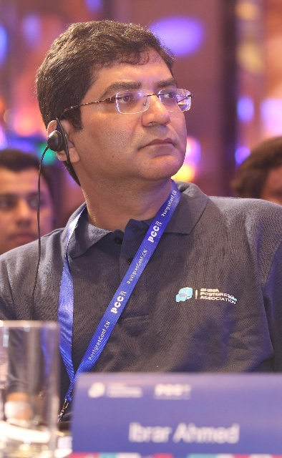
Who am I?
Software Career
Software industries since 1998.
PostgreSQL Career
Working on PostgreSQL Since 2006.
EnterpriseDB (Associate Software Architect core Database Engine) 2006-2009
EnterpriseDB (Software Architect core Database Engine) 2011 - 2016
EnterpriseDB (Senior Software Architect core Database Engine) 2016 – 2018
Percona (Senior Software Architect core Database Engine) 2018 – Present
@ibrar_ahmad
IBRAR AHMED
Senior Software Architect
https://www.facebook.com/ibrar.ahmed
Percona LLC
PostgreSQL Books
https://www.linkedin.com/in/ibrarahmed74/
PostgreSQL Developer's Guide
PostgreSQL 9.6 High Performance

Slide 3



Timeline
Tips
Heap vs Indexes
Index Useful Queries
5 Minutes
5 Minutes
5 Minutes
20 Minutes
5 Minutes
5 Minutes
Index Types
PostgreSQL Indexes

Slide 4
PostgreSQL And Artificial Intelegence
Artificial Intelligence
Machine Learning
Deep Learning
What is artificial intelligence?
How to avoid locking while creating Indexes
How to save space while creating index on big tables
Demonstration
Database
Demonstration Using Postgres
Why use a database?

Slide 5
01
Artificial Intelligence

Slide 6
What is Artificial Intelligence?
Machines that mimic "cognitive" functions that humans associate with the human mind, such as "learning" and "problem solving”*.
https://en.wikipedia.org/wiki/Artificial_intelligence

Slide 7
ARTIFICIAL INTELLIGENCE SLIDE
Make a big impact with our professional slides and charts
Supervised Learning
Regression and Classification
Unsupervised Learning
Association and Clustering
Reinforcement Learning
Learn From Environment

Slide 8
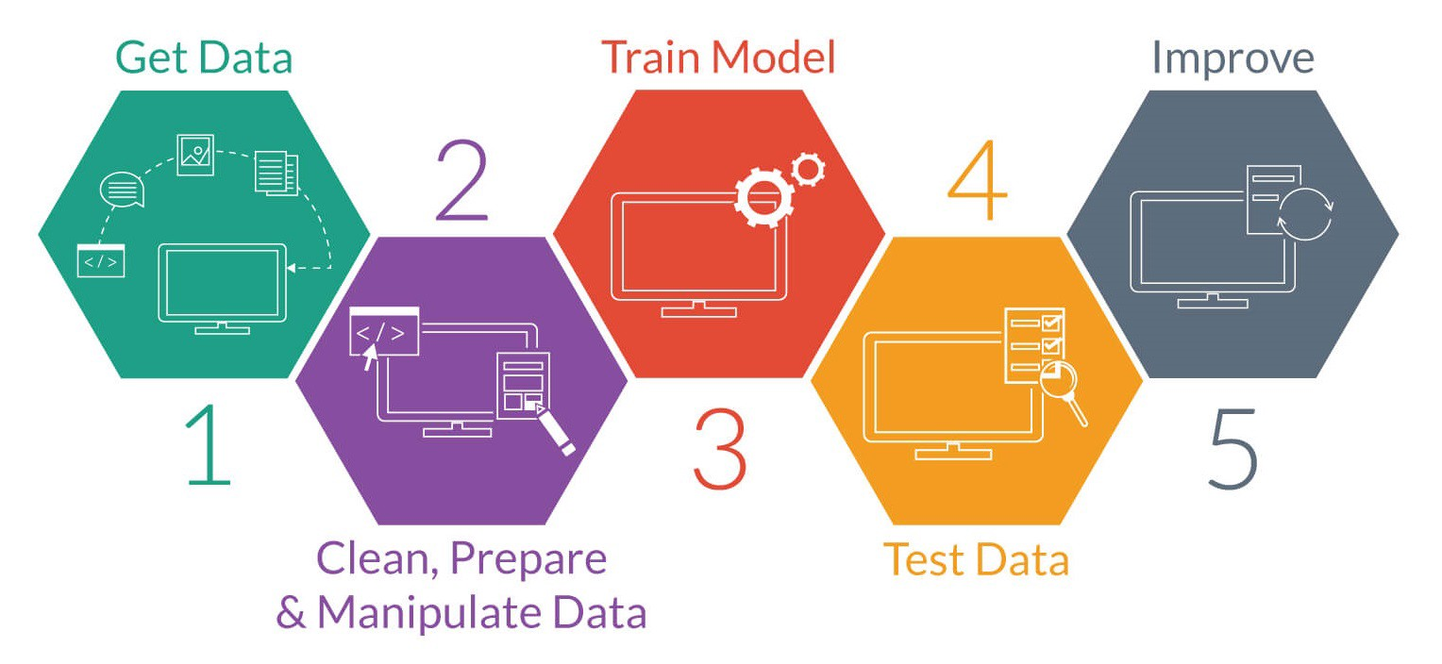
Licensed under CC BY-SA-NC

Slide 9
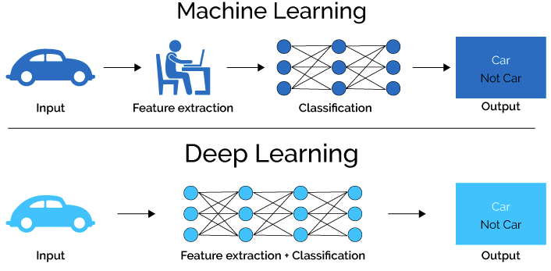
This Photo by Unknown Author is licensed under CC BY

Slide 10
Use previous activity as training data
Have seamless access to all your current data
Take immediate action on AI results, e.g., commit transaction only if likely non-fraudulent
AI can benefit from database transactions, concurrency, backup
Other benefits include complex data types, full text search, GIS, indexing
Postgres can do GPU-based computations inside the database (https://momjian.us/ main/blogs/pgblog/2020.html#June_29_2020)

Slide 11
User applications (already covered)
Performance adjustments
optimizer plans
index creation/destruction
database settings
resource usage
Alerting
malicious activity
resource exhaustion

Slide 12
Questions

Slide 13
Thank you!

Slide 14


