Slide 1
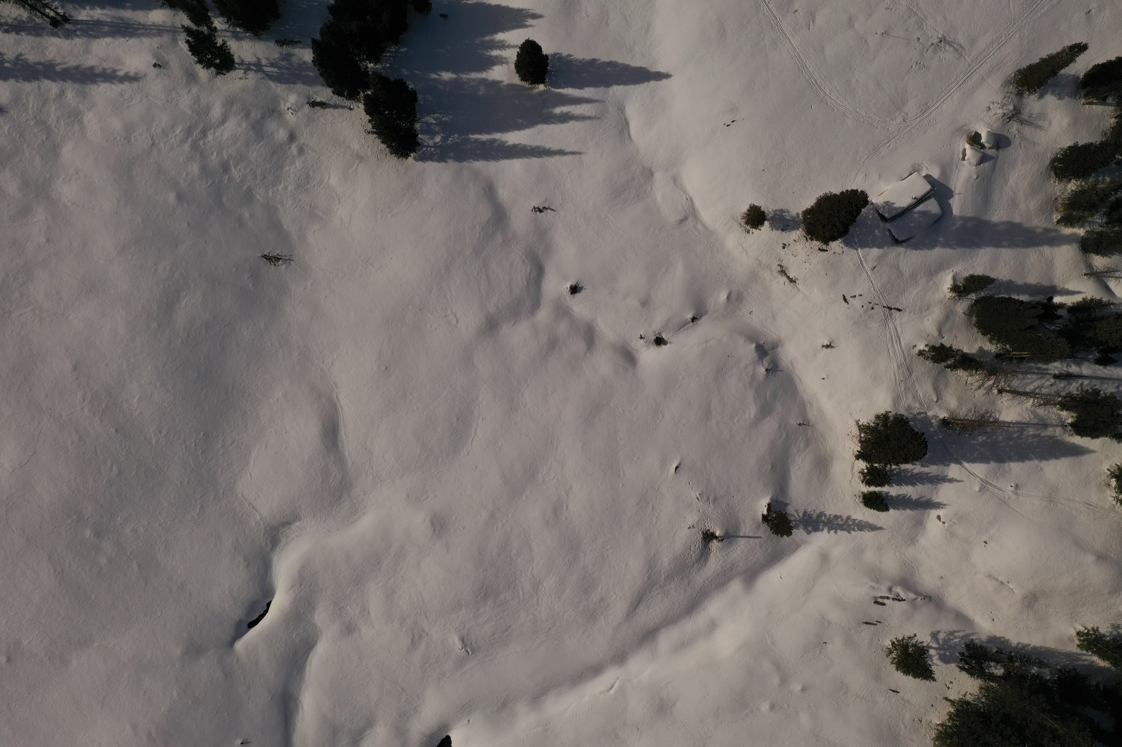
BIOL697: Remote Sensing of Ecological Systems
“Spring” 2022

Slide 2
Introductions - Breakouts

Slide 4
Strategies for Success
Resources:
Read the Syllabus (on Canvas)
Take Charge
Use Your Resources
Manage Your Frustration

Slide 5
The order of the week (and the next 5):
Asynchronous:
Synchronous (Wed. 6:30 - 8pm)
Pre-recorded lecture
Pre-class reading
Comprehension Quiz (due Wednesdays)
Reflection Assignment (due Sundays)
Discussion (45 min)
Break (5 min)
Interactive demo (40 min)

Slide 6
Independent Project
Related to your research!
Manageable
Incorporates concepts from the course
Wanna brainstorm? Shoot me an email.

Slide 7
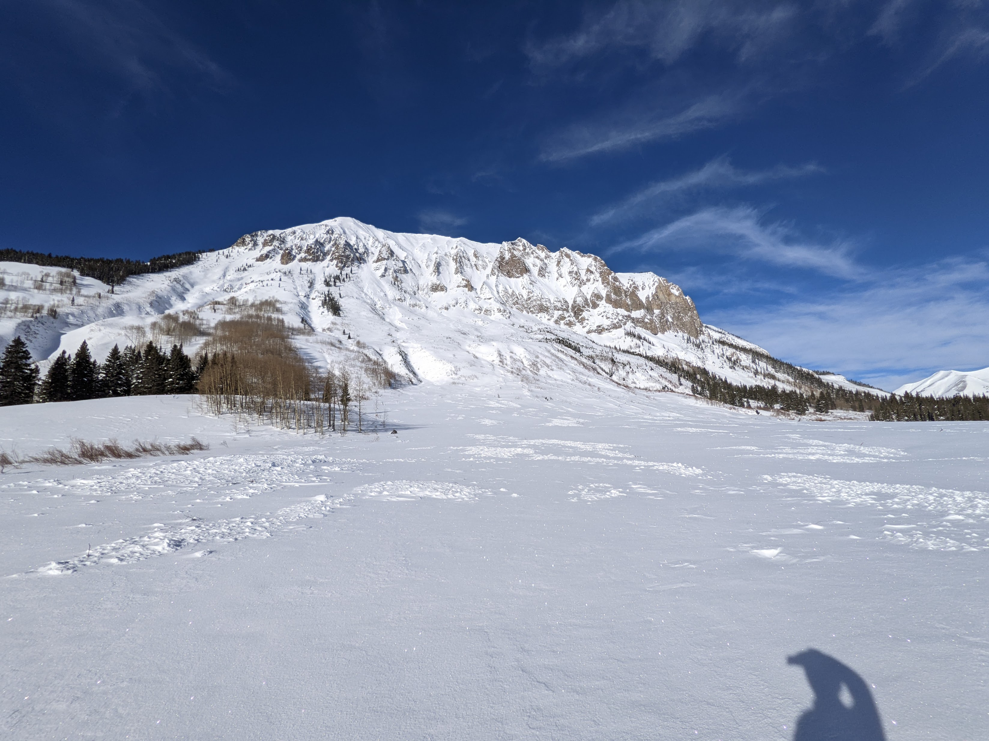
Optional Field Trip to Gothic – Feb. 5th (or 12th)

Slide 8
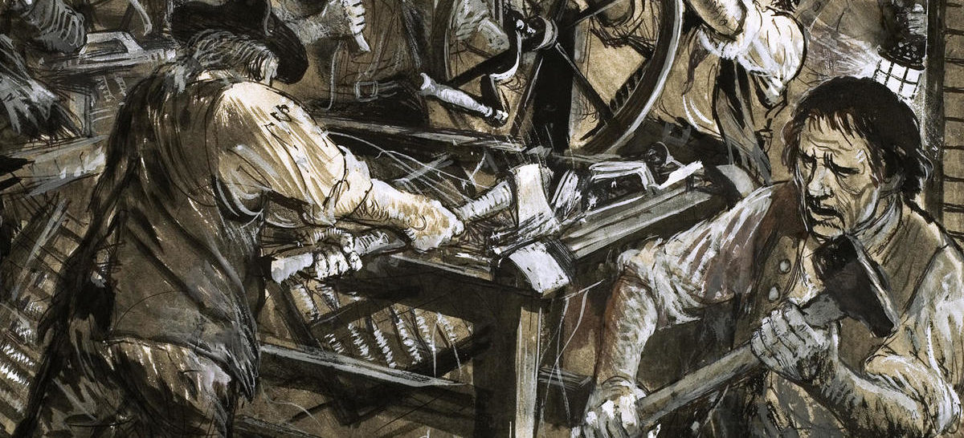
What’s a Luddite?

Slide 9
Discussion Questions for Week 1
How is Remote Sensing Changing Ecology, Conservation, and Resource management?
What is the promise?
What is the peril? What outcomes do we want to avoid?
How do we embrace the promise and avoid the peril?

