Slide 1


AFFIAT · ASWAN FINALS 2026 · GAMES
Pixel Verse Studios
Real science, hidden in play.
Two 16-bit games for ages 5 to 99. Dodge ocean trash. Fly to Jupiter's icy moon. Every fact in them is real.

Slide 2
Facts stick when you play them.
THE PROBLEM
OUR ANSWER
A fact in a lesson stays a sentence
Make the fact a game moment
"Europa hides an ocean." "Plastic hurts sea turtles." A child hears it, and the next day it is gone. Facts feel far away from play.
In Crab Quest you dodge the trash. In Space X you fly through Europa's ice. Each fact shows up where it makes sense in the story, and nothing in it is invented.
Ages 5 to 99 · short sessions · runs offline on a school computer
Pixel Verse Studios · AFFIAT · Afro-Asian Forum for Innovation and Technology · Aswan Finals 2026 · Games
2

Slide 3


Two games, one studio.
Crab Quest
Space X
Six chapters to get home
Journey to Jupiter
6 chapters, 6 ways to play
4 levels, one mission
Platforming, dodging, collecting, surviving
Launch pad, Earth orbit, asteroid belt, Europa
Real ocean threats
A fact card after every level
Birds, trash and a predator fish
A story line and one science fact
Ends in a coral sanctuary
A planet fact on every loss
Help a shrimp, then find your family
The Sun and all eight planets, with pictures
Pixel Verse Studios · AFFIAT · Afro-Asian Forum for Innovation and Technology · Aswan Finals 2026 · Games
3

Slide 4
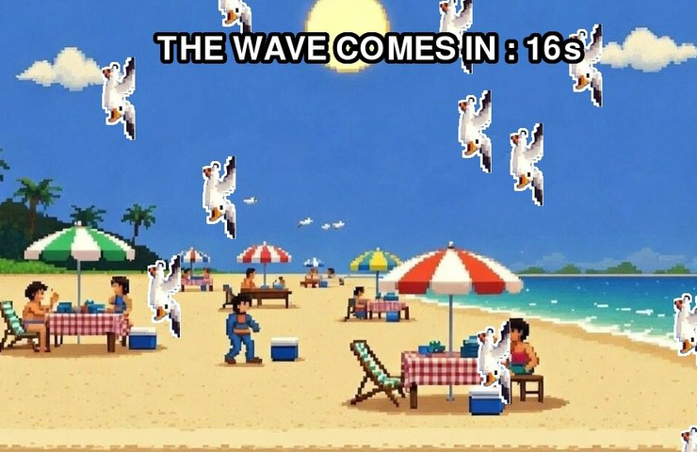
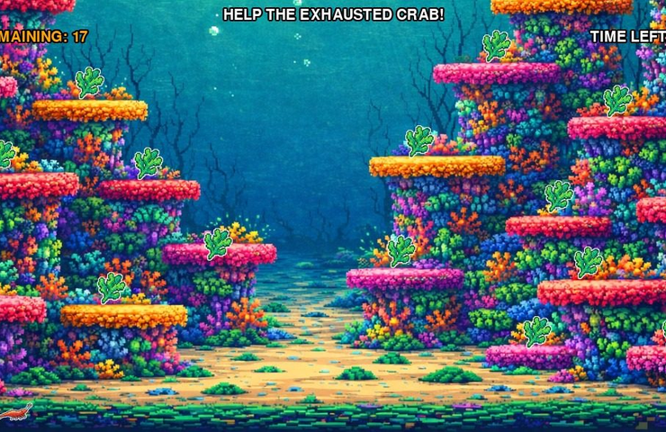
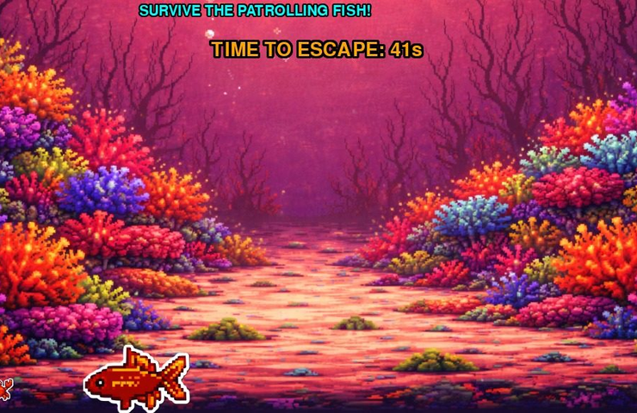
Crab Quest: six chapters to get home
Chapter 2 · Beach Run
Chapter 4 · Shrimp Help
Chapter 5 · Predator Chase
1
2
3
4
5
6
Kitchen Escape
Beach Run
Sea Floor Dodging
Shrimp Help
Predator Chase
Home Sweet Home
Jump the counter
Dodge birds, 30 s
Dodge trash, 10 s
Collect 17 algae
Survive 45 s
Reach your family
Pixel Verse Studios · AFFIAT · Afro-Asian Forum for Innovation and Technology · Aswan Finals 2026 · Games
4

Slide 5
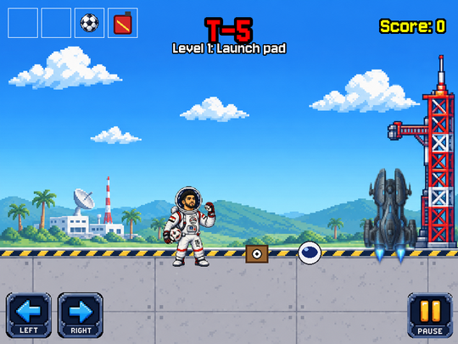
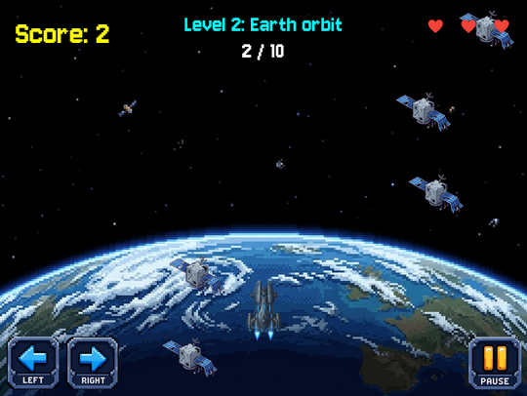
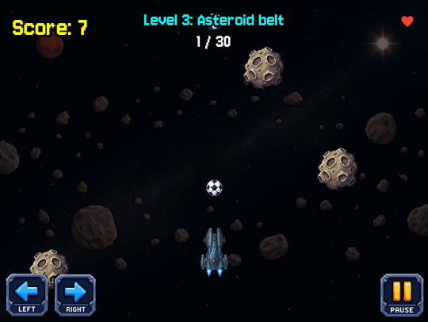
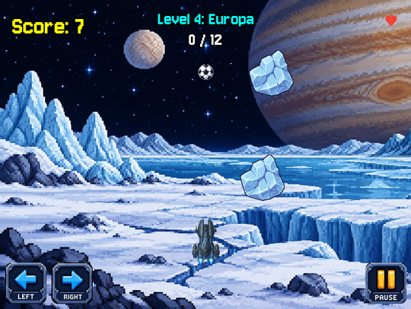
Space X: the Journey to Jupiter
1 · Launch pad: collect 4 items
2 · Earth orbit: dodge 10 junk
3 · Asteroid belt: shoot 30
4 · Europa: break 12 ice chunks
THE HERO'S MISSION
Fly to Europa, Jupiter's icy moon, and find out if its hidden ocean could hold life.
Lose all 3 hearts and the level restarts. Win level 4 and the Hero reaches Jupiter.
Pixel Verse Studios · AFFIAT · Afro-Asian Forum for Innovation and Technology · Aswan Finals 2026 · Games
5

Slide 6
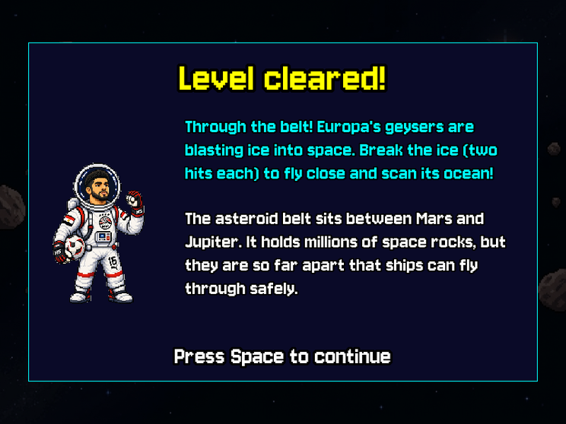
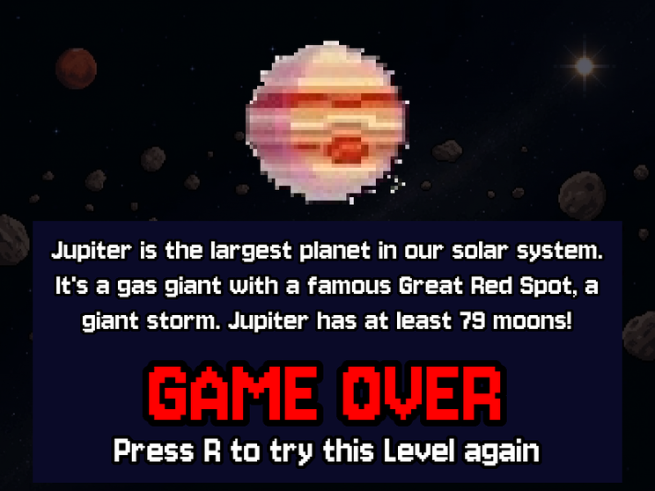
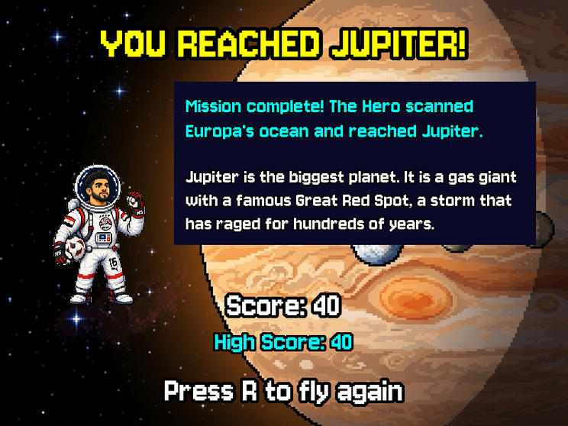
Learning happens at the moment it matters
A fact card after every level
A planet fact on every game over
The win screen on Jupiter
The Sun and all eight planets, each with a picture and a short fact.
The facts live in plain Python lists, so adding a planet or a story line means adding one entry.
Pixel Verse Studios · AFFIAT · Afro-Asian Forum for Innovation and Technology · Aswan Finals 2026 · Games
6

Slide 7
One simple idea: a mode switch
INPUT
PYGAME ZERO
ONE VARIABLE
MODULES
FILES
Keyboard · mouse
draw · update
game mode
screens · levels
images · music · data
›
›
›
›
arrows, Space, P, R, F and on-screen buttons
the only hooks in the main file
says which screen is showing
each one owns its drawing and rules
facts and targets in plain lists
CRAB QUEST
SPACE X
START_SCREEN → LEVEL_SELECT → LEVEL1 … LEVEL6
One self-contained module per chapter, with its own sprites, platforms and reset().
TITLE → PLAYING → FACT_CARD → GAME_OVER → WIN
Each level decides when it is cleared. The main file only switches modes.
Pixel Verse Studios · AFFIAT · Afro-Asian Forum for Innovation and Technology · Aswan Finals 2026 · Games
7

Slide 8
Built with free tools, in one repo
Python 3.11+
ONE GIT REPOSITORY
all game logic
PVS/
├── Crab-game/ Crab Quest
├── space-game/ Space X
│ ├── screens/ levels/
│ ├── parts/ data/
│ └── images/ music/ fonts/
├── pixel-verse-studios/ website
└── docs/ this deck
Pygame Zero 1.2.1
sprites, keys, mouse, music
Pygame 2.6.1
fullscreen, sounds, images
Jersey 10 font
SIL Open Font License
HTML + CSS
the studio website
PyInstaller · itch.io
release path, in progress
Pixel Verse Studios · AFFIAT · Afro-Asian Forum for Innovation and Technology · Aswan Finals 2026 · Games
8

Slide 9
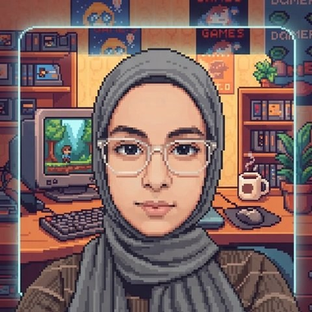
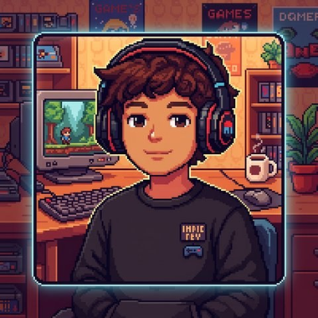
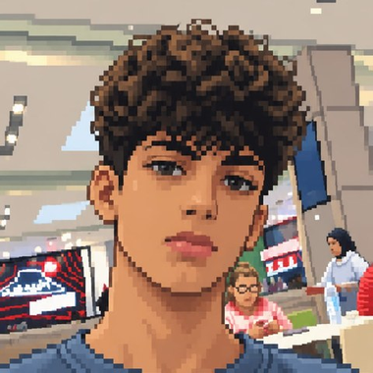

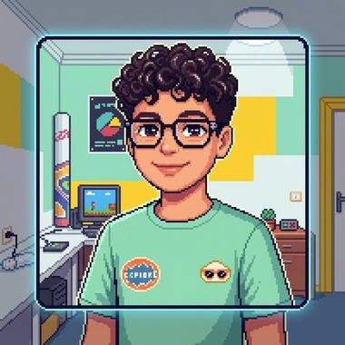
Five people. Two games.
Mariam Alaa
Selim Loai
Mohamed Loai
Medhat Ali
Salah Mohamed
Pixel Verse Studios: two complete educational games, with real facts and one clean architecture.
Pixel Verse Studios · AFFIAT · Afro-Asian Forum for Innovation and Technology · Aswan Finals 2026 · Games
9

Slide 10
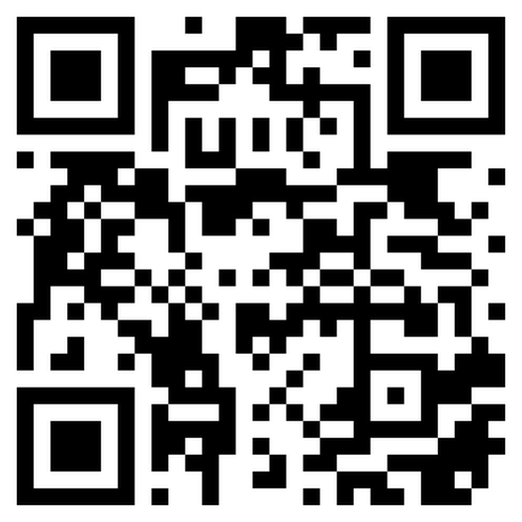
Thank you
What's next
Windows builds
Package both games with PyInstaller
An itch.io page
Both games, screenshots, controls and downloads
Scan to visit the studio
Test on a clean PC
Every chapter and every level, music on and off
Pixel Verse Studios · AFFIAT · Afro-Asian Forum for Innovation and Technology · Aswan Finals 2026 · Games

