Slide 1

Tech Flow Space
Blockchain Course

Slide 2
What is Blockchain?
Decentralized Distributed Ledger

Slide 3
Wikipedia:
A blockchain is a distributed database that maintains a continuously growing list of records called blocks that cannot be edited or changed.

Slide 4
Wikipedia Contd:
Let's unpack this -
Three important properties
1. It is distributed - which means the ledger has more than one copy
2. It maintains a continuously growing list of records or transactions
3. It cannot be changed.

Slide 5
Wikipedia Contd:
How is this different from a regular database?
For example a bank uses SQLServer to store accounts and transaction information.
Multiple replicas can satisfy the distributed condition.
Does not satisfy the other two -
Previous txns can be removed without affecting the db.
DB admin can easily go to the database and change the data.

Slide 6
Wikipedia Contd:
This blockchain definition satisfies the condition for permissioned or private blockchain.
For a public blockchain it has to satisfy one more condition - decentralized.
Decentralization : In addition to distributed there is no single point of control or decision making.

Slide 7
Chain of transactions:
Lets see some good explanation in the internet of this concept -
He talks about money transfer - we can think of any value transfer
https://youtu.be/93E_GzvpMA0?t=86
Open ledger or open database

Slide 8
Chain of transactions contd.
Chain of transactions that everyone on the network can see and confirm
This chain of txns are distributed so there are many copies of it that are synchronized (same view)

Slide 9
Lets get some visual concept of Blocks
Hash Function : A function that takes any length string and outputs a fixed length string.
Eg: -
“A” → Func() → “XXXX..” 32 byte string
Full content of Webster Dictionary → Func() → “XYXK..”v 32 byte string
Example of an online hash function --
https://www.xorbin.com/tools/sha256-hash-calculator

Slide 10
Lets get some visual concept of Blocks
Hash Function Property:
Small change in input produces a large change in output.
One way function - easy to go from “A” to “XXXX..”
Impossible to go from “XXXX..” to “A”
Same input produces same output
For any size input ( letter “A” to full content of a book) produces same size output.

Slide 11
Lets get some visual concept of Blocks contd.
https://www.youtube.com/watch?v=SSo_EIwHSd4
Block stores one or more transactions and their details
Changes on previous transactions are very difficult
Each block carries the hash of the previous block
Blocks are generated periodically ( avg. 10 min for bitcoin, 15 sec for Ethereum)
First block is called the genesis block and doesn’t have previous block hash.

Slide 12
History of Blockchain
It was initiated by Stuart Haber and W. Scott Stornetta in 1991 with ‘cryptographically secure chain of blocks’
Satoshi Nakamoto Released Bitcoin whitepaper on 2008
Seminal moment because it solved the basic double spend problem.

Slide 13
History contd.
Double spend problem in digital world
A Rs. 100 note can only be given once.
Digital data can be copied as many times as you want
How does the system make sure that a digital data representing some value cannot be sent to more than one entity.

Slide 14
History contd.
Bitcoin system is limited in the sense that it just manages the ownership of Bitcoin. It’s very good in doing that.
It hasn’t been hacked since it was introduced.
Think about for moment - a software that is
Open sourced (hackers can see the code)
No one person or entity controls it
This validates the cryptography (Math) behind blockchain concept.

Slide 15
History contd.
In 2013, a young 19-year-old programmer, Vitalik Buterin wanted something more flexible.
Instead of being limited to Bitcoin what if it could manage the ownership of any data state - in other words a world computer.
This gave birth to Ethereum that was launched on July 2015.
Since then 100s of other blockchains have been launched trying to solve some limitations of public blockchains like Bitcoin or Ethereum.

Slide 16
History contd.
Fun Facts:
First BTC Transaction was 10,000 BTC ($84,200,000) for 1 Pizza on May 22, 2010 - Celebrated as Bitcoin Pizza Day
April 6th, 2018 - TD Ameritide published the first Blockchain based advertisement
https://www.tdameritrade.com/landing-pages/offer/blockchain/index.html?cid=TVTDACDDRTVJ64

Slide 17
History contd.
April 28th 2018 - The Treaty between Donald Trump and Kim Jong-un was recorded in Ethereum Blockchain
https://etherscan.io/tx/0xe4ee15d3f63db8464a649e3237ed83e930f9b3e40e842537a626745d1c96553c
https://etherscan.io/tx/0xf56d81301da93f71368ad7f8d605648d77be6edb13e8875cf3e5906f38d1b548

Slide 18
History contd.
Since then 100s of other blockchains have been launched trying to solve some limitations of public blockchains like Bitcoin or Ethereum.
Although Open ledger is good for some use cases, business don’t want their transactions to be public.
But they saw the benefit in cryptographically secured ledger.
To solve this problem Enterprise blockchain initiative started around 2015

Slide 19
History contd.
Present Day - There are lot of blockchain solutions trying to compete - EOS, ICONLoop, NEO, QTUM, TRON, Ripple , Binance etc.
Hyperledger and Enterprise Ethereum are the most popular ones in this space.

Slide 20
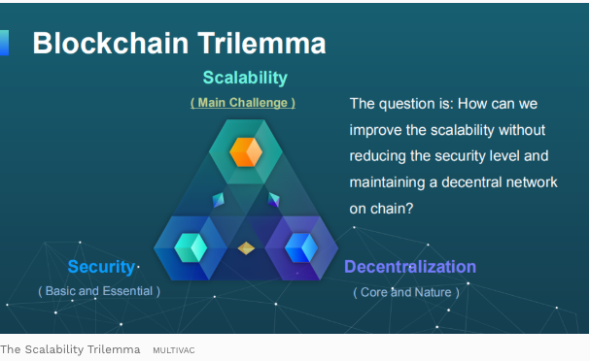
History contd.
Why so many Blockchains?

Slide 21
Why is this a disruptive technology?
Bitcoin: Deflationary hard money that is competing with the current systems in the world that is implementing inflationary currencies. Austrian vs Keynesian
Bitcoin: Decentralized, censorship resistant. No one government or entity can control it.
Bitcoin solved the doublespend problem. First in history!
Ethereum: World computer - write a program once and deploy as smart contract, the network guarantees that the program runs as specified in the code. Code cannot be changed.

Slide 22
Why is this a disruptive technology contd.
These properties provides the basic building blocks of moving away from third party trusted system that is currently implemented in the world.
E.g All financial applications right now, voting system, identity etc.
There is third party or middleman extracting rent in pretty much any system we currently have.

Slide 23
Why is this a disruptive technology contd.
Key benefits
Transparency
Immutability
Redundancy
Security
Blockchain provides a way to remove that third party or middleman.

Slide 24
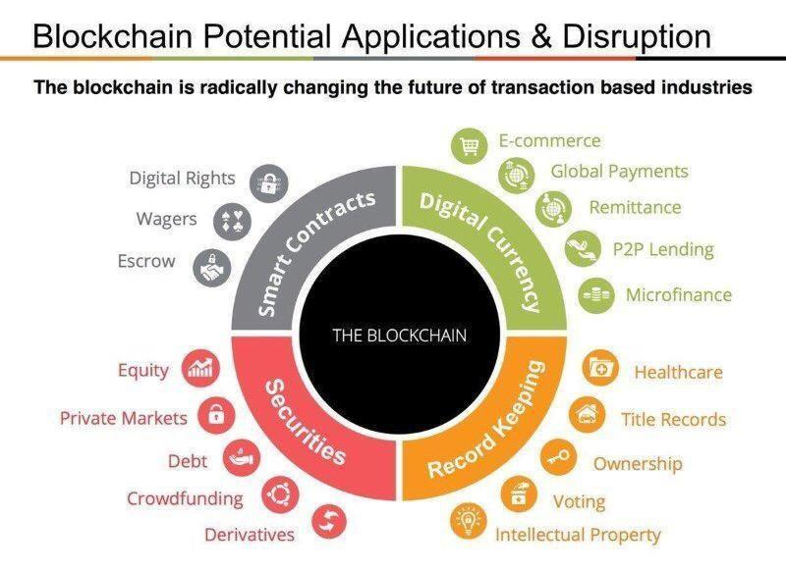
Why is this a disruptive technology contd.

Slide 25
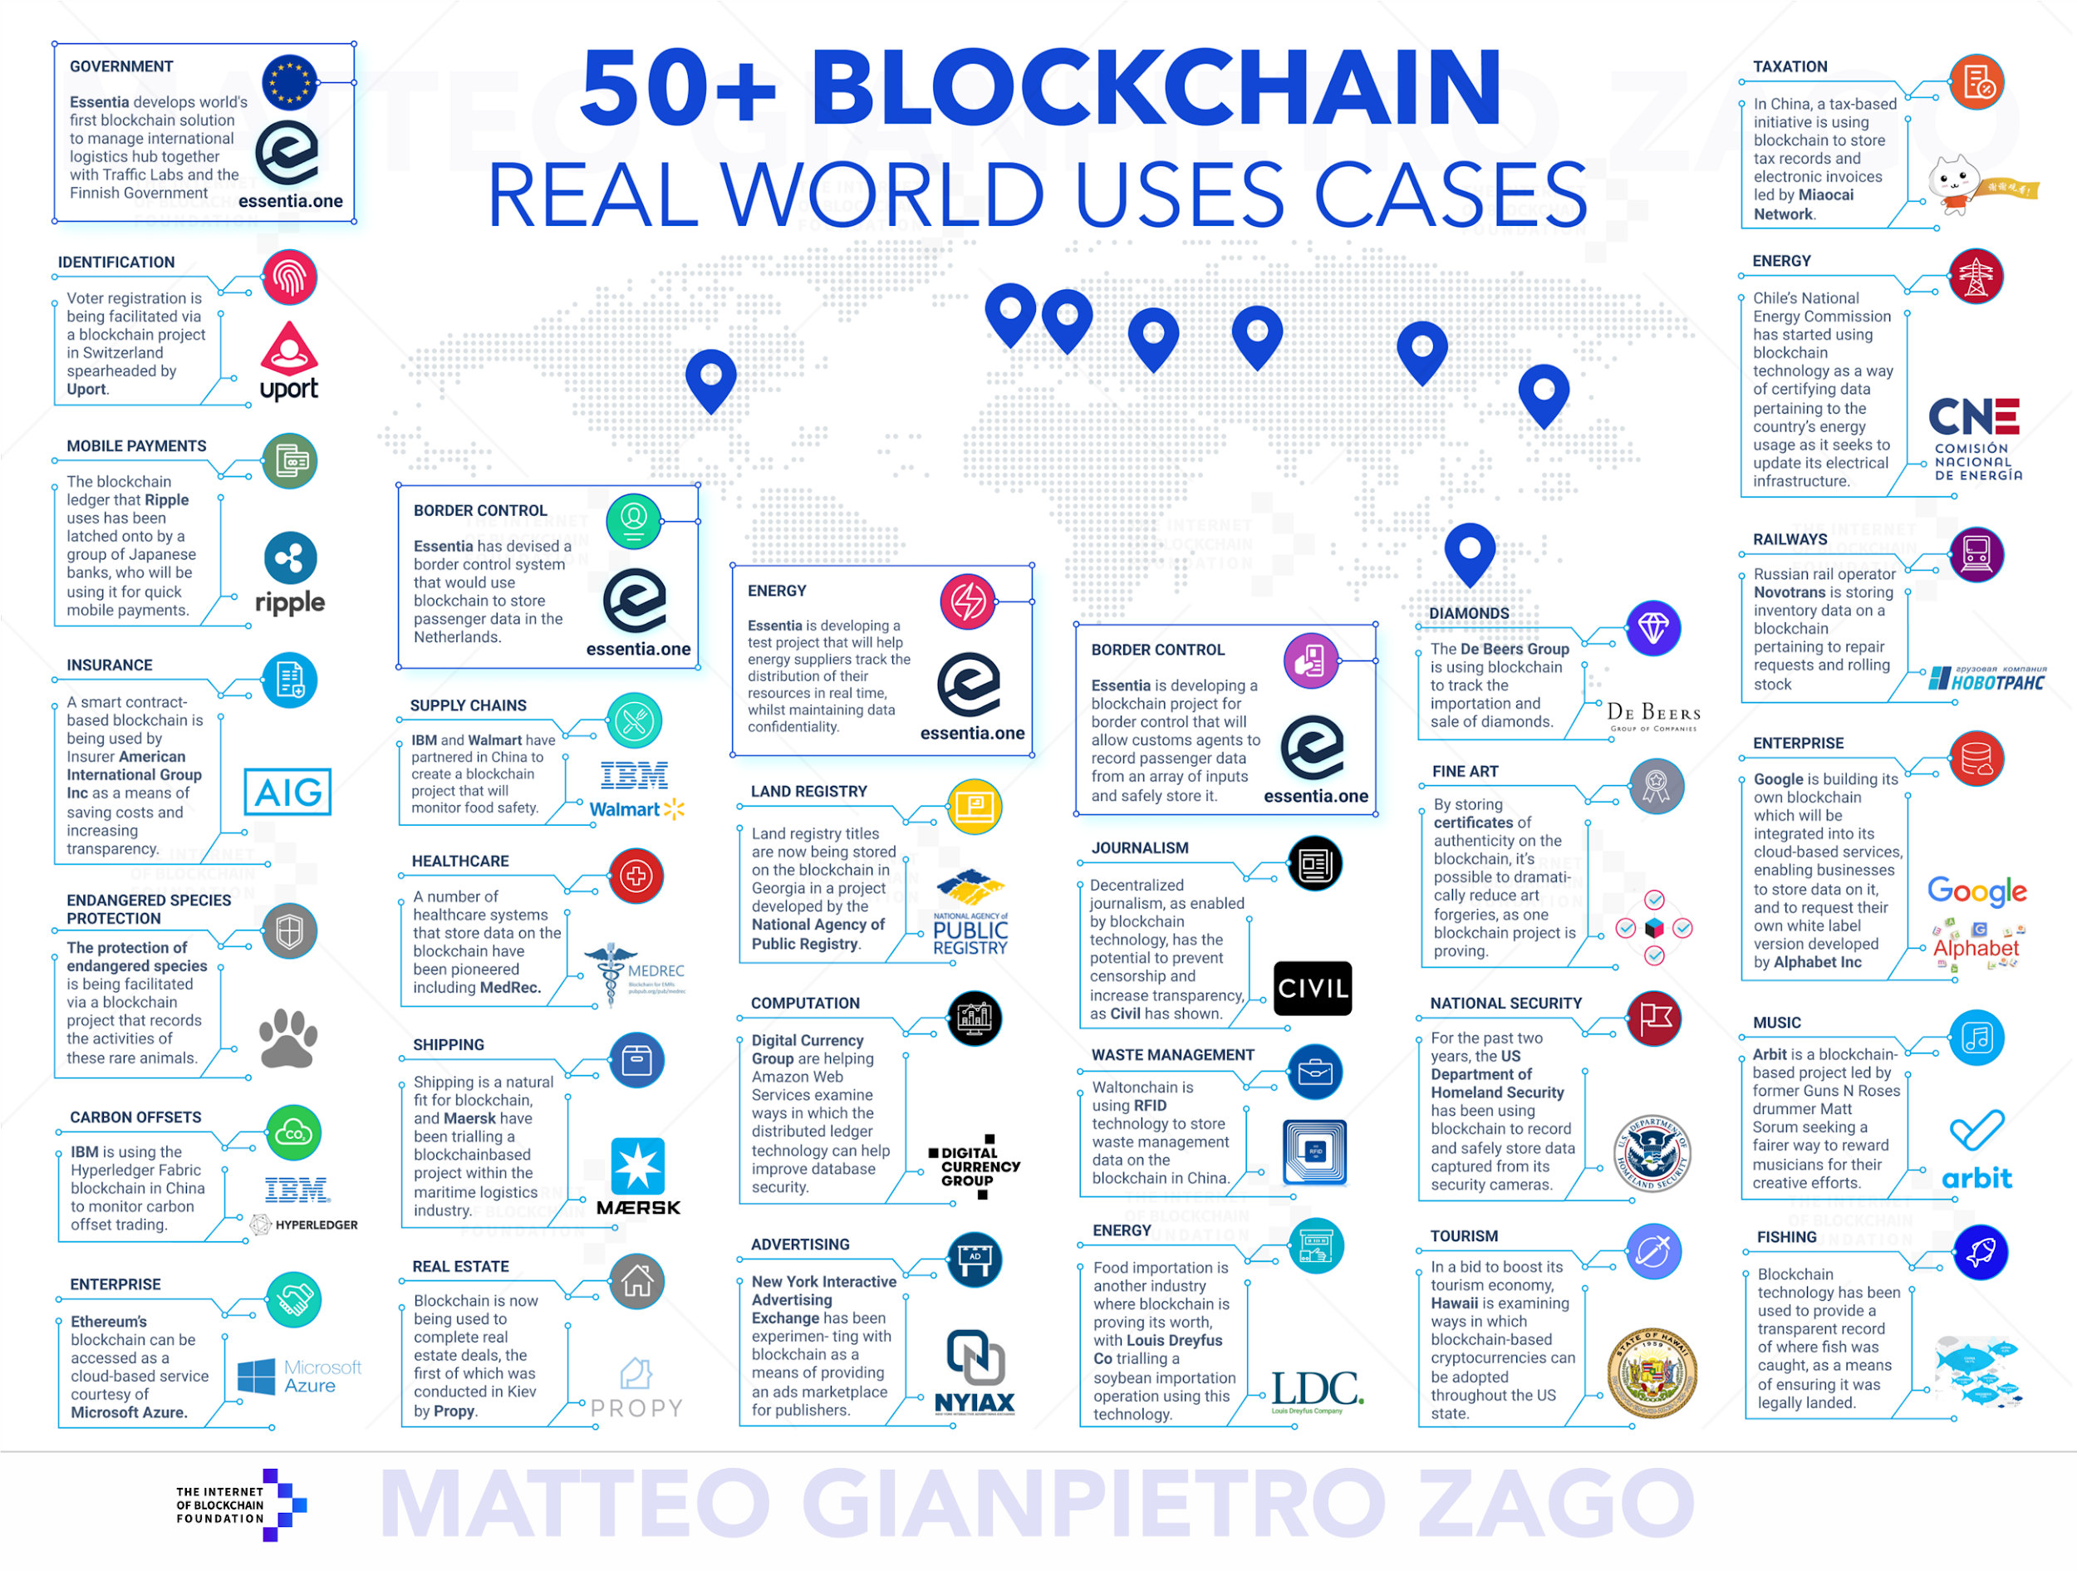
Current Use Cases

Slide 26
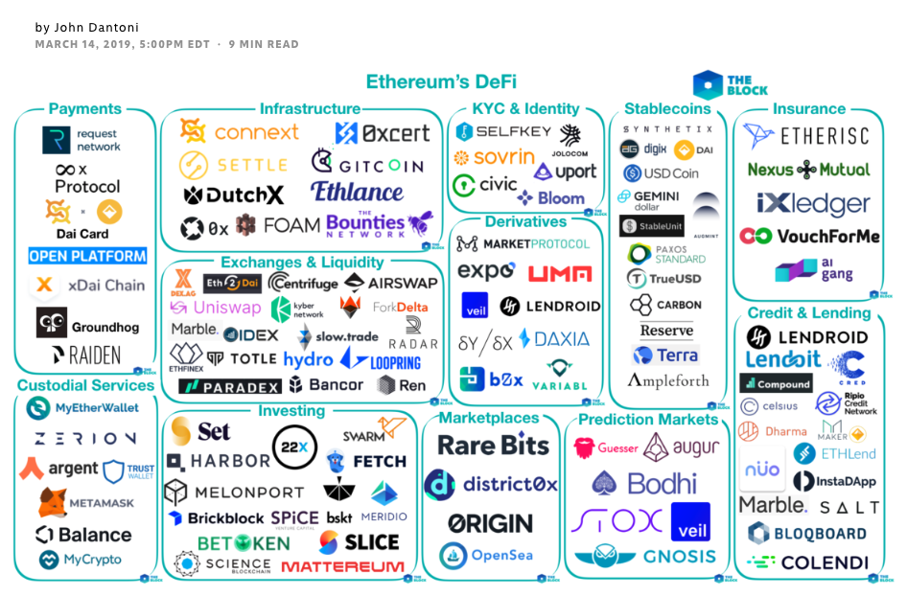
Current Use Cases

Slide 27
Types of Blockchain
Public - Permissionless
A public blockchain is a decentralized network where anyone can join, participate within the network
Ledger is shared and transparent.
Anyone can download the ledger and see transactions
Ethereum and Bitcoin are the examples of the public blockchain

Slide 28
Types of Blockchain Contd.
Private - Permissioned
Private network has access control features and participate in the network by invitation.
Consortium of participants coordinate among themselves.
Transactions can be private
This type of blockchain is highly applicable for Enterprise adoption. Hyperledger is an example.

Slide 29
Key Features of Blockchain
Distributed
Many copies of ledger
Decentralized
No one single point of control
Trustless
Cannot be corrupted

Slide 30
Key Features of Blockchain
Faster
Faster Settlement than the traditional system
Secured
Everyone is aware of the data state. Cryptographically secured data.
Consensus based
Group of participants decides

Slide 31

Career Opportunities

Slide 32
Career Opportunities
According to one of the biggest job portals in the world, Upwork, demand for blockchain developers is accelerating.
Better Pay
Remote Flexibility
Demand for Blockchain Engineers grows by 400% since end of 2017
CNBC notes the demand is further fueled by the interest of global tech giants such as Facebook, Amazon, IBM and Microsoft.

