Slide 1

Tech Flow Space
Blockchain Course -Session 5

Slide 2
Decentralized Applications
(dApps)

Slide 3
dApps Characteristics
Open source - code is visible for everyone to verify. Once deployed cannot be changed unless via some governance model
Decentralized - no central control of storing , executing the app. Execution visible to all.
Incentivized - the system sustains itself such that participants are incentivized to be honest

Slide 4
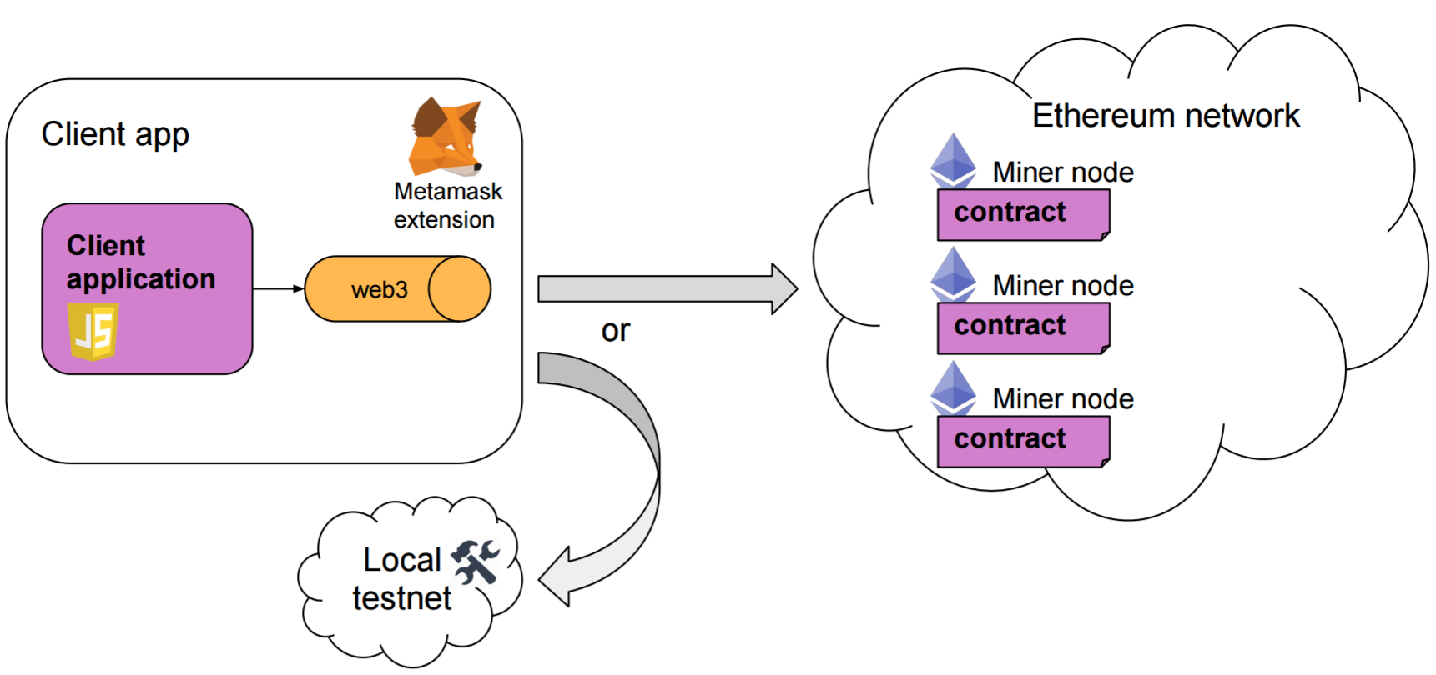
New WebApp Paradigm - web 3.0

Slide 5
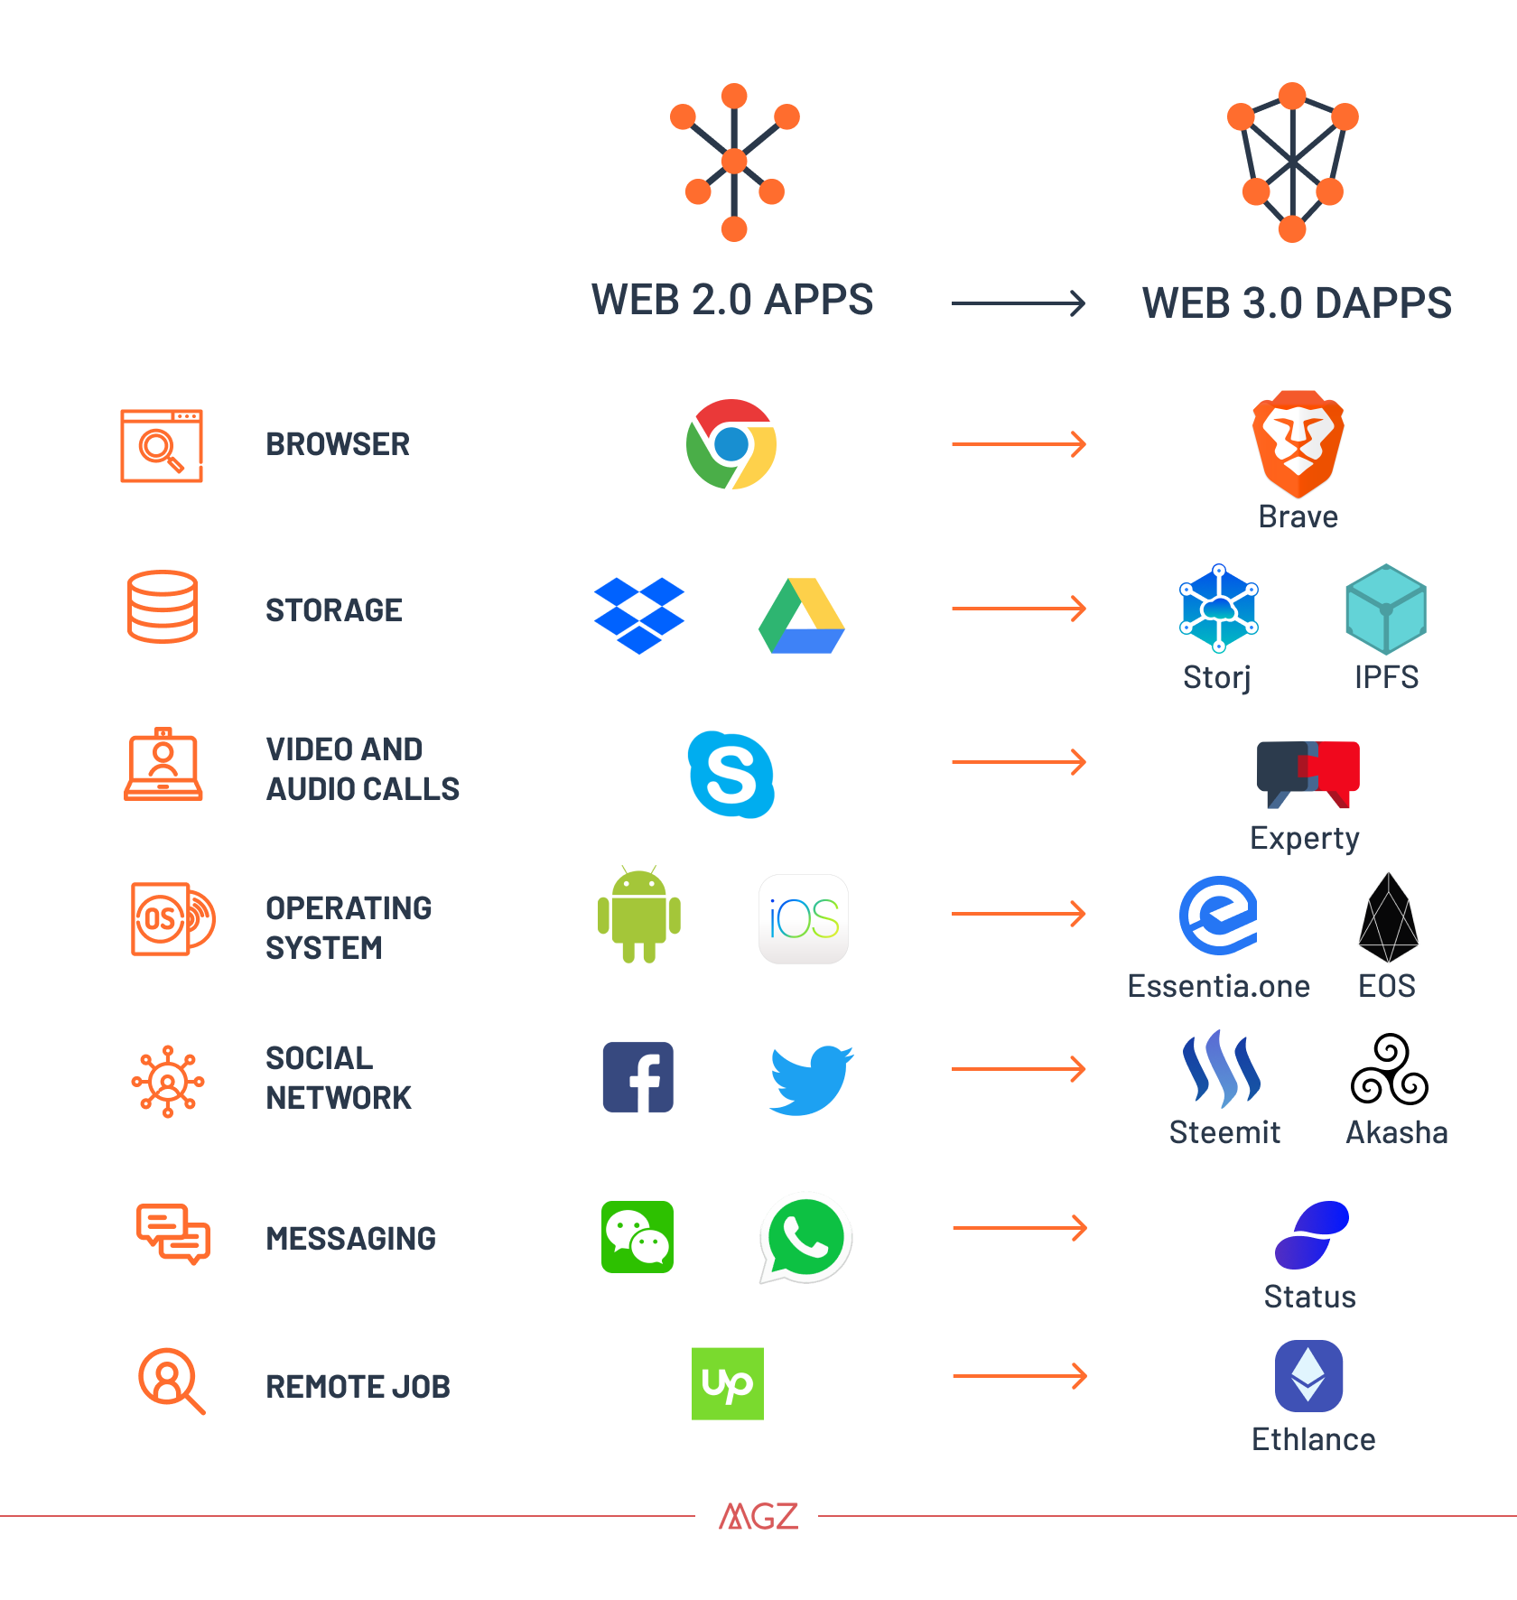
Web 2.0 to Web 3.0

Slide 6
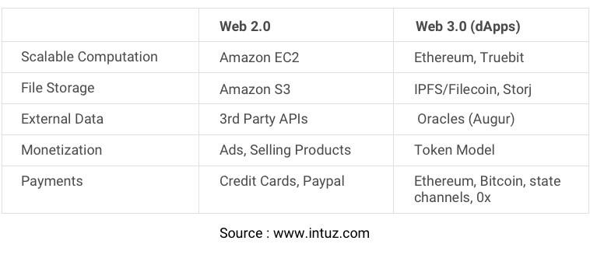
Web 2.0 vs Web 3.0

Slide 7
dApps Ecosystems
https://dappradar.com/
~2400 dApps
~11000 smart contracts
Gaming apps more prominent
Popular platforms -
Ethereum
EOS
LOOP

Slide 8
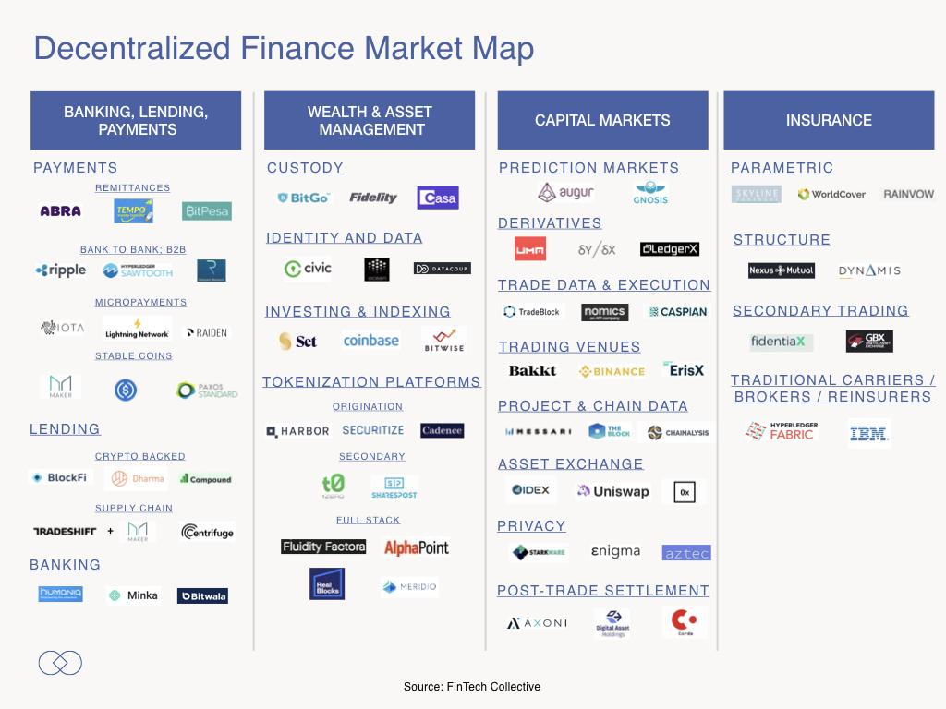
DeFi - Decentralized Finance

Slide 9
DeFi - Decentralized Finance
Ethereum is the king of Defi
More robust smart contract language
More secure than other dApps
Some popular examples :
EtherRisc insurance platform
Uport, Bloom, Civic - Kyc and Identity
BlockFi, Celcius, Dharma, EthLend - Lending
Augur - Prediction Market

Slide 10
dApp Lab :
Tools and Frameworks :
Web3.js Library
Truffle Framework
Ganache local blockchain
Nodejs
OpenZepplin OS

Slide 11
ERC20 Tokens
What are Tokens ?
Digital enitiy that can represent any physical or virtual assets
For example , IOU, payment currency, asset in a company, a real estate like house or land etc.
Managed and executed as smart contract
Its a Smart contract and has standard interfaces to -
Know total supply
Know balance of the token for an address
Change ownership
Standard allow interoperability between different applications like wallets, exchanges etc .

Slide 12
Tools and Frameworks
Web3.js
Ethereum javascript API, Also available in many other languages
Supports communication with local or remote Ethereum nodes
Can be injected into browser enabling communication with browser based wallets such as metamask
Truffle
Makes developer’s life easy with suite of tools
Compiler , testing framework, network management
Truffle boxes - entire dApp examples

Slide 13
Lab : Create your own token!!
https://gitlab.com/techflowspace/tfs-blockchain-class-2019/tree/master/session-5/erc20-techflow-token
Uses OpenZeppelin Library
Provides best practices to create secure smart contract
Battle tested
Reusable

Slide 17
Resources
Web3.js
dApp Radar
ERC-20
Ethereum DeFi Ecosystem
Truffle deepdive
Truffle migrations

