Slide 1

Tech Flow Space
Blockchain Course -Session 6

Slide 2
Enterprise Blockchain

Slide 3

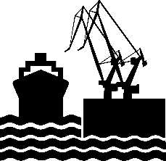

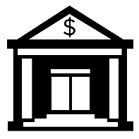






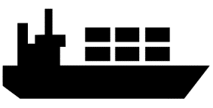

Problem Being Solved
Recording of events is becoming much more complex…
Airport’s records
Bank’s
records
Port’s
records
Airline’s records
Authority's records
Ocean Carrier’s records
… Inefficient, expensive, vulnerable, lack of transparency

Slide 4


Basic change to business process
Traditional Way
Blockchain Way
Digitally signed,
encrypted
transactions & ledger
Auditor’s records
Auditor
Party A’s records
Clearing House
Party B’s records
Party A
Party B
Bank’s records
All parties have
same replica
of the ledger
Bank
… Inefficient, inconsistent, reconcile immutability, finality

Slide 5
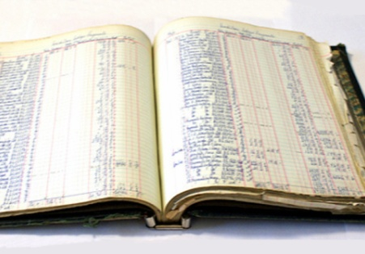
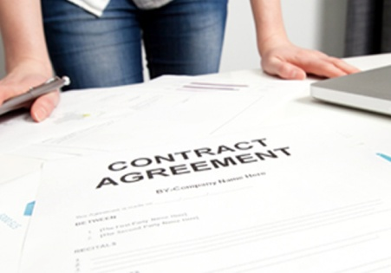


Blockchain for Business
Shared Ledger
Smart
Contract
Business terms embedded in transaction database & executed with transactions
Append-only distributed system of record shared across business network
Ensuring appropriate visibility; transactions are secure, authenticated & verifiable
All parties agree to network verified transaction
Privacy
Consensus
… Broader participation, lower cost, increased efficiency

Slide 6
Popular Enterprise Blockchains
Hyperledger family
Enterprise Ethereum
Quorum
Corda

Slide 7
Blockchain Applications
Supply Chain – Food Safety (Walmart), Logistics (Maersk)
Health Data Exchange (FDA)
Know Your Customer
Trade/Channel Finance (IGF)
Trade Information Warehouse (DTCC)
Post-Trade Reconciliation/Settlement
Private Equity Fund Management (Unigestion)
Syndicated Loans
Diamond/Valuables Tracking and Protection – Provenance Management (Everledger)
Cross-Border Payment, Payments for/by Unbanked Populations
Low volume stock trading (JPX)

Slide 8




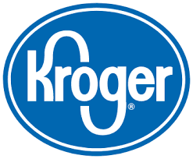
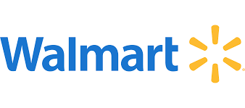



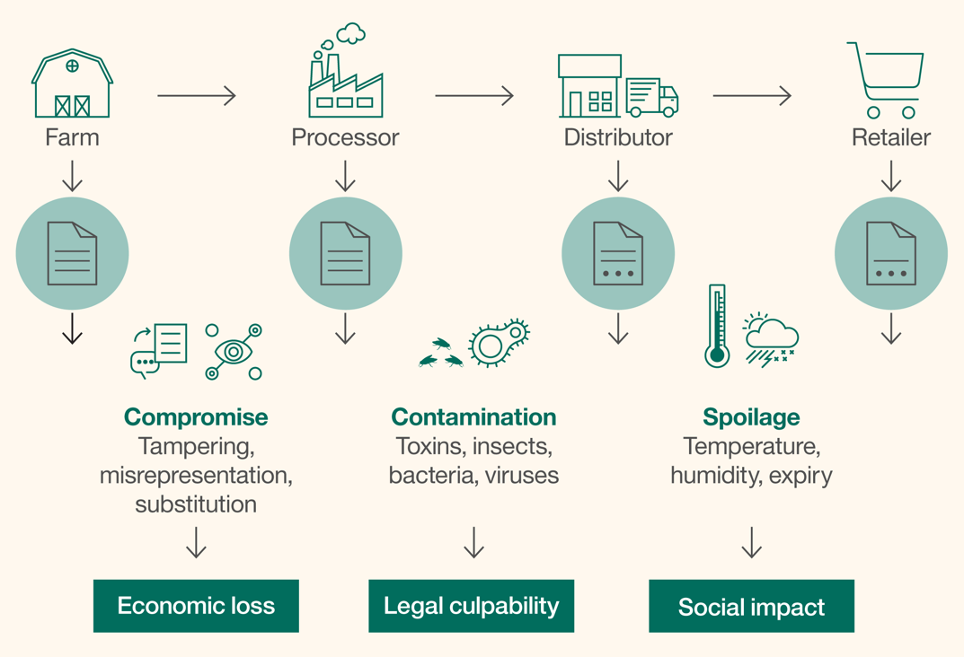
Food Trust/Safety
What?
Provide trusted source of information and traceability to improve transparency and efficiency across food network
How?
Shared ledger for storing digital compliance documentation, test results and audit certificates network
Benefits
Reduce impact of food recalls through instant access to end-to-end traceability data to verify history in food network & supply chain
Help address 1 in 10 people sickened and 400K fatalities worldwide which occur every year from food-born illnesses

Slide 9
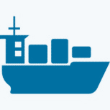

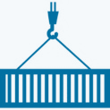

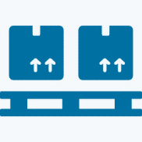

Global Trade Digitization (GTD)
What?
An open, extensible platform for sharing shipping events, messages, and documents across all the actors and systems in the supply chain ecosystem.
How?
Providing Shared Visibility and Shared State for Container Shipments
Benefits
Increase speed and transparency for cross border transactions through real time access to container events.
Reduced cost and increased efficiency through paperless trade
Supply Chain Actors
Carriers
Transportation management
Customs Dashboard
Supply Chain Visibility systems
GTD
Platform
Shippers
Trade Associations
Logistic actors internal systems
Provider of interface:
value-add partners
Supply Chain Management
Port community systems
Authorities
Terminals
Event publishers & subscribers

Slide 10
Hyperledger
Permissioned blockchain
Hosted by Linux Foundation
open source collaborative effort
IBM, Microsoft, Intel, Hitachi etc.
smart contracts are called chain-code

Slide 11
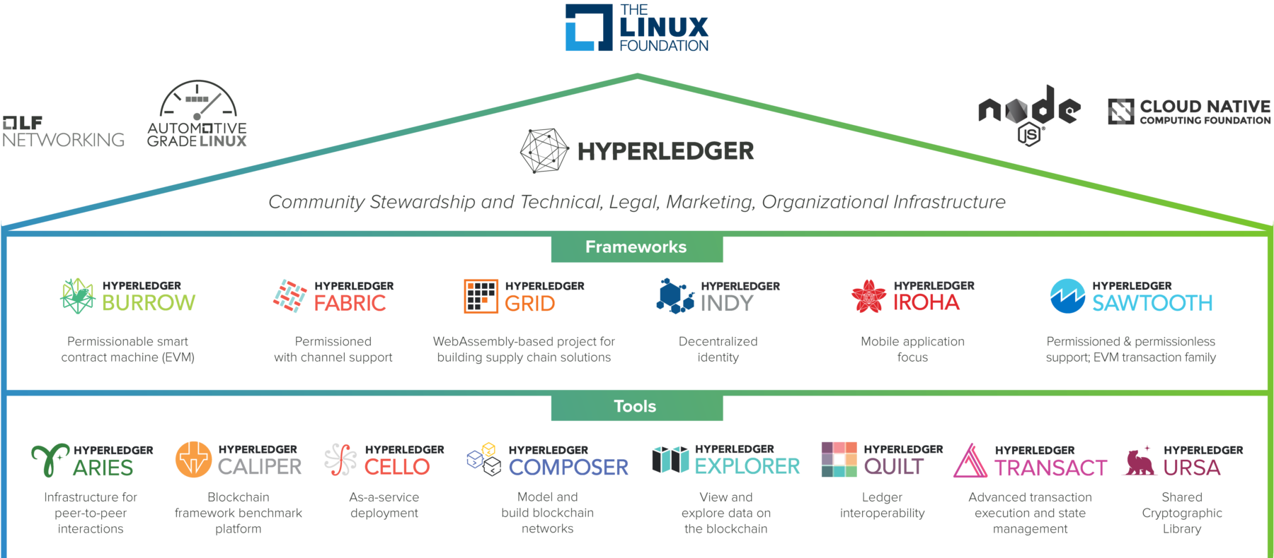
Hyperledger Family

Slide 12
Hyperledger Fabric
High-performance
Secure
permissioned blockchain
Code written in Go
chaincode (smart contracts) in Go, Javascript, or Java
SDKs in Node.js, Java, Go, REST and Python.

Slide 13
Hyperledger Fabric Model
Assets
Chaincode
Ledger
Privacy
Security and membership service
Consensus

