Slide 1
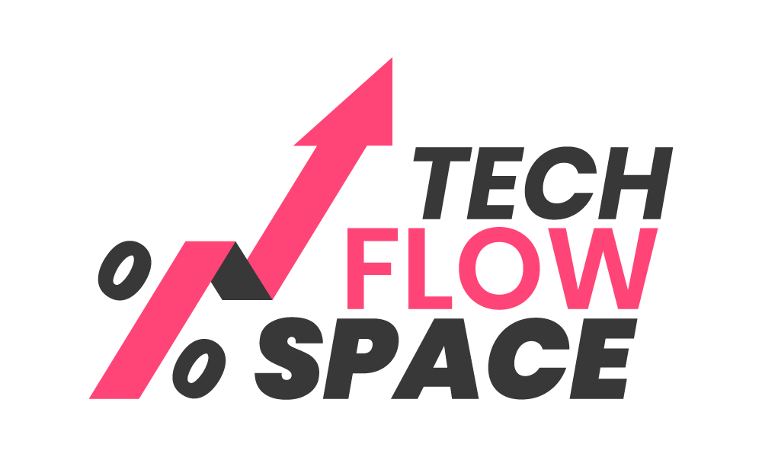
Tech Flow Space
Blockchain Course -Session 8

Slide 2
It’s a very very vibrant ecosystem

Slide 3
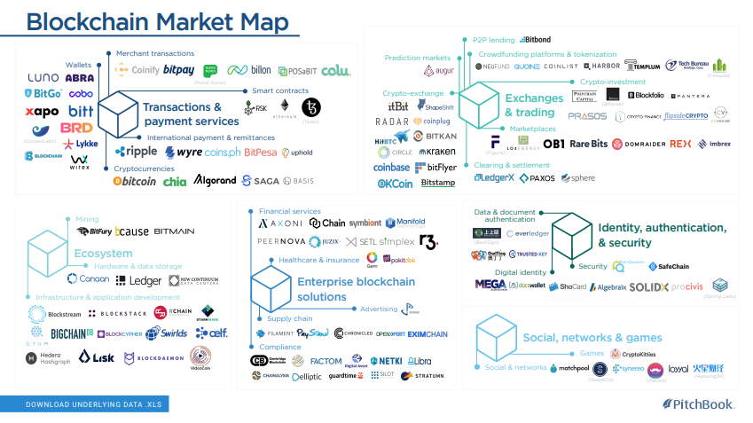

Slide 4
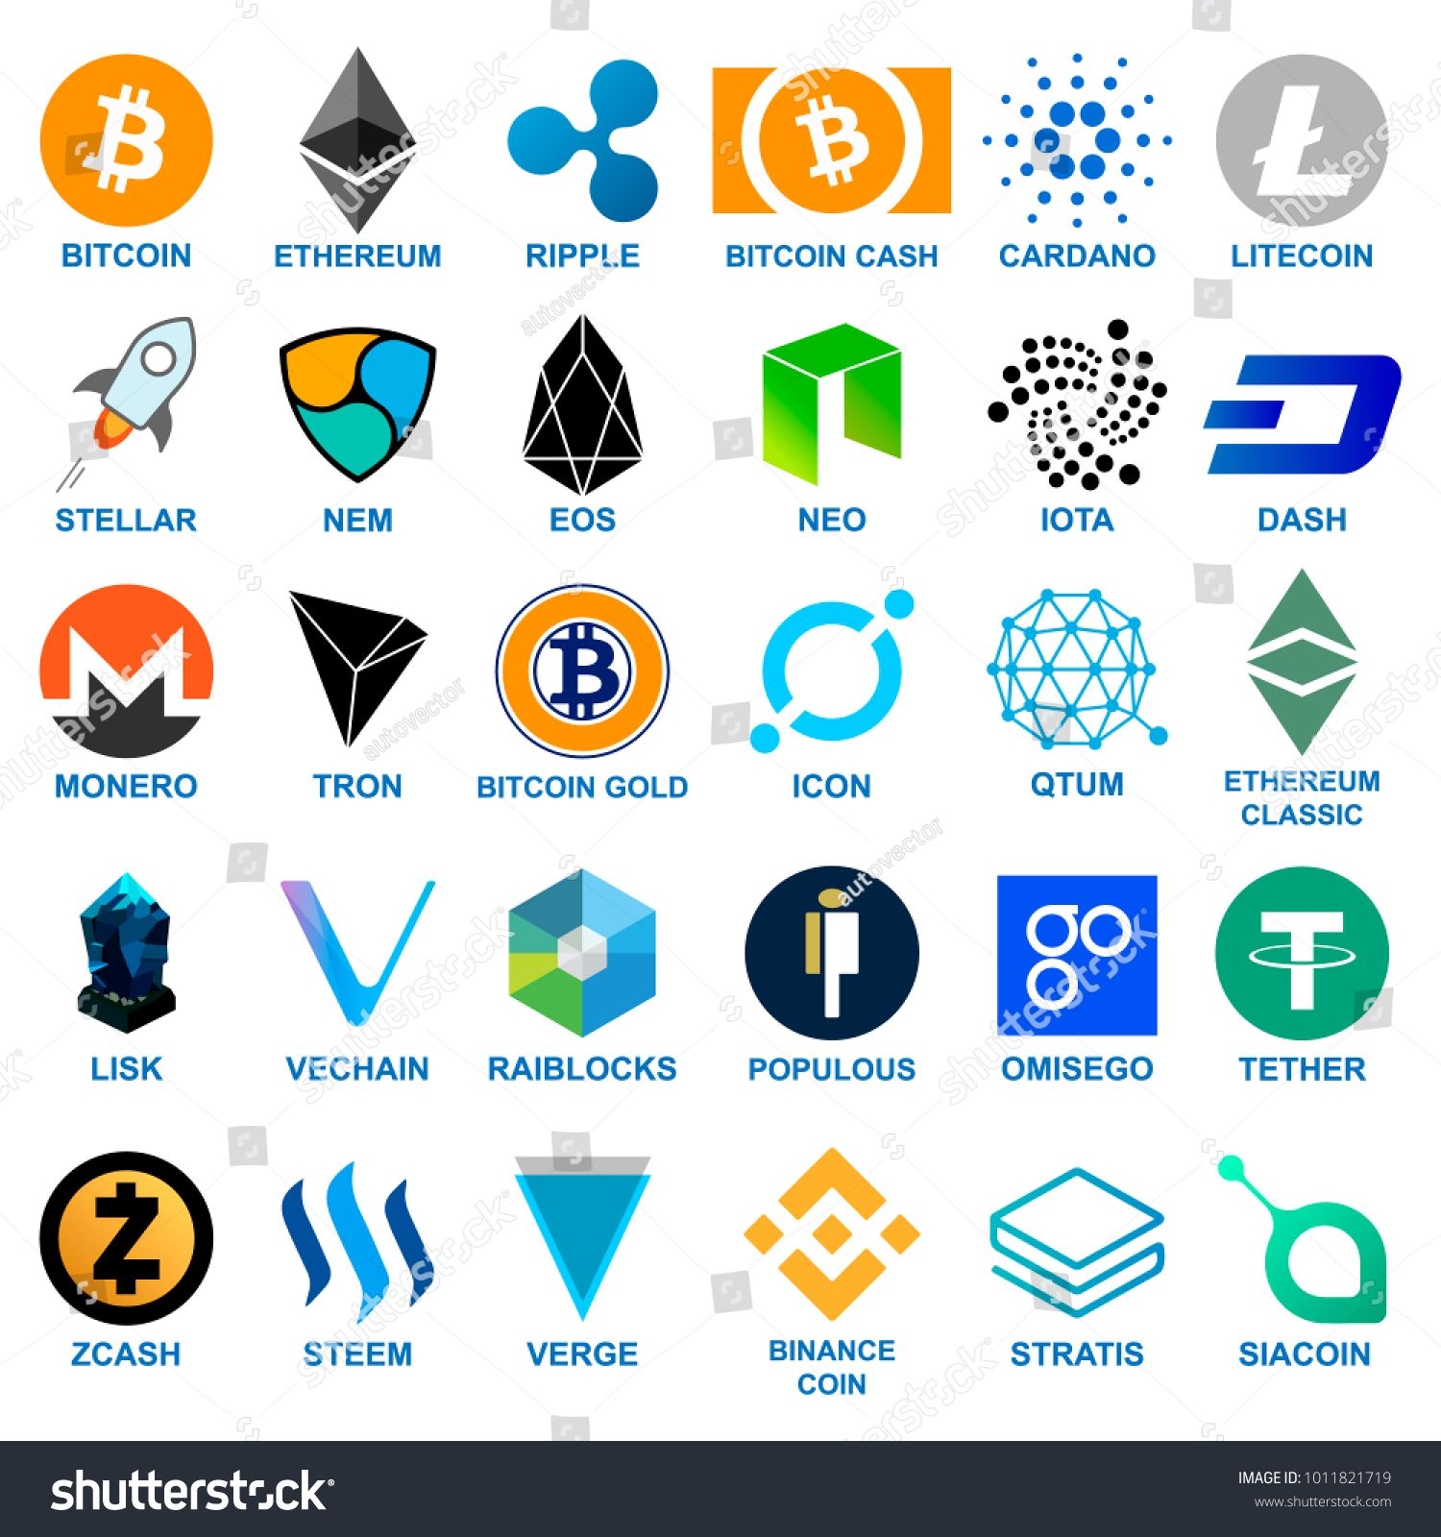
Many platform in the Market

Slide 5
And Many More….

Slide 6
Let’s Explore some Popular and Useful Blockchain

Slide 7
Blockstack
Decentralized internet platform
Full-stack alternative to traditional cloud computing for building secure, private applications
Blockstack provides -
highly scalable and performant decentralized storage system, called Gaia
universal ID and authentication system, called Blockstack Auth (No need for password based login and separate logins per app)
Blockchain called stacks to handle minimal state and logic
First company to get SEC Approval to raise fund from non-accredited investors

Slide 8
Blockstack contd...
A Blockstack user gets digital keys to create their identity on the Blockstack network
User Owns their data and network
Content are stored securely and in encrypted form.
Easy to write a decentralized app as the platform provides identity and storage.
Most business logic and data processing runs on the client, instead of on centralized servers

Slide 9
Blockstack contd. - Incentivization
Stacks (STX) token is the native utility token
App reviewers review apps for quality. Rewarded for app reviews
App reviewers evaluated based on performance and elected every year
Top apps receive token rewards each block, based on a weighted average set by the Reviewer
Apps listed under https://app.co/ more than 100 apps

Slide 10
Blockstack apps - example
Trove
User authentication managed by blockstack
Storage managed by blockstack
Client heavy decentralized app

Slide 11
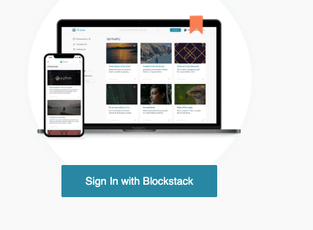
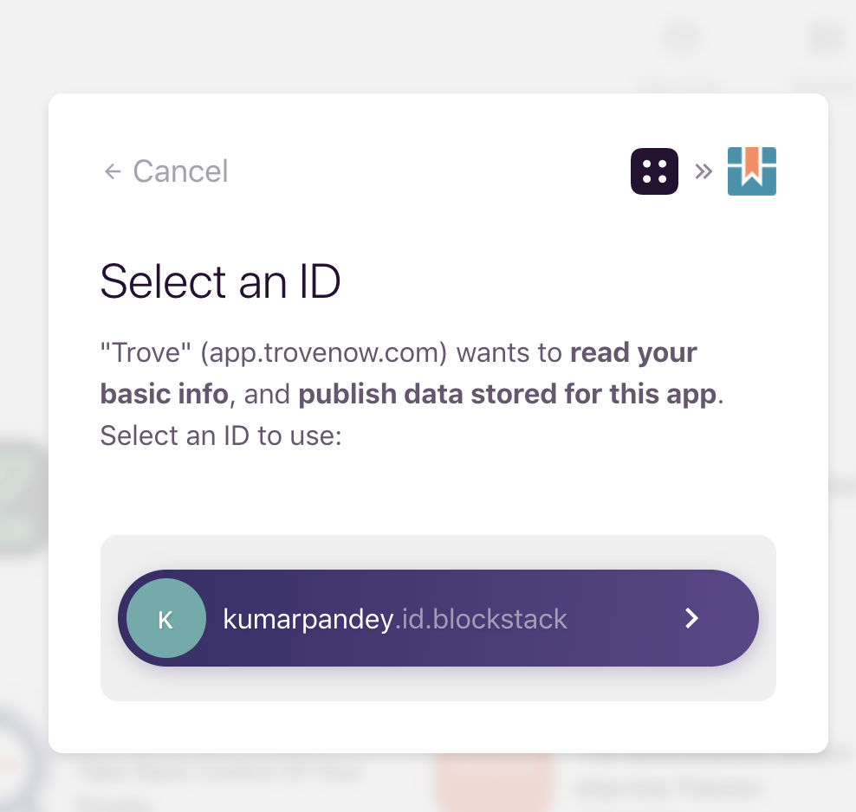
Blockstack apps - example

Slide 12
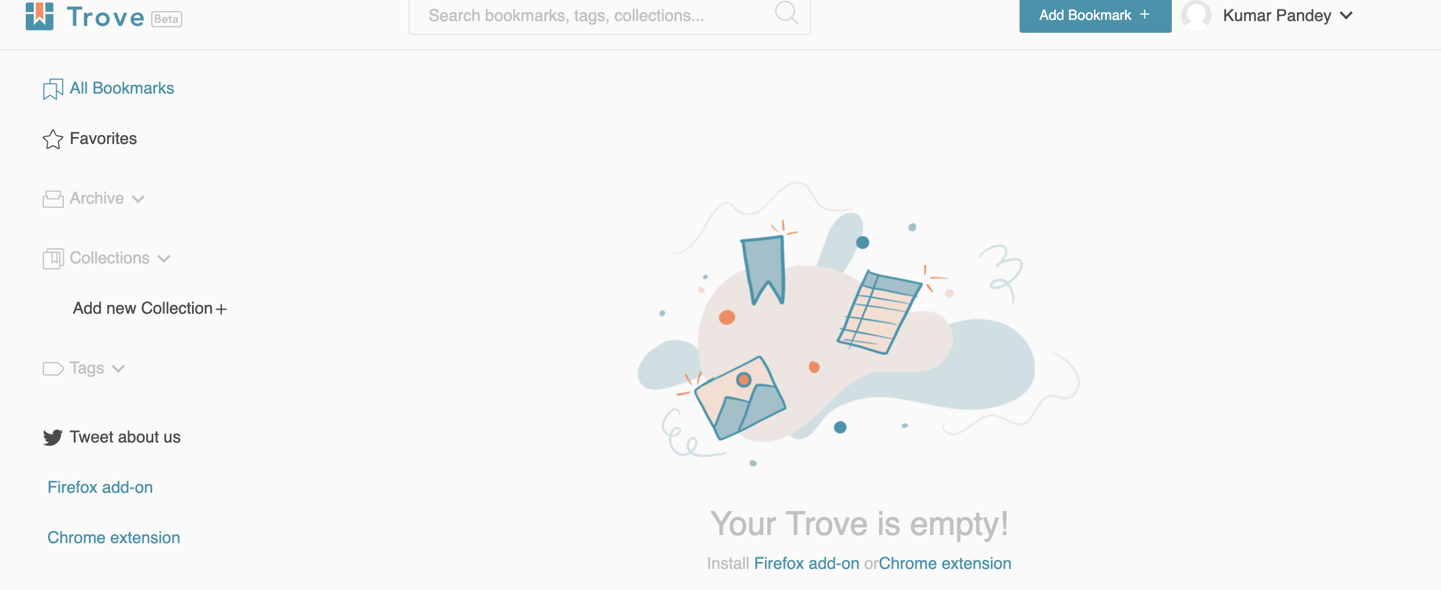
Blockstack apps - example

Slide 13
COSMOS
Decentralized network of independent blockchains
“Third generation”

Slide 14
Cosmos
So far we talked about building dApps on top if existing blockchain
Building app specific blockchain was difficult.
Cosmos allow developers to build their own blockchain and allow them transact with each other. App specific blockchain
Solves three major problem of common blockchain platform
Interoperability
Scalability
Self sovereignty of each blockchain

Slide 15
Developer Tools
Tendermint BFT : Packages networking and consensus layer into a generic engine.
State of the art blockchain engine
Public : Proof of stake
Private : Pre-authorized validators
High performance
Instant finality ( as opposed to say 15 sec on ETH and 10 min on Bitcoin)
Cosmos SDK : Framework for building blockchain applications on top of tendermint
Ethermint : port of Ethereum VM into cosmos so you can run your dApp
IBC (inter-blockchain communication protocol) : Allows for different blockchains to transfer values ( e.g tokens) and data

Slide 16
Cosmos contd...
Cosmos Hub: The Cosmos Hub is the first blockchain to be launched in the Cosmos Network
Facilitate transfers between blockchains.
ATOM as the Native Token
Staking and governance as first priority
Token transfer just enabled
IBC - App specific blockchain can communicate.

Slide 17
Top Projects on Cosmos
Binance DEX : Build on cosmos SDK
IRISNet : Integrate business services from heterogeneous systems into the Cosmos Network
Sentinel : Multi-protocol network layer - decentralized Virtual Private Network (dVPN)
Agreements Network : Contract management platform aiming to serve as the legal layer for the networked world
FOAM : Proof of location
TruStory : Social network application for news authenticuty to fight “fake news”

Slide 18
Other Blockchain
EOS
TRON
Harmony
IOTA
loom
And many more...

Slide 19
Resources
Blockstack
Blockstack whitepaper
https://cosmos.network/

