Slide 1
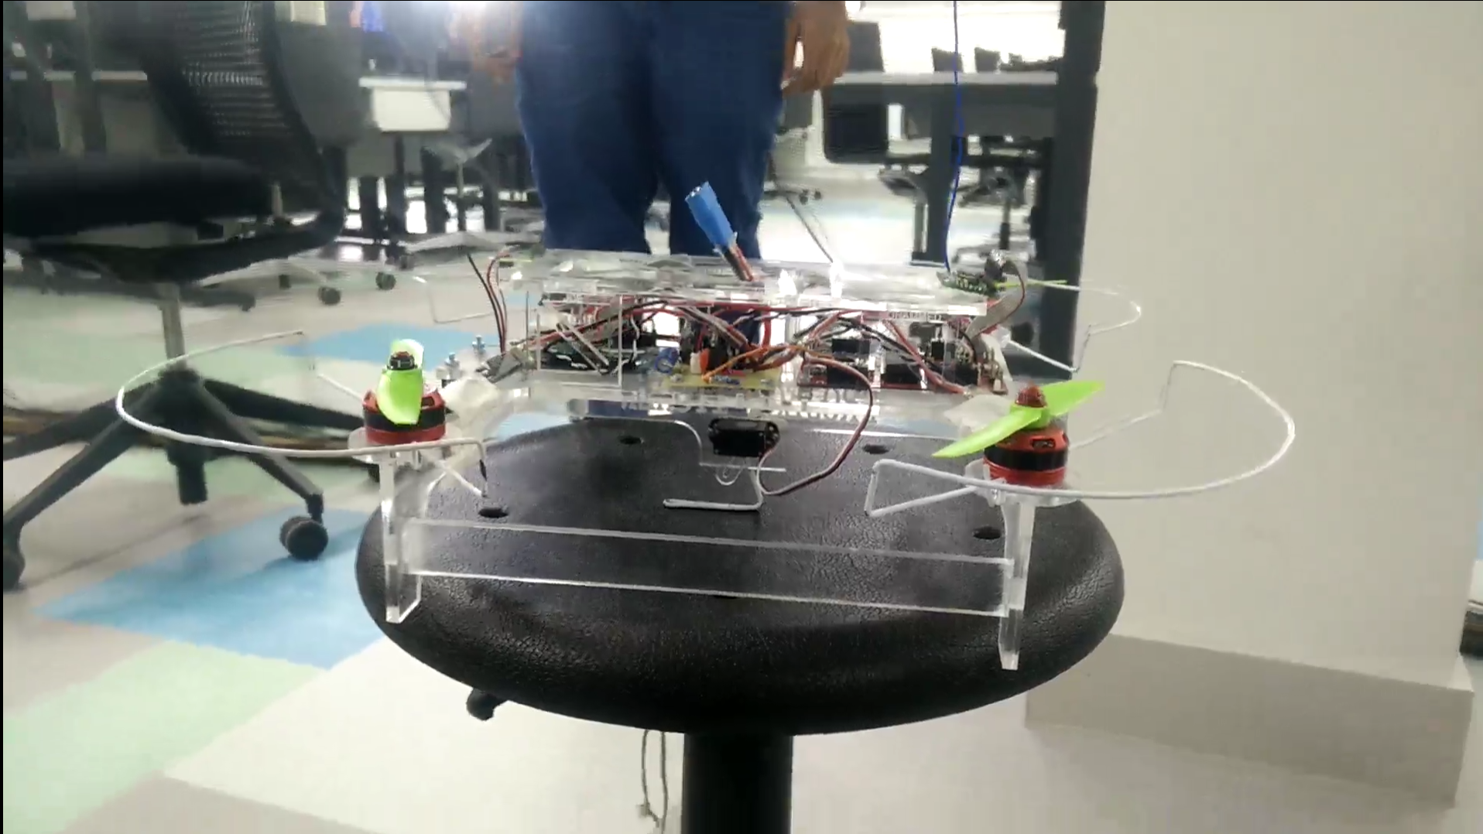
D4 - System Design Exercise Project Itchen
Team Ganges
24/03/2017

Slide 2
Team Ganges
Lawrence Gray – Control, Chassis Design
Joe Hindmarsh – Control, Extra Features
Joel Trickey – Communications, Encryption
Mohammed Ibrahim – Communications, User Interface
Ben Rowlinson – Team Leader, Integration
Notes:
INSERT TEAM PHOTO HERE!

Slide 3
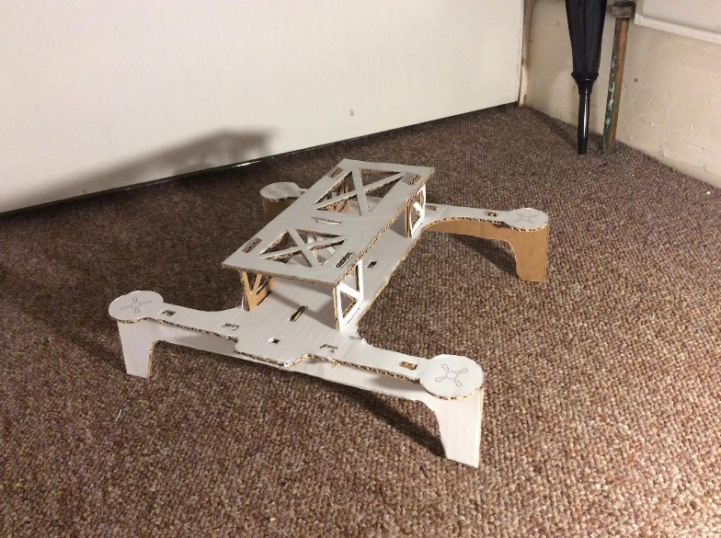
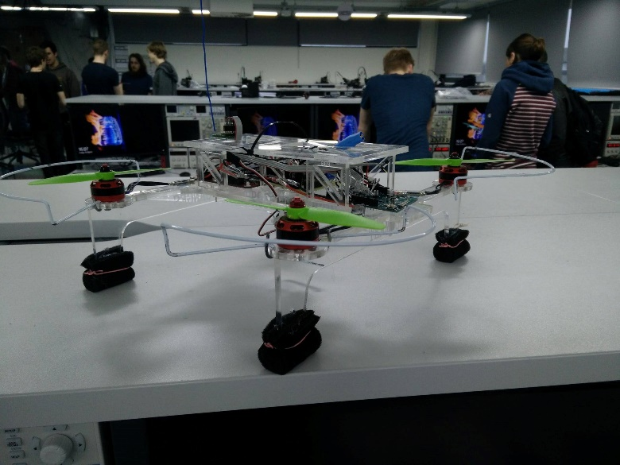
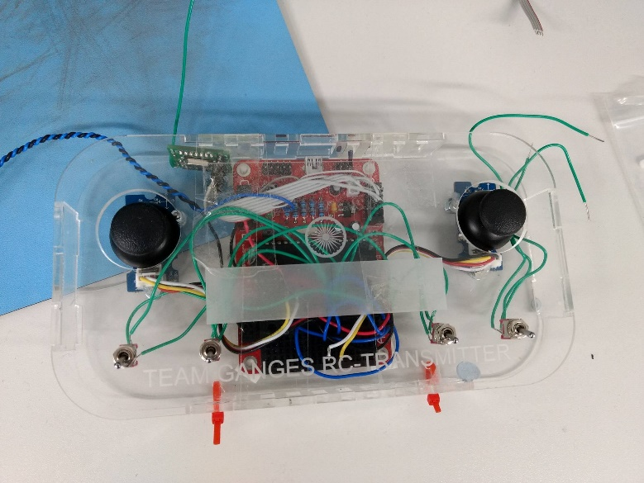
The Brief
“To design and build an unmanned aerial vehicle (UAV) that can pickup, carry and drop-off a cargo”

Slide 4
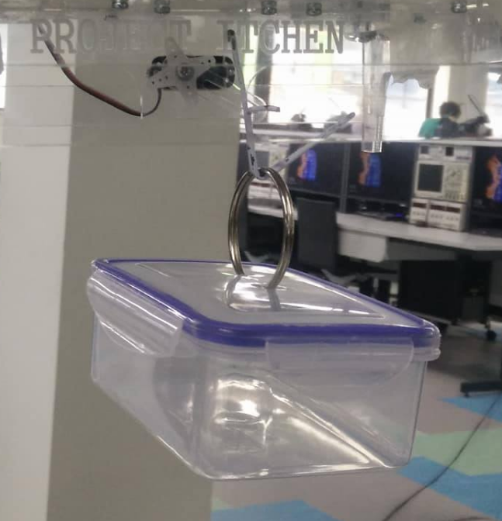
Target Market
Itchen required a solution which:
Has good cargo to UAV weight ratio
Is safe for the users
Is a low cost solution
We delivered a UAV which incorporates:
Custom User interface
Two way communications
Automated Stabilisation
Assisted Cargo Acquisition

Slide 5
Costings
Retail at £300 gives a profit margin of 46.7%
1228 units to be sold to breakeven (at a yield of 90%)
Expected that more UAVs needed for sustainable wide range delivery network

Slide 6
Development
Hardware Sourcing
Software Development
Chassis Manufacture
System Integration
Full system tuning/testing
Documentation

Slide 7
Problems
Didn’t fly reliably
Heavy - >900g
Small Propellers

Slide 8
Solutions and the Future
Close to good stability
All image and content acknowledgement to Team Ganges
Notes:
With a few more hours of tuning and debugging we could achieve stable flight

