Slide 1
HTML Form Controls Review and Internet Architecture Concepts
PROG1608: Week 1

Slide 2
This Week’s Plan
HTML5 Web Form Controls
Install XAMPP
Code a simple PHP input/output page

Slide 3
Let’s Get to Work!!
Web Form Controls Review
Helpful sites in External Links
Let’s work together and code the web form controls page
Starter file can be downloaded from the Week 1 in-class exercise folder

Slide 4
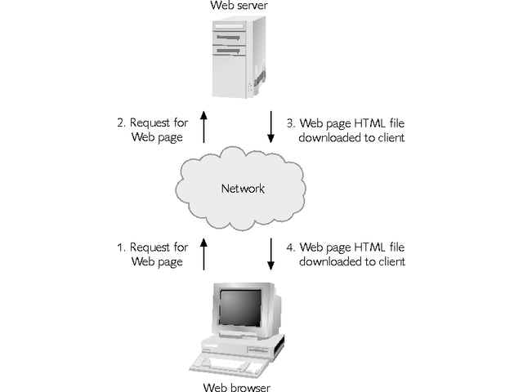
Client-Server Communication: The Big Picture
The Web has a client/server architecture
Programs on servers communicate and share files with client workstations over a network

Slide 5
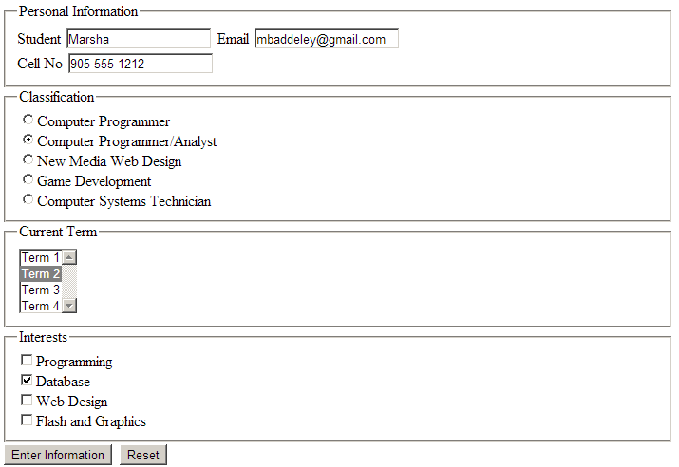
Name/Value Pairs
REQUEST
txtName=Marsha
txtEmail=mbaddeley@gmail.com
txtPhone=905-555-1212
radType=CPA
cboTerm=2
chkDB=Database
btnSubmit=Enter Information
RESPONSE
Resulting HTML page

Slide 6
Form Tag: Container of Input Controls
The form tag contains, or groups, input controls
action directs the input values to an URL
method determines how input values will be sent
post – name/values are sent as invisible form parameters
get – all name/values are appended to the URL

Slide 7

Buttons: Default Actions
submit: invokes the form’s submit() method to send data to the action argument URL
reset: restores initial values as set in design by invoking the reset() method
We use the value attribute of the button to change its text from the default words (submit or reset) to custom wording

Slide 8
Buttons: Custom Actions
When we want our own code to execute, we implement an input type called, button
This example demonstrates custom inline JavaScript code

Slide 9
Input Controls
Standard attributes
id, name, type
ID vs. Name
id is set when you want to change something about a control outside of form tags – the id value MUST BE UNIQUE
name is required if you are going to send data to another page for processing – it needs to associate the value to a name
type determines what kind of input control it is going to be (radio, check box, text box …)

Slide 10
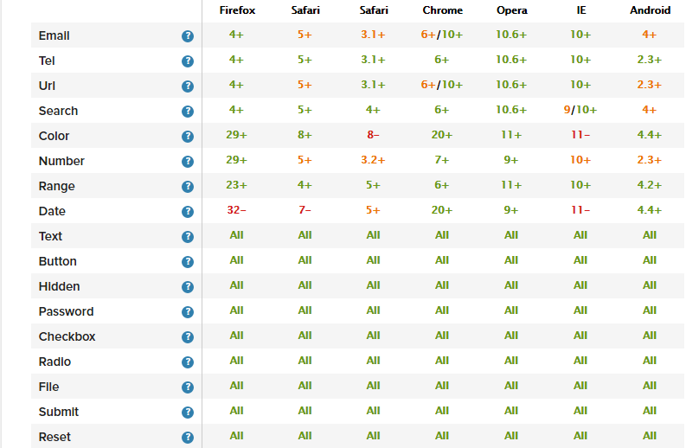
More About <input> type Attribute
Taken from: http://www.wufoo.com/html5/

Slide 11
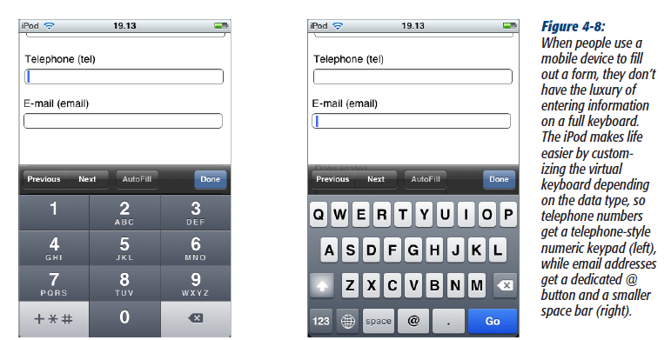
Using the type Attribute to Support Mobile Sites
Taken from: “HTML5: The Missing Manual.” The telephone field has type=“tel”
and the email field has type=“email.” Although there are browser limitations for these new types, they are worth using so that you make your sites robust and flexible.

Slide 12
Additional HTML5 Attributes Used in this Course
required: when the user clicks the Submit button, controls that have this attribute must have a value.
autofocus: the control that has this attribute defaults to having the curser active on it.
placeholder: sample prompt text that instructs users how to complete data entry
required and autofocus are not assignment statements, whereas placeholder is
Sample syntax, using all three attributes:

Slide 13

Special Notes About Checkboxes
checked=“checked” defaults checking the box
Checkboxes can share the same name or have unique ones
If names are shared, they are sent as comma separated values and can be treated like an array

Slide 14
Special Notes About Checkboxes
The value attribute is associated with the checkbox name & specifies the value of the check box when checked
The default value sent, if no value attribute is specified, is “on”.
If it is not checked, no value is sent!

Slide 15
Special Note About Radio Buttons
All rules that apply to checkboxes apply to radio buttons, too … with one exception:
Radio buttons can act as mutually exclusive
To do so, they must share the same name attribute

Slide 16
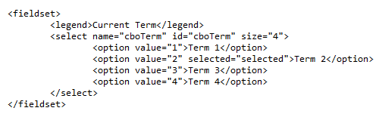
One of These Things Are Not Like the Others: Select Tags
size - specifies number of list items displayed
if size=“1” then it’s a drop down box
a size greater than 1 always makes it appear as a listbox
option tag is used to specify the individual items in the list. This is where the value is assigned.
selected=“selected” defaults the option tag when the page loads.
multiple=“multiple” allows you to select many items in the list

Slide 17
Strategizing By Control Type
We have to differentiate if a control acts like an array or a single object because …
It effects
How you design it
How you access it in code
How you get its value(s)
We will complete practice exercises over the next couple of weeks to help you to work with single values vs. an array of values

Slide 18
In Summary
When you click the Submit Button:
Name/value pairs in corresponding form tags are sent across the Internet
The server page that processes name/value pairs on the server is also listed in the action argument
The server page processing name/value pairs sends back a response to the client in the form of a web page

Slide 19

What’s Next??
10 minute break
Begin work on Lab 1A

