Slide 1
Persisting Data with Cookies!
PROG1608/BTGD9113

Slide 2



Review of Client-server Communication
Client sends name/value pairs using form action and method attributes
Server-side page catches name/value pairs via $_GET or $_POST
A response is written back using echo
Data are passed from page-to-page but not remembered after request/response is complete
Need to store data somewhere when the request is received
REQUEST
www.someAddy.com/somepage.php
RESPONSE
(echo)

Slide 3
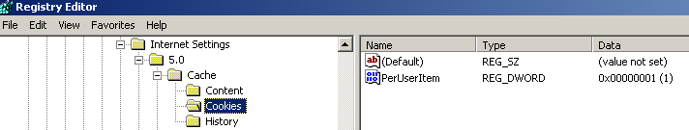
Some Ways to Persist Data
Database
For PHP, this is typically MySQL or PostGreSQL
Cookies
Small bits of information stored on the client
Session variables
Small bits of information stored on the server

Slide 4
More About Cookies
Typically used for:
Recalling a username
Remembering a user’s preferred theme
Simple site visit counter
Important Big Picture Concepts/Limitations
Cookies have to be turned on by user
A user can manually delete a cookie
A cookie is only recalled by the browser in which it was made
Cookies are passed via the document header

Slide 5
Setting and Getting Cookies
NOTE: because cookies are passed via a document’s header, put all cookie code before any references to echo or to HTML output
Setting
setcookie(name, value, expiration);
setcookie(“userName”, “Rosebud”, time() + 60 * 60 * 24);
Getting
Access values using the $_COOKIE associative array
$user = $_COOKIE[“userName”];

Slide 6
Is the Cookie Already Set?
Sometimes you need to see if a cookie already exists so you can get it from the COOKIE associative array
if(isset($_COOKIE[“userName”])
$user = $_COOKIE[“userName”];

Slide 7
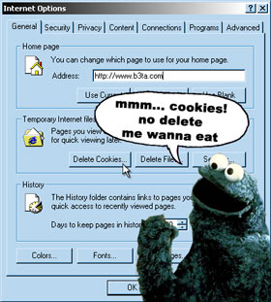
Deleting a Cookie
User’s can manually delete a cookie via the browser’s options dialog
In code, you set the cookie’s expiration to the past
setcookie(“userName”, “Rosebud”, time() -1);
… or you can refer to the cookie by name only
setcookie(“userName”);

