Slide 1
Arrays
Working with Collections of Data

Slide 2
Agenda
Arrays Lecture
Hands-on Practice Exercise

Slide 3
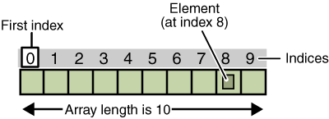
What is an array
An array is a collection “group” of similar data
Array of integers, array of strings.
In most languages, you cannot mix the types in an array; however, PowerShell will let you do that
A string is actually already an array, it is an array of chars

Slide 4
Creating/declaring an arraY
An array of strings
$workstations = “L1”, “L2”, “L3”, “L4”, “L5”
… or $workstations = @(“L1”, “L2”, “L3”, “L4”, “L5”)
An array of numbers
$numbers = 1,2,3,4,5
…or $numbers = (1..5)
But both of the above are loosely typed arrays. That means that you could add another non-number to the $numbers array as follows:
$numbers += get-date

Slide 5
Creating/declaring an array cont.
To create a strongly typed array:
[int[]]$numbers = (1..10)
NOTE: you must use the [] after the data type to make a strongly-typed array
You can combine array contents! For example:
$lowNumbers = (1..5)
$highNumbers = (6..10)
$allNumbers = $lowNumbers + $highNumbers

Slide 6
Accessing individual elements
Given this array
$workstations = “L1”, “L2”, “L3”, “L4”, “L5”
You can access any of its individual elements using square bracket notation to reference one of its index values
Write-host $workstations[2]

Slide 7
Using iteration structures to loop through array elements
Understanding that you can access array elements via its index, you can use loops as follows to work with a series of array elements:
$workstations = “L1”, “L2”, “L3”, “L4”, “L5”
for($x = 0; $x -le $workstations.getUpperBound(0); $x++)
{ write-host $workstations[$x] }
#you can also use the count property of the array to set the boundary for looping as follows
for($x = 0; $x -lt $workstations.count; $x++)
{
write-host $workstations[$x]
}

Slide 8
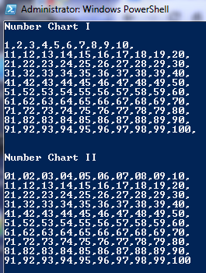
Your turn!
Recall that you can also iterate via a while loop. Try looping through the workstations array using this iteration structure!
Create a script that will create two types of number charts.

