Slide 1
GROUP-OBJECT
Getting MIN, MAX, SUM, AVG, and COUNT from GROUPS

Slide 2
A Note about pipeline transitions
Type this:
gps | select ID, name, handles, ws | ? cpu –GT 4
This next command will tell you why you didn’t get any results back:
gps | select ID, name, handles, ws | ? cpu –GT 4 | gm
We will correct this cmdlet logic now!

Slide 3
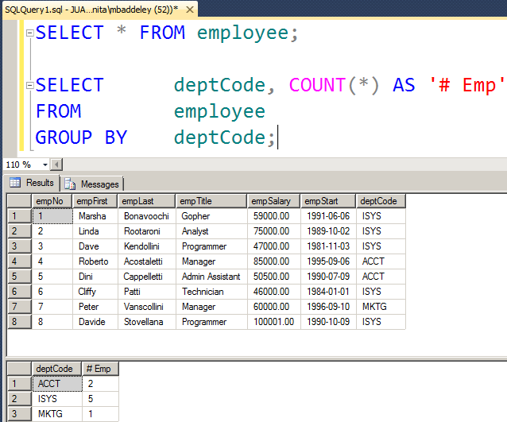

GROUPING Data: SQL AS Your Starting Reference
In SQL, you tell the database which redundant field you want to collapse, and then it will perform a summary per collapsed item

Slide 4
PowerShell Grouping
In PowerShell, you can use group-object to specify the redundant field:
gps | group-object ProcessName
gps | group ProcessName
Now see what members you have to work with!
gps | group ProcessName | gm

Slide 5
Remember, the Order of Piping Matters!
We will start to create our output:
gps | group name | select name, count | sort count –desc
Now if we want to get the top or first 3 process groups, we can use the –first parameter … but note the output
gps | group name | select name, count –first 3 | sort count –desc
How did the cmdlet above get the first 3?

Slide 6
Using piping order for group-by sorting
Let’s rearrange the piping sequence:
gps | group name | sort count –desc | select name, count –first 3

Slide 7
Other Summaries?
Group-Object can give you COUNT as summary data
What cmdlet can you use to access MIN, MAX, SUM, AVG data?
Code the cmdlet syntax that will output the MIN and MAX handles values for all chrome processes

