Slide 1
Beginning to Write Powershell scripts
The Information Stream

Slide 2
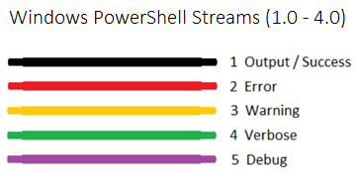
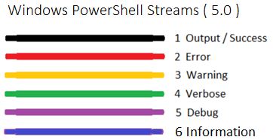
New to Powershell 5!
All of the these information streams can be stored, redirected, and/or suppressed

Slide 3
Write-host
Write-host used to get a bad rap
It goes directly to the host
It cannot be suppressed or stored
But the advantage of write-host is that it doesn’t pollute the information stream!
You can change its display colors via these properties
ForegroundColor and BackgroundColor
Write-Host can take in values from the Pipeline (i.e. “hello world” | write-host)

Slide 4
Write-information
Responds to
$InformationPreference variable
InformationAction parameter
It can be stored in a variable (InformationVariable) for later use
It cannot change its color coding and it cannot take in values from the Pipeline
You can use a tag parameter so it can be categorized in the stream

Slide 5
Assignment 2 overview and Style
Lets review the specs now
Use ISE for this assignment
Add these PS standard sections to the PS file:
SYNOPSIS
DESCRIPTION
NOTES
To do that we will use these characters
<# and #> for multi-line comments
Dot notation (.) to declare some comments as PS standard sections

Slide 6
Adding Flowerbox output to assign 2
Use the Write-Host cmdlet
Here are some helpful examples to assist in making the flowerbox
Write-Host (blank line)
Write-Host “Text”
Write-Host “`nText” (newline then Text)
Write-Host “Text`n” (Text then newline)
Write-Host “`n” (blank line)
The “`” character is called a “backtick” and is only used to format outputted text
`n (newline)
`r (carriage return)
`t (tab)
` (on its own it means a line wrap or line continuation)

Slide 7
Some notes about strings/text
If you surround your text in double quotes, it won’t interfere with interpretation of special characters, like the backtick
write-host “First Name `t Last Name”
If you use single-quotes around text, it treats special characters literally. See what happens:
write-host ‘First Name `t Last Name’

