Slide 1
Decision Structures

Slide 2

Today’s agenda
Finish lecture on variables and parameterization
Learn about conditional statements
Complete Practice Exercise

Slide 3
Working With “Other” Data Types
You can store what comes back from a cmdlet in a variable
Let’s do this:
$device = get-WmiObject -Class Win32_LogicalDisk | select deviceID, freeSpace, size, availability |
? deviceID -EQ "C:"
Now see what data type $device is …

Slide 4
Using dot notation with variables
We can refer to an object’s properties and methods via dot notation:
#assignment statements to access values
$amountFree = $device.freeSpace
$capacity = $device.size
#calculate percent of capacity
$percOfCap = ($amountFree /$capacity) * 100

Slide 5
Evaluating Conditions: One Outcome
If logic when you only have one outcome on one evaluation:
#example 1: output to user when disk space is getting low if($percOfCap –le 20)
{
write-host “Warning: disk space is getting low”
}

Slide 6
Evaluating Conditions: Either/Or Logic
If/else logic provides 2 branches – one for a true condition and one for the false outcome
#example 2: either warn for low disk space or confirm sufficiency if($percOfCap –le 20)
{
write-host “Warning: disk space is getting low”
}
else
{
write-host “Disk space is sufficient”
}

Slide 7

Evaluating Conditions: Multiple Outcomes
if($percOfCap -ge 80)
{ write-host "Lots of space left“ }
elseif($percOfCap -ge 50)
{ write-host "Over half the disk remaining“ }
elseif($percOfCap -ge 20)
{ write-host "Getting low on disk space“ }
else
{ write-host "Time to clean up your hard drive!“ }
Use if …elseif logic when your have multiple tests on the same variable

Slide 8
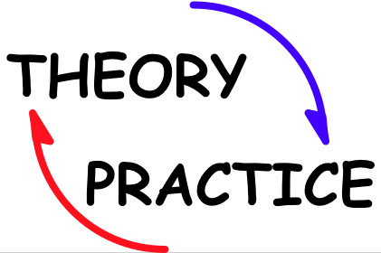
Your Turn!
Try the conditional logic practice assignment in the Week 4 folder

