Slide 1
Iteration
Looping through Collections

Slide 2
Agenda
Take up Test 1
Today we are going to learn about looping structures and how they could be used in PowerShell

Slide 3

What is iteration and why do we need it?
Iteration means that we repeat/loop through programming logic for set number of times/conditions
There are various types of loops for particular contexts:
for
for each
while
do while
You will see that each type of loop has a similar template structure:
PerformLoopType (test condition for loop start/stop) { #run some block of code}

Slide 4
For loop
This type of loop has all of the start and stop boundaries held within the conditional statement:
A counter and its starting point
The stopping point for the counter
An incrementer for the counter
for($x=0; $x -le 4; $x++)
{
write-host $x
}

Slide 5
While loop
This type of loop has the same start and stop boundaries as the for loop:
A counter and its starting point
The stopping point for the counter
An incrementer for the counter
However, the three parts of the counter are separated as follows:
$x=0
while($x –le 4)
{ write-host $x $x++ }

Slide 6
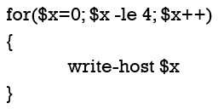
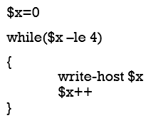
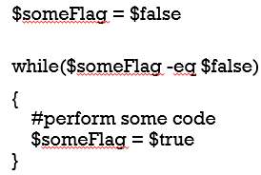
For loop vs. while loop
Both of these loops only execute if their conditions are met
When your test to start/stop the loop is solely based on counting a number, you are free to use either construct. Perhaps the for loop is nicer because all of its parts are managed in one place
But the while loop offers a type of flexibility that the for loop doesn’t have:
You can perform non-numeric tests for your start and stop points in a while loop

Slide 7
Do While loop
This type of loop has the same start and stop boundaries as the for and while loop:
A counter and its starting point
The stopping point for the counter
An incrementer for the counter
And the three parts of the counter are separated, but this loop always executes at least 1 time because the condition is tested after the iteration, not before it.
$x=0
do
{ write-host $x $x++ } while($x –le 4)

Slide 8

Practice time!
Use iteration to make the flowerbox, as seen below. Here are some hints and guidelines:
The flowerbox should be 50 characters wide
It should have one row of 50 stars, a following row of spaces surrounded by a star on each side, and a final row of 50 stars
You can use more than one loop to do this task
Recall that to concatenate a string (or make a running string), you can use the += operator

Slide 9

Adding Complexity to practice
Make a more dynamic flowerbox. This time, the width of it is determined dynamically by the message that you want to output in it.
Hints:
Make a string and store it in a variable. In this case, I have made a literal string, “This is a test flower box”
Do you recall how to get how long a string is?
How would you use that length to set the boundaries of your looping?

Slide 10
What is next?
We still have to explore one more type of loop: for each
We will work with arrays next week
Assignment 4

