Slide 1
PowerShell variables
And Parameterizing Scripts

Slide 2
Today You Will Learn How To:
Identify primitive variable types
Understand the difference between loosely and strongly typed variables
Explicitly cast variables for proper use in PS
Use variables to parameterize a PS script

Slide 3
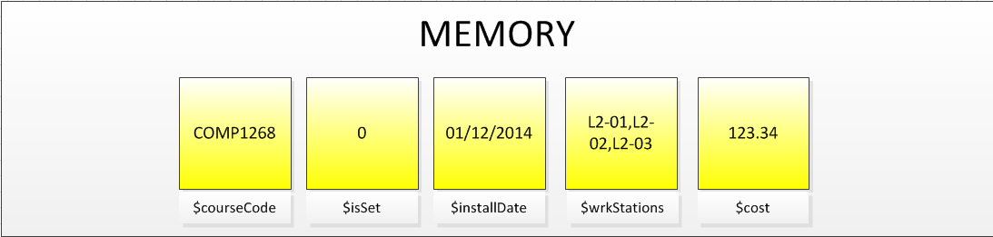
What is a Variable?
A placeholder to store a value in memory
We give variables names so we can refer to them in our code
The $ sign in PS is used to specify that something is a variable
They have a particular “life span” in memory

Slide 4
Naming Rules for Variables
Avoid reserved words (for, do, else, etc.)
You can use almost any characters in your variable names. Not all characters are legal (+, -, $, % &, etc.).
Industry standards typically suggest to use only alphanumeric characters.
Avoid spaces and use camelBackNotation

Slide 5
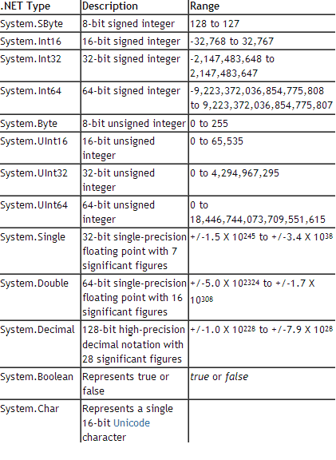
.NET Primitive Data Types
Just as we had in SQL Server, there are some basic, or common, types available to us in PS:
number,
string,
and date time types
NOTE: One thing that differentiates PowerShell from some other programming environments is this: all variables are objects that possess attributes and methods

Slide 6
Number Types: Whole Numbers
Declaring an INTEGER variable
Use Set-Variable OR the $
$Age = 29
Write-Host $Age
To look at variable members (properties, methods) use
$Age | Get-Member

Slide 7
Number Types: Decimals
Declaring a DOUBLE variable
Use Set-Variable OR the $
$Salary = 101.29
Write-Host $Salary
To look at variable members (properties, methods) use
$Salary | Get-Member

Slide 8
Number Types: True/False Values
Declaring a BOOLEAN variable
Use Set-Variable OR the $
$Retired = $False … or you can say $Retired = 0
$Retired = $True … or you can say $Retired = 1
Write-Host $Retired
To look at variable members (properties, methods) use
$Retired | Get-Member

Slide 9
Variable Length String Type
Declaring a STRING variable
Use Set-Variable OR the $
$FirstName = “Bob”
Write-Host $FirstName
To look at variable members (properties, methods) use
$FirstName | Get-Member

Slide 10
String Types: Single Character
Declaring a CHAR variable
Use Set-Variable OR the $
[char]$Gender = “M” (Strong Typing)
Write-Host $Gender
To look at variable members (properties, methods) use
$Gender| Get-Member

Slide 11
Date Time Type
Declaring a DATETIME variable
Use Set-Variable OR the $
[datetime]$RetirementDate= “September 15, 2019”
Write-Host $RetirementDate
To look at variable members (properties, methods) use
$RetirementDate | Get-Member

Slide 12
Date Time Type – Explicitly Casting
Is there a difference?
$StartDate = “September 15, 2013”
[datetime]$EndDate = “September 15, 2014”
Do a Get-Member and what do you find?
$EndDate.AddDays(45)
$EndDate.AddDays(-105)

Slide 13

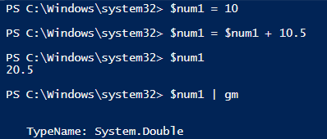
Loose Vs Strongly Typed Variables
These are loosely typed $num1 = 10 $num2 = 5
Because they are numbers, the + sign means addition
Watch what happens when we do this:
The engine implicitly casts the variable to a new type to handle the decimal

Slide 14
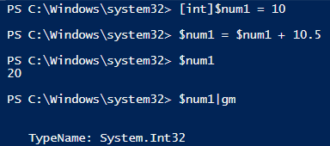
Explicitly Casting a Number Type
If we were to explicitly cast a number to a specific type, it stays as that type until we change it.
Look what happens now:
The engine truncates the decimal so that the number remains an INT

Slide 15
Strings
When you declare a variable like this:
$first = “Bob”
$last = “Smith”
The plus sign now is interpreted as concatenation:
write-host $first + ‘ ‘ + $last
But remember, you don’t have to concatenate if you surround variables in double quotes:
write-host “$first $last”

Slide 16

Your Turn!
Create a script that will handle the following data:
First Name
Middle Initial
Last Name
Phone#
Address
Age
Gender
Start Of Work Date
Currently Employed Status
Salary
Output each variable value to the screen so that its format appears as follows:

Slide 17
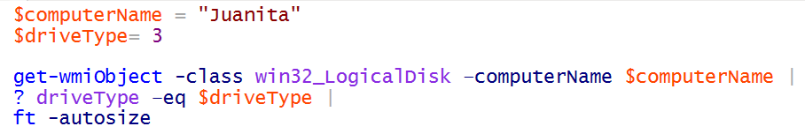
Using Variables Within cmdlets
Download Get-DiskInventory.ps1 from and save it to c:\
Declare these 2 variables:
$computerName = “localhost”
$driveType = 3
Now we can use them in an initial call to get-wmiObject

Slide 18
Parameterizing Variables in a Script
If we take our variable list, comma separate them, and nest them in a param method, we can now form parameters by which we can call our script. This example demonstrates optional parameters that are defaulted
param
(
$computerName = “localhost” ,
$driveType = 3
)
NOTE: you cannot have any non-commented code happen before your param method

Slide 19
Demo of Required and Positional Parameters
param
(
[Parameter(Mandatory=$True,Position=1)] $computerName ,
[Parameter(Mandatory=$True)] $driveType
)

Slide 20
Calling a Script
Run this command:
help c:\ Get-DiskInventory.ps1
Now see how we have intellisense/tab assistance when we run just this:
c:\ Get-DiskInventory.ps1

Slide 21
Your Turn!
Write a script that dynamically parameterizes these aspects of get-eventLog
logName
entryType
Default the logName to system and the entry type to error
Bonus! Add a variable in your parameter list that will enable the user to find a string pattern within the fatal property of get-EventLog. For example, look for “fatal” anywhere in the message property

