Slide 1
Iterating through an array of objects
Working with the foreach loop

Slide 2
Agenda
Start-Sleep and Write-Progress cmdlets
For loop and working with objects
Practice work

Slide 3

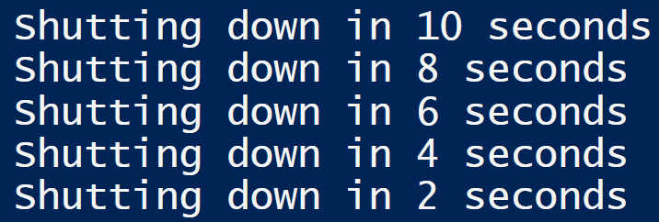
Start-sleep
Review its online help
Using the start-sleep cmdlet in a loop
Problem-solving together to make a count-down timer

Slide 4
Start-sleep with write-progress
Adding the start-sleep/loop logic to a progress bar
Write-progress cmdlet
Team coding competition for bonus marks

Slide 5
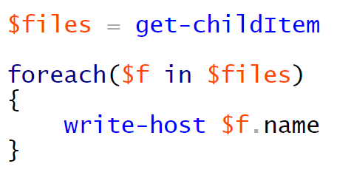
Looping through arrays of objects
The for loop is designed to loop through a collection of objects
Let’s use get-childItem to examine the syntax
The foreach loop does not need a counter
It is forward-only
The loop runs through the entire collection
Each iteration, it extracts the current object out of the collection and stores it in the supplied variable ($f)
Inside of the loop, we can use that variable ($f) to refer to aspects, or properties, of the object using dot notation

Slide 6

Using Booleans in loops for Process searches
Let’s modify our example and do a search for notepad processes running
Our program will continuously run every 5 seconds
If it finds 5 or more notepad processes, it will stop them; otherwise, it will continue to run and output that it is still searching

Slide 7
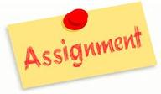

Review of Assignment 4
Please open Assignment 4 now

Slide 8

Homework
Watch and make notes on videos that review functions in PowerShell
We will review its content via a quiz

