Slide 1
Powershell Providers
File system, Registry Providers, and Environment Variables

Slide 2
Today’s agenda
In-class Quiz
Intro Demo/Discussion on Providers
File System
Registry Provider

Slide 3
In-class quiz
In Week 3 folder
5 minutes in duration
Forward-only – you cannot backtrack

Slide 4
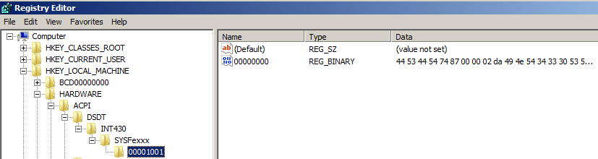
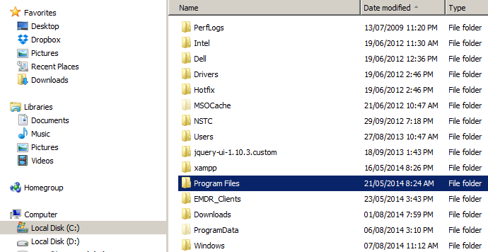
The Big Picture
We can think of Windows as being organized by Items that can have Child-items – a hierarchy

Slide 5
Windows Providers
In PowerShell, you have access to key Windows O/S data stores via a Provider
Enter this command:
Get-PSProvider

Slide 6

Access to Data Stores
A provider allows any data store to be exposed like a file system as if it were a mounted drive
To do that, you need to work through PSDrive
get-PSDrive
The PSProvider outlines the capabilities of each data store but the PSDrive provides the path and means to accessing store details

Slide 7
The File System
Let’s view all the overarching cmdlets for these tasks:
get-command –noun *item*
Recall our object-oriented theory
Item refers to a data store object (i.e. folder)
Child-Item is an object, too – an object within an object (i.e file)
Item property refers to the attributes of a data store (i.e last updated value). Note: not all data stores objects have properties
And verbs tell use what we can do with a data store or data store property

Slide 8
Navigation Commands: Set-Location
Re-run: get-PSDrive
Type this command:
set-location –path HKCU:
Alternatively … sl – HKCU:
Now type this:
set-location –path c:
Set-location is like using cd in Cmd.exe, but in this case we can move through PS Drive Volumes, even though they are not all traditional folder structures

Slide 9
Demo 1: Typical File Structure Actions
Run this command:
new-item TestFolder1
See that you are prompted for a type … Why?
Now type this:
mkdir TestFolder2

Slide 10
Demo 1 Continued: Adding and Removing Items
Run this command :
new-item -Path TestFolder1 -Name testFile.txt -Type file
Now we will remove both folders:
remove-item *testFolder*

Slide 11
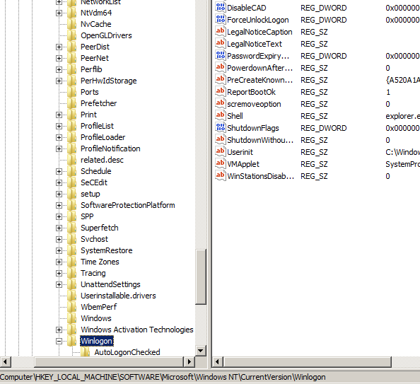
Demo 2: Changing Registry Settings Require Users to CTR-ALT-DEL on Login
Set-location to most immediate parent item: currentVersion
Use set-ItemProperty to change DisableCAD value within Winlogon

Slide 12
Your Turn!
Code the cmdlet that will change the registry key so that UAC is Disabled:
The item property to change is EnableLUA
0 disables it
1 enables it

Slide 13
Final Notes for Now
We can make a short cut as a PSDrive to more directly navigate to a common area
Use new-PSDrive cmdlet

Slide 14
Turning back to Providers: envt
Review of default providers:
Get-PSProvider
Entering the environment provider logical drive:
sl env:
Take a look at what we can access! gci

Slide 15
Review of provider item theory
Let’s bridge this to our knowledge
The PS Provider and drives allow us to access key system information like files, the registry and environment variables
We use the generic term, “item” to refer to these key objects and their children
But we must remember that not all objects can use all of the generic item commands!
Environment variables do not have item properties, but they are classified as items
We will raise an error by trying to use the get-ItemProperty command
get-itemProperty –path env:\userName

Slide 16
How to access environment variables
Even though we cannot use get/set itemProperty commands with environment variables, we can use get-item commands and we can access environment variable values
#get windows directory property details
get-item env:windir
#get the environment variable value – way #1
(get-item env:windir).value
# get the environment variable value – way #2
$env:windir

Slide 17
Setting environment variables
We can change the userProfile environment variable as follows:
set-item -path userProfile -Value ‘SomeNewDir’

