Slide 1
String properties and methods

Slide 2

This week’s agenda
Learn about common String Methods and Properties
Practice Test … Coming Soon to a Lab Near You!
Test 1 will run on October 17th

Slide 3
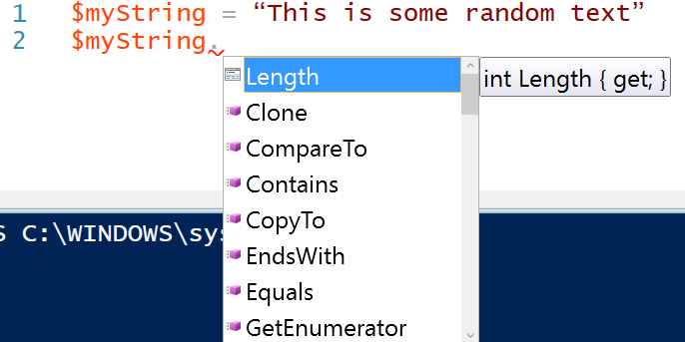
Reminder: Accessing methods and properties of an object
$myString = “This is some random text”
In ISE, or the Console, you can access its properties and methods using get-member
$myString | get-member
In ISE, you can use dot notation to pull up the same list of members

Slide 4
Interpreting member information
ISE
Length is a property of the string object
It is a whole number/INT
You can get its value, but you cannot set it
CONSOLE

Slide 5

Integration time
Declare a string variable and use an assignment statement to set it to a literal value
Use another variable to store its length
Code the following conditional logic:
If the string’s length is less than or equal to 20, output this message in green text:
“Text length fits within rules”
Otherwise, output this message in red:
“Text exceeds length limits”

Slide 6

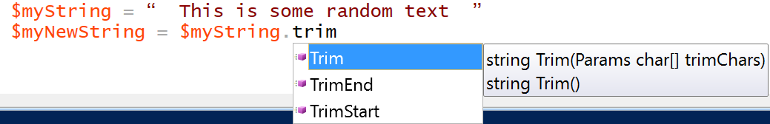

Common string methods: trim
In most languages, you can trim off aspects of the string from both ends, or just from the left or right sides (or TrimStart/TrimEnd)
This Figure shows that Trim works without parameters - Trim() – in which case it cuts off leading or trailing spaces.
It can also trim special one or many characters from either side (i.e Trim(“*”) or Trim(“*”, “ “ )
You can chain method calls together to apply more than one action on an object!

Slide 7
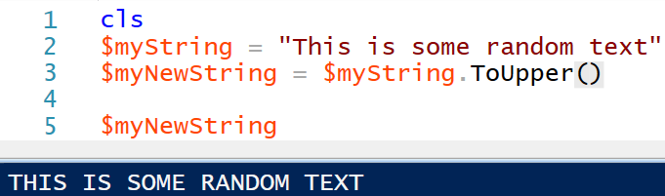
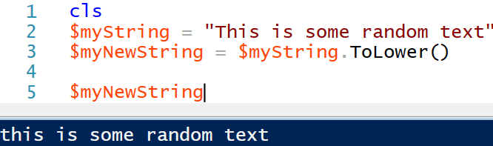

Common string methods: setting case to all lower or upper characters
“A string, is a string, is a string...” You can call string methods without using a variable

Slide 8
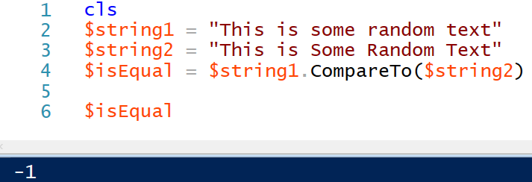
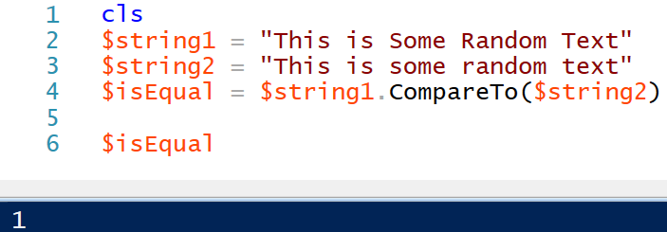
Common string methods: comparing
compareTo(s) returns 0 if the strings are identical and 1 or -1 if they are not
Why did one operation yield -1 and the other 1??
We can combine toLower() or toUpper() with compareTo() to avoid differences in case

Slide 9

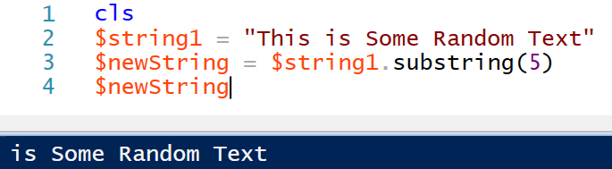
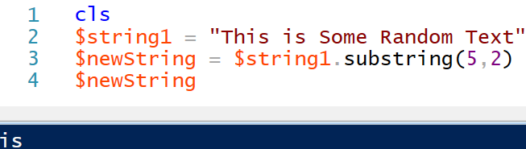
Common string methods: getting a portion of the characters
You can either start at a point in the string and Substring(startInt) will extract from that point onward
Or, you can set a start point and a number of chars, and Substring(startInt, numChars) will exact that section
NOTE: the first char in the string starts at 0

Slide 10
Integration time
How would you get the last 4 characters of any string?
Play with the string that we have been using today to build your answer …

Slide 11
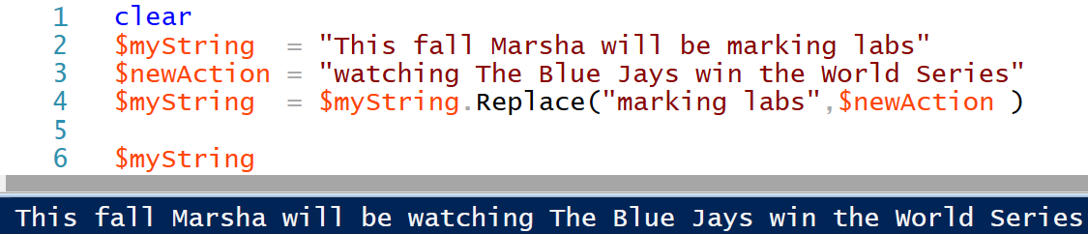
Common string methods: replacing text

Slide 12
Integration and research time
Research how you can use a method to determine if a string contains a set of text. For example, does the string contain the text, “rosebud?”
Use this method to code this logic:
Have the user enter a text value for searching
Search for the occurrence of that text in a literal string that you have set
If a match is found, output the message, “text found in string;” otherwise, output, “not found in string.”

