Slide 1
Winforms Continued
Checkboxes, and referring to control events/values

Slide 2

Agenda
Announcements
65% of term grades covered after Lab 5 grade is entered
Lab 6 – worth 5%
Test 3 – worth 30%
Take up Last Quiz and Test 2
Lecture
Checkboxes and their uses
Accessing different control values
Events

Slide 3
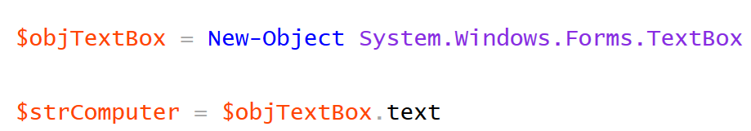

Accessing values of form controls
Getting or setting the value of a control is dependent on its properties.
A textbox holds its value in its Text property
...whereas combo boxes have Items, and users select one of its items, you access its value via the selectedItem property

Slide 4
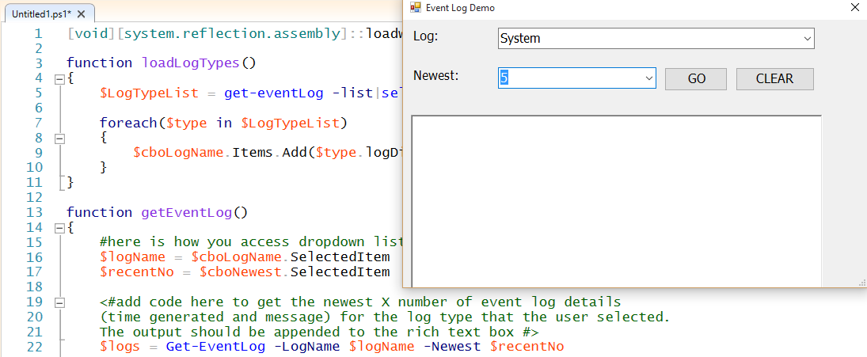
Reminder of values used in last Quiz

Slide 5

Single Checkboxes: If/Else Logic
Checkboxes can be used on a form as an isolated object, like in Assignment 5
In this scenario, the checkbox, acts as an either/or construct:
either it is checked or it is not
We can use one of two properties to test this:
The checked property will –eq $true or $false
The checkedState property will –eq one of three possible values:
“Checked”, “Unchecked”, or “Indeterminate”

Slide 6
Using Checkbox With If/else Logic
We often hook our checkbox logic right up to an if/else statement:
$chkStatus = $myCheckbox.checked
if($chkStatus –eq $true)
{
#do code for running services
}
else
{
#do code for stopped services
}

Slide 7
More on GUI events
Every object/control has its own events. Each control has key/core events as follows:
Typically we,
click on buttons
change the check state of a checkbox
change the item in a combo box
As an example, here are all of the checkbox events and form events

Slide 8
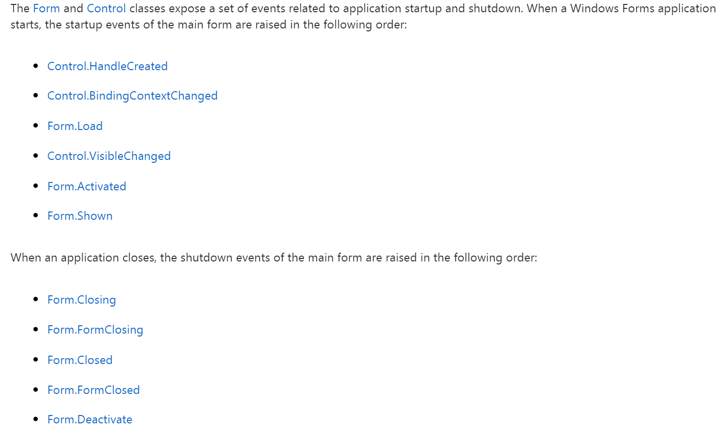
Details on the lifecycle of form events
Typically, when we want to affect the appearance of a form and the default data of its controls, we do that on the form’s load event b/c that happens before the form becomes visible and active

Slide 9
Events for lab 5
You will code one function, which results in loading the dropdown list with service names; however, it will be called from 2 events:
The load event of the form
The CheckStateChanged event of the checkbox
Remember to add an event handler to a control in PS, we preface the event with add_
add_load
add_checkStateChanged

Slide 10
Demo of working lab
Note how the events occur and what results from those events
The load event of the form is not a user driven action per se … it is a lifecycle event
The checkStateChanged event is a user-driven event

