Slide 1
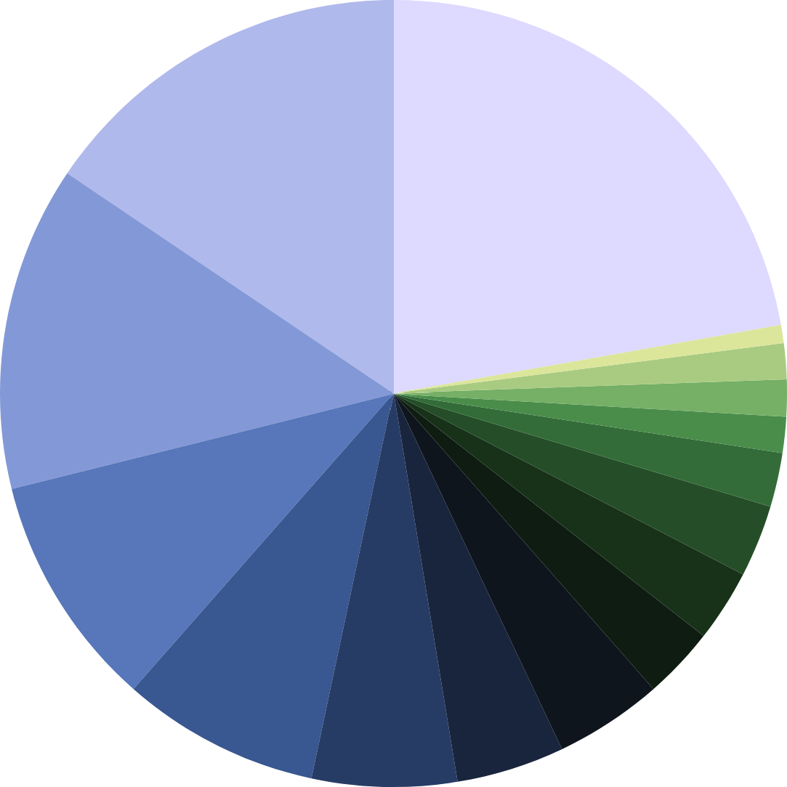
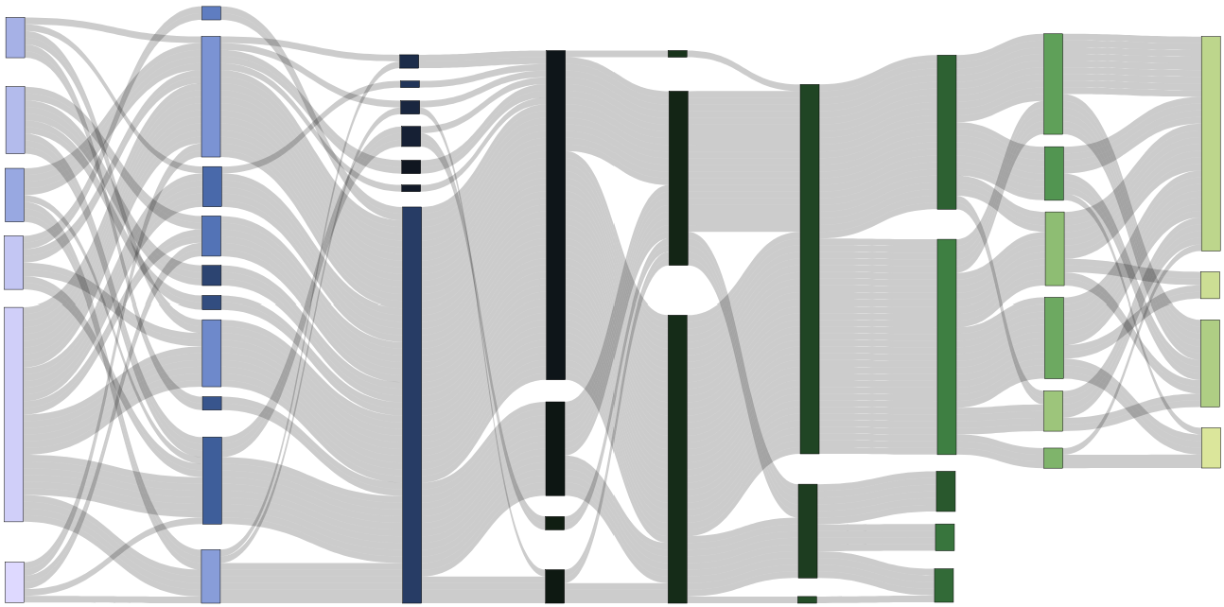
Signal Processing Pipeline: Statistics of Methods used
All numbers in %
Toolboxes Used
Homer3
53
1
OpenPoTATo
Nilearn
NIRFAST(ER)
NeuroDOT
NIRS-SPM
AtlasViewer
Satori
R
Homer2
Python (custom)
NIRS Brain AnalyzIR 30
3
3
3
4
4
Matlab (custom) 26
6
6
9
MNE 19
QT NIRS 16
Other 11
9
Manual Selection
3
Trial Rejection
9
1
PCA
3
1Hz
Consec. Gaussian
26
TDDR
1
2Hz
21
14
SNR
3
3HZ
Short Channels (SC)
4
4Hz
33
OLS
46
Single Metric
3
5Hz
37
Other Method
11
SPM
37
11
SCI
9
Wavelet Filter
1
8Hz
Single Method
Band Pass
67
9
Targeted PCA
70
11
Other Method
16
Gamma
4
Spline SG
79
GLM
6
PCA of SC
Manual Selection
3
CBSI
17
Hybrid Spline-Wavelet
46
AR-IRLS
17
Canonical
SC (13)
Polyn. Drift (11)
PCA of SC (6)
Cosine Drift (4)
Other (3)
14
Multiple Regressors
17
PSP
84
No Re-
sampling
39
46
3
Other Method
9
Glover
SCI
Combined Metrics
16
TDDR (7)
Spline (6)
Wavelet Filt. (6)
Mon. Interp. (6)
CBSI (4)
Spline SG (4) Trial Rejection (4)
Targeted PCA (1)
20
Low Pass
61
None
9
Unknown
15
SNR
19
4
FIR
10
Other Method
Combined Methods
9
Baseline Correction
9
High Pass
20
Block Average
6
Detrending
9
No Pruning
11
No Removal
7
No Filter
1
Other
7
No Correction
Pruning
Motion Artifacts
Resampling
Filtering
Physio.
Preproc.
HRF Estimation
Solvers / Modifiers
HRF Regressors
Other Regressors

Slide 2
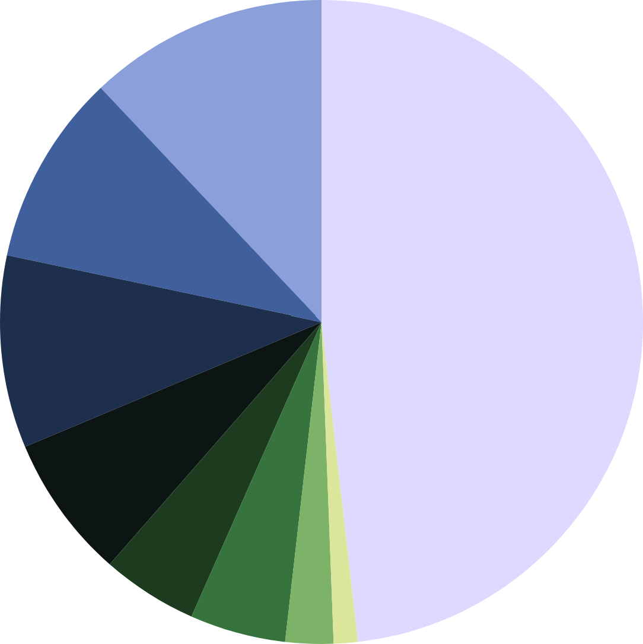
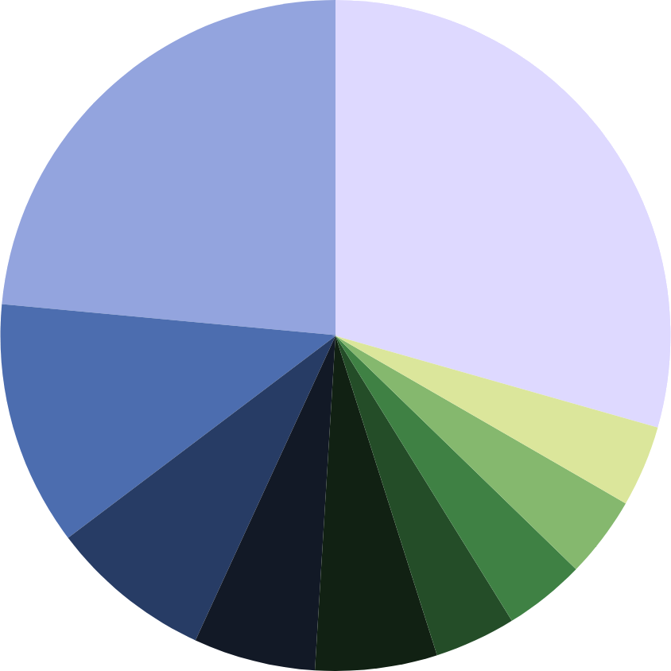
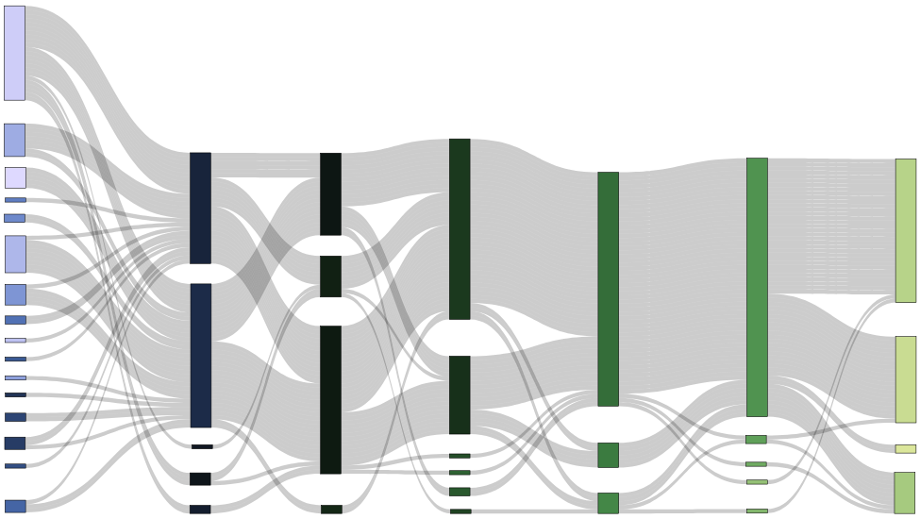
Statistical Analysis Pipeline: Statistics of Methods used
All numbers in %
Toolboxes Used
Homer3 12
NIRS Brain AnalyzIR 15
R 12
F Statistics
Unknown / Other
Wilcoxon Signed Rank
Repeated Meas. ANOVA
Linear Mixed Effects
ANOVA
Mixed Effects NN
Two-Sample t-Test
Python (custom)
JASP
Satori
Homer2
O. PoTATo
Paired t-Test
22
3
3
9
3
3
6
Matlab (custom)
59
Multiple Methods
4
34
One-Sample t-Test
9
4
6
6
3
9
1
12
One-Sample t-Test
7
Paired t-Test
29
2
Two-Sample t-Test
40
HbO & HbR
Channel
3
t-Test NN
69
GLM Beta Values
52
No
Correction
13
Linear Mixed Effects
Channel & ROI
7
Mixed Effects NN
15
84
No Test for Normality
93
α=0.05
3
Robust Mixed Effects
2
Fixed Mixed Effects
52
HbO only
2
Random Effects
Benjamini- Hochberg
2
Hotelling T2 Test
28
Signal Amp. (windowed)
31
2
Permutation Test
53
ROI
2
Bootstrap Estimation
4
Wilcox. Sign.-Rank
3
α=0.001
Benjamini- Yekutieli
2
HbR Only
2
Binned Amplit.
9
Shapiro-Wilk.
α=0.025
3
4
Repeated Meas. ANOVA
4
Multiple Types
2
Laterality Index
2
α=0.01
Image &
ROI
3
Other
Kolmog. -Smirn.
2
15
Bonferroni
4
Unknown / Other
3
Other
3
2
HRF slope
7
2
Unknown
Stat. Method
Signal Type
Signal Space
Metric
Test for Normality
Significance Level
Multiple Comparisons
Correction

Slide 3
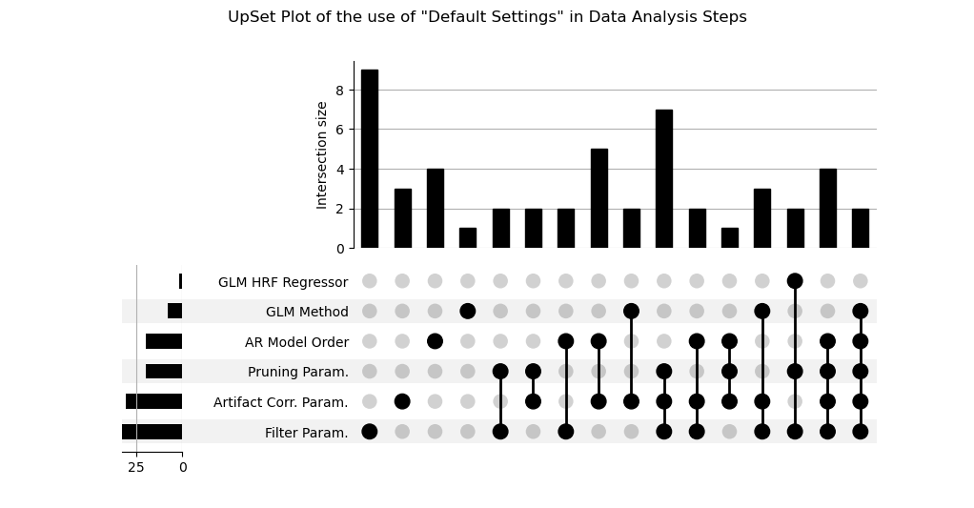
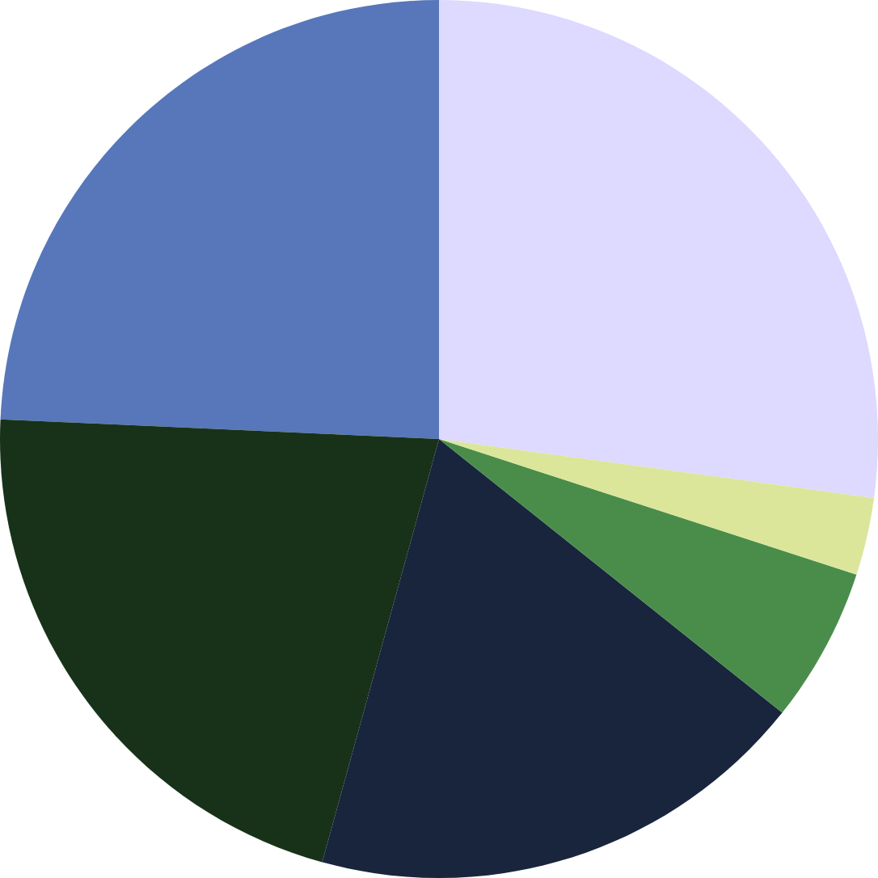
none
Intersection sizes: Multiple uses of “default” settings
24.3%
27.1%
no use of defaults
1x
2x
3x
4x
5x
∑
18.6%
2.9%
5.7%
21.4%
Frequency of use of “default”
settings per method
2.9%
11.4%
28.6%
28.6%
44.3%
47.1%

Slide 4
OLD

Slide 5
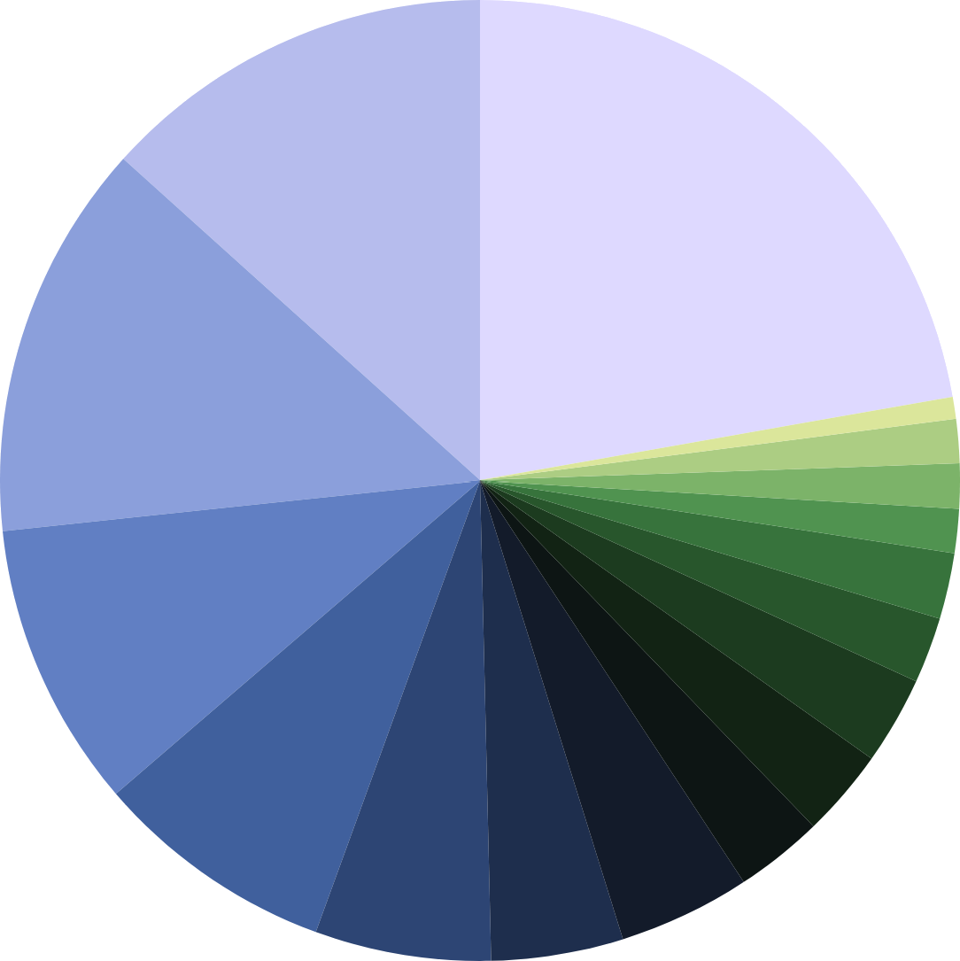
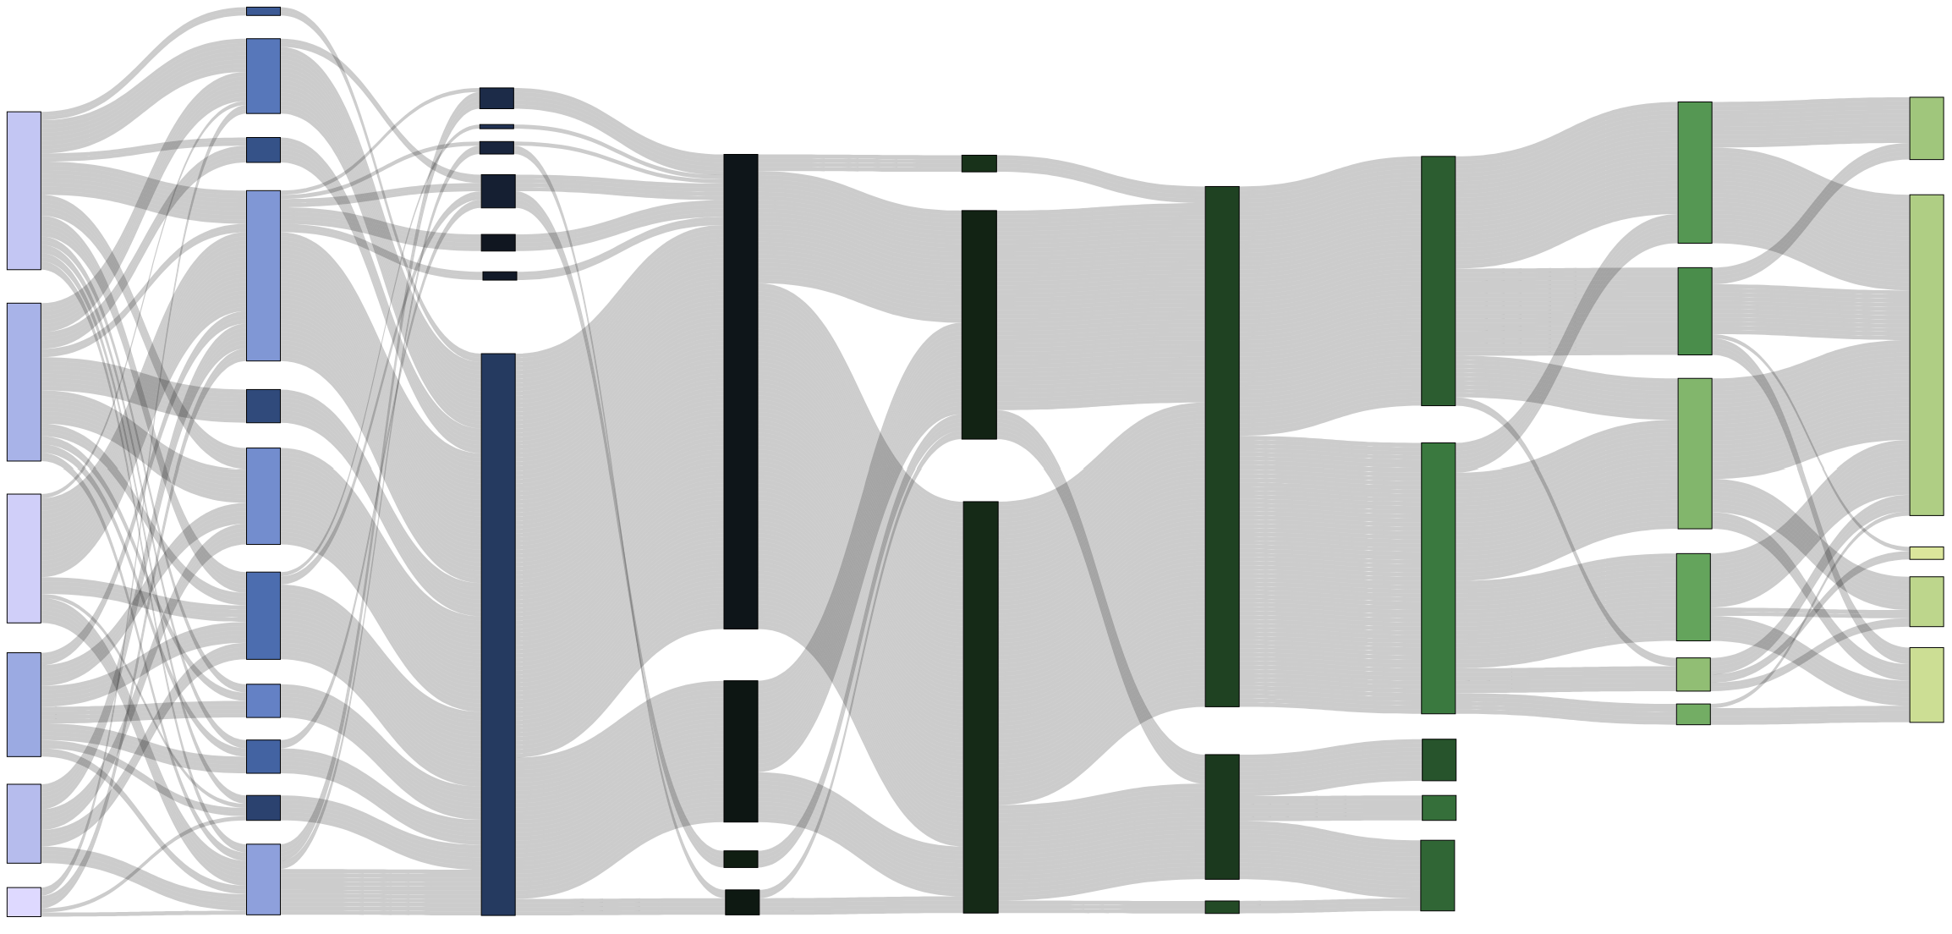
Signal Processing Pipeline: Statistics of Methods used
All numbers in %
Toolboxes Used
Matlab 25.71
Homer3 42.86
OpenPoTATo 1.43
Nilearn 2.86
NIRFAST(ER) 2.86
NeuroDOT 2.86
NIRS Toolbox 4.29
NIRS-SPM 4.29
AtlasViewer 5.71
Satori 5.71
RStudio 5.71
Homer2 8.57
Python (custom) 8.57
AnalyzIR 25.71
MNE 18.57
QT NIRS 15.71
2.9
Other Method
Other 11.43
10.0
Targeted
PCA
2.9
1Hz
Polynomial Drift
1.4
2Hz
11.4
Manual Pruning
7.1
CBSI
2.9
3HZ
1.4
PCA
21.4
Consec. Gaussian
32.9
4.3
4Hz
7.1
TDDR
2.9
5Hz
1.4
8Hz
Other Method
32.9
OLS
11.4
SPM
27.1
70.0
Short Channels (SC)
35.7
SNR Threshold
8.6
Spline SG
70.0
Band Pass
Hybrid Spline Wavelet
15.7
Gamma
8.6
78.6
GLM
34.3
SCI
No Resampling
4.3
Cosine Drift
14.3
Wavelet Filter
84.3
45.7
AR-IRLS
17.1
Canonical
11.4
PCA of SC
25.7
Other Method
7.1
Trial Rejection
8.6
Glover
11.4
Unknown
Low Pass
61.4
None
4.3
FIR
5.7
Spline Interp.
20.0
8.6
Baseline Correction
24.3
PSP
5.7
Monotonic Interp.
20.0
Block Average
5.7
Detrending
11.4
No Artefact Removal
2.9
High Pass
7.1
No Correction
8.6
No Pruning
7.1
No Filter
1.4
Other
Pruning
Motion Artefacts
Resampling
Filtering
Physio.
Preproc.
HRF Estimation
Solvers / Modifiers
HRF Regressors
Other Regressors

Slide 6
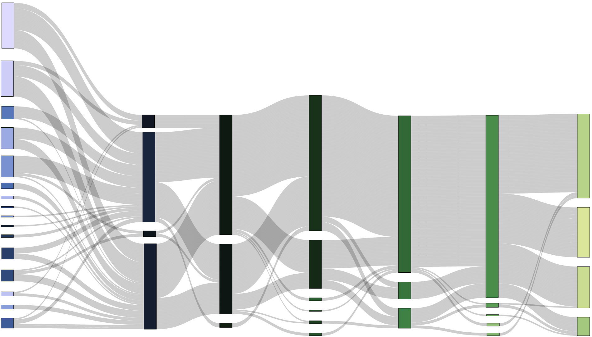
Statistical Analysis Pipeline: Statistics of Methods used
All numbers in %
Toolboxes Used
Homer3 11.76
AnalyzIR 14.71
RStudio 11.76
8.82 5.88
5.88
2.94
1.47
Python
JASP
Satori
Homer2
Open PoTATo
Matlab 58.82
29.4
Paired t-Test
29.4
One-Sample t-Test
10.3
Two-Sample t-Test
2.9
Other
13.2
Mixed Effects*
17.6
Linear Mixed Effects
69.1
GLM Beta Values
51.5
No Correction
1.5
Robust Mixed Effects
54.4
HbO only
70.6
ROI
1.5
Fixed Mixed Effects
83.8
No Test for Normality
1.5
Hotelling T2 test
83.8
α=0.05
1.5
Permutation Test
Benjamini- Hochberg
2.9
Bootstrap Estimation
1.5
HbR only
13.2
2.9
Multiple Comparisons
2.9
F Statistics
27.9
Signal Amp. (windowed)
7.4
Wilcoxon Signed Rank
44.1
HbO & HbR
44.1
Channel
4.4
ANOVA
1.5
Laterality Index
8.8
Shapiro-Wilk.
25
FDR
4.4
Rep. Meas. ANOVA
1.5
Binned Amplit.
Kolmog. -Smirn.
1.5
α=0.001
7.4
Unknown / Other
1.5
HRF slope
7.4
1.5
α=0.025
2.9
Image
2.9
Other
2.9
α=0.01
14.7
Bonferroni
1.5
Unknown
Stat. Method
Signal Type
Signal Space
Metric
Test for Normality
p-Val
Multiple Comparisons
Correction

