Slide 1
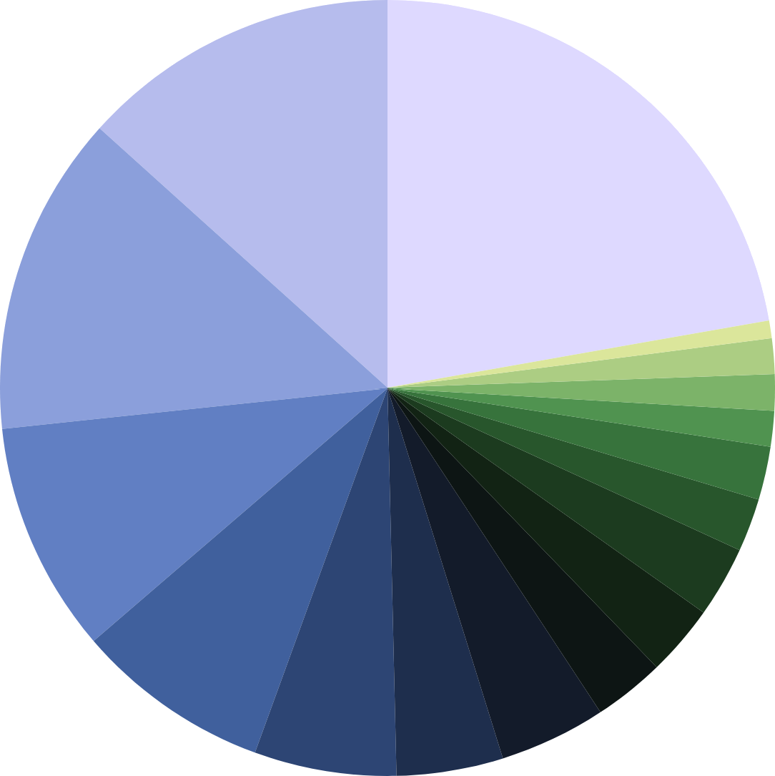
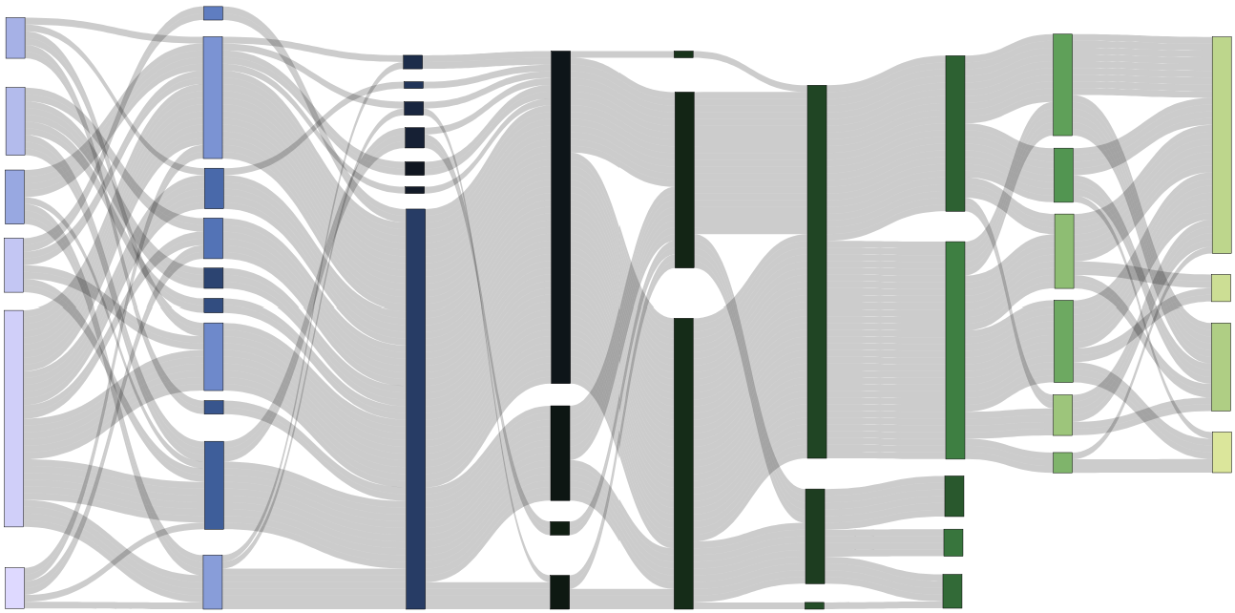
Signal Processing Pipeline: Statistics of Methods used
All numbers in %
Toolboxes Used
Matlab 25.71
Homer3 42.86
OpenPoTATo 1.43
Nilearn 2.86
NIRFAST(ER) 2.86
NeuroDOT 2.86
NIRS Toolbox 4.29
NIRS-SPM 4.29
AtlasViewer 5.71
Satori 5.71
RStudio 5.71
Homer2 8.57
Python (custom) 8.57
AnalyzIR 25.71
MNE 18.57
QT NIRS 15.71
Other 11.43
Manual Selection
2.9
Trial Rejection
8.6
1.4
PCA
2.9
1Hz
Consec. Gaussian
25.7
TDDR
1.4
2Hz
21.4
14.3
SNR
2.9
3HZ
Short Channels (SC)
4.3
4Hz
32.9
OLS
45.7
Single Metric
8.6
2.9
5Hz
37.1
Other Method
11.4
SPM
11.4
SCI
Wavelet Filter
1.4
8Hz
Single Method
Targeted PCA
70.0
Band Pass
Other Method
8.6
15.7
Gamma
11.4
4.3
Spline SG
78.6
GLM
5.7
PCA of SC
Manual Selection
2.9
CBSI
17.0
Hybrid Spline-Wavelet
45.7
AR-IRLS
17.1
Canonical
SC (12.9)
Polyn. Drift (11.4)
PCA of SC (5.7)
Cosine Drift (4.3)
Other (2.9)
14.3
No Re-
sampling
Multiple Regressors
17.0
PSP
Other Method
84.3
SCI
2.9
8.6
Glover
Combined Metrics
16.0
TDDR (7.4)
Spline (5.7)
Wavelet Filt. (5.7)
Mon. Interp. (5.7)
CBSI (4.3)
Spline SG (4.3) Trial Rejection (4.3)
Targeted PCA (1.4)
20.0
Low Pass
61.4
None
8.6
Unknown
15.0
SNR
4.3
FIR
10
Other Method
Combined Methods
8.6
Baseline Correction
2.9
High Pass
20.0
Block Average
5.7
Detrending
8.6
No Pruning
11.4
No Removal
7.1
No Filter
1.4
Other
7.1
No Correction
Pruning
Motion Artefacts
Resampling
Filtering
Physio.
Preproc.
HRF Estimation
Solvers / Modifiers
HRF Regressors
Other Regressors

Slide 2
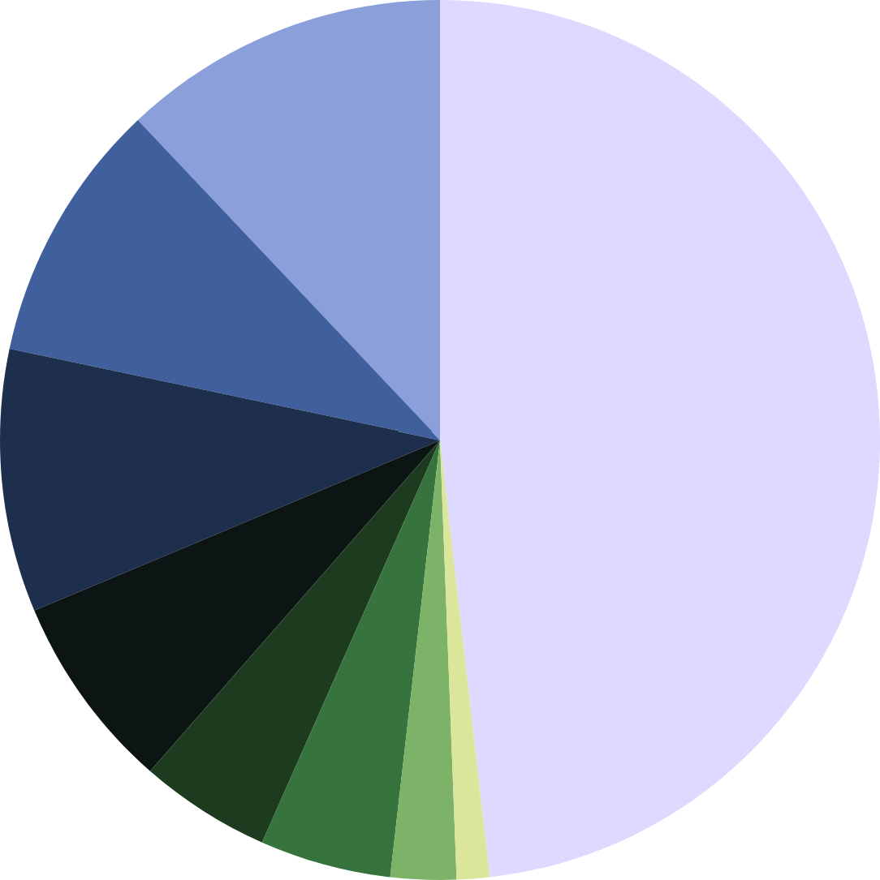
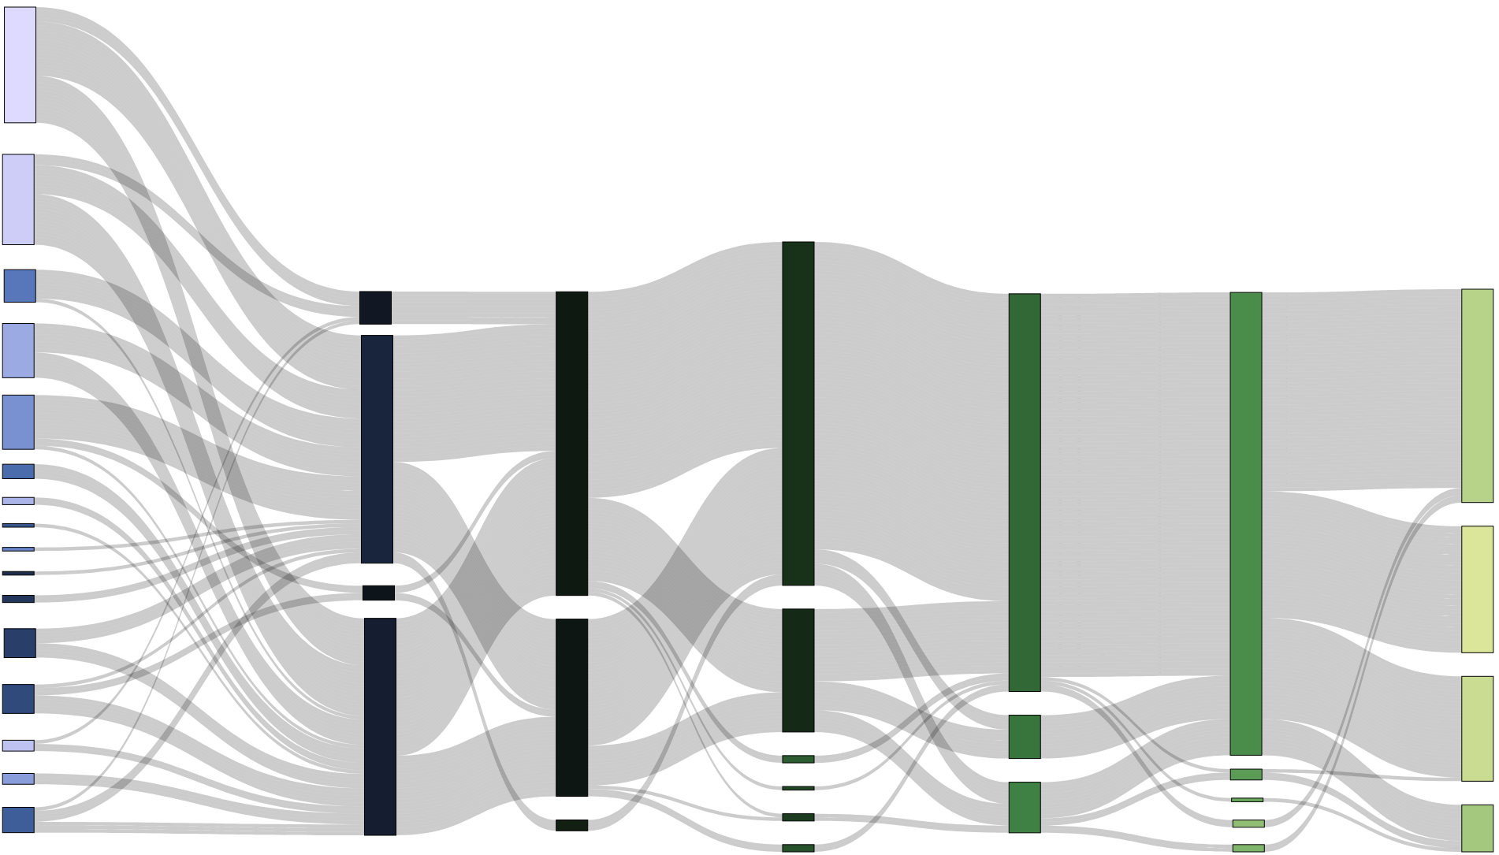
Statistical Analysis Pipeline: Statistics of Methods used
All numbers in %
Toolboxes Used
Homer3 11.76
AnalyzIR 14.71
RStudio 11.76
8.82 5.88
5.88
2.94
1.47
Python
JASP
Satori
Homer2
Open PoTATo
Matlab 58.82
29.4
Paired t-Test
29.4
One-Sample t-Test
10.3
Two-Sample t-Test
2.9
Other
13.2
Mixed Effects*
17.6
Linear Mixed Effects
69.1
GLM Beta Values
51.5
No Correction
1.5
Robust Mixed Effects
54.4
HbO only
70.6
ROI
1.5
Fixed Mixed Effects
83.8
No Test for Normality
1.5
Hotelling T2 test
83.8
α=0.05
1.5
Permutation Test
Benjamini- Hochberg
2.9
Bootstrap Estimation
1.5
HbR only
13.2
2.9
Multiple Comparisons
2.9
F Statistics
27.9
Signal Amp. (windowed)
7.4
Wilcoxon Signed Rank
44.1
HbO & HbR
44.1
Channel
4.4
ANOVA
1.5
Laterality Index
8.8
Shapiro-Wilk.
25
FDR
4.4
Rep. Meas. ANOVA
1.5
Binned Amplit.
Kolmog. -Smirn.
1.5
α=0.001
7.4
Unknown / Other
1.5
HRF slope
7.4
1.5
α=0.025
2.9
Image
2.9
Other
2.9
α=0.01
14.7
Bonferroni
1.5
Unknown
Stat. Method
Signal Type
Signal Space
Metric
Test for Normality
p-Val
Multiple Comparisons
Correction

Slide 3
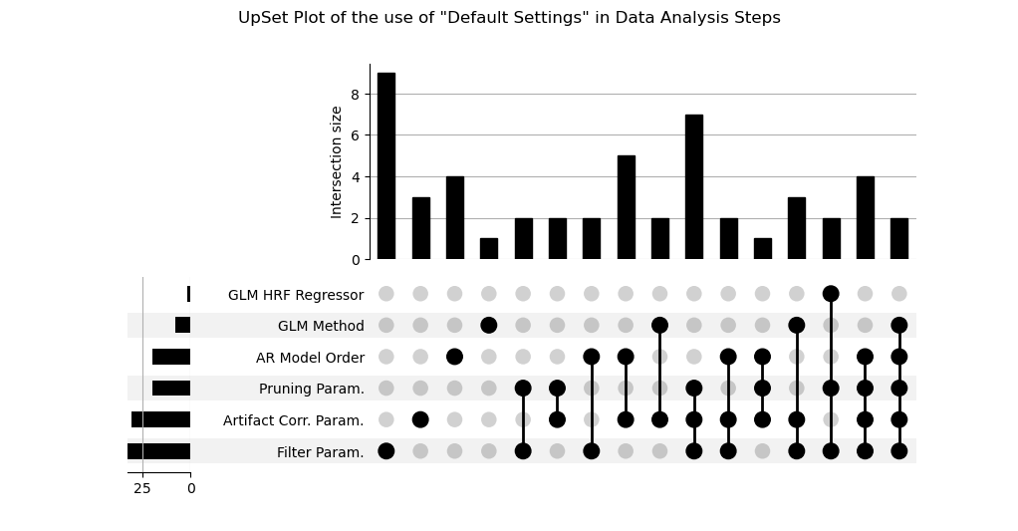
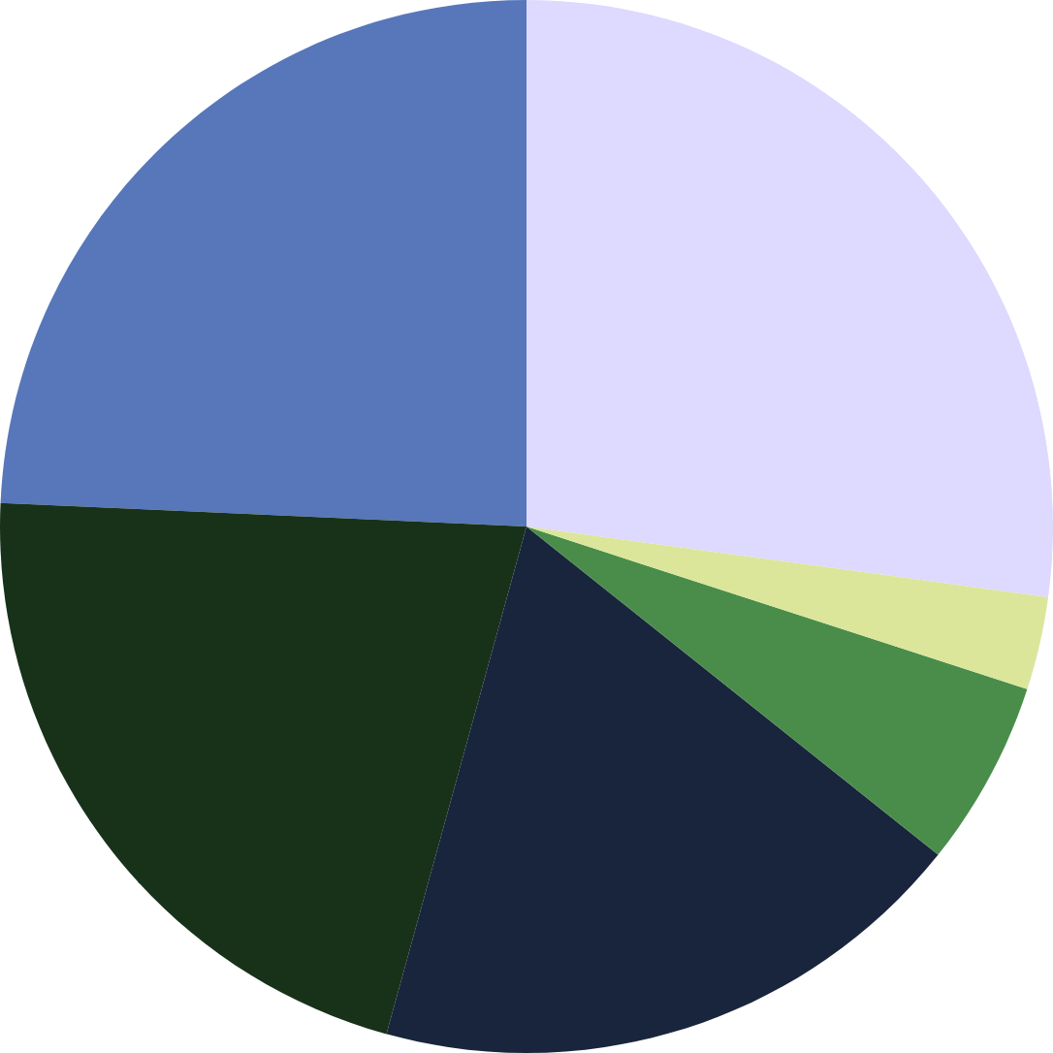
none
Intersection sizes: Multiple uses of “default” settings
24.3%
27.1%
no use of defaults
1x
2x
3x
4x
5x
∑
18.6%
2.9%
5.7%
21.4%
Frequency of use of “default”
settings per method
2.9%
11.4%
28.6%
28.6%
44.3%
47.1%

Slide 4
OLD

Slide 5
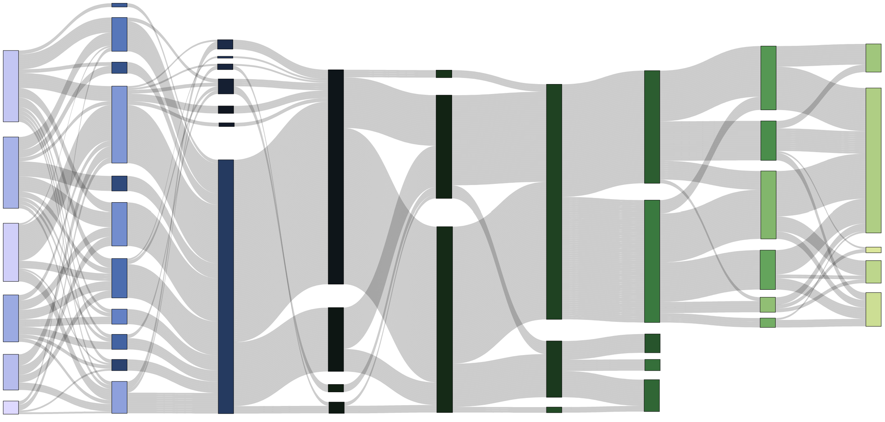
Signal Processing Pipeline: Statistics of Methods used
All numbers in %
Toolboxes Used
Matlab 25.71
Homer3 42.86
OpenPoTATo 1.43
Nilearn 2.86
NIRFAST(ER) 2.86
NeuroDOT 2.86
NIRS Toolbox 4.29
NIRS-SPM 4.29
AtlasViewer 5.71
Satori 5.71
RStudio 5.71
Homer2 8.57
Python (custom) 8.57
AnalyzIR 25.71
MNE 18.57
QT NIRS 15.71
2.9
Other Method
Other 11.43
10.0
Targeted
PCA
2.9
1Hz
Polynomial Drift
1.4
2Hz
11.4
Manual Pruning
7.1
CBSI
2.9
3HZ
1.4
PCA
21.4
Consec. Gaussian
32.9
4.3
4Hz
7.1
TDDR
2.9
5Hz
1.4
8Hz
Other Method
32.9
OLS
11.4
SPM
27.1
70.0
Short Channels (SC)
35.7
SNR Threshold
8.6
Spline SG
70.0
Band Pass
Hybrid Spline Wavelet
15.7
Gamma
8.6
78.6
GLM
34.3
SCI
No Resampling
4.3
Cosine Drift
14.3
Wavelet Filter
84.3
45.7
AR-IRLS
17.1
Canonical
11.4
PCA of SC
25.7
Other Method
7.1
Trial Rejection
8.6
Glover
11.4
Unknown
Low Pass
61.4
None
4.3
FIR
5.7
Spline Interp.
20.0
8.6
Baseline Correction
24.3
PSP
5.7
Monotonic Interp.
20.0
Block Average
5.7
Detrending
11.4
No Artefact Removal
2.9
High Pass
7.1
No Correction
8.6
No Pruning
7.1
No Filter
1.4
Other
Pruning
Motion Artefacts
Resampling
Filtering
Physio.
Preproc.
HRF Estimation
Solvers / Modifiers
HRF Regressors
Other Regressors

Slide 6
Statistical Analysis Pipeline: Statistics of Methods used
All numbers in %
Toolboxes Used
Homer3 11.76
AnalyzIR 14.71
RStudio 11.76
8.82 5.88
5.88
2.94
1.47
Python
JASP
Satori
Homer2
Open PoTATo
Matlab 58.82
29.4
Paired t-Test
29.4
One-Sample t-Test
10.3
Two-Sample t-Test
2.9
Other
13.2
Mixed Effects*
17.6
Linear Mixed Effects
69.1
GLM Beta Values
51.5
No Correction
1.5
Robust Mixed Effects
54.4
HbO only
70.6
ROI
1.5
Fixed Mixed Effects
83.8
No Test for Normality
1.5
Hotelling T2 test
83.8
α=0.05
1.5
Permutation Test
Benjamini- Hochberg
2.9
Bootstrap Estimation
1.5
HbR only
13.2
2.9
Multiple Comparisons
2.9
F Statistics
27.9
Signal Amp. (windowed)
7.4
Wilcoxon Signed Rank
44.1
HbO & HbR
44.1
Channel
4.4
ANOVA
1.5
Laterality Index
8.8
Shapiro-Wilk.
25
FDR
4.4
Rep. Meas. ANOVA
1.5
Binned Amplit.
Kolmog. -Smirn.
1.5
α=0.001
7.4
Unknown / Other
1.5
HRF slope
7.4
1.5
α=0.025
2.9
Image
2.9
Other
2.9
α=0.01
14.7
Bonferroni
1.5
Unknown
Stat. Method
Signal Type
Signal Space
Metric
Test for Normality
p-Val
Multiple Comparisons
Correction

