Slide 1
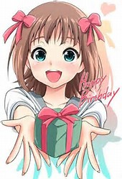
Hope you can make it
-Ashlae A. Alexander

Slide 2

Hey, you’re invited to my super kawii birthday party we’re going to Funplex
We want you to be there!

