Slide 1
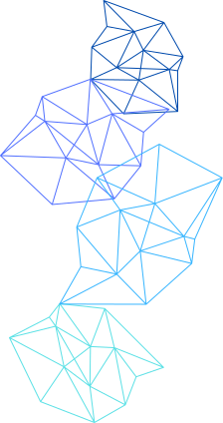

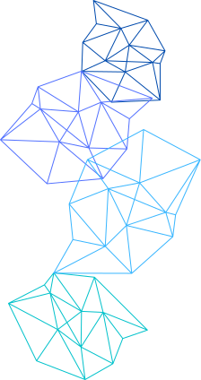
PARBUTTERFLY
A Framework

Slide 2
INTRODUCTION
Birpartite Graphs
Butterflies
Parallelize?

Slide 3
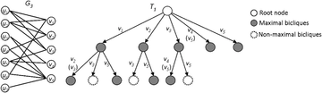
THE MOTIVATION
Counting and Peeling
Too slow to solve sequentially
Millions of vertices

Slide 4
THE FRAMEWORK
For butterfly counting and peeling
Ranking
Retrieving
Aggregating
Counting

Slide 5
FEATURES
Counting Framework
Peeling Framework
Optimizations
Bounds

Slide 6
RESULTS
Tested on 48-core AWS EC2 instance using KONECT real-world graphs
6.3–13.6x speedup vs. sequential, 10.4–38.5x self-relative (LiveJournal), 349.6–5169x vs. PGD/ESCAPE
Vertex peeling: 1.3–30696x speedup; Edge peeling: 3.4–7.0x speedup
Batching for counting and histogramming for peeling

Slide 7
STRATEGY
METIS: Partitions bipartite graph into P P P balanced subgraphs, minimizing edge-cuts for load balancing
MPI: Manages inter-node communication, exchanging boundary vertex/edge data and aggregating global counts
OpenMP: Parallelizes intra-node tasks (wedge retrieval, aggregation, peeling) across CPU cores

Slide 8
STRATEGY
Counting: Local wedge processing per node, MPI for boundary data, OpenMP for parallel aggregation
Peeling: Local vertex/edge removal, MPI for global synchronization, OpenMP for count updates
Optimizations: Edge-cut minimization, asynchronous MPI, dynamic OpenMP scheduling, sparsification

Slide 9
APPLICATIONS
Link Spam Detection
Document Clustering
Dense Subgraph Discovery

Slide 10
CONCLUSION
Impact
Future Work
Key Takeaway

Slide 11
ANY QUESTIONS?

