Slide 1

Breast Cancer Classification
Created By:
Syed Ibtehaj Raza, Rizvi (40218265)
Faiza Tahsin (40197995)
Zarin Tasnim (40208529)

Slide 2
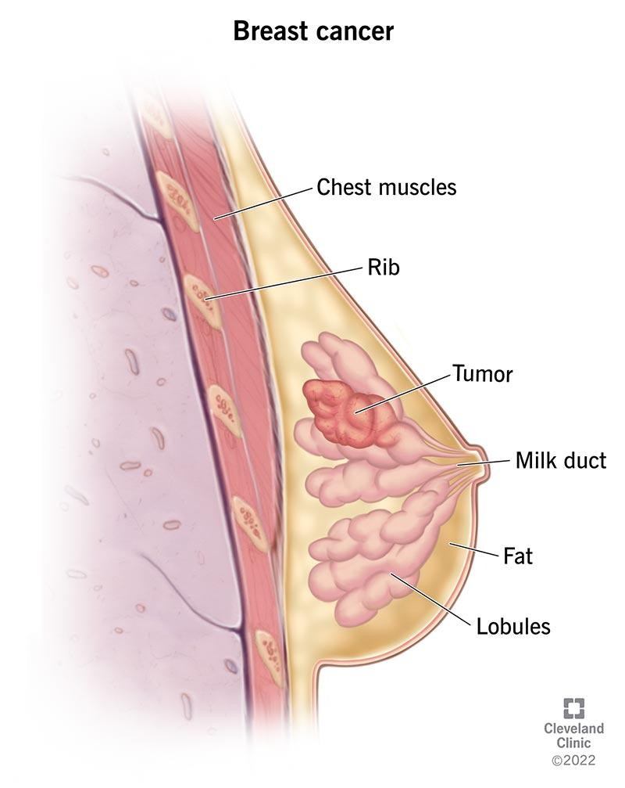
Our goal?
It’s one of the most common cancers among women.
But early detection can lead to a successful treatment.
Our goal is to use machine learning algorithms to classify the cancer as Noninvasive Ductal Carcinoma and Invasive Ductal Carcinoma tumors.
Models of our choice:
ResNET
Inception
and VGG

Slide 3
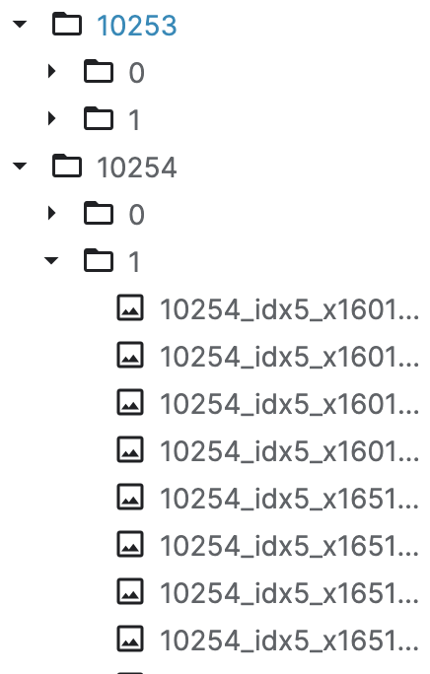
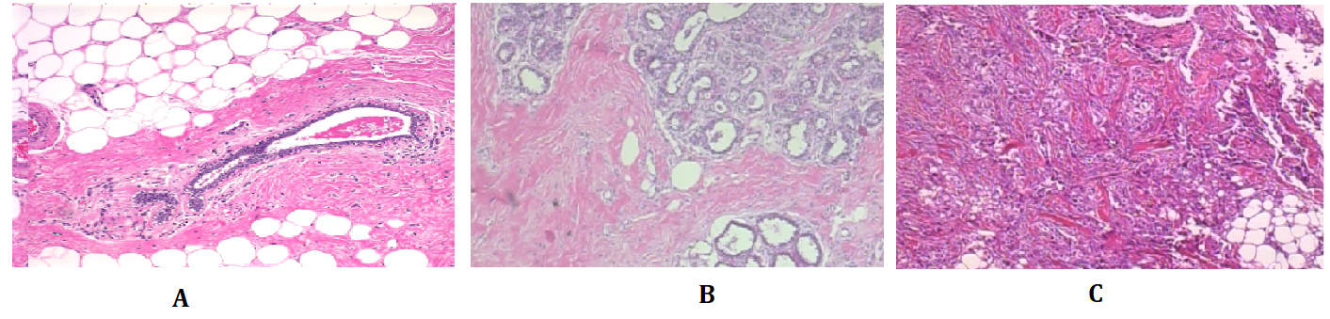
What Kind of data we are working with:
We are using Breast Histopathology Images as our dataset.
It consists of:
198,738 IDC(-) image patches
78,786 IDC(+) image patches
In total 277,524 patches.
Patient ID
Classes
Patches
Original Source:
http://gleason.case.edu/webdata/jpi-dl-tutorial/IDC_regular_ps50_idx5.zip
https://www.kaggle.com/datasets/paultimothymooney/breast-histopathology-images

Slide 4
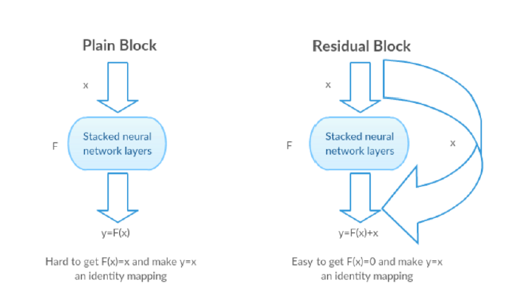
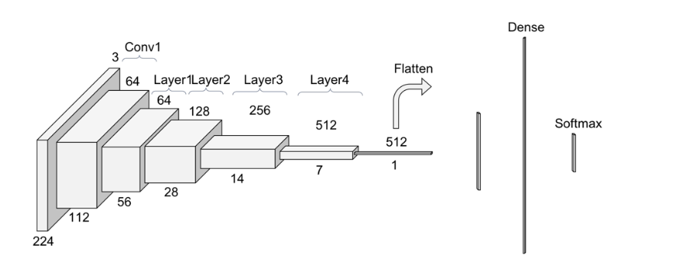


Our Work
Background:
The deeper the better
BUT the more layers we add, the gradients of the loss function approaches zero and performance degrade. Vanishing Gradient
ResNET:
This problem became the main motivation of making the ResNet. Which uses skip connections to avoid degradation.
Pic taken from google
Pic taken from towardsscience.com

Slide 5
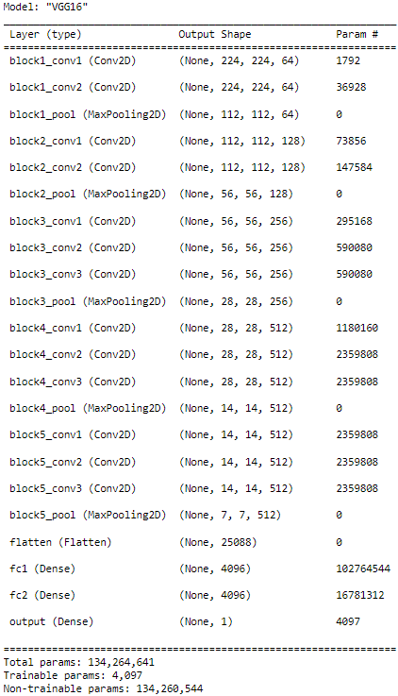
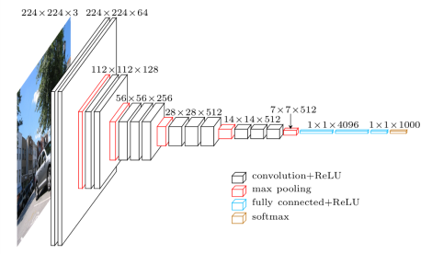
Our Work
VGG16:
The major difference between conventional architecture and our custom architecture is in the last dense layer units and activation function which is 1 and Sigmoid respectively.
Figure: Conventional architecture of VGG16 model ³
Table: Summary of our custom VGG16 model

Slide 6
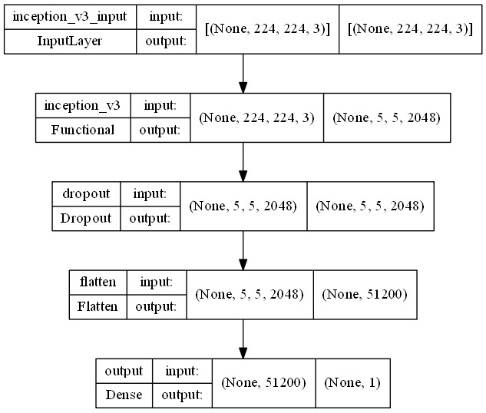
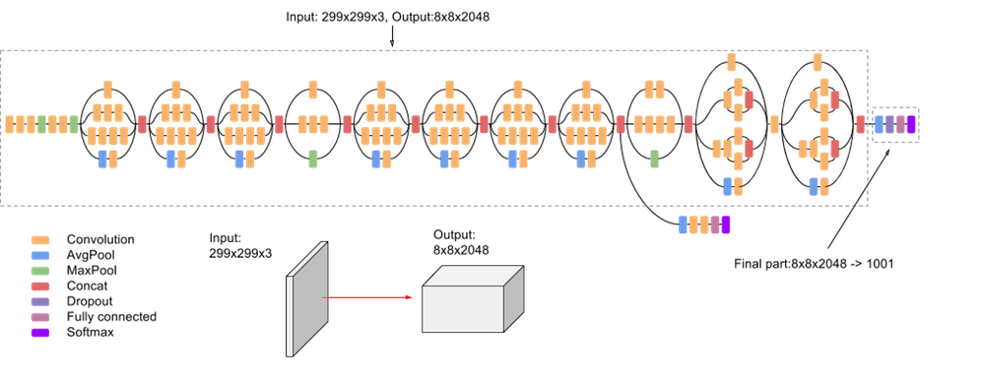
Our Work
Inception V3:
This two figure illustrates the difference between our architecture and the original inceptionV3 architecture
Figure : InceptionV3 Architecture
Reference : of InceptionV3 Architecture
Figure: Our InceptionV3 Model
Notes:
Inception-v3 belongs to the Inception family which is also a convolutional neural network architecture which enables many modifications, including the use of Label Smoothing, Factorized 7 x 7 convolutions, and the use of an auxiliary classifier to relay label information through the network. The model consists of two parts. In the first step, it extracts basic features from input data with a convolutional neural network and then classifies them based on the newfound features with fully-connected and softmax layers in the second part. The original inspection model architecture looks like this(left diagram). (Right Figure) This figure is our inceptionv3 model which we have implemented. In our model, we kept the last 3 layers trainable, and made the rest of the layers non-trainable. We have taken the image size as 224x224x3 which we fed into the network. We have added a dropout of 0.5 to prevent the model from overfitting. Then we have used flatten for converting the data into a 1-dimensional array for inputting it to the next layer. Finally we have used a dense layer where we have used sigmoid activation function for prediction.

Slide 7
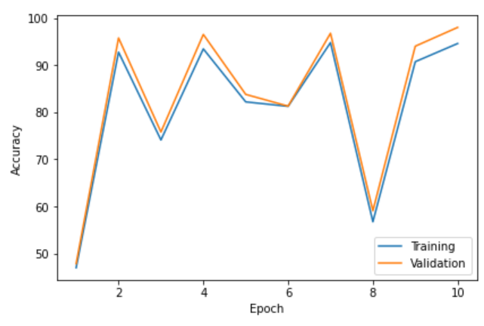
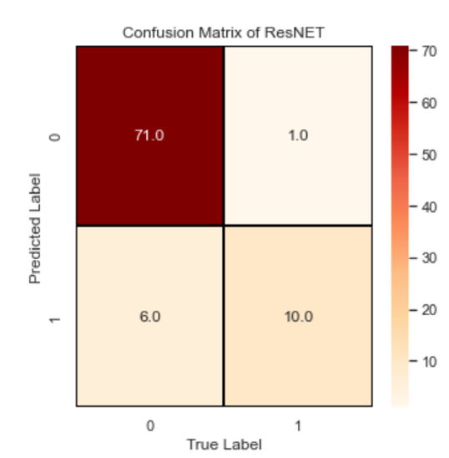
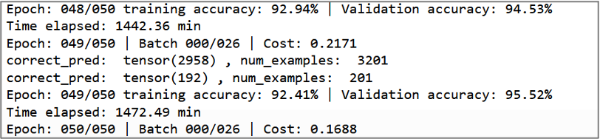

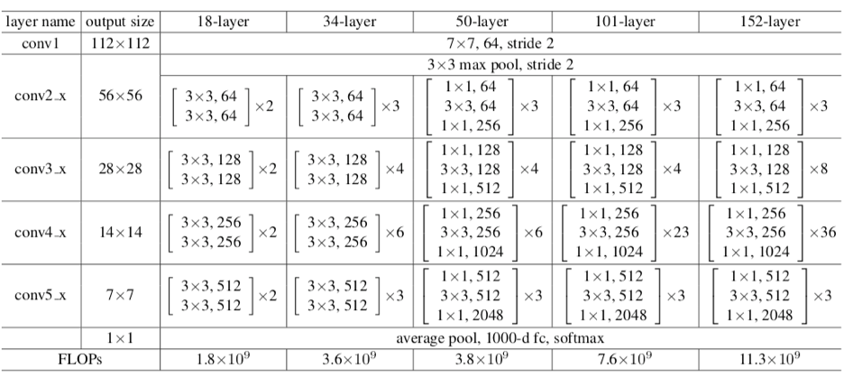
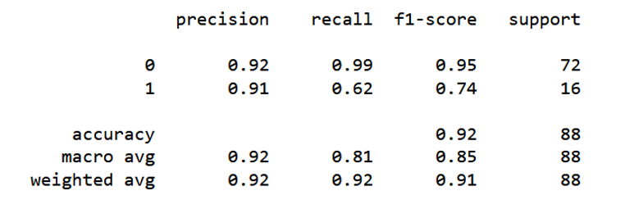
ResNET
34:

Slide 8

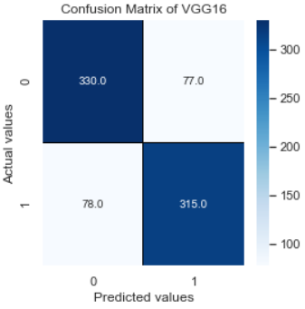
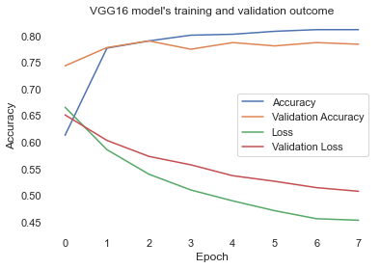
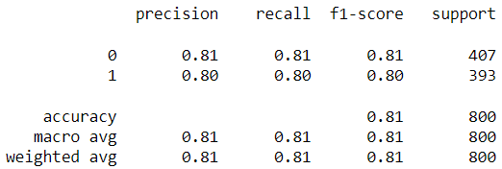
VGG16:
Training outputs:
Confusion matrix:
Model evaluation on test data:
Training and validation outcomes:
Classification report:
Notes:
Training Outputs : While doing the model fitting we pass some callbacks, namely, model checkpoint and early stopping. In early stopping we set patience to 5 which means that the model will stop to train if it doesn’t see any rise in validation accuracy in 5 epochs.
In our case, it stopped at epoch 8.
“For rest of the figures, no description needed.But if you want I can provide”

Slide 9
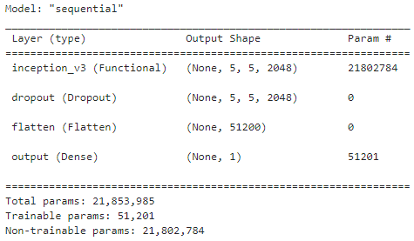
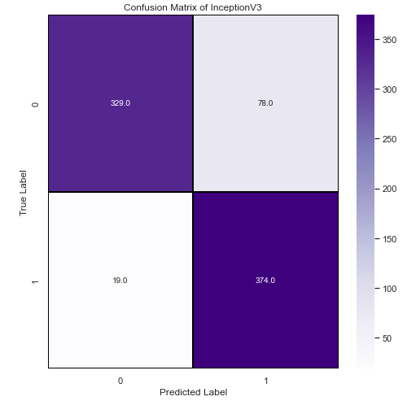
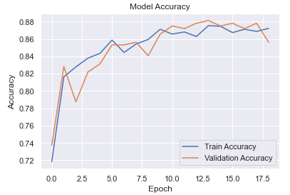
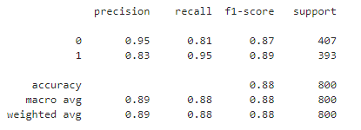

InceptionV3
Figure : Model Summary of inceptionV3
Figure: Model Accuracy Plot
Figure : Confusion Matrix of InceptionV3
Figure: Model Evaluation on Testing Data
Figure : Score Values
Figure : Training Accuracy
Notes:
Confusion Matrix : As shown in the confusion matrix the model is predicting the right class in most of the cases. For label : 0 the model is predicting 329 true positive and for label : 1 374 true positive.
Model Summary : this is the model summary where you can see we have used 51,201 trainable parameters.
Accuracy Plot : As shown in the plot that our model doesn’t overfit or underfit. As we have used early stop and we are monitoring the validation accuracy. If the validation accuracy degrades it will monitor for following 5 epochs and if it doesn’t improve the model will stop training and it will be saved.

Slide 10
Conclusion and References:
https://iq.opengenus.org/inception-v3-model-architecture/
https://machinelearningmastery.com/how-to-implement-major-architecture-innovations-for-convolutional-neural-networks/
https://towardsdatascience.com/step-by-step-vgg16-implementation-in-keras-for-beginners-a833c686ae6c

