Slide 1
Convenience vs.
Homemade Foods
Healthy Weight Management
Sports Nutrition

Slide 2
Three Levels of Convenience
Basic
Complex
Manufactured

Slide 3
اطبخ لي mobile app
Idea:
help chefs to market their home made food through mobile application.
Help customers to find healthy and good quality home made food .

Slide 4
Complex Convenience Foods
Several ingredients with more time-saving processing, these often cost more than homemade
Examples:
  ready to use frosting
  frozen waffles
  frozen entrees

Slide 5
Manufactured Convenience Foods
cannot be made at home, relatively expensive because of production technology
Examples:
  carbonated beverages
  instant breakfast
  ready to eat cereals

Slide 6
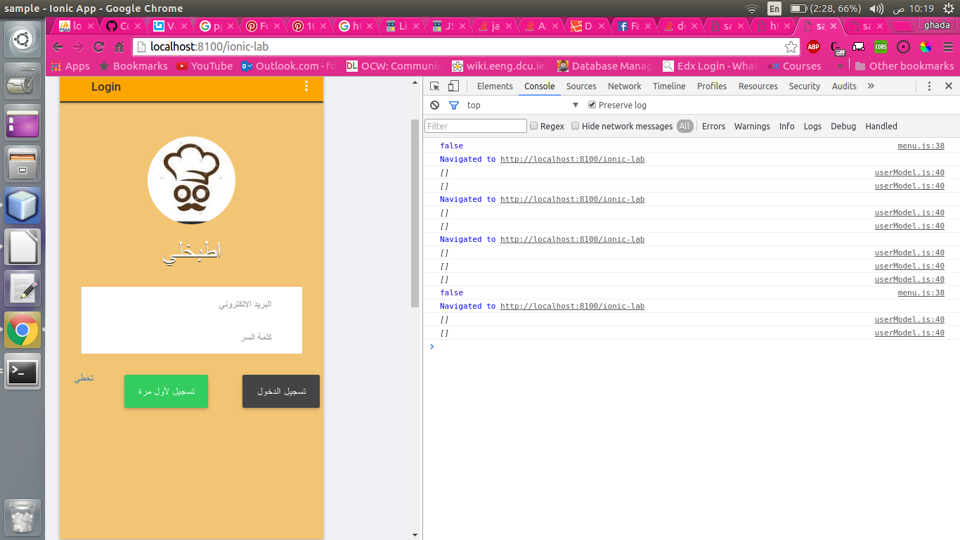
Cook delivery mobile application

Slide 7
Advantages of Convenience Foods
Less preparation time
Reduced planning, buying and storing of ingredients
Fewer leftovers
More variety, especially for inexperienced cooks
Faster and easier cleanup
Storability – usually keep well for extended periods

Slide 8
Disadvantages of Convenience Foods
May be less meat, fish or cheese than you would include in homemade versions
Cooking time is sometimes increased for thawing or longer baking time
Harder to control fat, salt and sugar levels
Cost per serving may be higher than homemade

Slide 9
Low Cost Convenience Foods
Frozen juice concentrate
Cake and pancake dry mixes
Canned vegetables and fruits
Plain frozen vegetables
Instant mashed potatoes
Spaghetti sauce
Instant nonfat dry milk
Macaroni and cheese dry mix
Canned condensed soups
Frozen french fries
Bread, crackers, rolls

Slide 10
High Cost Convenience Foods
Frozen vegetables with sauce
Coating mixes
Carry-out or deli items
Frozen entrees or dinners
Instant hot cereals
Fancy bakery items
Ready to use frosting
Frozen pancake batter
Meat “helpers”
Seasoned rice

Slide 11
Convenience Foods Save
Time But Can Cost More
Convenience foods can cost more than the same foods you make at home.
Choose them carefully. Make foods at home, if you have the time.
What adds to the cost of convenience foods?
  packaging
  precooking
  seasoning and sauces
Compare the cost of common convenience foods: Is extra convenience worth the extra cost?
  homemade vs. frozen dinner
  homemade vs. bakery
The more done to foods by someone else – the more you pay:
  Make your own convenience foods
    Leftovers are one key to convenience
    Plan meals so you will have leftovers to eat later in the week.
$ Make Your Food Dollars Count $___

