Slide 1

Python
CONDITIONAL STATEMENTS IN PYTHON
Pooja Godse

Slide 2
Agenda
If-else-elif
Loops
While
For
Loop Control

Slide 3
Recap
Variables
Operators
Operator Precedence

Slide 4
Control Structures
Flow of control through any given function is implemented with three basic types of control structures:
Sequential
Selection: These are the types of selection statements:
if
if/else
Repetition: There are two types of loops:
while
for

Slide 5
Conditional Statements
Conditional Statements are used to execute a statement or a group of statements when some condition is true.
Types of Conditional Statements
If condition is false
Condition
If condition is true
if
Elif
else
Conditional code

Slide 6
Conditional Statements
Scenario: Children whose height is no larger than 140cm can enjoy a free ride

Slide 7
Conditional Statements
User enters his height
Height>140cm
No
Yes
Paid ride
Enjoy free ride

Slide 8
If-else
Syntax
if test expression:
Body of if
else:
Body of else
The program evaluates the test expression and will execute statement(s) only if the test expression is True.
If the condition is False, the body of else is executed. Indentation is used to separate the blocks.

Slide 9
Why we need Conditional statements
x = 4
if x > 2 :
print(‘Bigger‘)
else :
print('Smaller‘)
print('All done‘)
X = 4
no
x > 2
yes
print('Smaller‘)
print ('Bigger‘)
Print('All Done‘)

Slide 10
Why we need Conditional statements
X = 4
x = 4
if x > 2 :
print('Bigger‘)
else :
print('Smaller‘)
Print('All done‘)
no
x > 2
yes
print('Smaller‘)
Print('Bigger‘)
Print('All Done‘)

Slide 11
if-else-else
if x < 2 :
print('Small‘)
elif x < 10 :
print(‘Medium‘)
else :
print('LARGE‘)
print('All done‘)
yes
x < 2
print 'Small'
no
yes
x<10
print 'Medium'
no
print 'LARGE'
print 'All Done'

Slide 12
if-else-else
x = 0
if x < 2 :
print 'Small'
elif x < 10 :
print ('Medium‘)
else :
print ('LARGE‘)
print 'All done'
X = 0
yes
x < 2
print 'Small'
no
yes
x<10
print 'Medium'
no
print 'LARGE'
print 'All Done'

Slide 13
if-else-else
x = 5
if x < 2 :
print(“Small”)
elif x < 10 :
print 'Medium'
else :
print(“LARGE”)
print 'All done'
X = 5
yes
x < 2
print 'Small'
no
yes
x<10
print 'Medium'
no
print 'LARGE'
print 'All Done'

Slide 14
If-else-if
x = 20
if x < 2 :
print 'Small'
elif x < 10 :
print 'Medium'
else :
print 'LARGE'
print 'All done'
X = 20
yes
x < 2
print 'Small'
no
yes
x<10
print 'Medium'
no
print 'LARGE'
print 'All Done'

Slide 15
if-else-if
# No Else
x = 5
if x < 2 :
print 'Small'
elif x < 10 :
print 'Medium'
print 'All done'
if x < 2 :
print 'Small'
elif x < 10 :
print 'Medium'
elif x < 20 :
print 'Big'
elif x< 40 :
print 'Large'
elif x < 100:
print 'Huge'
else :
print 'Ginormous'

Slide 16
Self Check
Which will never print?
if x < 2 :
print 'Below 2'
elif x >= 2 :
print 'Two or more'
else :
print 'Something else'
if x < 2 :
print 'Below 2'
elif x < 20 :
print 'Below 20'
elif x < 10 :
print 'Below 10'
else :
print 'Something else'

Slide 17
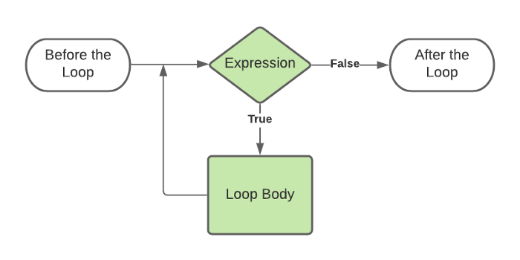
While Loop
Syntax:
while expression:
statements.
Image credit: https://medium.com/code-85/

Slide 18
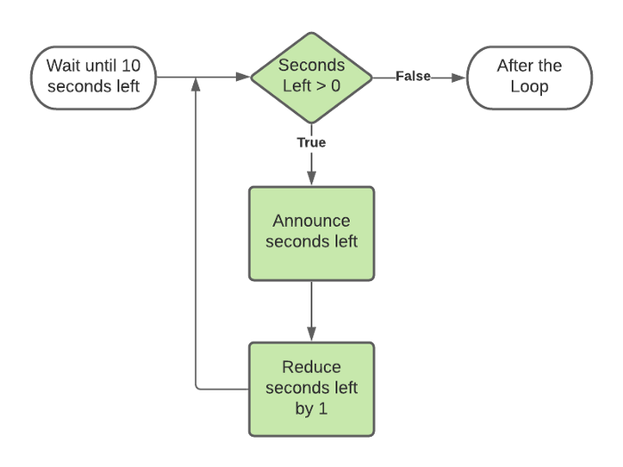
While loop example
Image credit: https://medium.com/code-85/

Slide 19
While Loop
New Years Countdown
1. Define the start of the countdown 2. Write while loop with condition 3. Print seconds left 4. Reduce seconds left

Slide 20
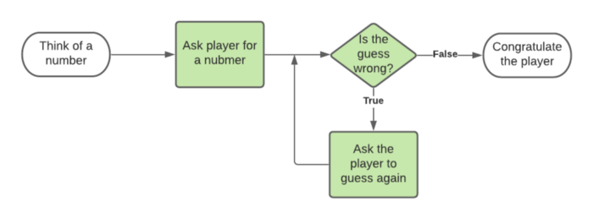
Number Guessing Game
Image credit: https://medium.com/code-85/

Slide 21
For Loop
For loop is a Python loop which repeats a group of statements a specified number of times.
Item from sequence
If no more items in the sequence
Syntax:
for variable in sequence:
statements.
True
Next item from sequence
Execute Stmts

Slide 22
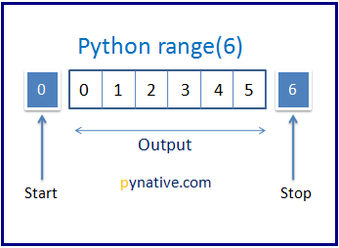
For Loop
range() takes mainly three arguments
start - integer starting from which the sequence of integers is to be returned
stop - integer before which the sequence of integers is to be returned.
The range of integers ends at stop - 1.
step (Optional) - integer value which determines the increment between each integer in the sequence
n = 6
for i in range(0, n):
print(i)
Source credit: https://pynative.com

Slide 23
Quick Check
Create a range of even numbers.

Slide 24
Questions?

Slide 25
Thank you.

