Slide 1
PYTHON
OPERATORS IN PYTHON
Pooja Godse

Slide 2
Agenda
Printing Output
Operators
Operator Precedence

Slide 3
Recap
What is Python?
Why Python?
Python Applications
Python Installation
Demo of Hello world
Comments, Literals and Indentation
Python Code Execution

Slide 4
Printing Output
We use the print() function to output data to the standard output device (screen).
Syntax :
objects is the value(s) to be printed.
print(*objects, sep=' ', end='\n', file=sys.stdout, flush=False)
sep separator is used between the values
It defaults into a new line.
The file is the object where the values are printed and its default value is sys.stdout (screen).

Slide 5
Operators
In computer programming languages operators are special symbols which represent computations, conditional matching etc.
The values the operator uses are called operands.
c = a + b
a and b are called operands
+ is an operator

Slide 6
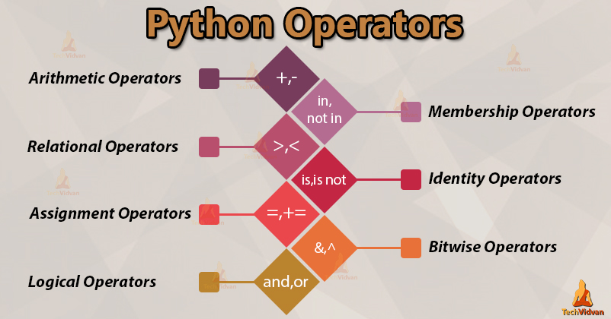
Types of Operators
Source credit: https://techvidvan.com

Slide 7
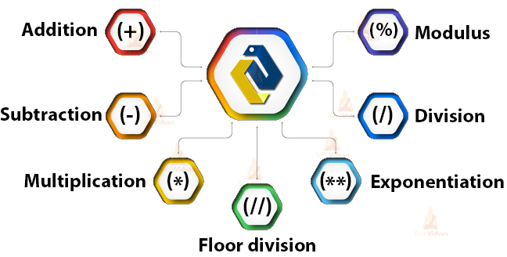
Arithmetic Operators
Source credit: https://techvidvan.com

Slide 8
Arithmetic Operators
Operator | Name | Example
+ | Addition | x + y
- | Subtraction | x - y
* | Multiplication | x * y
/ | Division | x / y
% | Modulus | x % y
** | Exponentiation | x ** y
// | Floor division | x // y

Slide 9
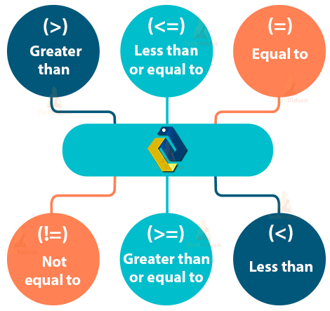
Relational Operators
Source credit: https://techvidvan.com

Slide 10
Relational Operators
Operator | Name | Example
== | Equal | x == y
!= | Not equal | x != y
> | Greater than | x > y
< | Less than | x < y
>= | Greater than or equal to | x >= y
<= | Less than or equal to | x <= y

Slide 11
Logical Operators
Operator | Description | Example
and | Returns True if both statements are true | x < 5 and x < 10
or | Returns True if one of the statements is true | x < 5 or x < 4
not | Reverse the result, returns False if the result is true | not(x < 5 and x < 10)

Slide 12
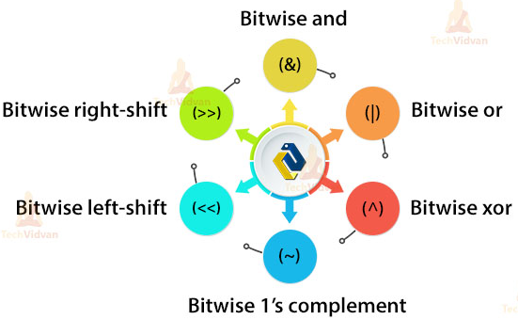
Bitwise Operators
Source credit: https://techvidvan.com

Slide 13
Bitwise Operator
& (operator)
| operator
x = 5 = 0101
y = 4 = 0100
x & y = 0101 & 0100 = 0100 = 4
x = 5 = 0101
y = 4 = 0100
x | y = 0101 | 0100 = 0101 = 5

Slide 14
Bitwise Operator
^ operator
~ operator
x = 5 = 0101
y = 4 = 0100
x ^ y = 0101 ^ 0100
= 0001 = 1
x = 5 = 0101
~x = ~0101 = -(0101 + 1)
= -0110 = -6

Slide 15
Bitwise Operators
>> operator
<< operator
x = 10 = 0000 1010
x >> 1 = 0000 0101 = 5
x = 5 = 0000 0101
x << 1 = 0000 1010 = 10

Slide 16
Self Check
c = 10
d = -10
print("c >> 1 =", c >> 1)
print("d >> 1 =", d >> 1)
c = 5
d = -10
print("c << 1 =", c << 1)
print("d << 1 =", d << 1)
a = 5
b = 6
print("a & b =", a & b)
print("a | b =", a | b)
print("~a =", ~a)
print("a ^ b =", a ^ b)

Slide 17
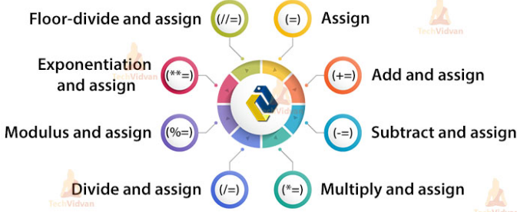
Assignment Operators
Source credit: https://techvidvan.com

Slide 18
Self Check
x = 15
y = 4
print('x + y =',x+y)
print('x - y =',x-y)
print('x * y =',x*y)
print('x / y =',x/y)
print('x // y =',x//y)
print('x ** y =',x**y)
x = 15
y = 4
print('x &= y =', x&=y)
print('x |= y =', x|=y)
print('x ^= y =', x ^= y)
print('x >>= y =', x >>= y)
print('x <<= y =',x <<= y)

Slide 19
Special Operators
Identity Operator
Membership Operator

Slide 20
Identity Operator
is and is not are the identity operators in Python.
They are used to check if two values (or variables) are located on the same part of the memory.
Two variables that are equal does not imply that they are identical.

Slide 21
Example
a = 20
b = 20
if ( a is b ):
print("a and b have same identity")
else:
print("a and b do not have same identity")
if ( id(a) == id(b) ):
print("a and b have same identity")
else:
print("a and b do not have same identity")
b = 30
if ( a is b ):
print("a and b have same identity")
else:
print("a and b do not have same identity")
if ( a is not b ):
print("a and b do not have same identity")
else:
print(" and b have same identity")

Slide 22
Self Check
x = 5
print(type(x) is int)
print(type(x) is not float)
y = 3.23
print(type(y) is not float)
print(type(y) is int)

Slide 23
Membership Operator
in and not in are the membership operators in Python.
They are used to test whether a value or variable is found in a sequence (string, list, tuple, set and dictionary).
In a dictionary we can only test for presence of key, not the value.

Slide 24
Operator Precedence
Operator precedence determines the grouping of terms in an expression and decides how an expression is evaluated.

Slide 25

Operators | Meaning
() | Parentheses
** | Exponent
+x, -x, ~x | Unary plus, Unary minus, Bitwise NOT
*, /, //, % | Multiplication, Division, Floor division, Modulus
+, - | Addition, Subtraction
<<, >> | Bitwise shift operators
& | Bitwise AND
^ | Bitwise XOR
| | Bitwise OR
==, !=, >, >=, <, <=, is, is not, in, not in | Comparisons, Identity, Membership operators
not | Logical NOT
and | Logical AND
or | Logical OR

Slide 26
Self Check
a = 20
b = 10
c = 15
d = 5
e = 0
e = (a + b) * c / d
print ("Value of (a + b) * c / d is ", e)
e = ((a + b) * c) / d
print("Value of ((a + b) * c) / d is ", e)
e = (a + b) * (c / d)
print("Value of (a + b) * (c / d) is ", e)
e = a + (b * c) / d
print("Value of a + (b * c) / d is ", e)

Slide 27
Operator precedence
Determine the hierarchy of operations and evaluate the following expression:
i = 2 * 3 / 4 + 4 / 4 + 8 - 2 + 5 / 8
Stepwise evaluation of this expression is shown below:
i = 2 * 3 / 4 + 4 / 4 + 8 - 2 + 5 / 8
i = 6 / 4 + 4 / 4 + 8 - 2 + 5 / 8 operation: *
i = 1 + 4 / 4 + 8 - 2 + 5 / 8 operation: /
i = 1 + 1+ 8 - 2 + 5 / 8 operation: /
i = 1 + 1 + 8 - 2 + 0 operation: /
i = 2 + 8 - 2 + 0 operation: +
i = 10 - 2 + 0 operation: +
i = 8 + 0 operation : -
i = 8 operation: +

Slide 28
Questions?

Slide 29
Thank you.

