Slide 1

Python
LOOP CONTROL STATEMENTS
IN PYTHON
Pooja Godse

Slide 2
Agenda
Break
Continue
Pass

Slide 3
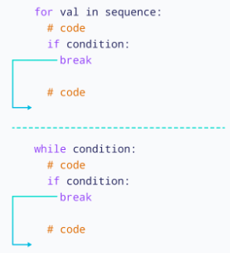
Break
Source credit: https://www.programiz.in

Slide 4
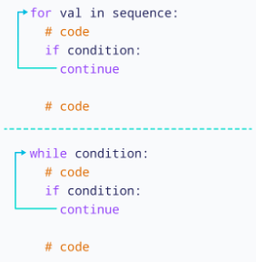
Continue

Slide 5
Questions?

Slide 6
Thank you.

