Slide 1

Python
LISTS IN PYTHON
Pooja Godse

Slide 2
What is a List?
A List is a compound data type, you can group values together.
A list contains items separated by commas and enclosed with in square brackets – [ ]
The items belonging to the list can be heterogeneous type.
Index starts at ‘0’.
A list in Python can grow and shrink in size

Slide 3
Creation of List
Creation of the list
list_str = ["apple", "banana", "cherry"]
list_int = [1,2,3]
list_mixed = [“London”, 12 , 56.78]
List_emp=[ ]
It is also possible to use the list() constructor to make a new list.
List_const = list(("apple", "banana", "cherry"))

Slide 4
Accessing elements of list
Accessing the list:
List indices start at 0.
If an index has a positive value it counts from the beginning
If the index has a negative value it counts from the end.
Example
color_list=["RED", "Blue", "Green", "Black"]
Item | Red | Blue | Green | Black
Index(from left to right) | 0 | 1 | 2 | 3
Index(from right to left) | -4 | -3 | -2 | -1

Slide 5
Accessing elements of list
markslist=[54,66,89,21]
#print all the elements of the list
print(markslist)
#access first element of list
print(markslist[0])
#access last element
print(markslist[-1])
#access all element one by one
for ele in markslist:
print(ele)
While accessing List elements, if you pass a negative index, python adds the length of the tuple to the index to get element’s forward index.
markslist[-1+4]=marklist[3]=21

Slide 6
Exercise
1. What is the result of the of this code?
nums=[23,33,11,1]
print(nums[-2])

Slide 7
Mutable Object
Simply put, a mutable object can be changed, but an immutable object cannot.
nums = [1, 2, 3]
l = nums
print(id(nums) == id(l))
nums.append(4)
print(id(nums) == id(l))
del nums[0]
print(id(nums) == id(l))

Slide 8
Mutable Object
a=[“beagles”, “donuts”]
id(a)
a=[“beagles”, “donuts”, “brownies”]
id(a)
same object
in memory
beagles
donuts
beagles
donuts
brownies
a
a

Slide 9
List Operations
Python Expression | Results | Description
len([1, 2, 3]) | 3 | Length
[1, 2, 3] + [4, 5, 6] | [1, 2, 3, 4, 5, 6] | Concatenation
['Hi!'] * 4 | ['Hi!', 'Hi!', 'Hi!', 'Hi!'] | Repetition
3 in [1, 2, 3] | True | Membership
for x in [1, 2, 3]: print(x) | 1 2 3 | Iteration

Slide 10
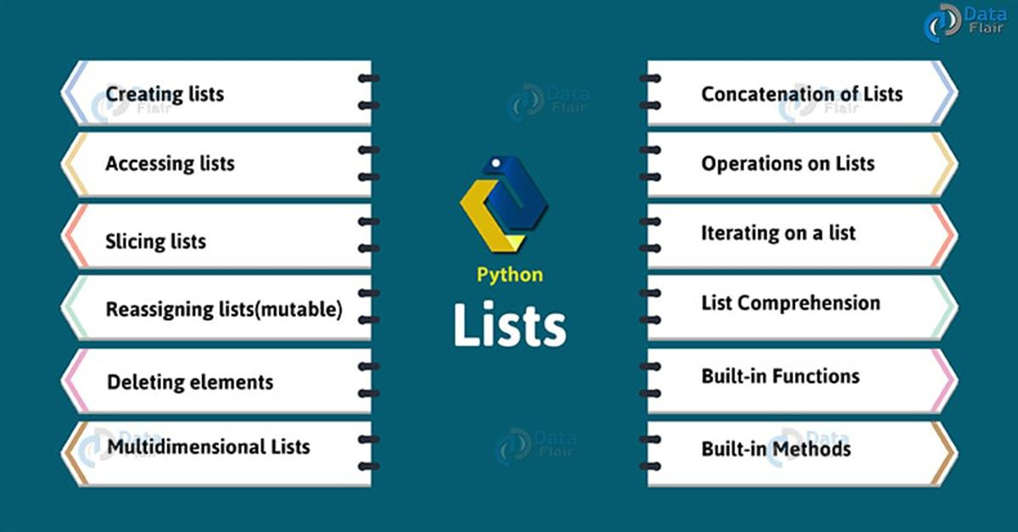
List Operations

Slide 11
List Methods
Removing items
remove(): removes the specified item
pop(): removes the specified index or the last item if index is not specified
del: deletes the list completely
Copying a list
copy()
built-in method list().
Joining two lists
Using operator ‘+’
extend()

Slide 12
Using Lists as Stacks
Give the back and forward button in web browser example.
The list methods make it very easy to use a list as a stack, where the last element added is the first element retrieved (“last-in, first-out”).
To add an item to the top of the stack, use append().
To retrieve an item from the top of the stack, use pop() without an explicit index.

Slide 13
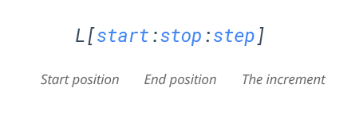
Slicing of a List
Mandatory parameters
Optional parameters
The index of the list where slicing starts.
Default index-0
The index of the list where slicing end.
Default value- len(list)-1
Allows you to select nth item within the range start to stop.

Slide 14
Examples
colors= ['red', 'green', 'blue', 'white', 'yellow']
print(colors[0:2])
['red', 'green']
print(colors[1:2])
['green']
print(colors[1:-2])
['green', 'blue']
print(colors[:3])
['red', 'green', 'blue']
print(colors[:])

Slide 15
Slice() function
The slice() method extracts a section of data and returns it as new data, without modifying it.
Syntax:
slice(start,stop,step)
colors= ['red', 'green', 'blue', 'white', 'yellow']
sli_col=slice(0,2)
print(colors[sli_col])
Slice object

Slide 16
Question
Can I insert and delete multiple items in a sequence using slicing in Python?
If yes, How??

Slide 17
Examples
#1. insert at the start
colors= ['red', 'green', 'blue', 'white', 'yellow']
nums=[1,2,3,4]
print(???)
#2. insert at the end
colors= ['red', 'green', 'blue', 'white', 'yellow']
nums=[1,2,3,4]
print(???)

Slide 18
Quick Check
How To Select An Element From A List
What Does The Index Out Of Range Error Mean?
How To Determine The Size Of Your List in Python
What’s the difference Between Python append() and extend() Methods?
How to concatenate Lists in Python?
How to sort a list?

Slide 19
List Comprehension
List comprehensions is a pythonic way of expressing a ‘for-loop’ that appends to a list in a single line of code.
List comprehensions hail from functional programming.
Less verbose, clearer and more readable.

Slide 20
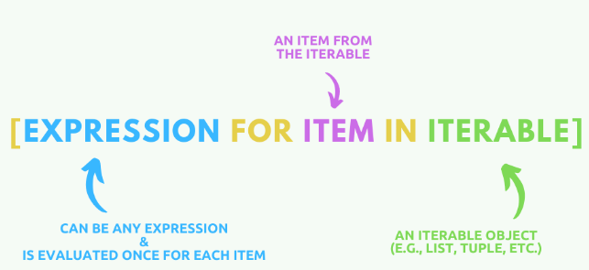
List Comprehension
Syntax: my_new_list = [expression for item in list]
Source credit: http:/programiz.com

Slide 21
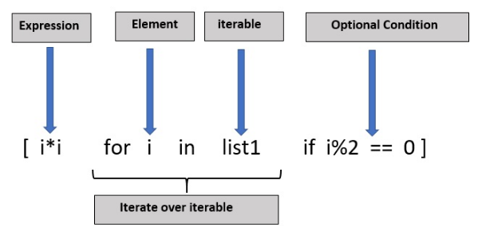

Python List Comprehension (Conditionals)
Conditionals can enhance Python list comprehensions significantly.
They server the following purposes:
To filter a list, and
To modify items in a list.
1. Finding Common Items in Two Lists Using List Comprehensions

Slide 22
Questions?

Slide 23
Thank you.

