Slide 1

PYTHON
Strings in Python
Pooja Godse

Slide 2
Agenda
Introduction to Strings
Strings immutability
String Slicing
In-built functions

Slide 3
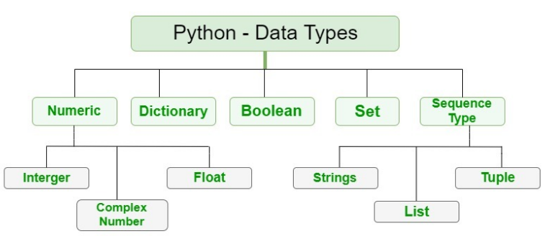
Objects in Python

Slide 4
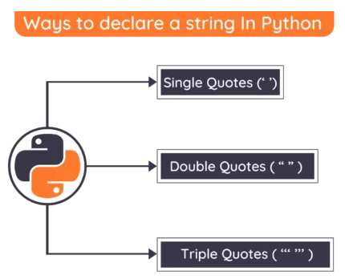
What is a String?
A string is a sequence of characters.
Usually strings are enclosed in single or double quotes
Strings are immutable

Slide 5
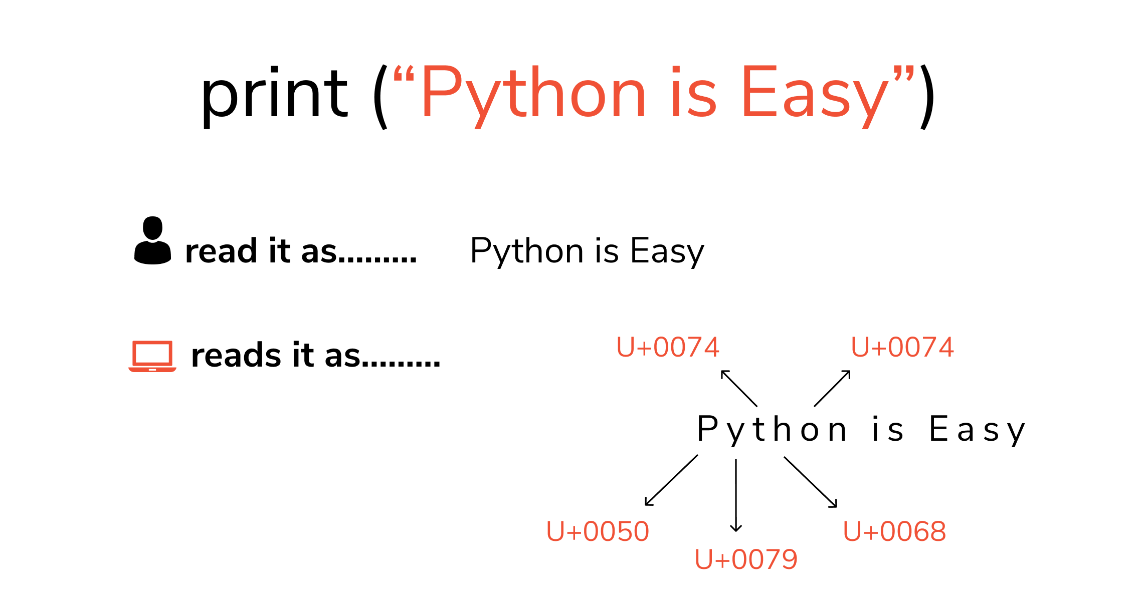
Strings in Python

Slide 6
Accessing a String?
0 | 1 | 2 | 3 | 4 | 5 | 6 | 7 | 8 | 9
H | E | L | L | O | W | O | R | L | D
-10 | -9 | -8 | -7 | -6 | -5 | -4 | -3 | -2 | -1

Slide 7
List of Mutable and Immutable objects.
Objects of built-in type that are mutable are:
Lists
Sets
Dictionaries
User-Defined Classes (It purely depends upon the user to define the characteristics)
Objects of built-in type that are immutable are:
Numbers (Integer, Rational, Float, Decimal, Complex & Booleans)
Strings
Tuples
Frozen Sets

Slide 8
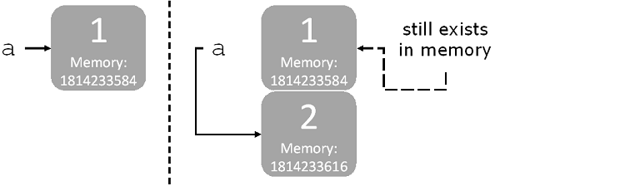
Strings are immutable
Definition: An immutable object is an object cannot change after creation.
id(a)
id(a)

Slide 9
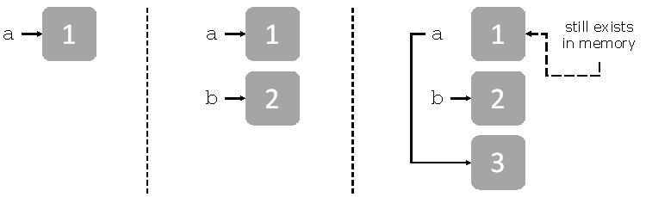
Example
a=1
b=2
c=3

Slide 10
Quick Check:
Draw out a diagram similar to the one in Figure 2 to show variables and objects that they point to (and any leftover objects) for the following sequence of statements.
sq=2*2
pi=3.14
pi=22/7
pi=3

Slide 11
Summary
In Python, Strings are stored as individual characters in a continuous memory location.
So strings in Python are arrays of bytes representing Unicode characters.
One major advantage of using Strings is that they can be accessed from both directions.
Forward Indexing starts with 0,1,2,3,4,.. and backward Indexing also known as negative indexing starts with -1,-2,-3,-4,..
Python does not support character datatype and hence a single character is also considered to be a string but with a string lengath of 1.

Slide 12
Quick Check
Would you use a mutable or an immutable type of object to store the following information?
Cities in a state
Your age
Group of items in a grocery store and their cost
Color of a car

Slide 13
String slicing
It is the creation of a new sub-string from the given string on the basis of the user-defined starting and ending indices.

Slide 14
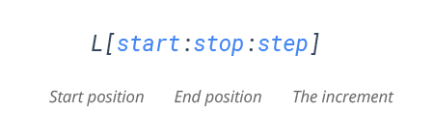
String Slicing
Mandatory parameters
Optional parameters
The index of the string where slicing starts.
Default index-0
The index of the string where slicing end.
Default value- len(string)-1
Allows you to select nth item within the range start to stop.

Slide 15
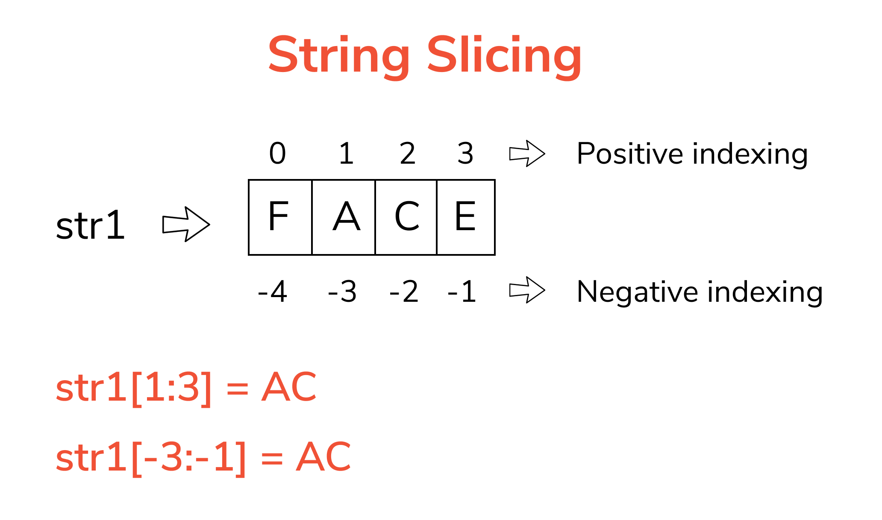
String Slicing

Slide 16
Quick Check
Does slicing change the existing string?
Given string: Hello World (Slice the string from 2nd to 8 th position)
Given String: Charlie (Slice the string from 2nd to last index)

Slide 17
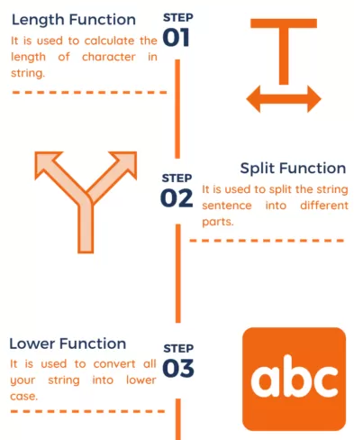
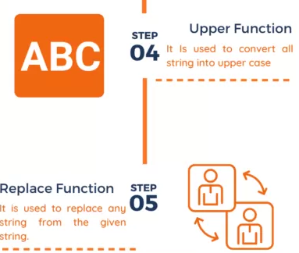
Python built-in functions
Source credit: https://pynative.com/

Slide 18
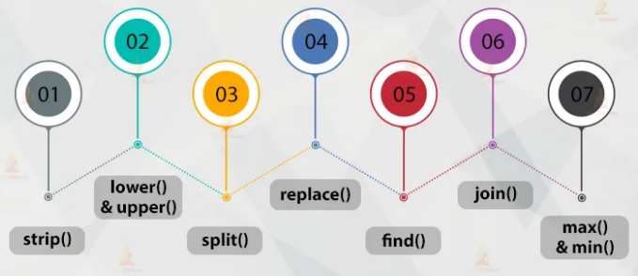
Python built-in functions
Source credit: https://tutorialpoint.com/

Slide 19
Questions?

Slide 20
Thank you.

