Slide 1
MSc SEMINAR | University of Babylon
Parallel Image Compression Using High-Performance Computing Strategies
LBG vector quantization, delta coding and Huffman coding with speed-aware MPI on a hybrid P/E-core CPU
Presented by MSc. Student Ibtihal Hussien
Supervised by Dr. Ahmed Badri · Dr. Esraa Hadi

Slide 2
Outline
Outline
Introduction
Literature Review
1
2
Problem Statement
Thesis Objectives
3
4
Proposed Work
Experimental Results
5
6
Conclusion
Future Work
7
8

Slide 3
Introduction
Why Image Compression?
Storage
Large image collections require a large amount of storage space.
Transmission
Smaller images reach the receiver sooner and use less network bandwidth.
Computation
A good compression ratio needs complex methods, so the compression itself must stay fast.
Image compression reduces the amount of data needed to represent an image.

Slide 4
Introduction
Lossless and Lossy Compression
Lossless
The original image is recovered exactly. Examples: RLE, Huffman, LZW.
Lossy
Some information is discarded to reach a higher compression ratio. Examples: VQ, DCT, DWT.
This work: lossy LBG vector quantization, followed by lossless delta coding and Huffman coding.

Slide 5
Introduction
Parallel Processing in Image Compression
Parallel processing improves processing speed and efficiency when handling large data.
LBG training dominates
It is the most time-consuming stage of the sequential program, so it is the stage worth parallelizing.
Data-parallel
Each training vector is assigned to its nearest codeword independently, so the work can be split across processes.
Hybrid CPU
P-cores and E-cores have different speeds, so an equal split can leave fast cores waiting.

Slide 6
Literature Review
Related Work: Compression Quality
Ref. | Image | Study | Algorithm | CR | PSNR (dB)
[6] | Lena | Thomas et al. | Wavelet coefficients + Huffman coding | 1.52 | 54.28
[16] | Lena | Ranjan and Kumar | 2D DWT + PCA + canonical Huffman | 4.41 | 34.78
 |  | This work | LBG-VQ + delta + Huffman | 23.50 | 29.67
[6] | Boat | Thomas et al. | Wavelet coefficients + Huffman coding | 1.41 | 54.07
 |  | This work | LBG-VQ + delta + Huffman | 26.54 | 29.11
[17] | Cameraman | Bilal et al. | FLBG (LBG with bilinear rescaling) | – | 25.3–26.8*
 |  | This work | LBG-VQ + delta + Huffman | 28.88 | 29.75
[16]: Lena 512 × 512, Table 1 (CR 4.4058, PSNR 34.7809 dB). [6]: near-lossless scheme. * [17]: FLBG PSNR over 0.15–0.625 bpp (CR not reported).
This work reaches a much higher compression ratio than [6] and [16], at a lower PSNR.
Notes:
CR values of 'This work' come from the previous Huffman-table accounting. Replace them with the CR column of correctness.csv after the rerun (expected change about -1.2%). Source values checked against the papers: [6] Table 1 and Table 3; [16] Table 1; [17] Table 1 (Cameraman, FLBG).

Slide 7
Literature Review
Related Work: Parallel Speedup
Study | Application | Parallel Resources | Baseline | Reported Speedup
Zangana (2025) | Image compression | 1–16 GPUs | 1 GPU | 9.09× (16 GPUs)
Papakyriakou et al. (2025) | MPI-based k-means clustering | 2–48 MPI processes (24 Raspberry Pi nodes) | 2 processes | ≈ 10× (181.8 s to 18.1 s)
Bystrov et al. (2023) | Discrete-element simulation | 8 heterogeneous containers | Sequential | Up to 6.0×
This work | MPI-based LBG image compression | 14 MPI processes (6 P + 8 E) | Sequential | 9.19× (LBG); 5.00× (gray total); 6.84× (color total)
Research gap
Existing parallel studies use other compression algorithms on GPUs, or target clustering and simulation workloads. To our knowledge, none of the reviewed studies evaluates MPI-parallel LBG for image compression on a hybrid P/E-core CPU.

Slide 8
Problem Statement
Problem Statement
Transmitting and storing uncompressed images consumes bandwidth and storage capacity.
1
LBG vector quantization gives a compact representation, but codebook training is computationally expensive: it repeatedly computes distances between training vectors and codewords.
2
On a hybrid CPU, an equal distribution of training vectors causes workload imbalance: the faster P-cores finish early and wait for the slower E-cores at synchronization points.
3
Reduce LBG training and total compression time through speed-aware workload distribution, while preserving the compression ratio and the reconstruction quality of the sequential implementation.

Slide 9
Objectives
Thesis Objectives
1. Image Compression Framework Development
To compress grayscale and color images by combining LBG vector quantization, delta coding, and Huffman coding.
2. LBG Execution-Time Reduction
To reduce codebook-training time by parallelizing the computationally intensive operations of LBG using MPI.
3. Workload Distribution Improvement
To distribute the training vectors according to the measured throughput of each MPI process on the P-cores and E-cores, and to improve performance compared with equal distribution.
4. Performance Evaluation and Result Verification
To evaluate compression, reconstruction quality and parallel performance, and to verify that the parallel results match the sequential implementation.

Slide 10
Stage 1
Block
Formation
1. Input image
512×512,
gray / color
2. 4×4 blocks
non-overlapping
3. Training vectors
16-D, N = 16,384
per channel
SEQUENTIAL: Process 0
16,384 training vectors per channel (16-D)
Stage 2
Parallel LBG
Training (MPI)
1. Distribute
MPI_Scatterv:
Equal / Adaptive
2. Assign
nearest codeword
on each process
3. Combine
Allreduce: sums,
counts, distortion
4. Refine and split
per level,
until K = 64
PARALLEL: all processes
codebook C + index array L (gathered on Process 0)
Stage 3
Lossless Index
Coding
1. Delta coding
differences of
VQ indices
2. Huffman coding
variable-length
codes
3. Compressed size
codebook + Huffman table
+ coded indices
SEQUENTIAL: Process 0
accounted size: codebook + Huffman table + coded indices
Stage 4
Decoding and
Evaluation
1. Huffman decoding
bit stream to
delta values
2. Inverse delta
recover
VQ indices
3. Reconstruction
codebook
lookup
SEQUENTIAL: Process 0
Parallel: all MPI processes work together
Sequential: executed on Process 0 only

Slide 11
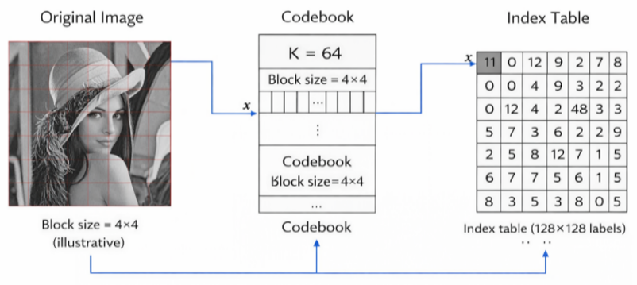
Stage 1
Block Formation
The image is divided into non-overlapping 4 × 4 blocks.
Each block becomes a 16-dimensional vector.
A 512 × 512 image gives N = 16,384 training vectors.
Color images: the R, G and B channels are processed independently.
Block-based vector quantization (illustrative)

Slide 12
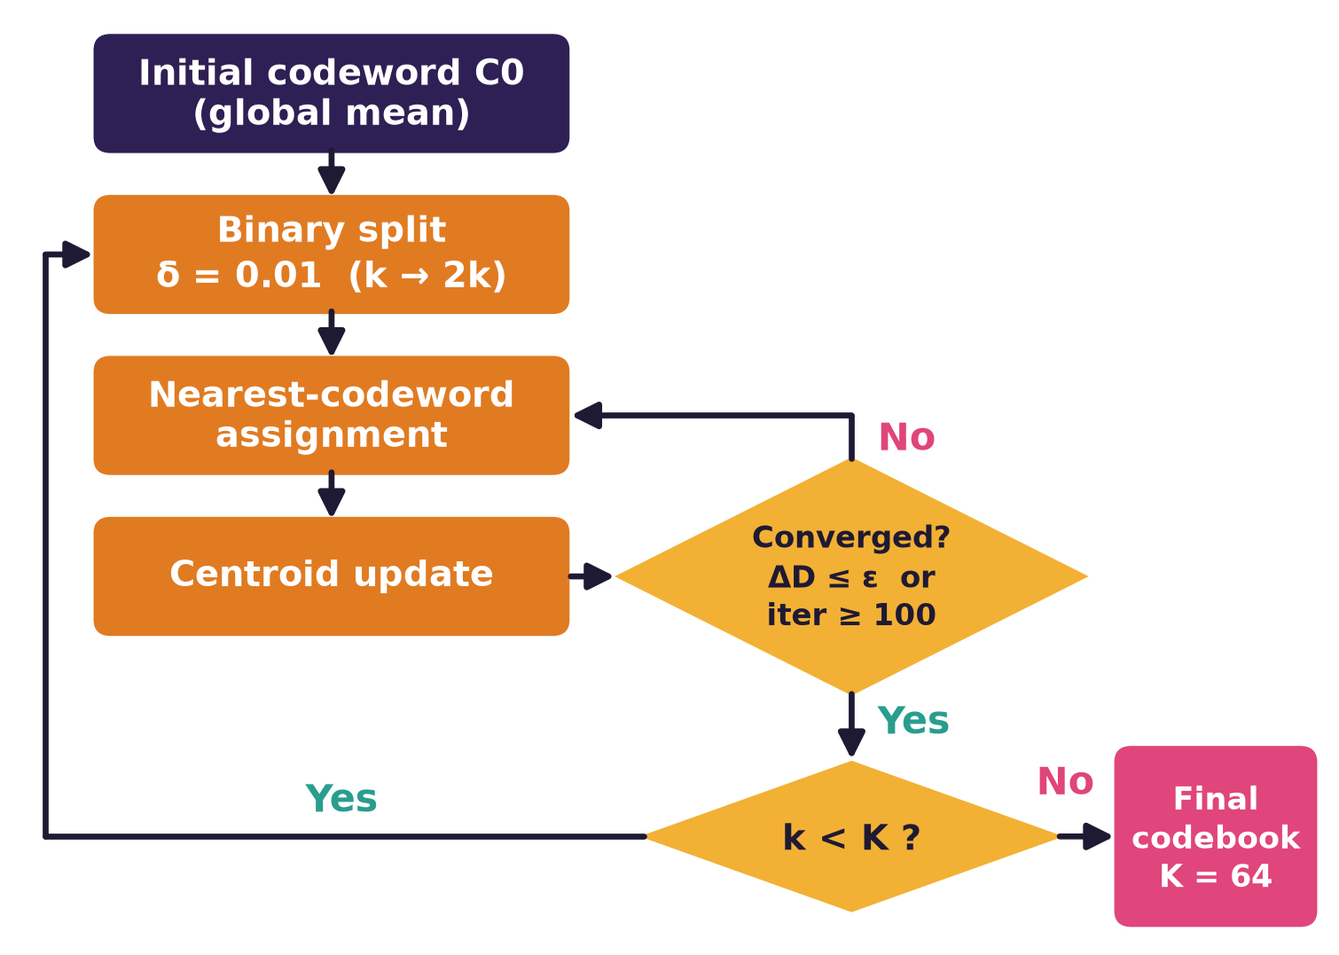
Stage 2
LBG Codebook Training
Start from the global mean as the first codeword.
Binary splitting (δ = 0.01) doubles the codebook size.
Lloyd refinement: assign each vector to its nearest codeword, then update the centroids.
Stop at ΔD ≤ ε or 100 iterations; repeat until K = 64.

Slide 13
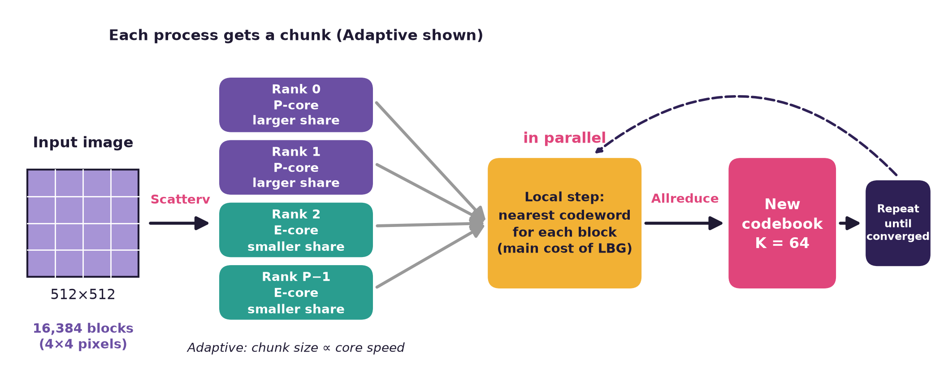
Stage 2
Parallel LBG Training (MPI)
SPMD: every process runs the same program on its own chunk of vectors.
Nearest-codeword assignment is local and is the main cost of LBG.
Allreduce combines sums, counts and distortion; every process updates the same codebook.
Gatherv collects the final indices on Process 0.

Slide 14
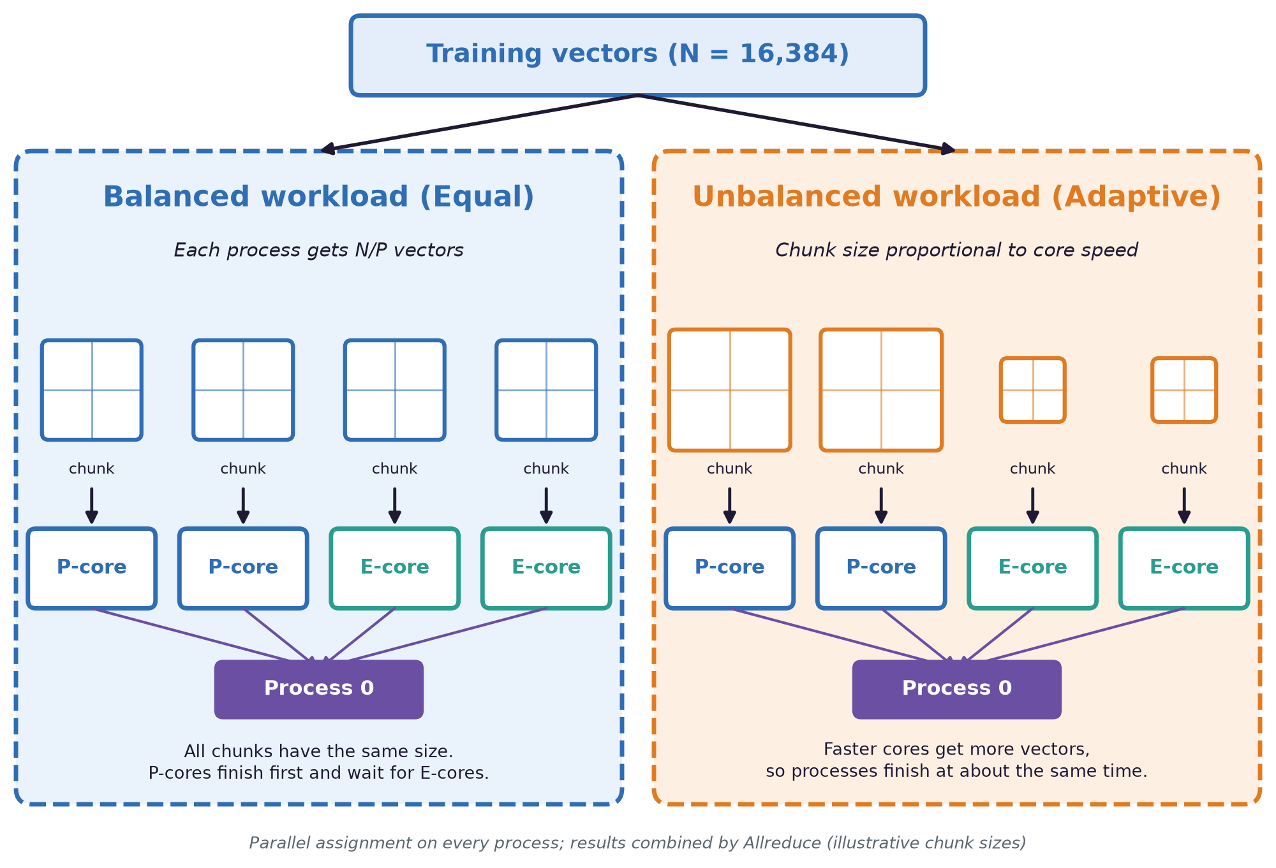
Stage 2
Balanced and Unbalanced Workload Distribution
Balanced (Equal), P ≤ 4: each process gets N/P training vectors.
Unbalanced (Adaptive), P > 4: each process gets a share proportional to its measured speed.
Share of process r: q_r = N · s_r / Σ s_j, where s_r is the speed of process r.
Speed s_r is measured once by a short calibration run (3 trials, the first is a warm-up).

Slide 15
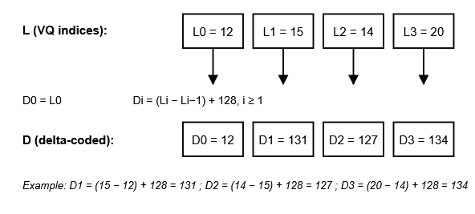
Stage 3
Delta Coding
Stores the difference between successive VQ indices (offset 128).
Neighbouring blocks are correlated, so the differences cluster around the offset.
Example (Lena): entropy falls from 5.39 to 4.67 bits per symbol.

Slide 16
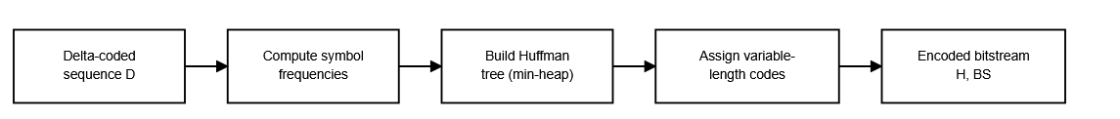
Stage 3
Huffman Coding
Frequent symbols receive shorter codewords, rare symbols longer ones (lossless).
Output: the Huffman codes and the encoded bitstream.
Accounted compressed size = codebook (K × 16 bytes, one byte per codeword element) + Huffman table + Huffman-coded data.
The table is accounted as 5 bytes per used symbol (1 byte symbol + 4 bytes frequency) plus 10 bytes of fixed metadata. The program accounts this size; it does not write a stand-alone compressed file.

Slide 17
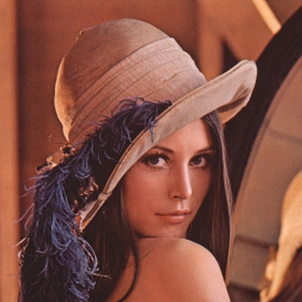

Stage 4
Decoding and Evaluation
1. Huffman decoding
bit stream → delta values
2. Inverse delta
deltas → VQ indices
3. Codebook lookup
index → 4×4 block
4. Reconstructed image
blocks → 512×512 image
Decoding and reconstruction run on Process 0.
Quality: MSE, PSNR and SSIM (SSIM is computed in parallel); size: CR and BPP.
Parallel performance: time, speedup, efficiency, throughput, Karp–Flatt.
Verification: the reconstructed image (MD5) and the metrics are identical for the sequential run, P = 4, and P = 14 (Adaptive and Equal).
Original
Reconstructed
Lena (color): PSNR 28.91 dB, SSIM 0.7594

Slide 18
Experimental Results
Experimental Setup
Hardware
Intel Core i7-13650HX: 6 P-cores and 8 E-cores (14 cores in total).
Software
Ubuntu 24.04, GCC 13.3 (-O2), Open MPI 4.1.6, written in C.
Protocol
Median of 5 runs; governor set to performance; processes bound to cores, P-cores first.
Data
8 standard 512 × 512 images: 4 grayscale and 4 color.
LBG settings
4 × 4 blocks, K = 64 codewords, δ = 0.01, ε = 0.0001 (relative improvement in distortion), at most 100 iterations per level.
Strategies
Equal (default for P ≤ 4) and Adaptive speed-aware (P > 4).

Slide 19
Results
Performance and Quality Evaluation Metrics
Compression Quality
Parallel Performance
Compression Ratio (CR)
Bits Per Pixel (BPP)
MSE
PSNR
SSIM
Execution Time
Speedup
Parallel Efficiency
Throughput
Karp–Flatt Metric
Each formula is shown next to the result it measures.

Slide 20
Results
Test Images
Grayscale
Insert image
Insert image
Insert image
Insert image
Lena
Boat
Cameraman
Peppers
Color
Insert image
Insert image
Insert image
Insert image
Lena
Peppers
F16
Gold Hill

Slide 21
Results
Reconstruction Results: Grayscale Images
Lena
Boat
Cameraman
Peppers
Original
Original
Original
Original
Original
Reconstructed
Reconstructed
Reconstructed
Reconstructed
Reconstructed
CR = ___
PSNR 29.67 dB SSIM 0.8190
CR = ___
PSNR 29.11 dB SSIM 0.8394
CR = ___
PSNR 29.75 dB SSIM 0.8855
CR = ___
PSNR 29.41 dB SSIM 0.7624

Slide 22
Results
Reconstruction Results: Color Images
Lena
Peppers
F16
Gold Hill
Original
Original
Original
Original
Original
Reconstructed
Reconstructed
Reconstructed
Reconstructed
Reconstructed
CR = ___
PSNR 28.91 dB SSIM 0.7594
CR = ___
PSNR 28.35 dB SSIM 0.6964
CR = ___
PSNR 29.47 dB SSIM 0.8539
CR = ___
PSNR 28.45 dB SSIM 0.7520

Slide 23
Results
Compression Results (4 × 4 blocks, K = 64)
CR = S_orig / S_comp BPP = compressed bits / number of pixels
MSE = mean (I − Î)² PSNR = 10·log₁₀(255² / MSE) dB SSIM: 11 × 11 Gaussian window, σ = 1.5
Image | Type | CR | BPP | MSE | PSNR (dB) | SSIM
Lena | Gray | ___ | ___ | 70.13 | 29.67 | 0.8190
Boat | Gray | ___ | ___ | 79.88 | 29.11 | 0.8394
Cameraman | Gray | ___ | ___ | 68.84 | 29.75 | 0.8855
Peppers | Gray | ___ | ___ | 74.47 | 29.41 | 0.7624
Mean (gray) | Gray | ___ | ___ | 73.33 | 29.49 | 0.8266
Lena | Color | ___ | ___ | 83.60 | 28.91 | 0.7594
Peppers | Color | ___ | ___ | 95.00 | 28.35 | 0.6964
F16 | Color | ___ | ___ | 73.41 | 29.47 | 0.8539
Gold Hill | Color | ___ | ___ | 92.97 | 28.45 | 0.7520
Mean (color) | Color | ___ | ___ | 86.25 | 28.80 | 0.7654
Color images: MSE and PSNR are computed over the RGB channels; SSIM is the mean of the channel-wise values. CR = original size / (codebook + Huffman table + Huffman-coded data).

Slide 24
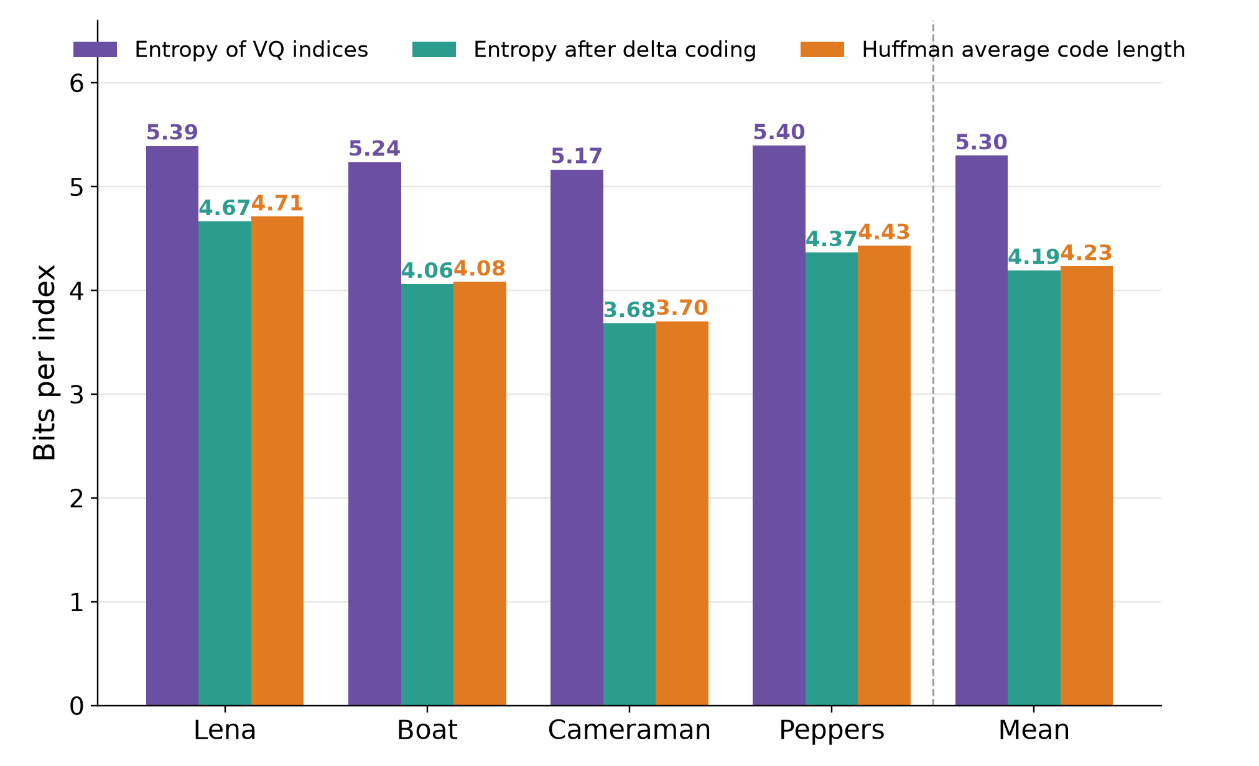
Results
Entropy and Delta–Huffman Coding Efficiency
H = −Σ p(s) · log₂ p(s) (bits / symbol)
Delta coding lowers the entropy of the index sequence from 5.30 to 4.19 bits on average (−1.10 bits).
The reduction depends on the spatial correlation of the image: 0.73 bits (Lena) to 1.48 bits (Cameraman).
The Huffman average code length (4.23 bits) is within 0.04 bits of the entropy after delta coding.
Compared with 6-bit fixed-length indices, the index data is 21.5% to 38.3% smaller (mean 29.5%).
Grayscale images, K = 64.

Slide 25
Results
Verification: Parallel Results Equal Sequential
Image | Type | PSNR (dB) | SSIM | LBG iterations | Metrics identical | MD5 identical
Lena | Gray | 29.67 | 0.8190 | 160 | Yes | Yes
Boat | Gray | 29.11 | 0.8394 | 151 | Yes | Yes
Cameraman | Gray | 29.75 | 0.8855 | 155 | Yes | Yes
Peppers | Gray | 29.41 | 0.7624 | 132 | Yes | Yes
Lena | Color | 28.91 | 0.7594 | 476 | Yes | Yes
Peppers | Color | 28.35 | 0.6964 | 438 | Yes | Yes
F16 | Color | 29.47 | 0.8539 | 479 | Yes | Yes
Gold Hill | Color | 28.45 | 0.7520 | 479 | Yes | Yes
Compared with the sequential run: parallel P = 4 (automatic), P = 14 (Adaptive) and P = 14 (forced Equal). Metrics: compression ratio, MSE, PSNR, SSIM and iteration count. MD5: checksum of the reconstructed image. Values shown are identical in all four runs.

Slide 26
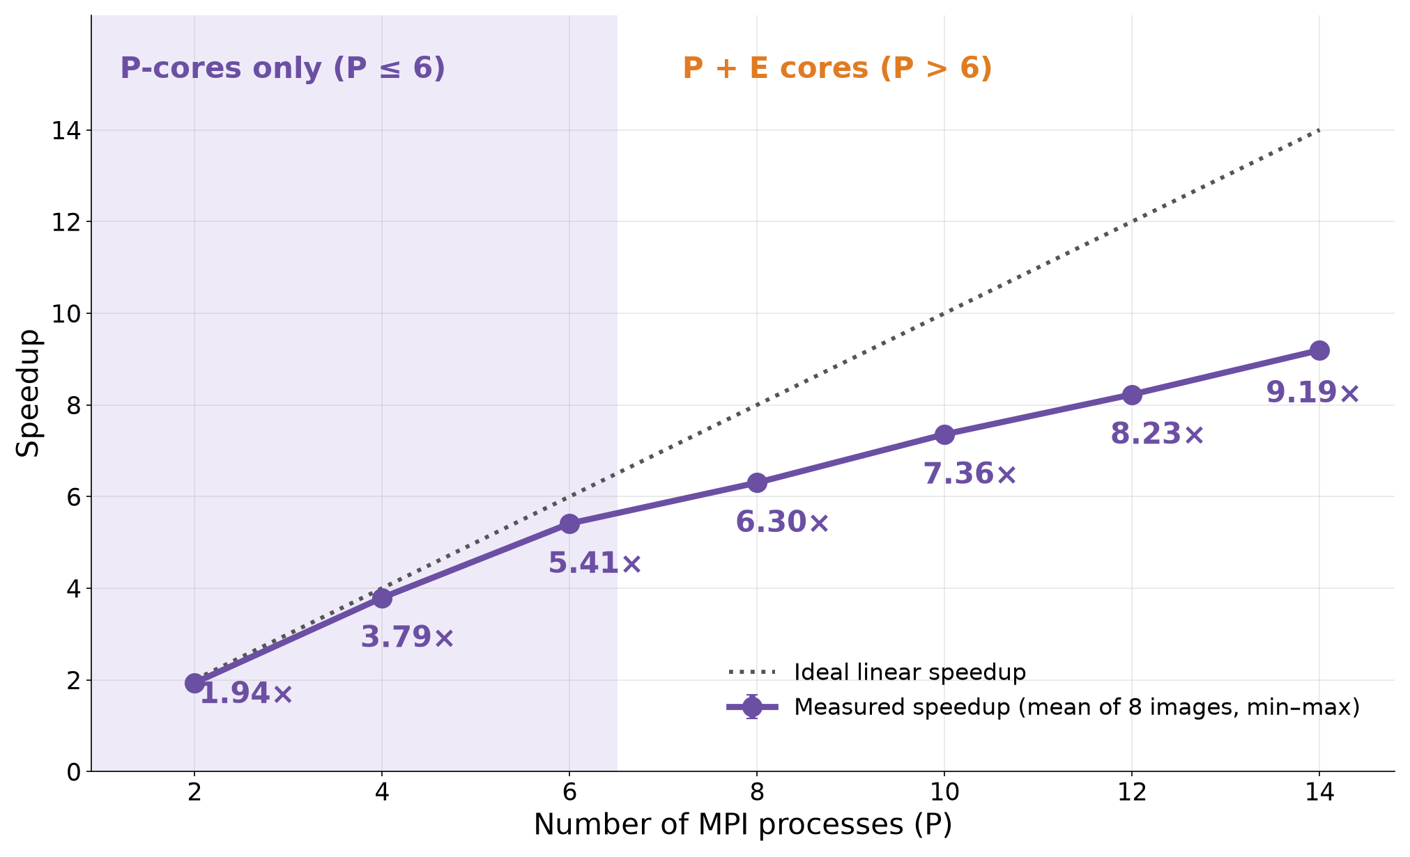
Results
Speedup of LBG Training
S = T_seq / T_P
LBG speedup reaches 9.19× on 14 processes.
Near-linear for P ≤ 6, where only P-cores are used.
The slope drops once the slower E-cores join.
Mean of the 8 images; the bars show the minimum and maximum.
This is the LBG stage. The total speedup is shown separately for gray and color two slides later.

Slide 27
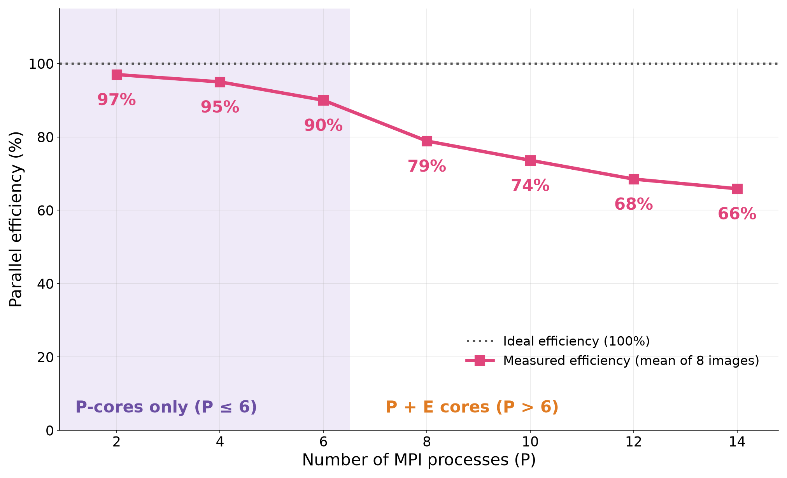
Results
Parallel Efficiency of LBG Training
E = S / P
Efficiency is 97% at P = 2 and stays at 90% or more up to P = 6 (P-cores only).
It drops to 79% at P = 8, where the E-cores start to be used, and reaches 66% at P = 14.
The E-cores are slower than the P-cores, so each added process contributes less than a full core.
Karp–Flatt stays near 0.04 for P ≥ 8: the serial fraction of LBG remains small.
Mean of the 8 images.

Slide 28
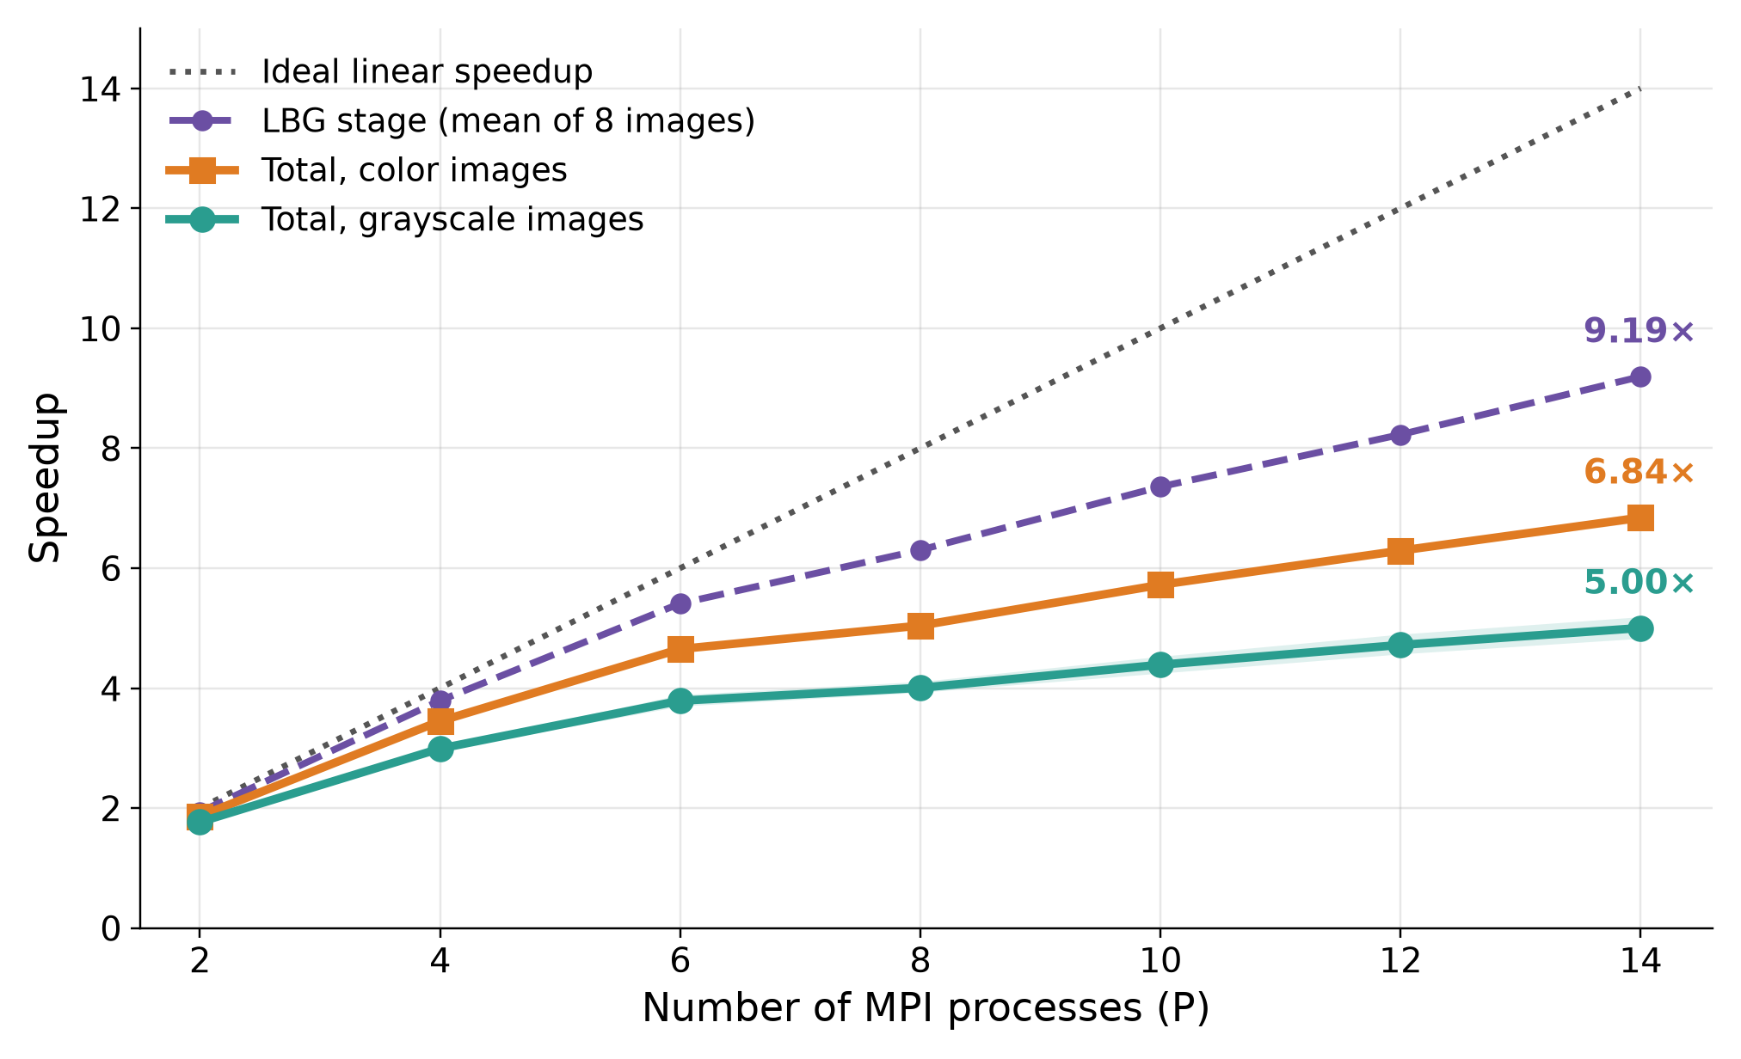
Results
Total Speedup: Grayscale and Color
S = T_seq / T_P
Total speedup at P = 14: 5.00× (grayscale) and 6.84× (color); efficiency 35.7% and 48.9%.
It is lower than the LBG speedup (9.19×) because the work outside LBG (mainly image reading and file output) runs on Process 0.
Color images gain more: LBG is 81% of their sequential time, against 77% for grayscale.
Total time is the whole program execution; the shaded bands show the minimum to maximum over the images of each type.

Slide 29
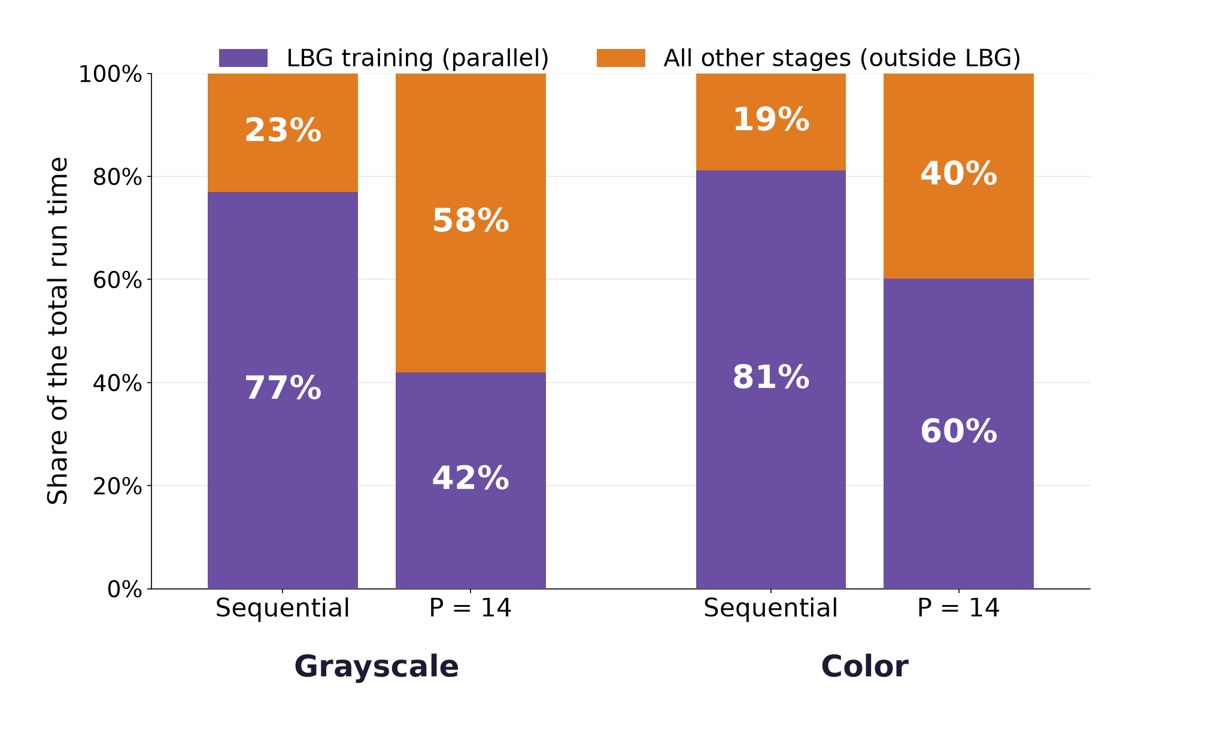
Results
Where the Time Goes
LBG training is 77% (gray) and 81% (color) of the sequential run time.
At P = 14 it shrinks to 42% and 60% of the run time.
The other stages do not shrink in the same way, so they become the larger part: about 58% (gray) and 40% (color).
By Amdahl's law this limits the total speedup to 5.00× (gray) and 6.84× (color), against 9.19× for LBG alone.

Slide 30
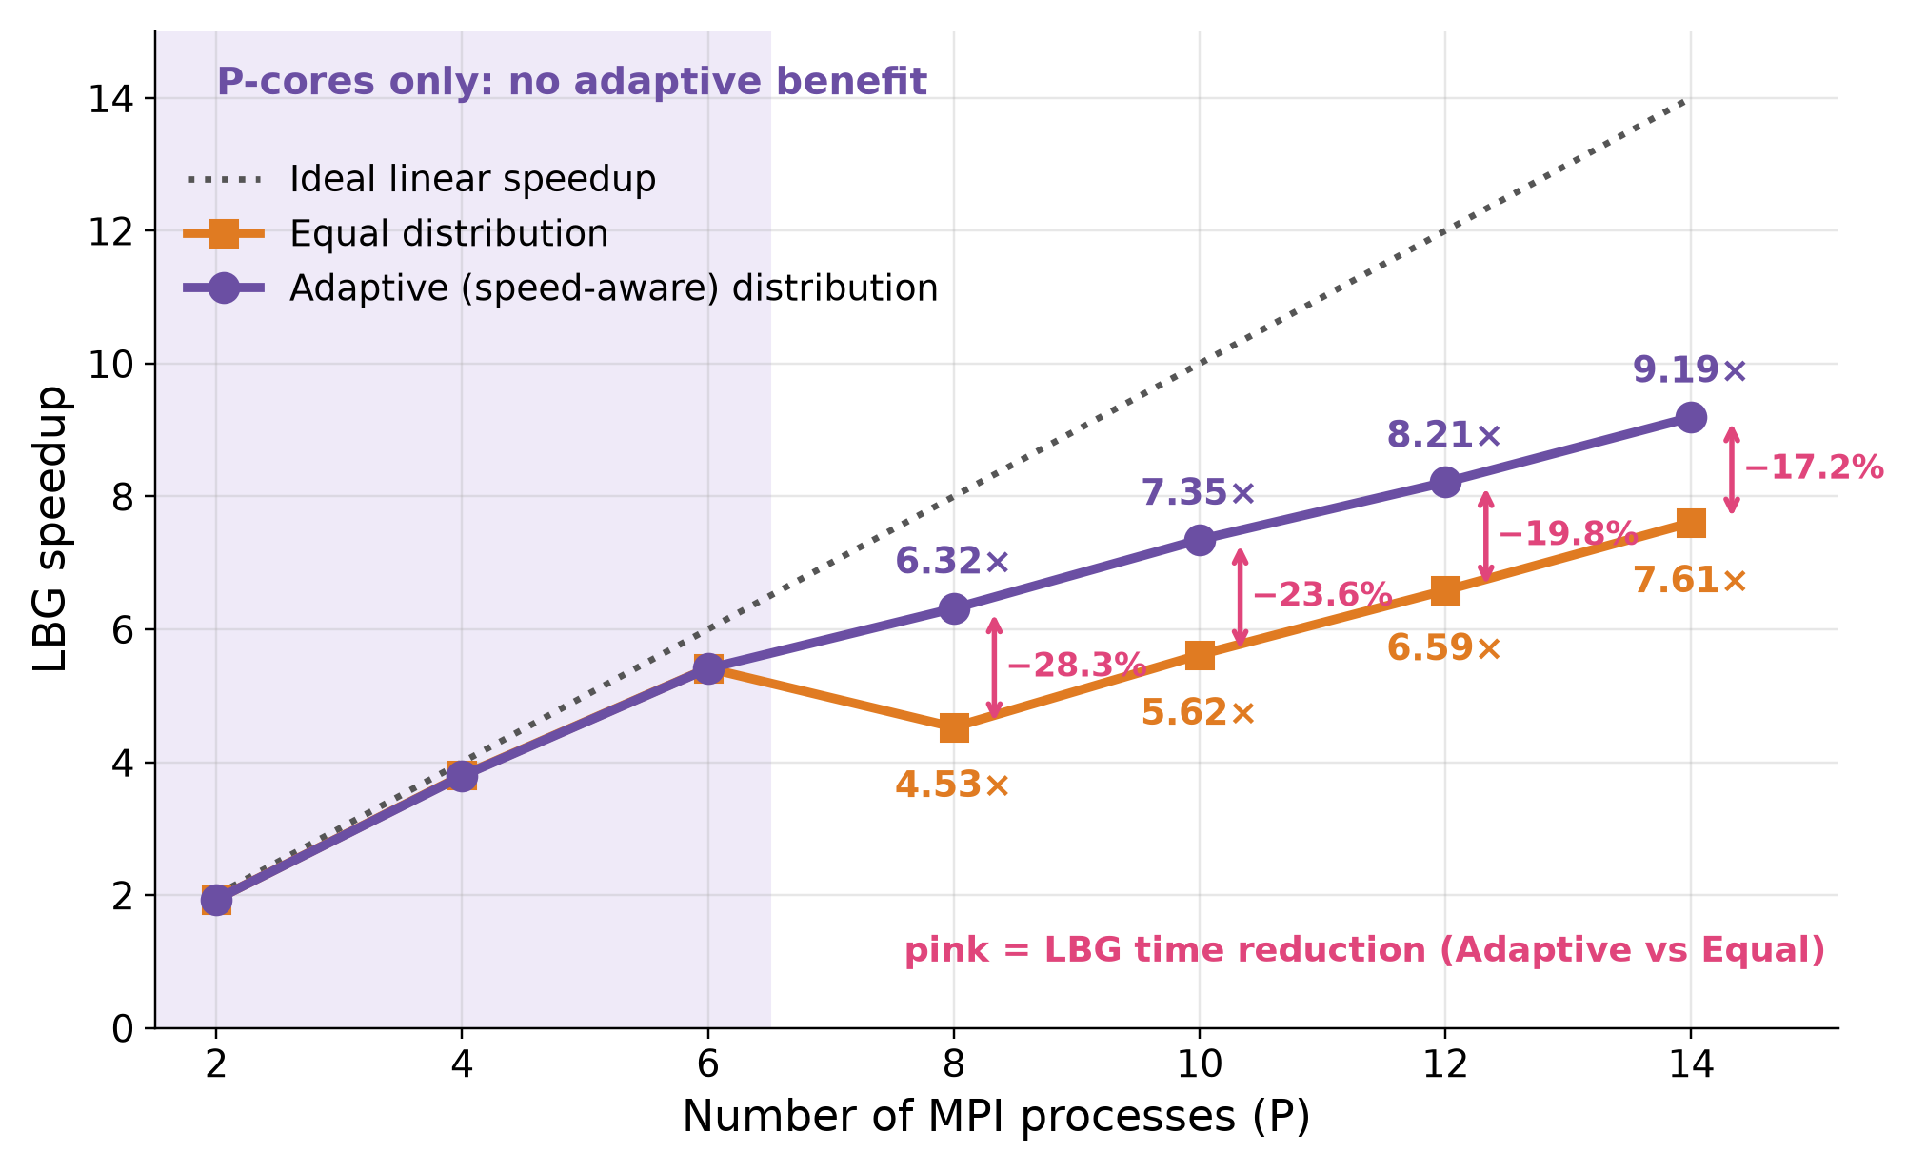
Results
Equal vs Adaptive Workload Distribution
With Equal distribution, the faster P-cores finish early and wait for the E-cores: 7.61× at P = 14.
Adaptive distribution reaches 9.19× at P = 14.
LBG time is reduced by 28.3%, 23.6%, 19.8% and 17.2% at P = 8, 10, 12 and 14.
Total time is reduced by 17.9% to 8.8%.
No adaptive-distribution benefit was observed when only P-cores were used (P ≤ 6).
The reconstructed images are identical in both cases.
Adaptive values here come from the Equal-vs-Adaptive runs, so they can differ by up to 0.02× from the main speedup runs.

Slide 31
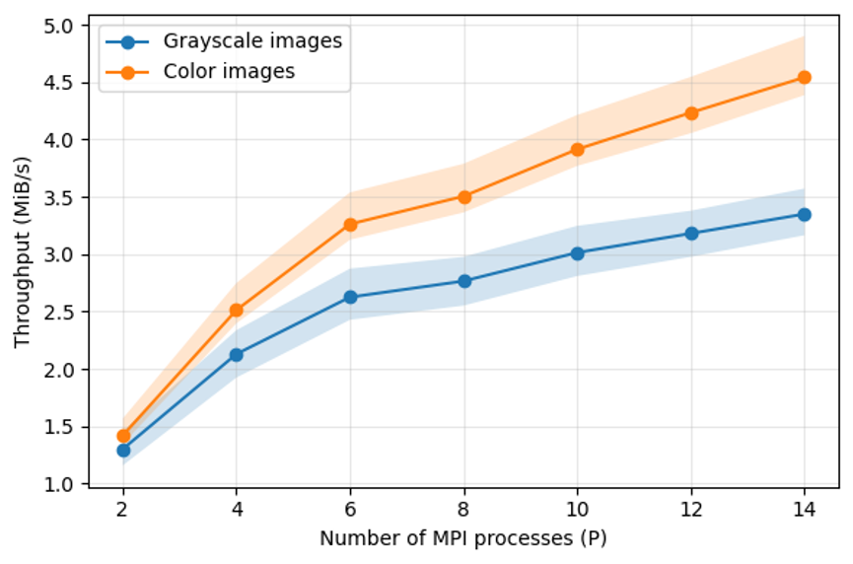
Results
Throughput
Throughput = I_size / T_total (MiB/s)
Throughput = original image size / total execution time (MiB/s).
Grayscale: 1.30 → 3.35 MiB/s from P = 2 to P = 14.
Color: 1.42 → 4.54 MiB/s.
Color images hold three times more data, but their total time grows by only about 2.2× at P = 14, so their throughput is higher.
Shaded bands: minimum to maximum over the images.

Slide 32
Results
Karp–Flatt Metric
e = (1/S − 1/P) / (1 − 1/P)
Karp–Flatt estimates the serial fraction of the program from the measured speedup.
LBG: about 0.04 for P ≥ 8; the serial fraction stays small and does not grow with P.
Total: about 0.14 (gray) and 0.08 (color); the work on Process 0 (mainly image reading and file output) limits the speedup.
Color is lower because LBG is a larger share of its time (81% against 77%).
P | LBG: KF | LBG: Eff. (%) | Total gray: KF | Total gray: Eff. (%) | Total color: KF | Total color: Eff. (%)
2 | 0.033 | 96.8 | 0.132 | 88.4 | 0.072 | 93.3
4 | 0.018 | 94.8 | 0.112 | 74.8 | 0.053 | 86.3
6 | 0.022 | 90.2 | 0.117 | 63.2 | 0.058 | 77.5
8 | 0.038 | 78.8 | 0.143 | 50.1 | 0.084 | 63.0
10 | 0.040 | 73.6 | 0.142 | 43.9 | 0.083 | 57.2
12 | 0.042 | 68.6 | 0.140 | 39.3 | 0.082 | 52.4
14 | 0.040 | 65.7 | 0.138 | 35.7 | 0.080 | 48.9
LBG: mean of the 8 images. Total: mean of the 4 grayscale and of the 4 color images, separately. KF = Karp–Flatt, Eff. = efficiency.

Slide 33
Conclusion
Conclusion
A hybrid image compression framework was implemented: LBG vector quantization, delta coding and Huffman coding.
LBG training was parallelized with MPI: 9.19× speedup on 14 processes (efficiency ≈ 66%); total speedup 5.00× (gray) and 6.84× (color).
The speed-aware (Adaptive) distribution reduced LBG time by 17.2–28.3% compared with Equal distribution (P = 8 to 14).
The parallel results were identical to the sequential ones: same reconstructed images and quality metrics.
Quality: mean PSNR 29.49 dB and SSIM 0.8266 (gray); 28.80 dB and 0.7654 (color), at a compression ratio of ___ (gray) and ___ (color).
The total speedup is limited by the work that runs on Process 0, mainly image reading and file output.

Slide 34
Future Work
Future Work
Improve the rate–distortion performance: color transform (YCbCr instead of RGB), prediction or context modeling of the VQ indices, and variable block sizes.
Accelerate the LBG assignment step, which dominates the run time, with GPUs (CUDA or OpenCL) combined with MPI.
Scale to multi-node clusters, larger images and image sequences that share one codebook.
Rebalance the workload during the run, using the measured compute time of each process and a load-imbalance measure.

Slide 35
References
References
[6] Thomas, S., Krishna, A., Govind, S., Sahu, A.K. (2025). A novel image compression method using wavelet coefficients and Huffman coding. J. Eng. Res., 13(1): 361-370.
[16] Ranjan, R., Kumar, P. (2023). An improved image compression algorithm using 2D DWT and PCA with canonical Huffman encoding. Entropy, 25(10): 1382.
[17] Bilal, M., Ullah, Z., Mujahid, O., Fouzder, T. (2024). Fast Linde–Buzo–Gray (FLBG) algorithm for image compression through rescaling using bilinear interpolation. J. Imaging, 10(5): 124.
Linde, Y., Buzo, A., Gray, R.M. (1980). An algorithm for vector quantizer design. IEEE Trans. Commun., 28(1): 84-95.
Zangana, H.M. (2025). Design and implementation of a novel parallel algorithm for efficient image compression in high-performance computing. EAI Endorsed Trans. AI Robot., 4. doi:10.4108/airo.7832
Bystrov, O., Pacevič, R., Kačeniauskas, A. (2023). Hybrid parallelization of discrete element software for heterogeneous resources. Proc. 7th Int. Conf. on Parallel, Distributed, GPU and Cloud Computing for Engineering, Civil-Comp Press, Paper 4.1. doi:10.4203/ccc.4.4.1
Papakyriakou, D., Barbounakis, I.S. (2025). Parallel k-means benchmarking on a CPU-bound Beowulf cluster of Raspberry Pi nodes: an MPI-based scaling analysis with CPU-centric performance evaluation. Int. J. Comput. Appl., 187(32).
Paul, R.K., Jena, S., Chandran, S., Bandyopadhyay, A., Swain, S. (2024). Image compression scheme based on optimized K-means clustering and higher-level decomposed DWT. Procedia Comput. Sci., 235: 642-655.

Slide 36
Thank You!
for your attention
Any questions?
Ibtihal Hussien
University of Babylon

