Slide 1
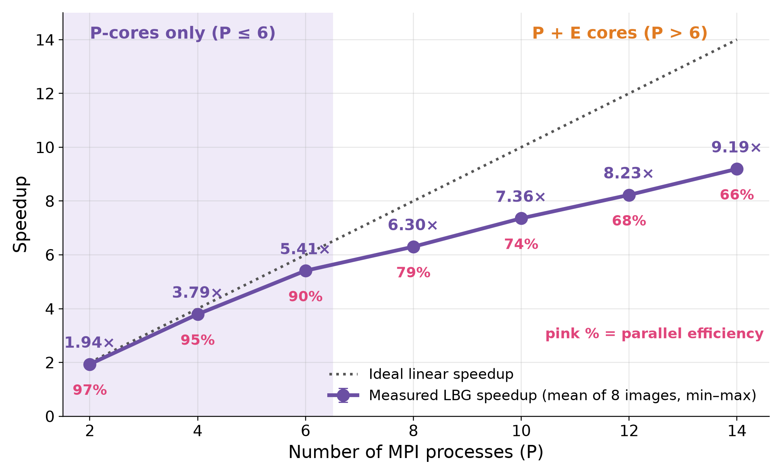
Results
Speedup and Efficiency of LBG Training
LBG speedup reaches 9.19× on 14 processes (efficiency ≈ 66%).
Near-linear for P ≤ 6, where only P-cores are used.
The slope drops once the slower E-cores join.
Karp–Flatt ≈ 0.04 for P ≥ 8: the serial fraction of LBG stays small.
Total time: 5.00× (gray) and 6.84× (color), because coding and reconstruction remain sequential.

