Slide 1
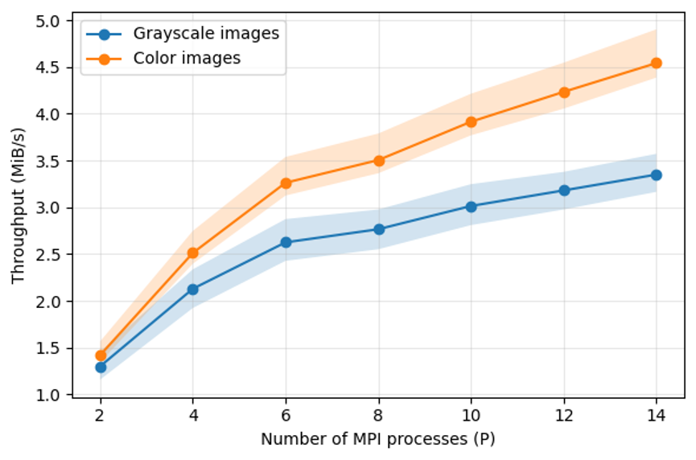
Results
Throughput
Throughput = original image size / total execution time (MiB/s).
Grayscale: 1.30 → 3.35 MiB/s from P = 2 to P = 14.
Color: 1.42 → 4.54 MiB/s.
Color images hold three times more data, but their total time grows by only about 2.2× at P = 14, so their throughput is higher.
Shaded bands: minimum to maximum over the images.

Slide 2
Results
Karp–Flatt Metric
P | LBG: Karp–Flatt | LBG: efficiency (%) | Total: Karp–Flatt | Total: efficiency (%)
2 | 0.033 | 96.8 | 0.101 | 90.8
4 | 0.018 | 94.8 | 0.081 | 80.5
6 | 0.022 | 90.2 | 0.084 | 70.4
8 | 0.038 | 78.8 | 0.110 | 56.5
10 | 0.040 | 73.6 | 0.109 | 50.6
12 | 0.042 | 68.6 | 0.107 | 45.9
14 | 0.040 | 65.7 | 0.105 | 42.3
Karp–Flatt estimates the serial fraction of the program from the measured speedup.
LBG: about 0.04 for P ≥ 8; the serial fraction stays small and does not grow with P.
Total: about 0.105 (gray ≈ 0.14, color ≈ 0.08); the sequential coding and reconstruction stages dominate.
This explains why the total speedup (5.00× gray, 6.84× color) is lower than the LBG speedup (9.19×).
Mean of all 8 images.

