Slide 1
Stage 1
Block
Formation
1. Input image
512×512,
gray / color
2. 4×4 blocks
non-overlapping
3. Training vectors
16-D,
N = 16,384
16,384 training vectors (16-D)
Stage 2
Parallel LBG
Training (MPI)
1. Distribute
MPI_Scatterv:
Equal / Adaptive
2. Assign
nearest codeword
on each rank
3. Combine
Allreduce: sums,
counts, distortion
4. Refine and split
per level,
until K = 64
codebook C + index array L (gathered on Rank 0)
Stage 3
Lossless Index
Coding (Rank 0)
1. Delta coding
differences of
VQ indices
2. Huffman coding
variable-length
codes
3. Compressed data
codebook + Huffman
table + coded indices
compressed data: codebook + Huffman table + coded indices
Stage 4
Decoding and
Evaluation
1. Huffman decoding
Rank 0
2. Inverse delta
recover
VQ indices
3. Reconstruction
codebook
lookup
4. Metrics
CR, BPP, MSE,
PSNR; parallel SSIM
Parallel: LBG training and SSIM | Rank 0: index coding, decoding, reconstruction, and remaining metrics

Slide 2
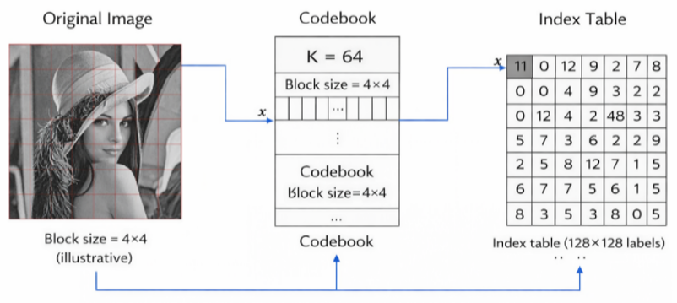
Stage 1
Block Formation
The image is divided into non-overlapping 4 × 4 blocks.
Each block becomes a 16-dimensional vector.
A 512 × 512 image gives N = 16,384 training vectors.
Color images: the R, G and B channels are processed independently.
Block-based vector quantization (illustrative)

Slide 3
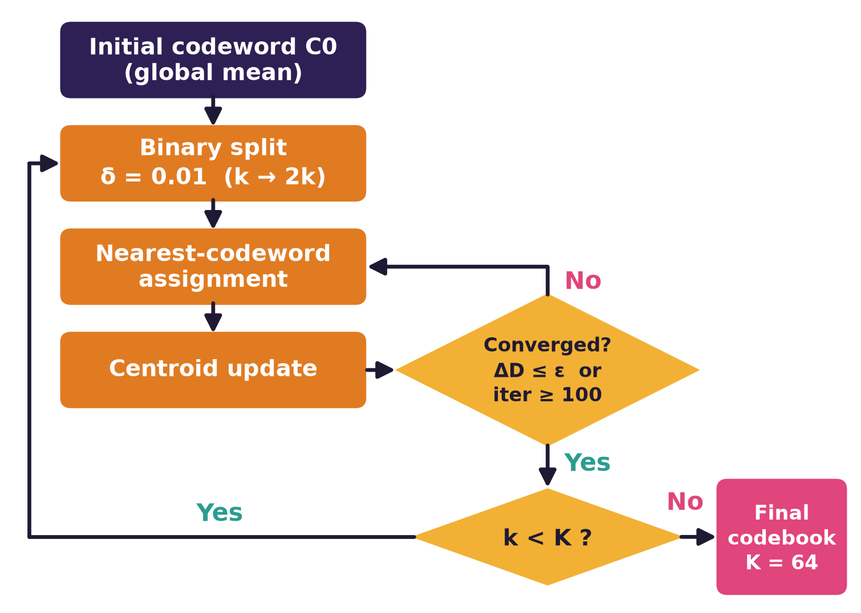
Stage 2
LBG Codebook Training
Start from the global mean as the first codeword.
Binary splitting (δ = 0.01) doubles the codebook size.
Lloyd refinement: assign each vector to its nearest codeword, then update the centroids.
Stop at ΔD ≤ ε or 100 iterations; repeat until K = 64.

Slide 4
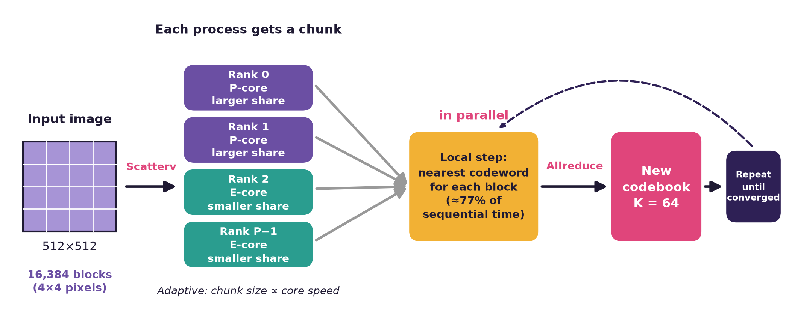
Stage 2
Parallel LBG Training (MPI)
SPMD: every rank runs the same program on its own chunk of vectors.
Nearest-codeword assignment is local: about 77% of the sequential time (gray).
Allreduce combines sums, counts and distortion; every rank updates the same codebook.
Gatherv collects the final indices on Rank 0.

Slide 5
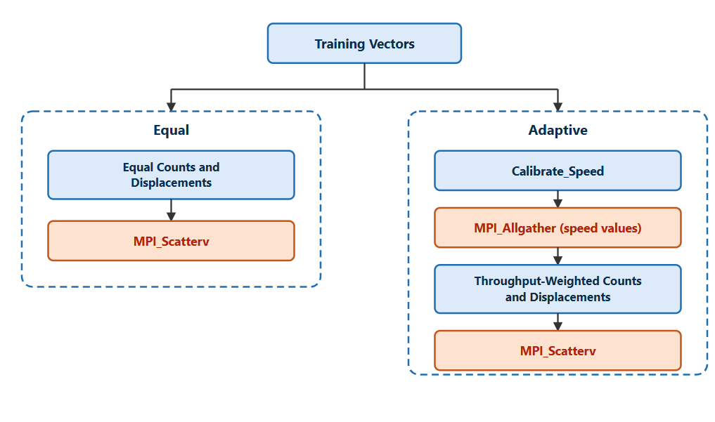
Stage 2
Equal and Adaptive Workload Distribution
Equal (default, P ≤ 4): each rank gets N/P vectors (rounded down or up).
Adaptive (P > 4): speed measured by calibration (3 trials, the first is a warm-up).
q_r = N · s_r / Σ s_j: faster cores receive more vectors.
Adaptive reduces LBG time by 17–28% compared with Equal (P = 8 to 14).

Slide 6
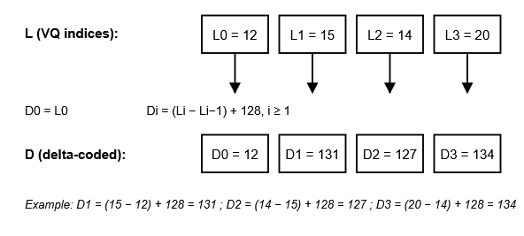
Stage 3
Delta Coding
Stores the difference between successive VQ indices (offset 128).
Neighbouring blocks are correlated, so the differences cluster around the offset.
Example (Lena): entropy falls from 5.39 to 4.67 bits per symbol.

Slide 7
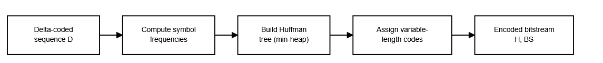
Stage 3
Huffman Coding
Frequent symbols receive shorter codewords, rare symbols longer ones (lossless).
Output: Huffman table (header) and the encoded bitstream.
Compressed size = codebook (K × 16 bytes) + Huffman table + Huffman-coded data.
The table is accounted as 5 bytes per used symbol (1 byte symbol + 4 bytes frequency) plus 10 bytes of fixed metadata.

Slide 8


Stage 4
Decoding and Evaluation
Huffman decoding
Inverse delta
Codebook lookup
Reconstructed image
Decoding and reconstruction run on Rank 0.
Quality: MSE, PSNR and SSIM (SSIM is computed in parallel); size: CR and BPP.
Parallel performance: time, speedup, efficiency, throughput, Karp–Flatt.
Verification: the reconstructed image (MD5) and the metrics are identical for the sequential run, P = 4, and P = 14 (Adaptive and Equal).
Original
Reconstructed
Cameraman: PSNR 29.75 dB, SSIM 0.8855

