Slide 1
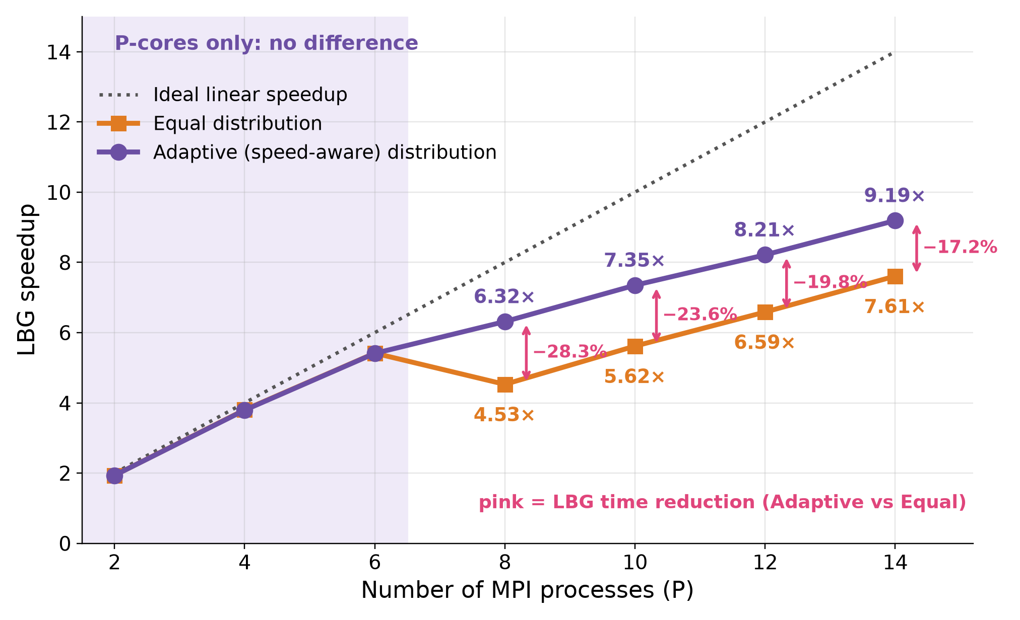
Results
Equal vs Adaptive Workload Distribution
With Equal distribution, the faster P-cores finish early and wait for the E-cores: 7.61× at P = 14.
Adaptive distribution reaches 9.19× at P = 14.
LBG time is reduced by 28.3%, 23.6%, 19.8% and 17.2% at P = 8, 10, 12 and 14.
Total time is reduced by 17.9% to 8.8%.
For P ≤ 6 (P-cores only) the two strategies are equivalent.
The reconstructed images are identical in both cases.

