Slide 1


Slide 2
Iris Flower Classification
Classification with KNN, K-Means, and Naive Bayes
Submitted by: Muhammad Ibtisam Ahmad
Submitted to: Hafiz Usama Ishtiaq

Slide 3
Introduction
The central focus of this machine learning project is the classification of iris flowers based on their distinct characteristics.
We employed three distinct algorithms - K-Nearest Neighbors (KNN), K-Means, and Naive Bayes - to address the classification task.
The core task involved predicting the species of iris flowers using key features like sepal length, sepal width, petal length, and petal width.
The dataset was sourced from Kaggle, known as the Iris Flower Dataset, renowned for its simplicity and effectiveness in introducing classification concepts.
Models were rigorously evaluated to ensure robust performance using metrics such as accuracy, precision, recall, and F1 score.
The project features impactful visualizations, including pairplots for KNN, scatter plots for K-Means clustering, and a confusion matrix for Naive Bayes, enhancing our understanding of model performance.

Slide 4
Libraries
Libraries for Data Handling and Analysis
import numpy as np
import pandas as pd
Libraries for Machine Learning Models
from sklearn.model_selection import train_test_split
from sklearn.neighbors import KNeighborsClassifier
from sklearn.cluster import KMeans
from sklearn.naive_bayes import GaussianNB
from sklearn import metrics
from sklearn.metrics import silhouette_score, davies_bouldin_score
Library for Visualization
import matplotlib.pyplot as plt
import seaborn as sns
from sklearn.metrics import confusion_matrix

Slide 5
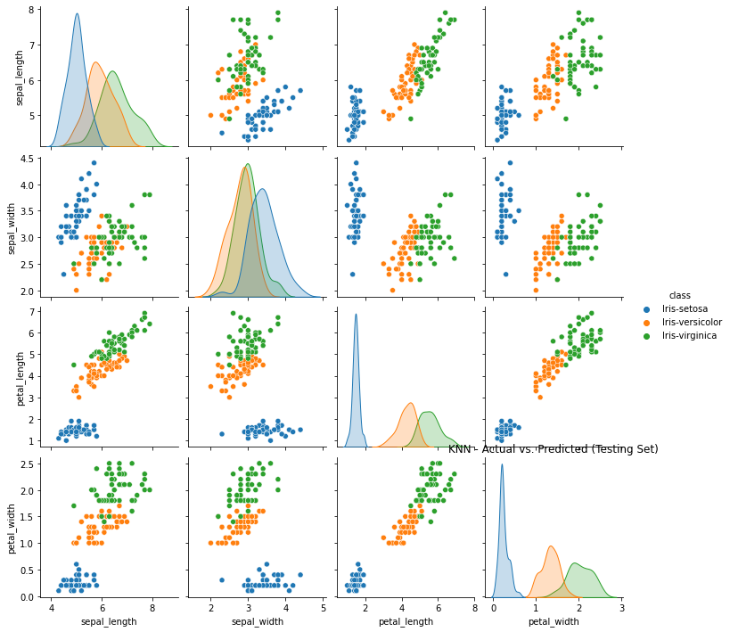
KNN Model
Accuracy: 1.0000
Precision: 1.0000
Recall: 1.0000
F1 Score: 1.0000
Implemented pairplots to visualize the actual vs. predicted values in the testing set.
Pairplots offer a comprehensive view of the relationship between different features and how well the model captures the underlying patterns.

Slide 6
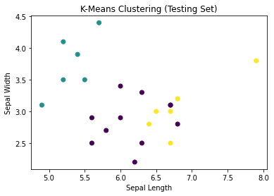
K-Means
Featured scatter plots to visualize the clustering results in the testing set.
Scatter plots depict how K-Means assigns data points to clusters, aiding in the interpretation of the dataset's natural groupings
K-Means Clustering Quality Metrics: Silhouette Score (Testing): 0.5318
Davies-Bouldin Index (Testing): 0.6372

Slide 7
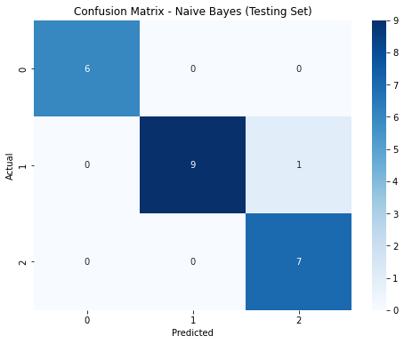
Naive Bayes Model
Accuracy: 0.9565
Precision: 0.9620
Recall: 0.9565
F1 Score: 0.9568
Visualized model performance through a confusion matrix, offering insights into the distribution of true positive, true negative, false positive, and false negative predictions.

Slide 8
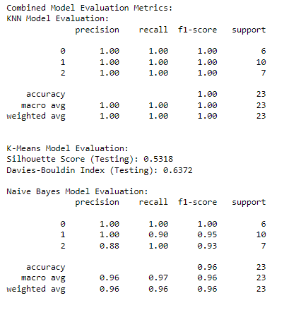
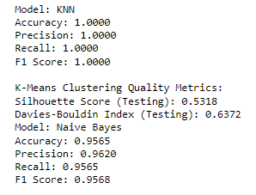
Combined Model Evaluation
Best Model (based on Accuracy): KNN

Slide 9
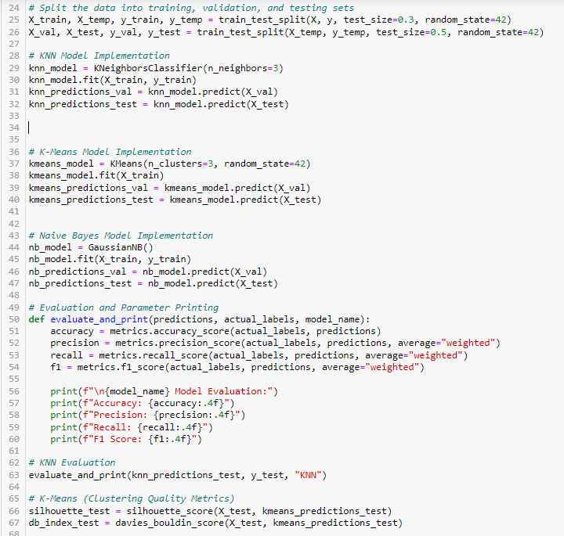
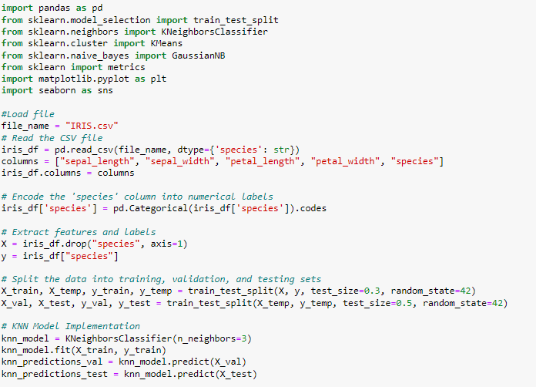
Code Snippets

Slide 10


