Slide 1
THESIS PROGRESS PRESENTATION
Perception of Glyphs
When do glyph sets stop being discernible as size is reduced?
Name · Programme · Bauhaus-Universität Weimar · Supervisor · August 2026
Notes:
Replace only the name, programme, and supervisor fields.
[Sources]
- Supervisor-provided thesis title and project description supplied by the user.

Slide 2
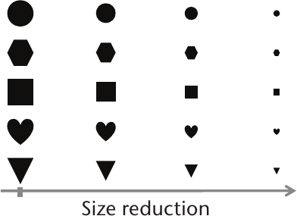
01 · THE PROBLEM
When do reduced glyphs stop being discernible?
As size decreases:
Fine detail disappears
Internal gaps close
Thin strokes weaken
Shape differences collapse
GLYPH SET · DECREASING DISPLAY SIZE
Target outcome
Smallest discernible size
+
Visual predictors of confusion
Legg et al., 2017 · Figure 1
At what point do set members become confused?
02
Notes:
[Sources]
- Supervisor-provided thesis title and project description supplied by the user.
- papers/Glyph_Visualization_A_Fail-Safe_Design_Scheme_Based_on_Quasi-Hamming_Distances.pdf, Figure 1, p. 32.

Slide 3
02–03 · AIM AND RESEARCH DIRECTION
The research goal is explicitly size-dependent
Primary aim · Size-dependent discernibility
Current focus · Computational basis for glyph selection
GOAL
Discernibility thresholds across display sizes
NOW
Seven feature families · clustering · candidate selection
LATER
Research questions · protocol · measures
03
Notes:
[Sources]
- wiki/thesis-overview.md
- wiki/evaluation-and-human-study.md

Slide 4
04 · LITERATURE REVIEW
Literature shaped the system and guides the next phase
Five implementation influences · one human-evaluation review
MEASURABLE STRUCTURE
Forsythe et al. (2003) · Garcia et al. (1994) · Borgo et al. (2013)
Evidence for measurable visual concepts
SET-RELATIVE SEPARATION
Legg et al. (2017) · Fuchs et al. (2014)
Pairwise distance · contour-aware contrasts
HUMAN EVALUATION
Fuchs et al. (2017)
Task- and condition-dependent performance
Reviewed gap · No validated size thresholds found for heterogeneous icon sets
04
Notes:
Five papers shaped the current measurements and glyph-selection workflow. The 2017 systematic review informs the later study-design phase.
Legg et al. support pairwise and set-relative perceptual distance; clustering is a project step applied afterward, not a method validated by that paper.
The stated research gap is limited to the reviewed local literature: this corpus does not establish validated size-dependent thresholds for heterogeneous icon sets.
Maguire et al. (2012) was reviewed as design context but is omitted from the main narrative because it did not materially determine the current image-feature implementation.
[Sources]
- papers/Forsythe-Measuring_cion_complexity_automated.pdf, pp. 4–7
- papers/Garcia-Development_validation_icons_abstractness.pdf, pp. 3–4, 11, 20
- papers/Glyph-based_Visualization_Foundations_Design_Guidelines_Techniques_Applications.pdf, pp. 7–10, 12, 16
- papers/Glyph_Visualization_A_Fail-Safe_Design_Scheme_Based_on_Quasi-Hamming_Distances.pdf, pp. 4–6
- papers/The_Influence_of_Contour_on_Similarity_Perception_of_Star_Glyphs.pdf, pp. 2–3, 6–8
- papers/A_Systematic_Review_of_Experimental_Studies_on_Data_Glyphs.pdf, pp. 1–17

Slide 5
04 · LITERATURE REVIEW
Visual concepts became measurable features
One close measure-level match · six project-defined proxies
FAMILY
LITERATURE BASIS
IMPLEMENTED REPRESENTATIVE
RELATION TO LITERATURE
Complexity
Forsythe et al. (2003)
Canny edge density
Closest measure-level evidence
Shape · Density
Garcia et al. (1994) · Fuchs et al. (2014)
Enclosure · Solid fill
Project-defined proxies
Stroke · Texture
Legg et al. (2017)
Orientation · Local texture
Project-defined proxies
Balance · Colour
Borgo et al. (2013)
Symmetry · Saturation
Project-defined proxies
Forsythe sample · 68 random icons from 239 McDougall symbols
Thesis contribution · Seven reproducible measurements across 28,749 icons
05
Notes:
The literature supports the visual constructs. Canny edge density has the closest measure-level evidence, but the repository extraction is still project-specific. The other six exact formulas are project-defined proxies and still require human validation.
The 239-icon source-set count is verified from the local McDougall corpus manifest and dataset provenance.
[Sources]
- papers/Forsythe-Measuring_cion_complexity_automated.pdf, pp. 4–7
- papers/Garcia-Development_validation_icons_abstractness.pdf, pp. 3–4, 11, 20
- papers/The_Influence_of_Contour_on_Similarity_Perception_of_Star_Glyphs.pdf, pp. 2–3, 6–8
- papers/Glyph_Visualization_A_Fail-Safe_Design_Scheme_Based_on_Quasi-Hamming_Distances.pdf, pp. 4–6
- papers/Glyph-based_Visualization_Foundations_Design_Guidelines_Techniques_Applications.pdf, pp. 7–10, 12, 16
- wiki/literature-and-evidence.md
- wiki/feature-system.md

Slide 6
04 · LITERATURE REVIEW
Literature guides glyph selection
Literature → candidate selection Participants → perceptual evidence
LEGG ET AL. · 2017
FUCHS ET AL. · 2014
FUCHS ET AL. · 2017
Multiple visual channels
Contour and fill effects
Task-dependent performance
EFFECT ON THIS WORK
EFFECT ON THIS WORK
EFFECT ON THIS WORK
Pairwise distance → project grouping
Close vs. distant candidates
Enclosure · solid fill
Controlled contrasts
Dashboard-selected stimuli
Participant validation
Thesis contribution · Confusion thresholds as display size decreases
06
Notes:
Legg et al. support pairwise and set-relative perceptual distance. The thesis applies project-defined clustering afterward to organize candidate glyphs; it is not a replication or validation of quasi-Hamming clustering.
Fuchs et al. (2014) reports task-specific contour and fill effects, not a universal accuracy benefit.
The 2017 review informs study-design options but does not define a finalized protocol for this thesis.
[Sources]
- papers/Glyph_Visualization_A_Fail-Safe_Design_Scheme_Based_on_Quasi-Hamming_Distances.pdf, pp. 4–6
- papers/The_Influence_of_Contour_on_Similarity_Perception_of_Star_Glyphs.pdf, pp. 2–3, 6–8
- papers/A_Systematic_Review_of_Experimental_Studies_on_Data_Glyphs.pdf, pp. 1–17
- wiki/evaluation-and-human-study.md

Slide 7
05 · RESEARCH JOURNEY
Analysis prepared glyph selection
Corpus → reliable features → comparable exploration → interpretable clusters
JUNE
JULY
EARLY AUG
10 AUG
Corpus + first pipeline
Feature repair
Comparable exploration
Interpretability
13 icon sets
Normalized images
First extraction + dashboard
Corrected semantics
Schema v2
Shared feature registry
Balanced sampling
Saved AI runs
Side-by-side comparison
Lasso selection
Cluster summaries
Post-hoc feature profiles
Result · Controlled glyph selection basis—not a discernibility threshold
07
Notes:
[Sources]
- Git history: 4e5d7d64a (2026-06-01), c9616aed2 (2026-07-21), 31e075b7b (2026-07-28), fce7512f1 (2026-08-10)
- wiki/README.md
- wiki/dashboard-implementation.md

Slide 8
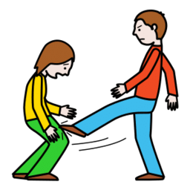

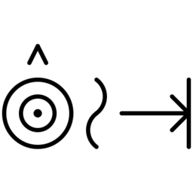
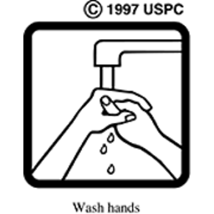





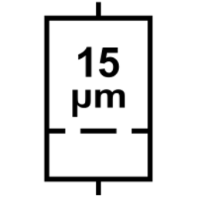



06 · IMPLEMENTATION
Thirteen source sets provide 28,749 study candidates
Canonical records · stable IDs · duplicates and alternate exports excluded
SOURCE SET + EXAMPLE
ICONS
SOURCE SET + EXAMPLE
ICONS
ARASAAC pictograms
13,798
Healthcare webfont
144
Blissymbolics
5,825
USP medication pictograms
83
OpenMoji
4,495
AIGA / DOT signs
80
Mulberry symbols
3,436
ISO 7010 safety signs
37
OCHA humanitarian icons
359
ISO 15223 medical devices
29
McDougall symbols
239
GHS hazard pictograms
9
Mapbox Maki
215
Stable ID → 256 × 256 normalized image → seven feature measurements → interactive review
08
Notes:
A usable icon record is the pipeline's canonical row: one selected source icon after dataset-specific duplicate and alternate-export rules are applied.
The displayed examples are representative normalized icons; they do not imply that every set uses the same visual style.
[Sources]
- icon_data/analysis/dataset.csv (28,749 rows; counts verified 2026-08-16)
- wiki/datasets-and-provenance.md
- wiki/pipeline.md

Slide 9
06 · IMPLEMENTATION
Seven families describe what may survive at small sizes
Candidate predictors of persistence—or confusion—at reduced sizes
COMPLEXITY
Canny edge density
BALANCE
Horizontal symmetry v2
SHAPE
Enclosure score v2
COLOR
Mean saturation v2
STROKE
Principal-axis orientation v2
TEXTURE
Local texture variation v2
DENSITY / FILL
Solid fill ratio v2
Important boundary
Candidate predictors only
Discernibility requires participant evidence
09
Notes:
[Sources]
- code/thesis_pipeline/features/registry.py
- wiki/feature-system.md
- wiki/literature-and-evidence.md

Slide 10
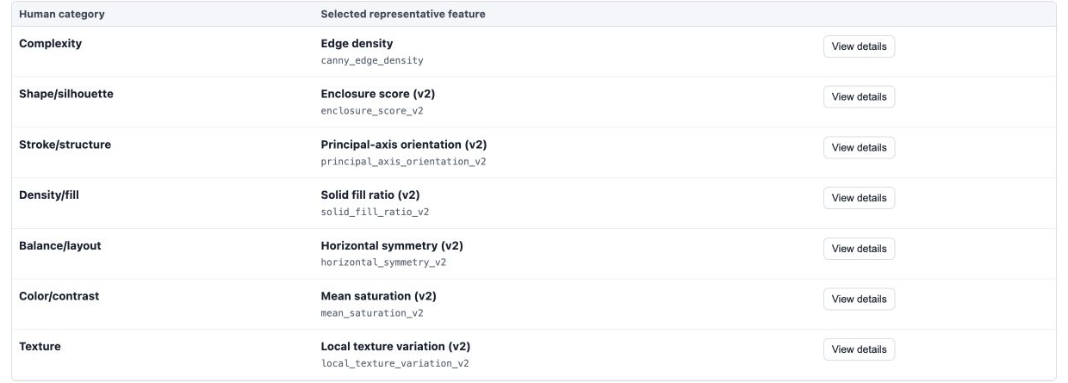
07 · CURRENT SYSTEM
Demo 1: inspect the seven feature families
Seven measurements · value-stratified examples
10
Notes:
Open one family detail during the live demo to show value-stratified examples and the selected representative.
[Sources]
- icon_data/analysis/analysis_dashboard/index.html (served and browser-verified 2026-08-13)
- code/build_analysis_dashboard.py
- wiki/dashboard-ui.md

Slide 11
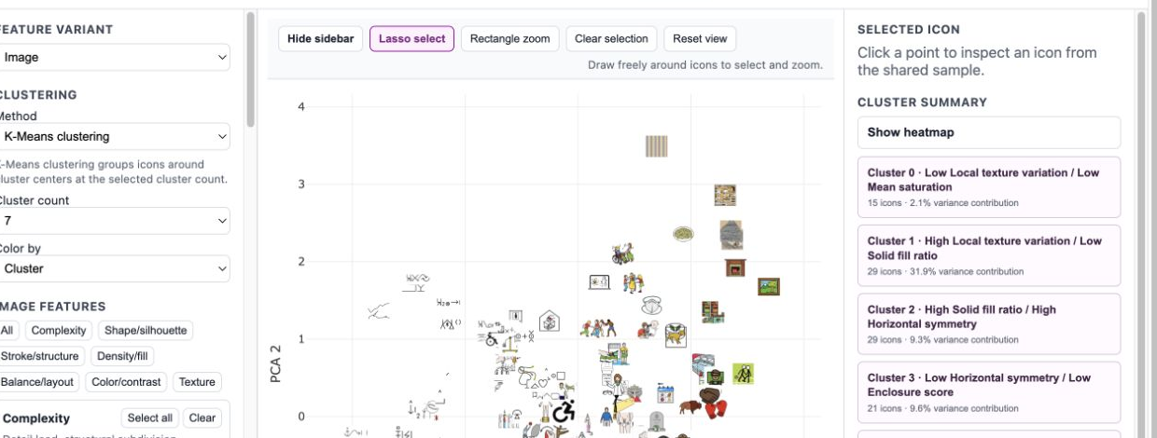
07 · CURRENT SYSTEM
Demo 2: inspect clustering
Lasso selection · cluster summaries · candidate contrasts
11
Notes:
During the live demo, use lasso selection, inspect one icon, and open one cluster summary.
The dashboard supports candidate selection; it does not measure discernibility.
[Sources]
- icon_data/analysis/analysis_dashboard/index.html (served and browser-verified 2026-08-13)
- code/build_analysis_dashboard.py
- wiki/dashboard-ui.md

Slide 12
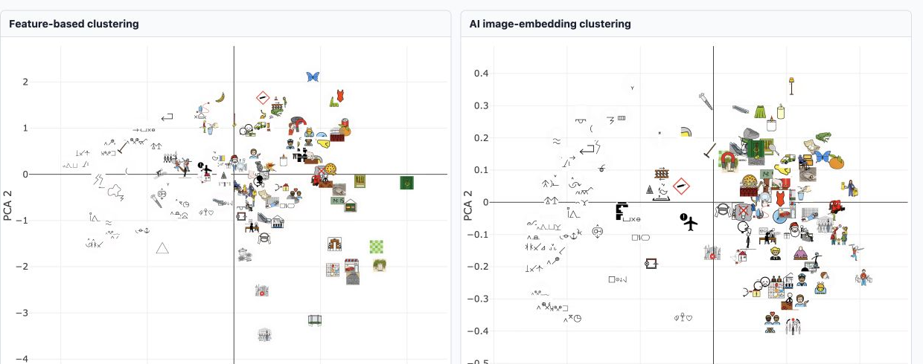
07 · CURRENT SYSTEM
Demo 3: compare feature and AI groupings
Pairwise agreement · 0.783 Partition similarity—not accuracy
12
Notes:
Pairwise agreement compares every icon pair: whether both clusterings put the pair together or both put it apart.
The AI image-embedding model receives normalized image pixels, not the seven thesis feature values.
[Sources]
- icon_data/analysis/analysis_dashboard/index.html (served and browser-verified 2026-08-13)
- code/thesis_pipeline/ai_clustering/metrics.py
- wiki/dashboard-ui.md
- wiki/similarity-and-clustering.md

Slide 13
08 · CURRENT PROGRESS
The current system is ready for glyph selection
BUILT AND WORKING
NEXT WORK
✓
Icon corpus and normalization
01
Select glyphs
Feature values · clusters · summaries
✓
Seven feature families
✓
Interactive UI and lasso inspection
02
Design the study
Only after glyph selection
✓
Clustering and cluster summaries
Not yet defined · participant protocol · task · measurements
13
Notes:
[Sources]
- wiki/README.md
- wiki/evaluation-and-human-study.md
- wiki/limitations-and-backlog.md

Slide 14
09 · NEXT PHASE
Next: select glyphs, then design the study
Immediate milestone · reviewed, defensible glyph selection
01
02
Select candidate glyphs
Design the user study
→
Dashboard review
Seven feature values
Clustering + lasso
Cluster summaries
Research questions
Task + conditions
Participant plan
Measurements
Current boundary · user-study design remains open
14
Notes:
The study-design details are intentionally left open at this stage.
[Sources]
- wiki/dashboard-ui.md
- wiki/dashboard-implementation.md
- wiki/evaluation-and-human-study.md

Slide 15
09 · NEXT PHASE
Existing user studies measure different outcomes
Similarity choice, pairwise differentiation, and task performance answer different questions
FUCHS ET AL. · 2014
LEGG ET AL. · 2017
FUCHS ET AL. · 2017
SIMILARITY CHOICE
PAIRWISE DIFFERENTIATION
SYSTEMATIC REVIEW
SAMPLE & TRIALS
SAMPLE & PROCEDURE
REVIEW SCOPE
62 accepted · 36 retained
48 trials per participant
Target + eight alternatives
20 recruited · 19 analysed
104 ratings · 96 randomized
64 controlled-study papers
Accuracy in 63 · time in 42
Task · choose the most similar
Outcome · one categorical choice
Task · rate differentiation, 0–10
Outcome · perceived distance
Output · tasks, measures, results
Finding · preference sometimes differed
15
Notes:
This slide separates three outcomes that should not be collapsed into one measure.
Fuchs et al. (2014), Experiment 2: 62 Amazon Mechanical Turk workers were accepted; 36 were retained after three control questions. Each participant completed 48 trials. A highlighted target appeared with eight alternatives in a 3×3 arrangement, and the participant selected the most similar glyph without training or an explanation of the encoded data.
Legg et al. (2017 issue; copyright 2016): 20 University of Oxford students or employees were recruited and one outlier was excluded. Participants rated 104 glyph pairs on an integer 0–10 scale according to how well they could differentiate them; the 96 non-reference pairs were randomized.
Fuchs et al. (2017): the systematic review synthesized 64 quantitative controlled data-glyph user-study papers. Accuracy was recorded in 63 of 64, completion time in 42, and qualitative feedback in 19. The authors also warn that participant preference did not always match measured performance.
Boundary for this thesis: these sources support similarity choice, pairwise differentiation, and task-performance measures. They do not directly establish semantic identification thresholds for heterogeneous icons at reduced sizes.
[Sources]
- papers/The_Influence_of_Contour_on_Similarity_Perception_of_Star_Glyphs.pdf, p. 6
- papers/Glyph_Visualization_A_Fail-Safe_Design_Scheme_Based_on_Quasi-Hamming_Distances.pdf, p. 4
- papers/A_Systematic_Review_of_Experimental_Studies_on_Data_Glyphs.pdf, pp. 1, 4
- wiki/literature-and-evidence.md
- wiki/evaluation-and-human-study.md

Slide 16
09 · NEXT PHASE
Possible direction for the thesis study
01
Control display size
02
Record accuracy and confusion
03
Ask which visual cues participants used
Finalize after glyph selection + supervisor discussion
16
Notes:
This is a discussion proposal only. The protocol, participant plan, sizes, stimuli, and measures are not finalized.
[Sources]
- wiki/evaluation-and-human-study.md

Slide 17
10 · CONCLUSION
A clear basis for the next research phase
01
Icon corpus + seven feature families implemented
02
UI + clustering + summaries ready for glyph review
03
Next: glyph selection → user-study design
Next milestone · a reviewed selection of candidate glyphs
17
Notes:
[Sources]
- wiki/thesis-overview.md
- wiki/evaluation-and-human-study.md
- wiki/limitations-and-backlog.md

