Slide 1
THESIS PROGRESS PRESENTATION
Perception of Glyphs
When do glyph sets stop being discernible as size is reduced?
Name · Programme · Bauhaus-Universität Weimar · Supervisor · August 2026
Notes:
Replace only the name, programme, and supervisor fields.
[Sources]
- Supervisor-provided thesis title and project description supplied by the user.

Slide 2
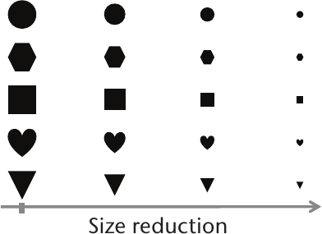
01 · THE PROBLEM
When do reduced glyphs stop being discernible?
As size decreases:
Fine detail disappears
Internal gaps close
Thin strokes weaken
Shape differences collapse
GLYPH SET · DECREASING DISPLAY SIZE
Target outcome
Smallest discernible size
+
Visual predictors of confusion
Legg et al., 2017 · Figure 1
At what point do set members become confused?
02
Notes:
[Sources]
- Supervisor-provided thesis title and project description supplied by the user.
- papers/Glyph_Visualization_A_Fail-Safe_Design_Scheme_Based_on_Quasi-Hamming_Distances.pdf, Figure 1, p. 32.

Slide 3
02–03 · AIM AND RESEARCH DIRECTION
The research goal is explicitly size-dependent
Primary aim · Size-dependent discernibility
Current focus · Computational basis for glyph selection
GOAL
Discernibility thresholds across display sizes
NOW
Seven feature families · clustering · candidate selection
LATER
Research questions · protocol · measures
03
Notes:
[Sources]
- wiki/thesis-overview.md
- wiki/evaluation-and-human-study.md

Slide 4
04 · LITERATURE REVIEW
Literature shaped the system and guides the next phase
Five implementation influences · one human-evaluation review
MEASURABLE STRUCTURE
Forsythe et al. (2003) · Garcia et al. (1994) · Borgo et al. (2013)
Evidence for measurable visual concepts
SET-RELATIVE SEPARATION
Legg et al. (2016) · Fuchs et al. (2014)
Distance · clustering · contour-aware selection
HUMAN EVALUATION
Fuchs et al. (2017)
Task- and condition-dependent performance
Research gap · No size-dependent thresholds for heterogeneous icon sets
04
Notes:
Five papers directly shaped the current measurements and glyph-selection workflow. The 2017 systematic review informs the later study-design phase.
Maguire et al. (2012) was reviewed as design context but is omitted from the main narrative because it did not materially determine the current image-feature implementation.
[Sources]
- papers/Forsythe-Measuring_cion_complexity_automated.pdf, pp. 4–7
- papers/Garcia-Development_validation_icons_abstractness.pdf, pp. 3–4, 11, 20
- papers/Glyph-based_Visualization_Foundations_Design_Guidelines_Techniques_Applications.pdf, pp. 7–10, 12, 16
- papers/Glyph_Visualization_A_Fail-Safe_Design_Scheme_Based_on_Quasi-Hamming_Distances.pdf, pp. 4–6
- papers/The_Influence_of_Contour_on_Similarity_Perception_of_Star_Glyphs.pdf, pp. 2–3, 6–8
- papers/A_Systematic_Review_of_Experimental_Studies_on_Data_Glyphs.pdf, pp. 1–17

Slide 5
04 · LITERATURE REVIEW
Visual concepts became measurable features
One directly examined measure · six project-defined proxies
FAMILY
LITERATURE BASIS
IMPLEMENTED REPRESENTATIVE
RELATION TO LITERATURE
Complexity
Forsythe et al. (2003)
Canny edge density
Directly examined
Shape · Density
Garcia et al. (1994) · Fuchs et al. (2014)
Enclosure · Solid fill
Project-defined proxies
Stroke · Texture
Legg et al. (2016)
Orientation · Local texture
Project-defined proxies
Balance · Colour
Borgo et al. (2013)
Symmetry · Saturation
Project-defined proxies
Forsythe sample · 68 random icons from 239 McDougall symbols
Thesis contribution · Seven reproducible measurements across 28,749 icons
05
Notes:
The literature names the visual concepts. Except for Canny edge density, the exact formulas are project-defined proxies and still require human validation.
The 239-icon source-set count is verified from the local McDougall corpus manifest and dataset provenance.
[Sources]
- papers/Forsythe-Measuring_cion_complexity_automated.pdf, pp. 4–7
- papers/Garcia-Development_validation_icons_abstractness.pdf, pp. 3–4, 11, 20
- papers/The_Influence_of_Contour_on_Similarity_Perception_of_Star_Glyphs.pdf, pp. 2–3, 6–8
- papers/Glyph_Visualization_A_Fail-Safe_Design_Scheme_Based_on_Quasi-Hamming_Distances.pdf, pp. 4–6
- papers/Glyph-based_Visualization_Foundations_Design_Guidelines_Techniques_Applications.pdf, pp. 7–10, 12, 16
- wiki/literature-and-evidence.md
- wiki/feature-system.md

Slide 6
04 · LITERATURE REVIEW
Literature guides glyph selection
Literature → candidate selection Participants → perceptual evidence
LEGG ET AL. · 2016
FUCHS ET AL. · 2014
FUCHS ET AL. · 2017
Multiple visual channels
Contour and fill effects
Task-dependent performance
EFFECT ON THIS WORK
EFFECT ON THIS WORK
EFFECT ON THIS WORK
Feature distance · clustering
Close vs. distant candidates
Enclosure · solid fill
Controlled contrasts
Dashboard-selected stimuli
Participant validation
Thesis contribution · Confusion thresholds as display size decreases
06
Notes:
The implemented distance and clustering are inspired by set-relative comparison; they are not a replication of quasi-Hamming distance.
Fuchs et al. (2014) reports task-specific contour and fill effects, not a universal accuracy benefit.
The 2017 review informs study-design options but does not define a finalized protocol for this thesis.
[Sources]
- papers/Glyph_Visualization_A_Fail-Safe_Design_Scheme_Based_on_Quasi-Hamming_Distances.pdf, pp. 4–6
- papers/The_Influence_of_Contour_on_Similarity_Perception_of_Star_Glyphs.pdf, pp. 2–3, 6–8
- papers/A_Systematic_Review_of_Experimental_Studies_on_Data_Glyphs.pdf, pp. 1–17
- wiki/evaluation-and-human-study.md

Slide 7
05 · RESEARCH JOURNEY
Analysis prepared glyph selection
Corpus → reliable features → comparable exploration → interpretable clusters
JUNE
JULY
EARLY AUG
10 AUG
Corpus + first pipeline
Feature repair
Comparable exploration
Interpretability
13 icon sets
Normalized images
First extraction + dashboard
Corrected semantics
Schema v2
Shared feature registry
Balanced sampling
Saved AI runs
Side-by-side comparison
Lasso selection
Cluster summaries
Post-hoc feature profiles
Result · Controlled glyph selection basis—not a discernibility threshold
07
Notes:
[Sources]
- Git history: 4e5d7d64a (2026-06-01), c9616aed2 (2026-07-21), 31e075b7b (2026-07-28), fce7512f1 (2026-08-10)
- wiki/README.md
- wiki/dashboard-implementation.md

Slide 8
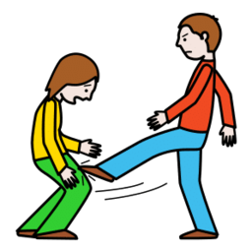

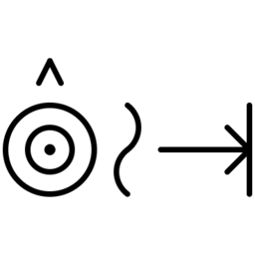
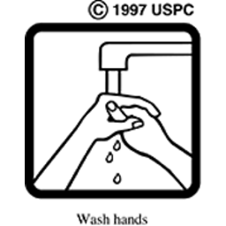





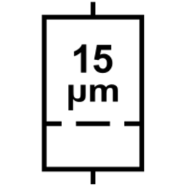



06 · IMPLEMENTATION
Thirteen source sets provide 28,749 study candidates
Canonical records · stable IDs · duplicates and alternate exports excluded
SOURCE SET + EXAMPLE
ICONS
SOURCE SET + EXAMPLE
ICONS
ARASAAC pictograms
13,798
Healthcare webfont
144
Blissymbolics
5,825
USP medication pictograms
83
OpenMoji
4,495
AIGA / DOT signs
80
Mulberry symbols
3,436
ISO 7010 safety signs
37
OCHA humanitarian icons
359
ISO 15223 medical devices
29
McDougall symbols
239
GHS hazard pictograms
9
Mapbox Maki
215
Stable ID → 256 × 256 normalized image → seven feature measurements → interactive review
08
Notes:
A usable icon record is the pipeline's canonical row: one selected source icon after dataset-specific duplicate and alternate-export rules are applied.
The displayed examples are representative normalized icons; they do not imply that every set uses the same visual style.
[Sources]
- icon_data/analysis/dataset.csv (28,749 rows; counts verified 2026-08-16)
- wiki/datasets-and-provenance.md
- wiki/pipeline.md

Slide 9
06 · IMPLEMENTATION
Seven families describe what may survive at small sizes
Candidate predictors of persistence—or confusion—at reduced sizes
COMPLEXITY
Canny edge density
BALANCE
Horizontal symmetry v2
SHAPE
Enclosure score v2
COLOR
Mean saturation v2
STROKE
Principal-axis orientation v2
TEXTURE
Local texture variation v2
DENSITY / FILL
Solid fill ratio v2
Important boundary
Candidate predictors only
Discernibility requires participant evidence
09
Notes:
[Sources]
- code/thesis_pipeline/features/registry.py
- wiki/feature-system.md
- wiki/literature-and-evidence.md

Slide 10
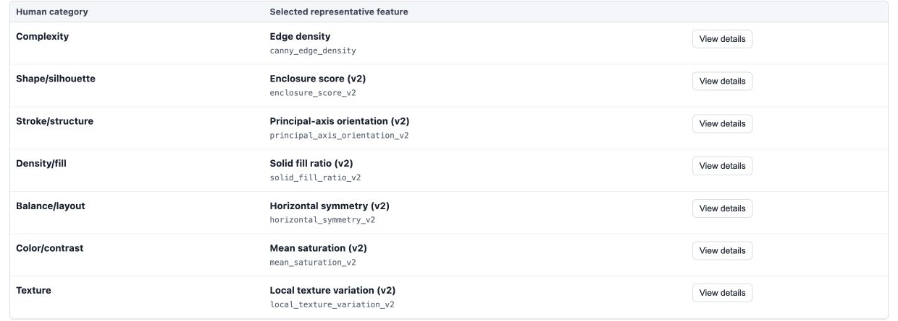
07 · CURRENT SYSTEM
Demo 1: inspect the seven feature families
Seven measurements · value-stratified examples
10
Notes:
Open one family detail during the live demo to show value-stratified examples and the selected representative.
[Sources]
- icon_data/analysis/analysis_dashboard/index.html (served and browser-verified 2026-08-13)
- code/build_analysis_dashboard.py
- wiki/dashboard-ui.md

Slide 11
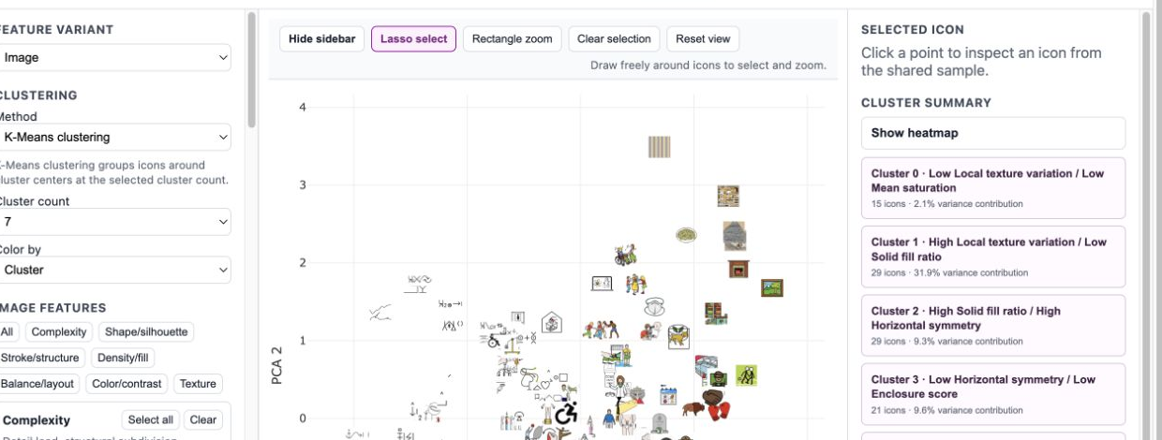
07 · CURRENT SYSTEM
Demo 2: inspect clustering
Lasso selection · cluster summaries · candidate contrasts
11
Notes:
During the live demo, use lasso selection, inspect one icon, and open one cluster summary.
The dashboard supports candidate selection; it does not measure discernibility.
[Sources]
- icon_data/analysis/analysis_dashboard/index.html (served and browser-verified 2026-08-13)
- code/build_analysis_dashboard.py
- wiki/dashboard-ui.md

Slide 12
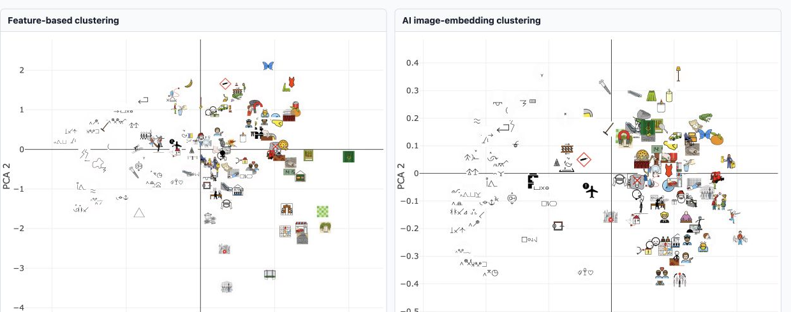
07 · CURRENT SYSTEM
Demo 3: compare feature and AI groupings
Pairwise agreement · 0.783 Partition similarity—not accuracy
12
Notes:
Pairwise agreement compares every icon pair: whether both clusterings put the pair together or both put it apart.
The AI image-embedding model receives normalized image pixels, not the seven thesis feature values.
[Sources]
- icon_data/analysis/analysis_dashboard/index.html (served and browser-verified 2026-08-13)
- code/thesis_pipeline/ai_clustering/metrics.py
- wiki/dashboard-ui.md
- wiki/similarity-and-clustering.md

Slide 13
08 · CURRENT PROGRESS
The current system is ready for glyph selection
BUILT AND WORKING
NEXT WORK
✓
Icon corpus and normalization
01
Select glyphs
Feature values · clusters · summaries
✓
Seven feature families
✓
Interactive UI and lasso inspection
02
Design the study
Only after glyph selection
✓
Clustering and cluster summaries
Not yet defined · participant protocol · task · measurements
13
Notes:
[Sources]
- wiki/README.md
- wiki/evaluation-and-human-study.md
- wiki/limitations-and-backlog.md

Slide 14
09 · NEXT PHASE
Next: select glyphs, then design the study
Immediate milestone · reviewed, defensible glyph selection
01
02
Select candidate glyphs
Design the user study
→
Dashboard review
Seven feature values
Clustering + lasso
Cluster summaries
Research questions
Task + conditions
Participant plan
Measurements
Current boundary · user-study design remains open
14
Notes:
The study-design details are intentionally left open at this stage.
[Sources]
- wiki/dashboard-ui.md
- wiki/dashboard-implementation.md
- wiki/evaluation-and-human-study.md

Slide 15
09 · NEXT PHASE
How prior research evaluated glyphs
Two participant studies · one systematic review
FUCHS ET AL. · 2014
LEGG ET AL. · 2016
FUCHS ET AL. · 2017
CONTROLLED EXPERIMENTS
PARTICIPANT SURVEY
SYSTEMATIC REVIEW
STUDY DESIGN
STUDY DESIGN
STUDY DESIGN
Three experiments
Target + eight alternatives
Lab and online samples
20 recruited · 19 analysed
104 randomized glyph pairs
64 controlled-study papers
Quantitative glyph tasks
Measure · choice, accuracy, time
Follow-up · questionnaire in Exp. 3
Measure · 0–10 differentiation rating
Context · no task
Output · task and measure taxonomy
No new participant experiment
15
Notes:
Fuchs et al. (2014) reported three controlled experiments. Experiment 1 used a target-plus-eight-alternatives similarity task with 12 novices and 12 experts; Experiment 2 was online; Experiment 3 collected accuracy, time, and a post-study questionnaire from 11 of 12 experts.
Legg et al. recruited 20 Oxford students or employees; 19 responses were analysed. Participants rated 104 glyph pairs on an integer 0–10 differentiation scale, with the non-reference pairs randomized.
Fuchs et al. (2017) is a systematic review, not a new participant experiment. It synthesized 64 papers with controlled quantitative glyph studies and categorized their tasks, measures, and outcomes.
[Sources]
- papers/The_Influence_of_Contour_on_Similarity_Perception_of_Star_Glyphs.pdf, pp. 9–10
- papers/Glyph_Visualization_A_Fail-Safe_Design_Scheme_Based_on_Quasi-Hamming_Distances.pdf, pp. 4–5, 8
- papers/A_Systematic_Review_of_Experimental_Studies_on_Data_Glyphs.pdf, pp. 11–12
- wiki/literature-and-evidence.md
- wiki/evaluation-and-human-study.md

Slide 16
09 · NEXT PHASE
Possible direction for the thesis study
01
Control display size
02
Record accuracy and confusion
03
Ask which visual cues participants used
Finalize after glyph selection + supervisor discussion
16
Notes:
This is a discussion proposal only. The protocol, participant plan, sizes, stimuli, and measures are not finalized.
[Sources]
- wiki/evaluation-and-human-study.md

Slide 17
10 · CONCLUSION
A clear basis for the next research phase
01
Icon corpus + seven feature families implemented
02
UI + clustering + summaries ready for glyph review
03
Next: glyph selection → user-study design
Next milestone · a reviewed selection of candidate glyphs
17
Notes:
[Sources]
- wiki/thesis-overview.md
- wiki/evaluation-and-human-study.md
- wiki/limitations-and-backlog.md

