Slide 1
THESIS PROGRESS PRESENTATION
[THESIS TITLE]
Research journey, current progress, and next study
Name · Programme · Supervisor · August 2026
Notes:
Replace the title and identity line when the final thesis wording is confirmed.
[Sources]

Slide 2
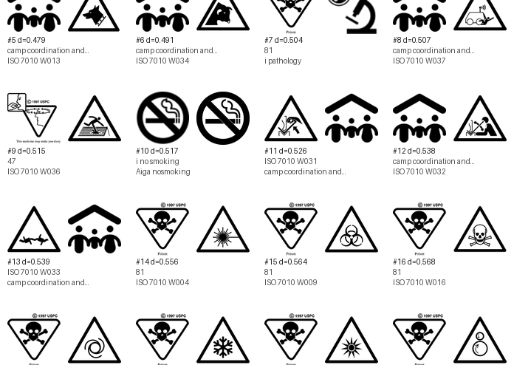
01 · THE PROBLEM
Visual similarity creates a practical comparison problem
Large icon collections contain repeated shapes, subtle variations, and icons that may become difficult to distinguish. Manual inspection cannot consistently explain which visible properties make two icons appear close or different.
The thesis therefore needs an auditable bridge between visible pixels and later human judgments—without confusing visual similarity with semantic meaning.
02
Notes:
[Sources]
- wiki/thesis-overview.md
- icon_data/analysis/similarity/closest_cross_set_pairs_euclidean.png

Slide 3
02–03 · AIM AND RESEARCH QUESTIONS
The study connects computer measurements with human responses
Working aim: organize literature-supported visible icon properties into measurable feature families, then test where those measurements agree—or disagree—with human identification and perception.
RQ1
Which visible properties can be measured consistently from normalized icon images?
RQ2
How can those measurements describe similarity, distance, and potential confusability?
RQ3
How well do computer-side measurements correspond to human identification and similarity judgments?
03
Notes:
[Sources]
- wiki/thesis-overview.md
- wiki/evaluation-and-human-study.md

Slide 4
04 · LITERATURE REVIEW
Seven papers define four parts of the thesis
The literature does not provide one complete model. Instead, it contributes complementary evidence for measurement, perceptual design, distinguishability, and evaluation.
MEASUREMENT
Forsythe · Garcia
Complexity, structure, abstractness, and the boundary between pixels and context.
VISUAL FOUNDATIONS
Borgo et al.
Visual channels, Gestalt organization, and task-dependent glyph design.
DISTINGUISHABILITY
Legg et al. · Fuchs et al. (contour)
Distance across channels, contour, closure, and similarity strategy.
DESIGN & EVALUATION
Maguire et al. · Fuchs et al. (review)
Systematic glyph design and evidence-based user-study planning.
04
Notes:
[Sources]
- wiki/literature-and-evidence.md
- notes/paper_feature_review.md
- papers/extracted_text/README.md

Slide 5
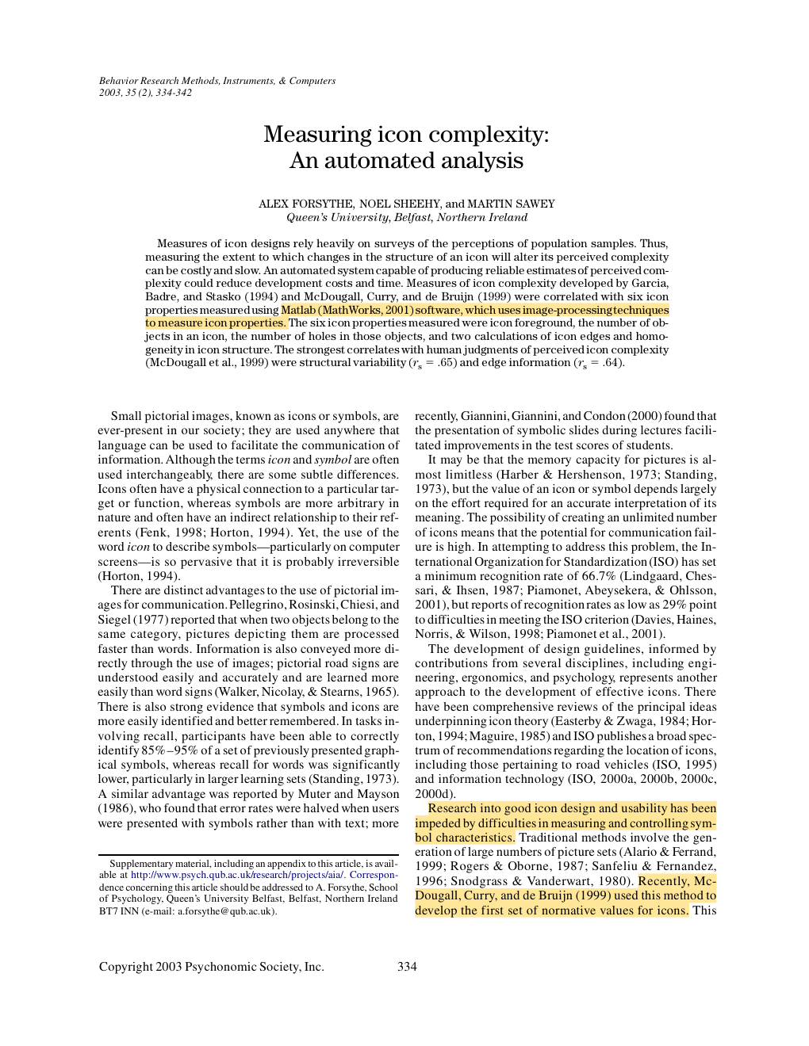
04 · LITERATURE REVIEW
Measuring icon complexity automatically
Forsythe, Sheehy & Sawey · 2003
PURPOSE
Test whether image-processing measurements can estimate human judgments of icon complexity.
METHOD
Six pixel-derived properties were correlated with established human complexity ratings for a random sample of 68 icons.
MAIN FINDING
Structural variability and edge information showed the strongest relationships with perceived complexity (ρ = .65 and .64).
WHY IT MATTERS HERE
Provides the strongest direct basis for edge density and structural variability as computational complexity proxies.
05
Notes:
Keep the claim narrow: the paper supports complexity estimation, not semantic understanding.
[Sources]
- papers/Forsythe-Measuring_cion_complexity_automated.pdf, pp. 1–9

Slide 6
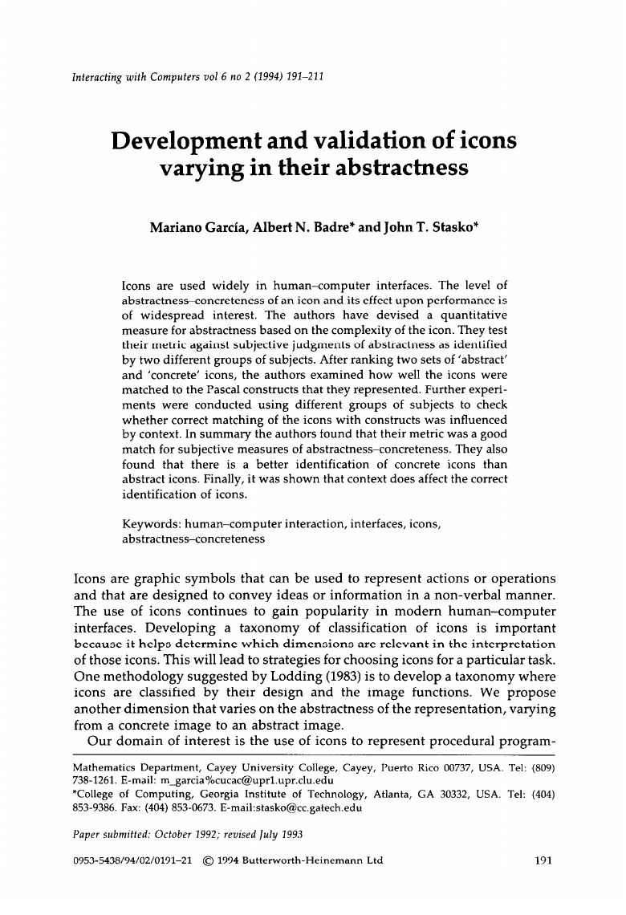
04 · LITERATURE REVIEW
Abstractness affects identification
Garcia, Badre & Stasko · 1994
PURPOSE
Develop a quantitative abstractness–concreteness metric and test whether it matches users’ judgments and task performance.
METHOD
Different participant groups ranked abstract and concrete icon sets, matched icons to Pascal constructs, and completed context conditions.
MAIN FINDING
The metric aligned with subjective judgments; concrete icons were identified better, and context changed identification performance.
WHY IT MATTERS HERE
Shows that measurable structure matters, but meaning and context cannot be inferred reliably from pixels alone.
06
Notes:
This paper combines a structural metric with subjective ranking and identification tasks.
[Sources]
- papers/Garcia-Development_validation_icons_abstractness.pdf, pp. 1–21

Slide 7

04 · LITERATURE REVIEW
Glyph design needs perceptual foundations
Borgo et al. · 2013
PURPOSE
Connect glyph visualization to semiotics, perception, design guidelines, implementation techniques, and application practice.
METHOD
A state-of-the-art review synthesizing foundations and design knowledge across glyph-based visualization research.
MAIN FINDING
Shape, colour, texture, size, orientation, curvature, and grouping act as visual channels whose effectiveness depends on task and context.
WHY IT MATTERS HERE
Provides the conceptual map for the thesis’s visual families while warning against treating feature distance as a complete perceptual model.
07
Notes:
This is a review and design synthesis, not a single controlled participant experiment.
[Sources]
- papers/Glyph-based_Visualization_Foundations_Design_Guidelines_Techniques_Applications.pdf, pp. 1–26

Slide 8
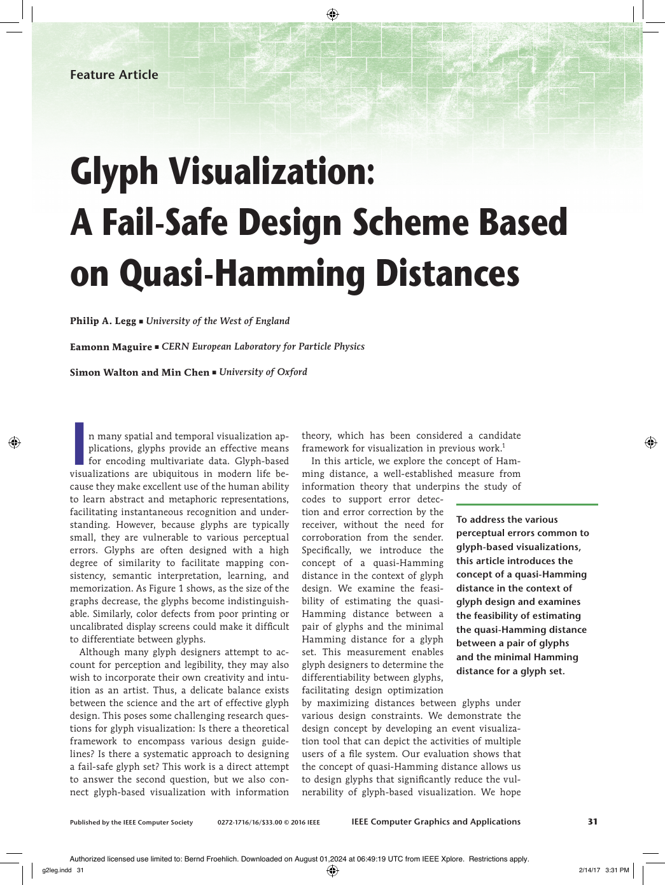
04 · LITERATURE REVIEW
Channel distance can reduce glyph confusion
Legg, Maguire, Walton & Chen · 2016
PURPOSE
Adapt Hamming distance to glyph design so visually separable glyph sets can be designed more systematically.
METHOD
The authors define quasi-Hamming distance, estimate channel separability with a 20-participant survey, and demonstrate it in a file-event glyph system.
MAIN FINDING
Increasing differences across visual channels can reduce vulnerability to perceptual errors, although separability varies by channel.
WHY IT MATTERS HERE
Motivates pairwise distinguishability and family-wise distance, but does not validate the thesis’s exact continuous feature formulas.
08
Notes:
Present quasi-Hamming distance as an inspiration for set-relative distinguishability, not as the implemented metric itself.
[Sources]
- papers/Glyph_Visualization_A_Fail-Safe_Design_Scheme_Based_on_Quasi-Hamming_Distances.pdf, pp. 1–11

Slide 9
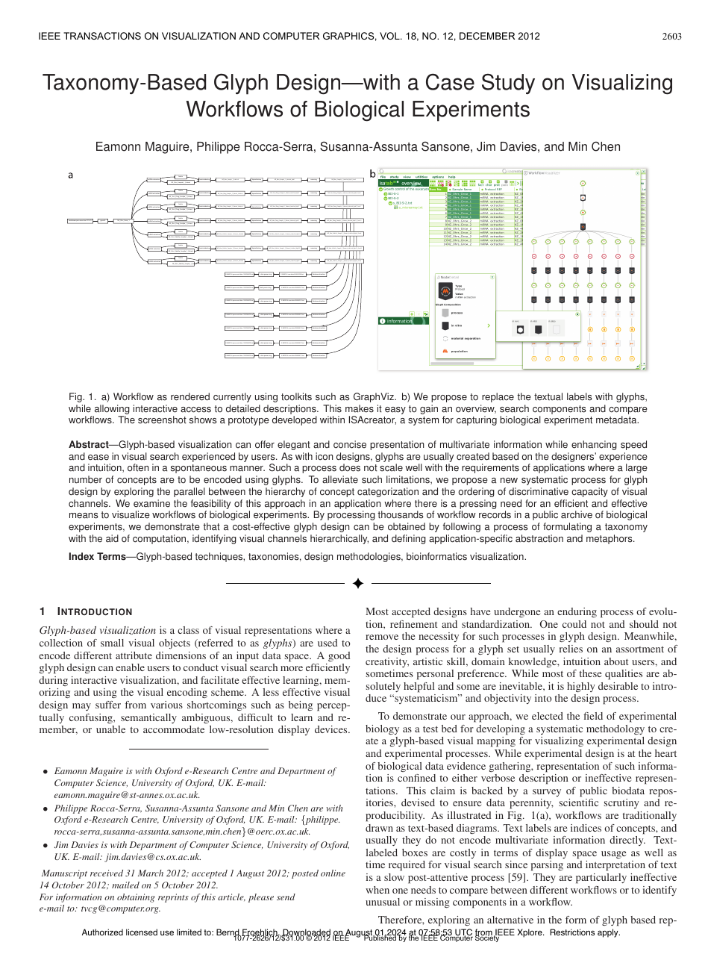
04 · LITERATURE REVIEW
A taxonomy can guide scalable glyph design
Maguire et al. · 2012
PURPOSE
Replace ad-hoc glyph creation with a systematic process that scales to many domain concepts.
METHOD
A design methodology combines a concept taxonomy, a hierarchy of visual channels, and a biological-workflow case study.
MAIN FINDING
Structured categorization and deliberate visual-channel assignment can produce a more scalable, application-specific glyph language.
WHY IT MATTERS HERE
Supports organizing semantic categories as metadata and design context—not claiming that low-level image features recover meaning.
09
Notes:
Keep taxonomy and semantic mapping outside the computer-vision feature families.
[Sources]
- papers/Taxonomy-Based_Glyph_Designwith_a_Case_Study_on_Visualizing_Workflows_of_Biological_Experiments.pdf, pp. 1–10

Slide 10
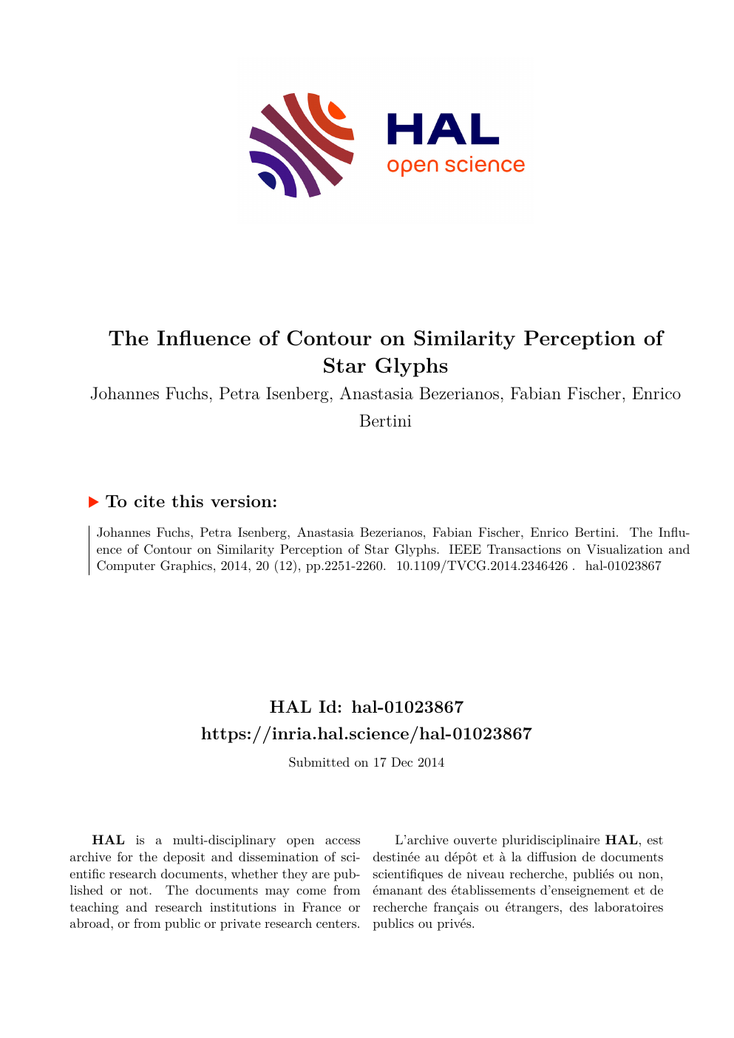
04 · LITERATURE REVIEW
Contours shift perceived similarity
Fuchs et al. · 2014
PURPOSE
Test how contour, fill, and reference structures influence similarity judgments for star glyphs.
METHOD
Three experiments compared experts, trained novices, and online participants using target-plus-alternative similarity-selection tasks.
MAIN FINDING
Simple star glyphs without contours best supported data similarity; contours could shift attention toward overall shape instead.
WHY IT MATTERS HERE
Justifies contour and enclosure features while showing that similarity is task-dependent and cannot be reduced to one universal distance.
10
Notes:
Experiment 1 included 12 novices and 12 experts; Experiment 2 retained 36 online participants after controls.
[Sources]
- papers/The_Influence_of_Contour_on_Similarity_Perception_of_Star_Glyphs.pdf, pp. 1–11

Slide 11
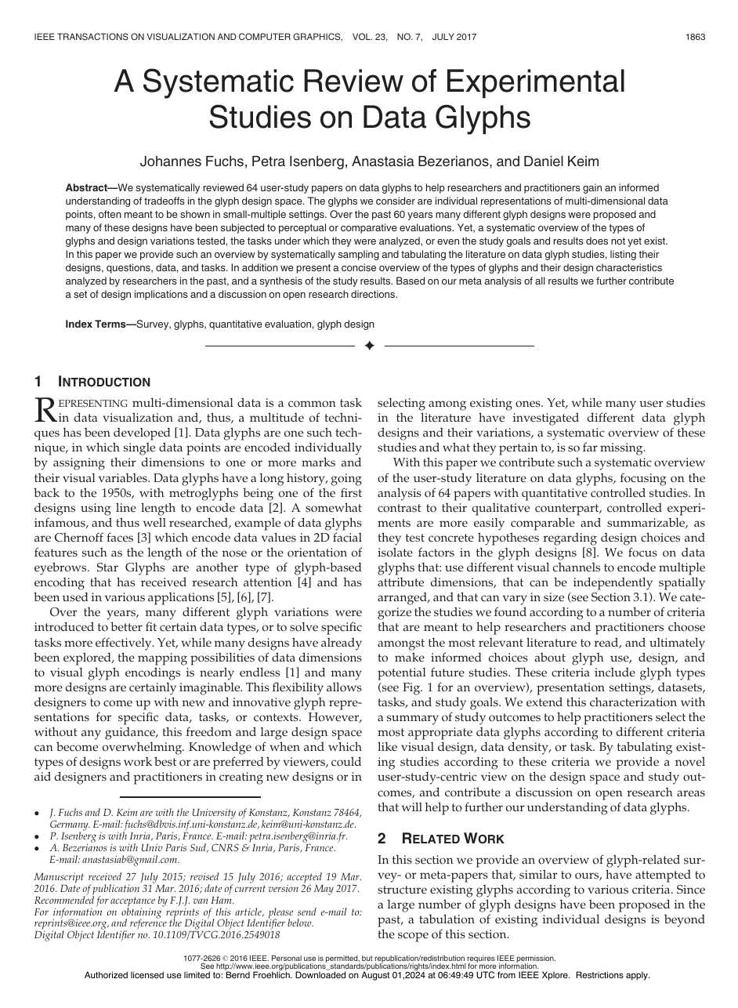
04 · LITERATURE REVIEW
Glyph evaluation is strongly task-dependent
Fuchs, Isenberg, Bezerianos & Keim · 2017
PURPOSE
Organize what controlled glyph studies tested, which tasks they used, and what design conclusions can be drawn.
METHOD
A systematic review and meta-analysis of 64 quantitative controlled user-study papers spanning roughly six decades.
MAIN FINDING
Glyph performance depends on design, task, presentation setting, and data; the review identifies evidence patterns and open research gaps.
WHY IT MATTERS HERE
Supports a quantitative human study and helps separate identification, similarity, confusability, accuracy, and response time as different outcomes.
11
Notes:
Use this paper to justify the study-design layer rather than an individual image-feature formula.
[Sources]
- papers/A_Systematic_Review_of_Experimental_Studies_on_Data_Glyphs.pdf, pp. 1–17

Slide 12
05 · RESEARCH JOURNEY
From corpus building to interpretable comparison
Each stage solved a different research problem—and exposed the next one.
JUNE
JULY
EARLY AUG
10 AUG
Corpus + first pipeline
Feature repair
Comparable exploration
Interpretability
Collected heterogeneous icon sets, normalized images, and built the first extraction and dashboard workflow.
Corrected measurement semantics, introduced schema v2, and aligned families through a shared registry.
Added balanced feature sampling, saved AI runs, and side-by-side representation comparison.
Added lasso selection, cluster summaries, and post-hoc measured feature profiles.
Result: an inspectable computer-side system—not yet a validated model of human perception.
12
Notes:
[Sources]
- Git history: 4e5d7d64a (2026-06-01), c9616aed2 (2026-07-21), 31e075b7b (2026-07-28), fce7512f1 (2026-08-10)
- wiki/README.md
- wiki/dashboard-implementation.md

Slide 13
06 · IMPLEMENTATION
The corpus became a reproducible analysis pipeline
13
28,749
256 × 256
81
source sets
canonical icon rows
normalized PNG images
active visual features
01
02
03
04
05
Source sets
Normalized images
Feature extraction
Similarity + clustering
Interactive review
Stable icon IDs carry each record from source data to later study responses.
13
Notes:
[Sources]
- wiki/README.md
- wiki/pipeline.md
- wiki/datasets-and-provenance.md

Slide 14
06 · IMPLEMENTATION
Seven feature families operationalize the literature
The representative metric is fixed for each family so the dashboard and later study exports remain comparable.
COMPLEXITY
Canny edge density
BALANCE
Horizontal symmetry v2
SHAPE
Enclosure score v2
COLOR
Mean saturation v2
STROKE
Principal-axis orientation v2
TEXTURE
Local texture variation v2
DENSITY / FILL
Solid fill ratio v2
Important boundary
These values describe visible structure; they do not recover an icon’s meaning.
14
Notes:
[Sources]
- code/thesis_pipeline/features/registry.py
- wiki/features-and-metrics.md
- wiki/literature-and-evidence.md

Slide 15

06 · IMPLEMENTATION
Measurement repair made the features auditable
The second feature schema made image assumptions explicit and separated reliable values from uncertain cases.
MASK QUALITY
489 uncertain masks excluded from quality-sensitive feature sampling
TRUE ZEROS
Valid zero measurements are retained rather than treated as missing
ORIENTATION
Undefined directions are excluded using confidence and anisotropy checks
RELEASE GATE
Example: original icon and accepted foreground mask
A frozen two-rater benchmark remains pending before feature-v2 release
15
Notes:
[Sources]
- wiki/README.md
- wiki/features-and-metrics.md
- wiki/evaluation-and-human-study.md
- icon_data/analysis/feature_v2_mask_overlays/082c5e659f3a2ac9.png

Slide 16
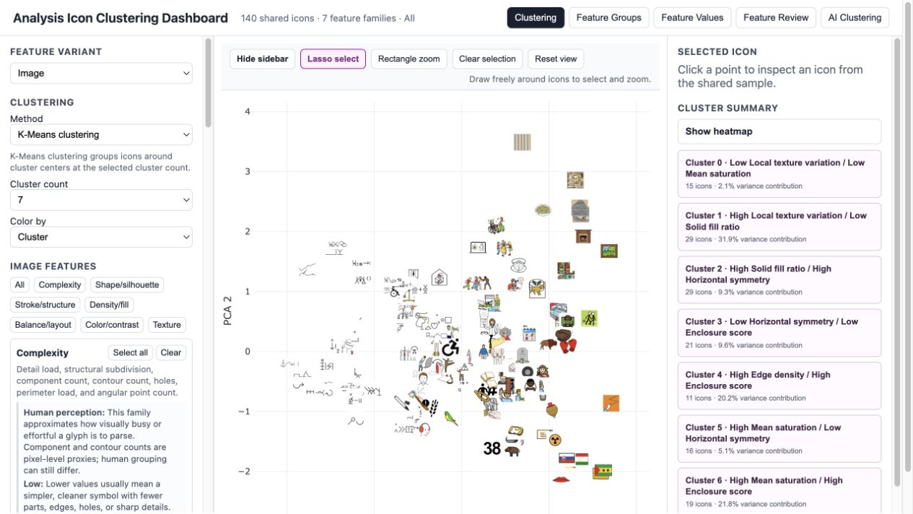
07 · CURRENT SYSTEM
The dashboard became the research instrument
One interface now supports sampling, value inspection, clustering, lasso selection, and export on the same icon IDs.
16
Notes:
[Sources]
- icon_data/analysis/analysis_dashboard/index.html (served and browser-verified 2026-08-13)
- code/build_analysis_dashboard.py
- wiki/dashboard-ui.md

Slide 17
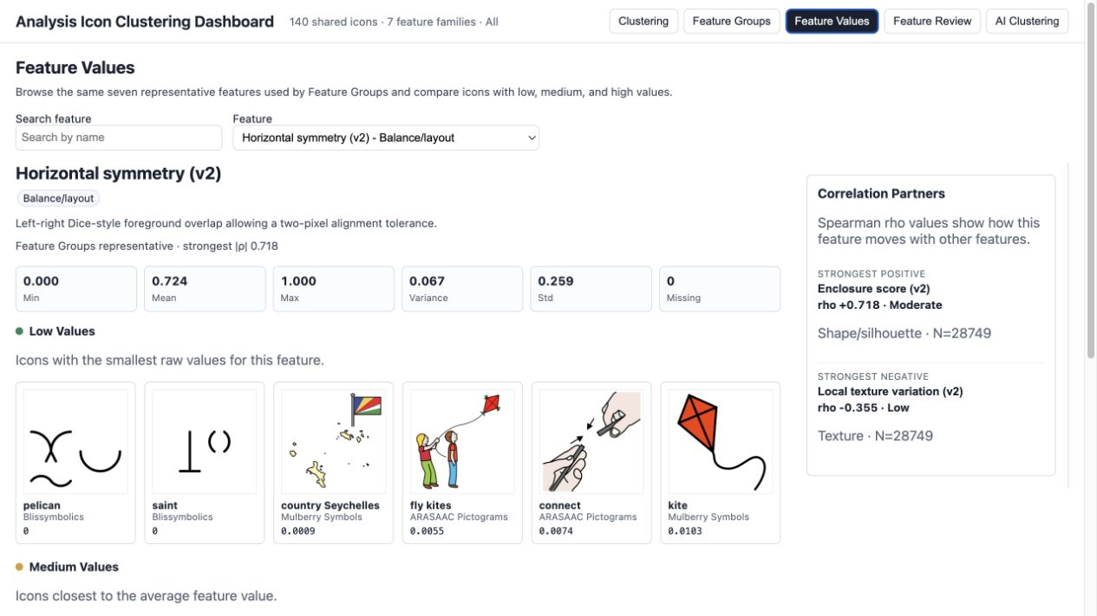
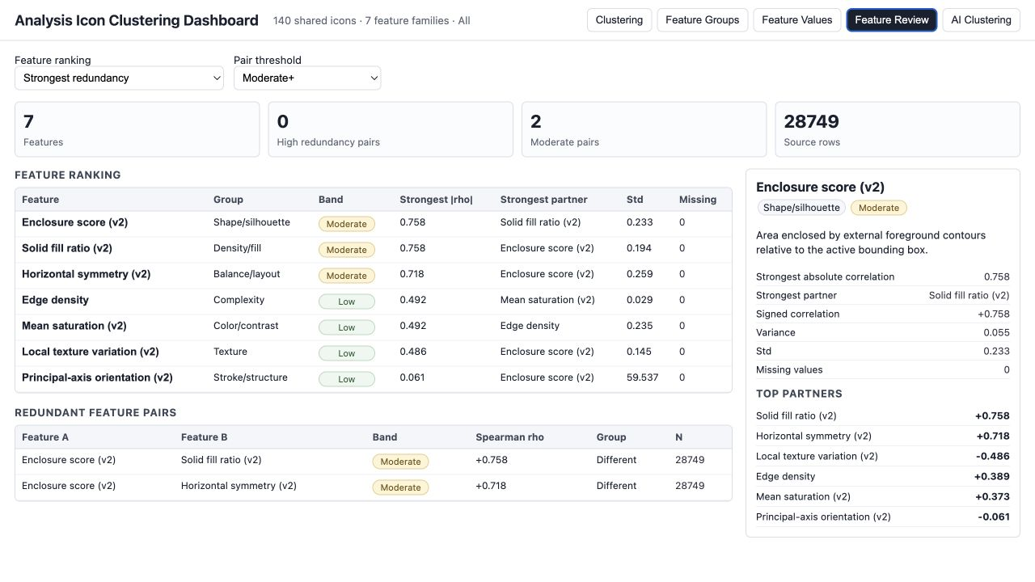
07 · CURRENT SYSTEM
Feature review reveals examples and redundancy
The value table exposes what a metric selects; the review view shows where families may overlap.
Current review: 7 feature families · 0 high-redundancy pairs · 2 moderate pairs
17
Notes:
[Sources]
- icon_data/analysis/analysis_dashboard/index.html (served and browser-verified 2026-08-13)
- icon_data/analysis/analysis_dashboard/dashboard_data.json

Slide 18
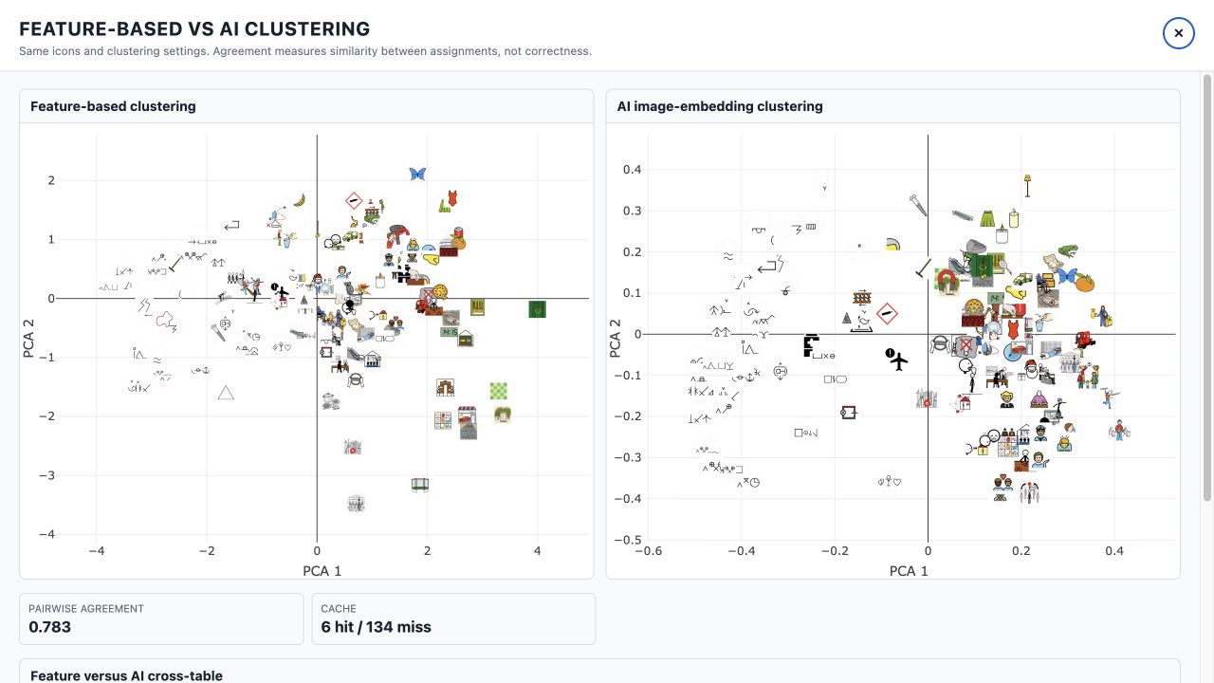
07 · CURRENT SYSTEM
Clustering compares representations—not truth
The same 140-icon sample can be grouped by measured features or by multimodal embeddings, then compared icon by icon.
Pairwise agreement = 0.783 here—but agreement is diagnostic, not evidence of perceptual correctness.
18
Notes:
[Sources]
- icon_data/analysis/analysis_dashboard/index.html (served and browser-verified 2026-08-13)
- wiki/dashboard-ui.md
- wiki/limitations-and-backlog.md

Slide 19
08 · CURRENT PROGRESS
Computer analysis complete; human validation pending
BUILT AND WORKING
NEXT EVIDENCE NEEDED
✓
Icon corpus and normalization
01
Two-rater feature benchmark
✓
Feature extraction and registry
02
Controlled stimulus set and pilot
✓
Similarity and cluster diagnostics
03
Participant-response dataset
✓
Interactive review and stable-ID exports
04
Computer–human agreement analysis
No participant-response dataset exists yet, so RQ3 remains open.
19
Notes:
[Sources]
- wiki/README.md
- wiki/evaluation-and-human-study.md
- wiki/limitations-and-backlog.md

Slide 20
09 · NEXT PHASE
The next phase is a controlled user study
Proposed pilot: ordinary participants complete distinct identification and similarity/confusability tasks.
01
02
03
04
05
Select
Design
Pilot
Collect
Compare
Matched icons and pairs; exclude uncertain measurements
Labels, confidence, timing, and similarity choices
Check clarity, duration, and trial difficulty
Consent, responses, and stable icon/pair IDs
Agreement, mismatch, and qualitative explanations
Immediate decision: freeze the feature benchmark, then lock the pilot stimuli and protocol.
20
Notes:
This is a proposed next-step design, not a completed or approved protocol.
[Sources]
- wiki/evaluation-and-human-study.md
- wiki/literature-and-evidence.md
- papers/A_Systematic_Review_of_Experimental_Studies_on_Data_Glyphs.pdf
- papers/The_Influence_of_Contour_on_Similarity_Perception_of_Star_Glyphs.pdf

Slide 21
10 · CONCLUSION
A clear computer-side foundation and validation path
01
Literature-defined visual concepts are now measurable and traceable.
02
The dashboard makes values, examples, clusters, and limitations visible.
03
The user study will test where those measurements match real human responses.
Next milestone · approved pilot design and frozen stimulus set
21
Notes:
[Sources]
- wiki/thesis-overview.md
- wiki/evaluation-and-human-study.md
- wiki/limitations-and-backlog.md

