Slide 1
THESIS PROGRESS PRESENTATION
[THESIS TITLE]
Research problem, questions, and literature review
Name · Programme · Supervisor · Date
Notes:
Replace the title and identity line when the final thesis wording is confirmed.
[Sources]

Slide 2
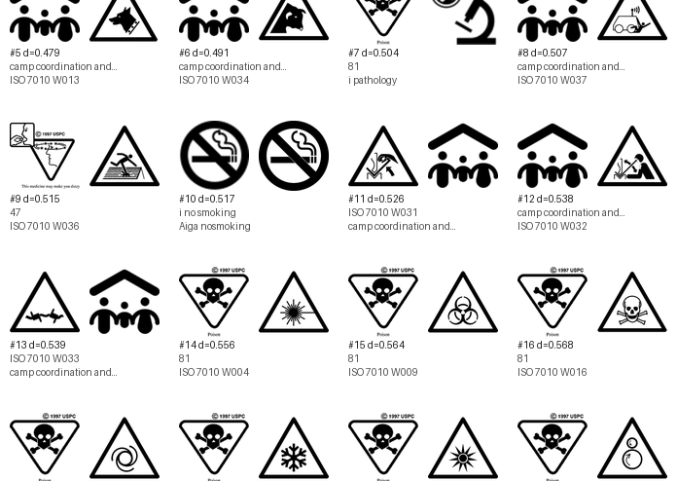
01 · THE PROBLEM
Visual similarity creates a practical comparison problem
Large icon collections contain repeated shapes, subtle variations, and icons that may become difficult to distinguish. Manual inspection cannot consistently explain which visible properties make two icons appear close or different.
The thesis therefore needs an auditable bridge between visible pixels and later human judgments—without confusing visual similarity with semantic meaning.
02
Notes:
[Sources]
- wiki/thesis-overview.md
- icon_data/analysis/similarity/closest_cross_set_pairs_euclidean.png

Slide 3
02–03 · AIM AND RESEARCH QUESTIONS
The study connects computer measurements with human responses
Working aim: organize literature-supported visible icon properties into measurable feature families, then test where those measurements agree—or disagree—with human identification and perception.
RQ1
Which visible properties can be measured consistently from normalized icon images?
RQ2
How can those measurements describe similarity, distance, and potential confusability?
RQ3
How well do computer-side measurements correspond to human identification and similarity judgments?
03
Notes:
[Sources]
- wiki/thesis-overview.md
- wiki/evaluation-and-human-study.md

Slide 4
04 · LITERATURE REVIEW
Seven papers define four parts of the thesis
The literature does not provide one complete model. Instead, it contributes complementary evidence for measurement, perceptual design, distinguishability, and evaluation.
MEASUREMENT
Forsythe · Garcia
Complexity, structure, abstractness, and the boundary between pixels and context.
VISUAL FOUNDATIONS
Borgo et al.
Visual channels, Gestalt organization, and task-dependent glyph design.
DISTINGUISHABILITY
Legg et al. · Fuchs et al. (contour)
Distance across channels, contour, closure, and similarity strategy.
DESIGN & EVALUATION
Maguire et al. · Fuchs et al. (review)
Systematic glyph design and evidence-based user-study planning.
04
Notes:
[Sources]
- wiki/literature-and-evidence.md
- notes/paper_feature_review.md
- papers/extracted_text/README.md

Slide 5
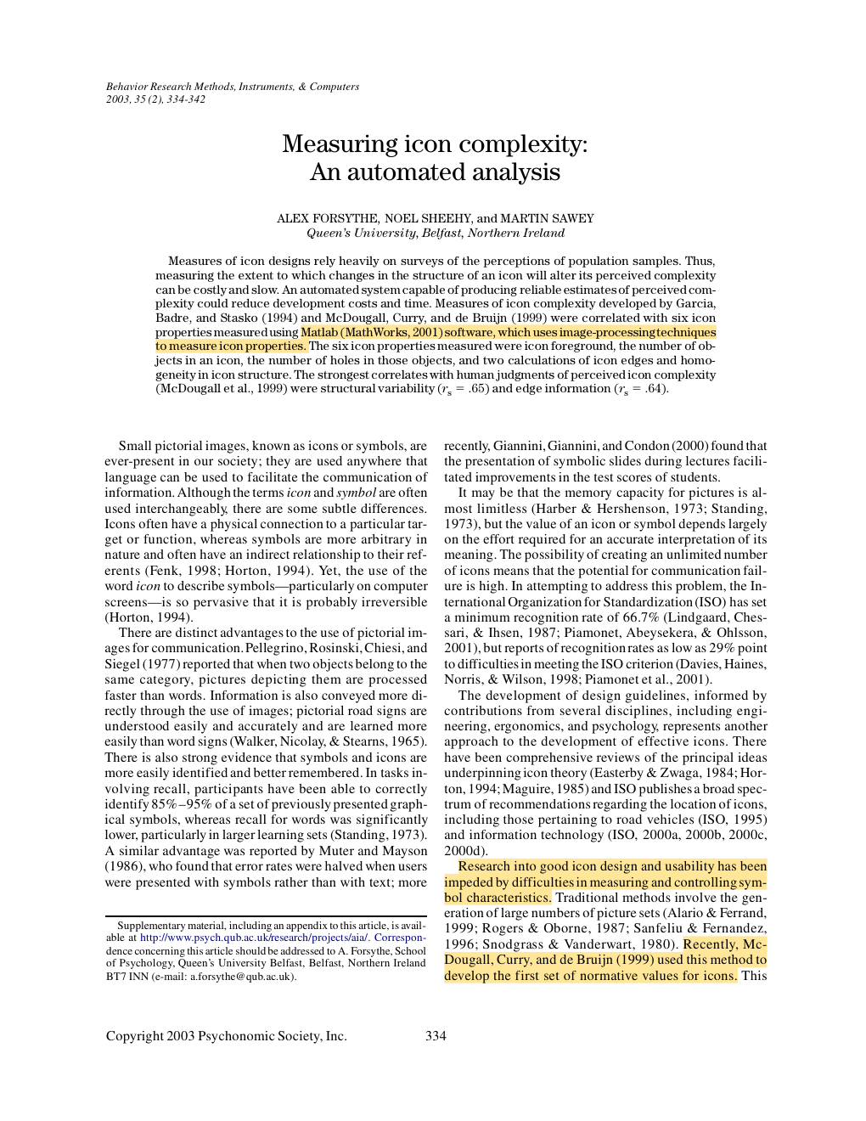
04 · LITERATURE REVIEW
Measuring icon complexity automatically
Forsythe, Sheehy & Sawey · 2003
PURPOSE
Test whether image-processing measurements can estimate human judgments of icon complexity.
METHOD
Six pixel-derived properties were correlated with established human complexity ratings for a random sample of 68 icons.
MAIN FINDING
Structural variability and edge information showed the strongest relationships with perceived complexity (ρ = .65 and .64).
WHY IT MATTERS HERE
Provides the strongest direct basis for edge density and structural variability as computational complexity proxies.
05
Notes:
Keep the claim narrow: the paper supports complexity estimation, not semantic understanding.
[Sources]
- papers/Forsythe-Measuring_cion_complexity_automated.pdf, pp. 1–9

Slide 6
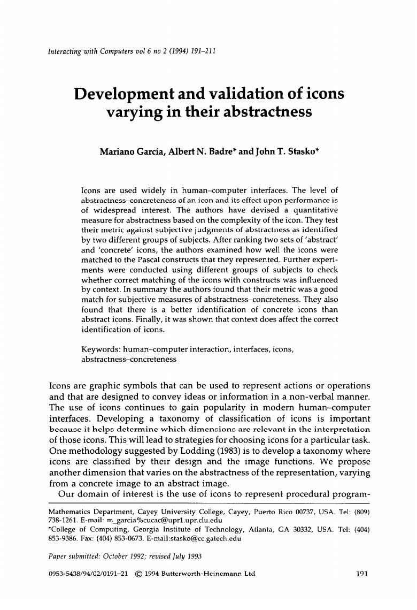
04 · LITERATURE REVIEW
Abstractness affects identification
Garcia, Badre & Stasko · 1994
PURPOSE
Develop a quantitative abstractness–concreteness metric and test whether it matches users’ judgments and task performance.
METHOD
Different participant groups ranked abstract and concrete icon sets, matched icons to Pascal constructs, and completed context conditions.
MAIN FINDING
The metric aligned with subjective judgments; concrete icons were identified better, and context changed identification performance.
WHY IT MATTERS HERE
Shows that measurable structure matters, but meaning and context cannot be inferred reliably from pixels alone.
06
Notes:
This paper combines a structural metric with subjective ranking and identification tasks.
[Sources]
- papers/Garcia-Development_validation_icons_abstractness.pdf, pp. 1–21

Slide 7

04 · LITERATURE REVIEW
Glyph design needs perceptual foundations
Borgo et al. · 2013
PURPOSE
Connect glyph visualization to semiotics, perception, design guidelines, implementation techniques, and application practice.
METHOD
A state-of-the-art review synthesizing foundations and design knowledge across glyph-based visualization research.
MAIN FINDING
Shape, colour, texture, size, orientation, curvature, and grouping act as visual channels whose effectiveness depends on task and context.
WHY IT MATTERS HERE
Provides the conceptual map for the thesis’s visual families while warning against treating feature distance as a complete perceptual model.
07
Notes:
This is a review and design synthesis, not a single controlled participant experiment.
[Sources]
- papers/Glyph-based_Visualization_Foundations_Design_Guidelines_Techniques_Applications.pdf, pp. 1–26

Slide 8
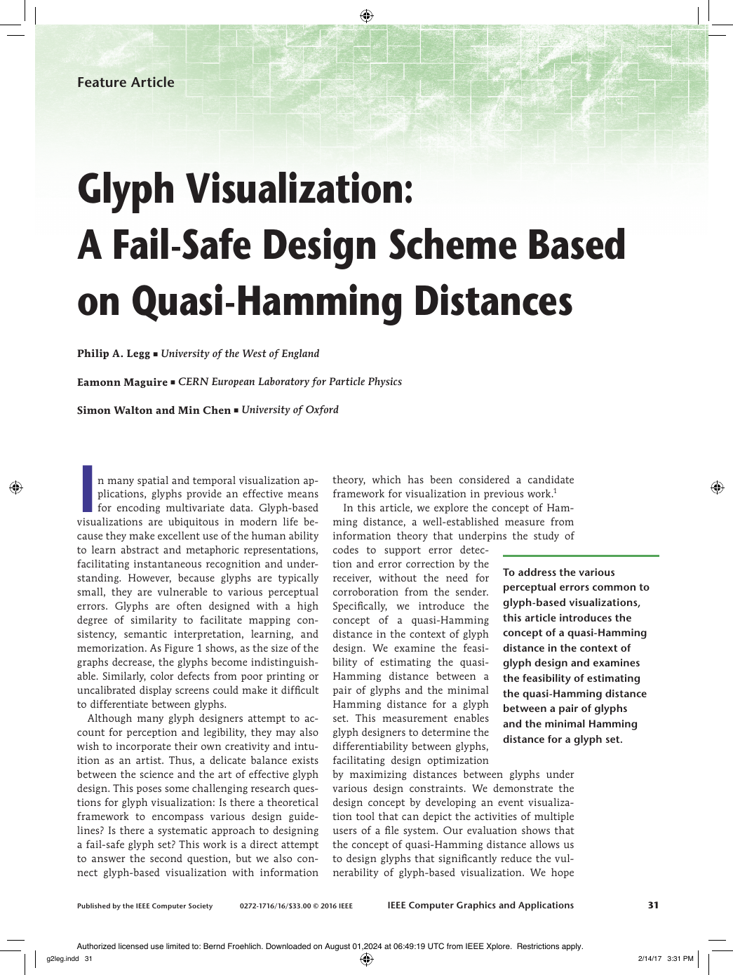
04 · LITERATURE REVIEW
Channel distance can reduce glyph confusion
Legg, Maguire, Walton & Chen · 2016
PURPOSE
Adapt Hamming distance to glyph design so visually separable glyph sets can be designed more systematically.
METHOD
The authors define quasi-Hamming distance, estimate channel separability with a 20-participant survey, and demonstrate it in a file-event glyph system.
MAIN FINDING
Increasing differences across visual channels can reduce vulnerability to perceptual errors, although separability varies by channel.
WHY IT MATTERS HERE
Motivates pairwise distinguishability and family-wise distance, but does not validate the thesis’s exact continuous feature formulas.
08
Notes:
Present quasi-Hamming distance as an inspiration for set-relative distinguishability, not as the implemented metric itself.
[Sources]
- papers/Glyph_Visualization_A_Fail-Safe_Design_Scheme_Based_on_Quasi-Hamming_Distances.pdf, pp. 1–11

Slide 9
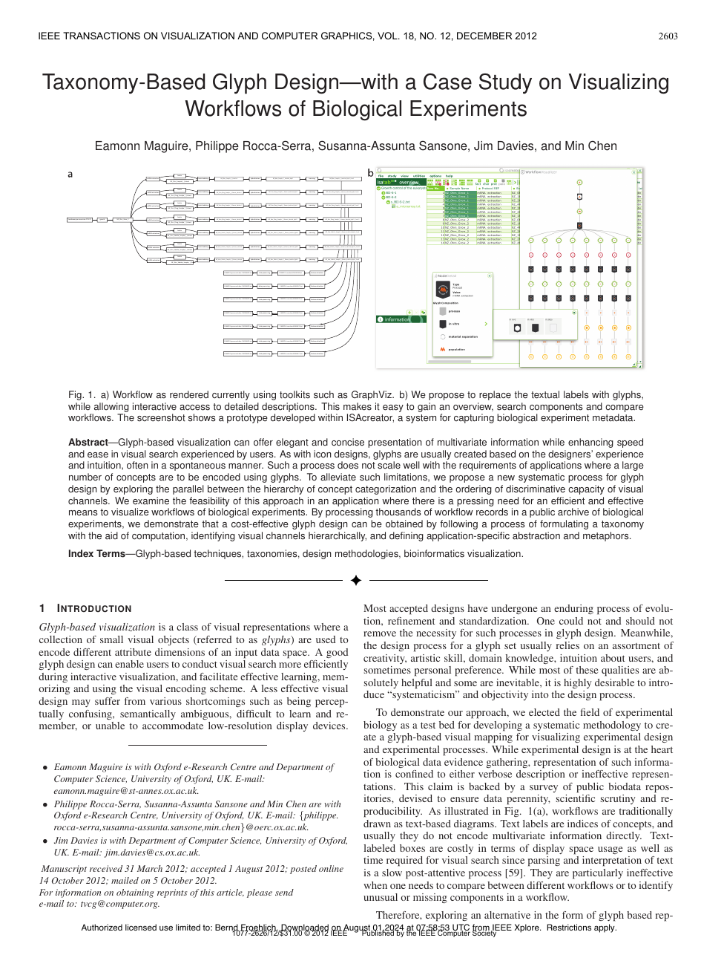
04 · LITERATURE REVIEW
A taxonomy can guide scalable glyph design
Maguire et al. · 2012
PURPOSE
Replace ad-hoc glyph creation with a systematic process that scales to many domain concepts.
METHOD
A design methodology combines a concept taxonomy, a hierarchy of visual channels, and a biological-workflow case study.
MAIN FINDING
Structured categorization and deliberate visual-channel assignment can produce a more scalable, application-specific glyph language.
WHY IT MATTERS HERE
Supports organizing semantic categories as metadata and design context—not claiming that low-level image features recover meaning.
09
Notes:
Keep taxonomy and semantic mapping outside the computer-vision feature families.
[Sources]
- papers/Taxonomy-Based_Glyph_Designwith_a_Case_Study_on_Visualizing_Workflows_of_Biological_Experiments.pdf, pp. 1–10

Slide 10
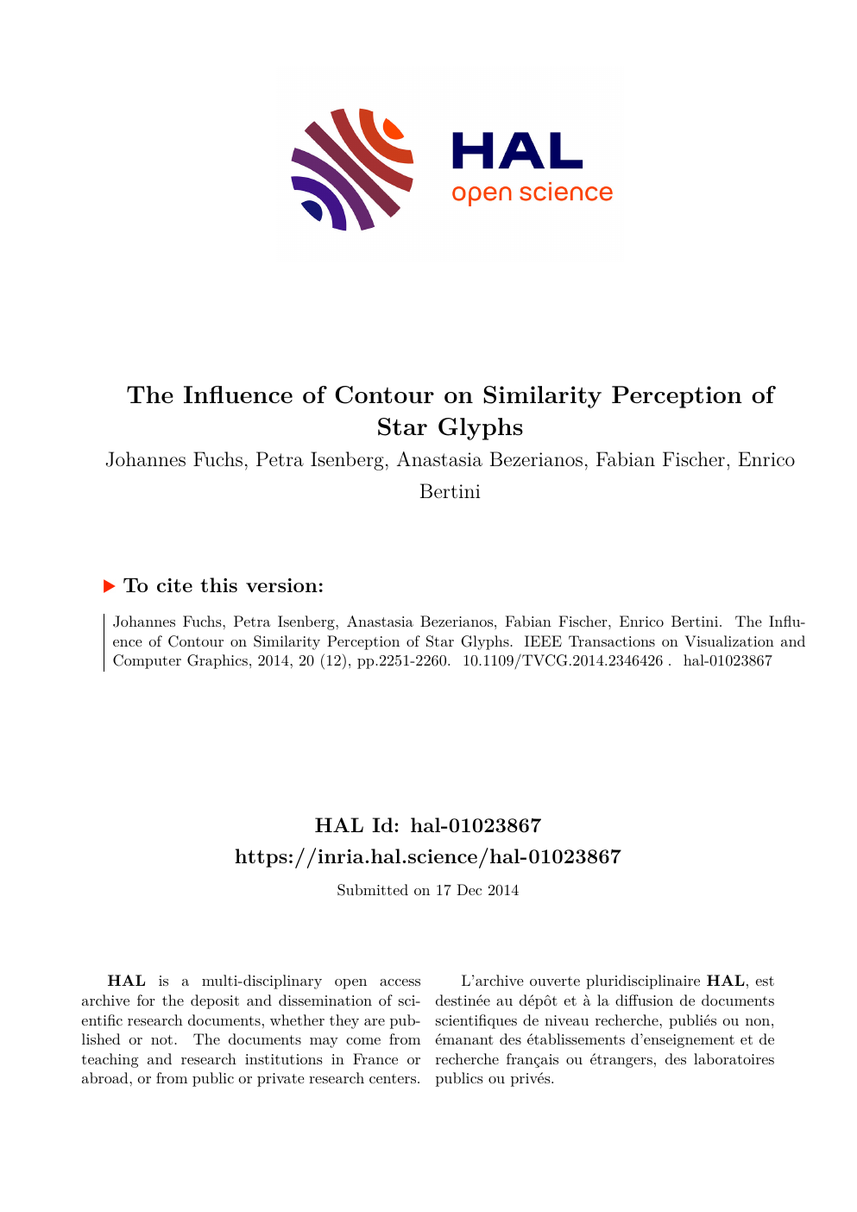
04 · LITERATURE REVIEW
Contours shift perceived similarity
Fuchs et al. · 2014
PURPOSE
Test how contour, fill, and reference structures influence similarity judgments for star glyphs.
METHOD
Three experiments compared experts, trained novices, and online participants using target-plus-alternative similarity-selection tasks.
MAIN FINDING
Simple star glyphs without contours best supported data similarity; contours could shift attention toward overall shape instead.
WHY IT MATTERS HERE
Justifies contour and enclosure features while showing that similarity is task-dependent and cannot be reduced to one universal distance.
10
Notes:
Experiment 1 included 12 novices and 12 experts; Experiment 2 retained 36 online participants after controls.
[Sources]
- papers/The_Influence_of_Contour_on_Similarity_Perception_of_Star_Glyphs.pdf, pp. 1–11

Slide 11
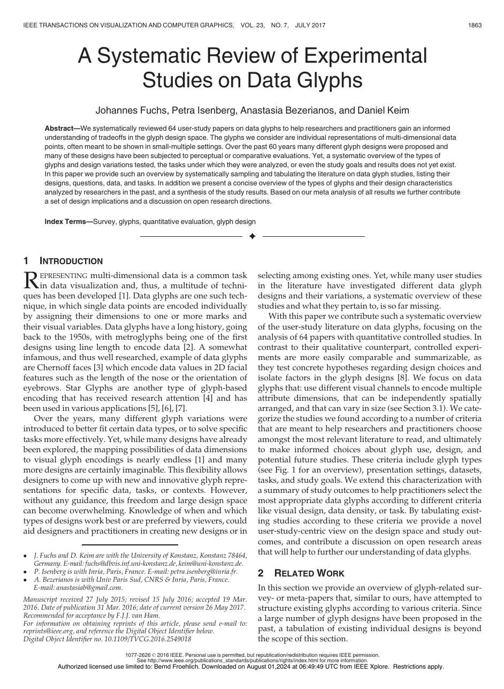
04 · LITERATURE REVIEW
Glyph evaluation is strongly task-dependent
Fuchs, Isenberg, Bezerianos & Keim · 2017
PURPOSE
Organize what controlled glyph studies tested, which tasks they used, and what design conclusions can be drawn.
METHOD
A systematic review and meta-analysis of 64 quantitative controlled user-study papers spanning roughly six decades.
MAIN FINDING
Glyph performance depends on design, task, presentation setting, and data; the review identifies evidence patterns and open research gaps.
WHY IT MATTERS HERE
Supports a quantitative human study and helps separate identification, similarity, confusability, accuracy, and response time as different outcomes.
11
Notes:
Use this paper to justify the study-design layer rather than an individual image-feature formula.
[Sources]
- papers/A_Systematic_Review_of_Experimental_Studies_on_Data_Glyphs.pdf, pp. 1–17

