Slide 1

Cohort: A25
Course name: Software Engineering Part. 1
Professor: Clément ZIANE
https://www.datasciencetech.institute

Slide 2



Software Engineering P1
Core data structure & complexity

Slide 3
Course Plan
Introduction to Rust and Memory Management
Core Data Structures and Complexity
Advanced Data Structures and Procedural Design
Testing, Correctness, and Performance

Slide 4
Core Data Structures and Complexity
Core concepts
  Lifetime
  Option/Result and ?
  Struct
    Definition
    Implement
  Traits
    Iterator trait
    Custom traits
  Generic Type
Core Data structures
  LinkedList
  VecDeque
  BinaryHeap
  HashMap
  HashSet
  BTreeMap
  BTreeSet

Slide 5
Core data structure & complexity
Core concepts

Slide 6

Lifetime
Lifetimes are a concept / feature that ensures references are always valid for the duration they are used. They are a way of annotating references with information about how long the data they point to will be valid.
Lifetimes address the problem of dangling references. A dangling reference occurs when a reference points to data that has been deallocated or is no longer valid. This can happen if the data a reference points to is dropped while the reference itself is still in use.

Slide 7

Inferred Lifetime : Elision Rules
Rust has rules for inferring lifetimes in certain cases, known as lifetime elision rules. These rules reduce the need for explicit lifetime annotations in common patterns.
Each input reference gets its own lifetime parameter.
If there is exactly one input lifetime, that lifetime is assigned to all output lifetimes.
If there are multiple input lifetimes, but one of them is &self or &mut self, the lifetime of self is assigned to all output lifetimes.
In this example :
The Rust compiler applies the first and second elision rules to infer the lifetimes of the references.
The lifetime of the returned &str is inferred to match the lifetime of the input s.

Slide 8
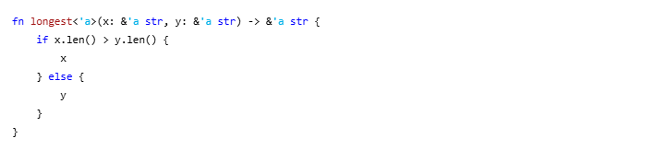
Lifetime Annotation
Lifetime annotations do not change how long any of the references live. Instead, they describe the relationships of the lifetimes of multiple references to each other. Lifetime annotations have a slightly unusual syntax: the names of lifetime parameters must start with an apostrophe (') and are typically all lowercase and very short.
In this example:
The function longest takes two string slices (x and y) and returns a string slice.
The lifetime annotation 'a indicates that both input references (x and y) and the returned reference must live at least as long as ‘a.
  'a is a placeholder for the concrete lifetime that is substituted when the function is called.
  The annotation 'a ties the lifetimes of x and y to the lifetime of the returned reference.
This means that the data referenced by x and y must remain valid for at least as long as the reference returned by the function is used.

Slide 9
Option & Result
We handle the absence of values and errors explicitly using Option and Result in Rust.
These types are fundamental for writing robust and safe code by forcing developers to handle potential failures and missing data explicitly.
Option
  The Option type is used when a value could be something (Some) or nothing (None).
  It is Rust's way of handling nullability without the risk of null reference errors.
Result
  The Result type is used for operations that can fail.
  It has two variants:
    Ok, representing success and containing a value.
    Err, representing failure and containing an error value.

Slide 10
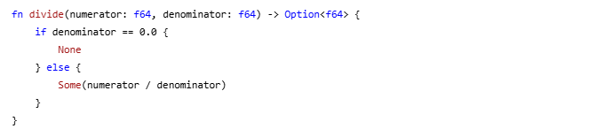
Option (1/2)
Use Cases
Representing an optional value.
Handling cases where a computation might not return a valid result.

Slide 11
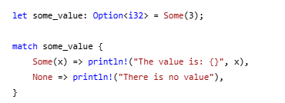
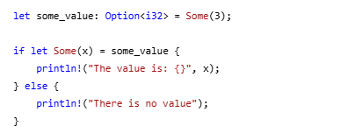
Option (2/2)
How to handle it :
Using Match
Using If let
Method | Description
unwrap | Returns the contained Some value. Panics if the variant is None.
expect | Similar to unwrap but allows specifying a custom panic message if the variant is None.
unwrap_or | Returns the contained Some value or a provided default if the variant is None.
map | Applies a function to the contained Some value and returns a new Option.
and_then | Chains computations that may return None. Applies a function that returns an Option.

Slide 12
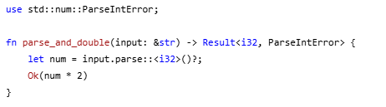
Result (1/2)
The Result type is used to handle operations that can either succeed or fail. It ensures that errors are handled explicitly, making the code safer and more predictable.
Common use cases :
File I/O operations
Parsing data
Network requests
Any operation that may encounter an error condition

Slide 13
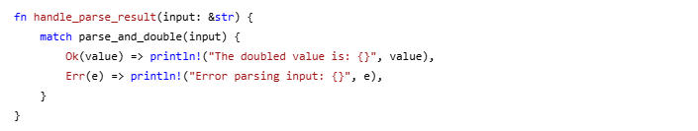
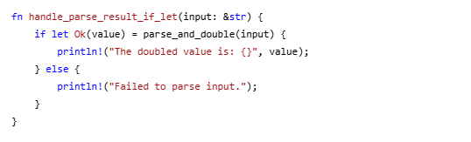
Result (2/2)
How to handle it :
Using Match
Using If let
Method | Description
unwrap | Returns the contained Ok value. Panics if the variant is Err.
expect | Similar to unwrap but allows specifying a custom panic message if the variant is Err.
unwrap_or | Returns the contained Ok value or a provided default if the variant is Err.
unwrap_or_else | Returns the contained Ok value or computes it from a closure if the variant is Err.
map | Applies a function to the contained Ok value and returns a new Result.
map_err | Applies a function to the contained Err value and returns a new Result.
and_then | Chains computations that may return Err. Applies a function that returns a Result.

Slide 14
Propagate error with ? (1/2)
Error propagation is a mechanism for handling errors by passing them up the call stack.
Instead of handling errors immediately where they occur, functions can delegate error handling to their callers.
This approach simplifies code by separating the core logic from error handling.
The ? Operator
The ? operator is used to propagate errors concisely. When applied to a Result or Option, it performs the following actions:
If the value is Ok or Some, it unwraps the value.
If the value is Err or None, it returns the error or None early from the function.

Slide 15
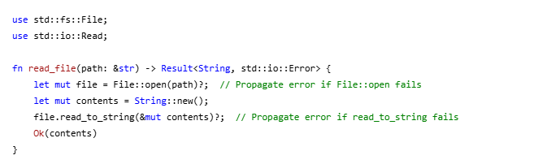
Propagate error with ? (2/2)
File::open(path)? attempts to open the file.
  If it fails, the error is returned immediately.
file.read_to_string(&mut contents)? attempts to read the file into a string.
If it fails, the error is returned immediately.
If both operations succeed, the function returns the file contents wrapped in Ok.

Slide 16
Structure (1/8)
A struct (short for structure) in Rust is a custom data type that allows you to group related data together.
Structs are used to create more complex data types by combining multiple fields of potentially different types.
They are fundamental for organizing and managing data in a meaningful way.
Use Cases :
Grouping related data (e.g., coordinates, user profiles, configuration settings).
Modeling real-world entities with attributes (e.g., users, products, network packets).
Encapsulating data and behavior (when combined with impl blocks).

Slide 17
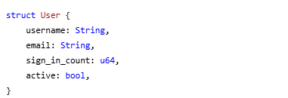
Structure(2/8)
To define a structure :
The User struct groups related fields: username, email, sign_in_count, and active.
Each field has a specified type (e.g., String, u64, bool).

Slide 18
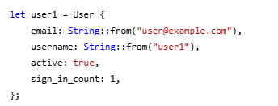
Structure(3/8)
To instantiate a structure :
An instance of the User struct is created by specifying values for each field.
The order of fields does not need to match the order in the struct definition.
Declaring a struct instance as mutable (mut) allows modification of its fields.
  Individual fields can be updated after creation.

Slide 19
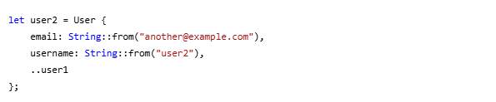
Structure(4/8)
You can also use the update syntax :
An instance of the User struct is created by specifying values for each field.
The order of fields does not need to match the order in the struct definition.
Declaring a struct instance as mutable (mut) allows modification of its fields.Individual fields can be updated after creation.

Slide 20
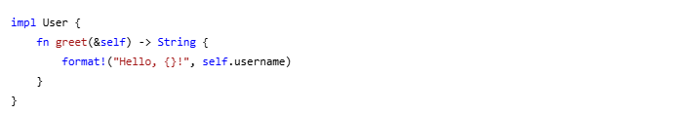
Structure (5/8)
Implement method to struct:
The ..user1 syntax copies the remaining fields from user1 into user2.
This avoids repeating the same values for active and sign_in_count.

Slide 21
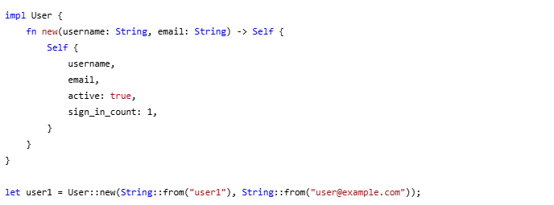
Structure (6/8)
You can also use a method to instantiate a struct (constructor like) :
Associated functions are defined within an impl block but do not take self as a parameter.
They are called using the :: syntax (e.g., User::new) cause it linked to the type not the instance.
Often used as constructors to create new instances of the struct..

Slide 22

Structure (7/8)
To use structure attribute :
To use structure method :

Slide 23


Structure (8/8)
There are different type of structure:
Tuple Structure :
  Tuple structs are similar to tuples but have a name and a specific type.
  Fields are accessed using index notation (black.0, black.1, black.2).
Unit-Like struct :
  Unit-like structs have no fields and are useful for implementing traits on types that don’t need to store data.

Slide 24
Traits
A trait in Rust is a way to define shared behavior across different types.
Traits are similar to interfaces in other languages, allowing you to specify methods that types must implement.
They enable polymorphism and code reuse by defining a set of methods that can be implemented by various types.
Use cases :
Define shared functionality for multiple types.
Enable polymorphism by allowing different types to be used interchangeably if they implement the same trait.
Use trait bounds to specify that a generic type must implement certain methods.

Slide 25

Iterator trait (1/4)
The Iterator trait in Rust is used to create iterators, which are objects that facilitate traversing through collections, such as arrays, vectors, and other data structures.
Iterators provide a sequence of values and allow for efficient, lazy evaluation of operations.
The Iterator trait requires the implementation of a single method: next.
next returns an Option<Self::Item>, which is Some(value) if there are more elements, or None if the iteration is complete.
type Item is an associated type that represents the type of elements being iterated over.

Slide 26
Iterator trait (2/4)
Method | Description
next | Advances the iterator and returns the next value.
map | Applies a function to each element and returns a new iterator.
filter | Filters elements based on a predicate and returns a new iterator.
take | Creates an iterator that yields the first n elements.
collect | Transforms an iterator into a collection.
fold | Accumulates a value by applying a function, consuming the iterator.
for_each | Applies a function to each element, consuming the iterator.
enumerate | Yields both the index and the element.
zip | Combines two iterators into a single iterator of pairs.
chain | Concatenates two iterators.

Slide 27
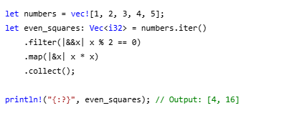
Iterator trait (3/4)
Example with filter and map :
filter retains only the even numbers.
map squares each remaining number.
collect gathers the results into a new vector. (Iterator are Lazy)

Slide 28
Iterator trait (4/4)
Method | Ownership | Description
iter() | Borrows | Creates an iterator that borrows each element immutably.
iter_mut() | Mutably Borrows | Creates an iterator that borrows each element mutably.
into_iter() | Consumes | Creates an iterator that takes ownership of each element, consuming the collection.

Slide 29

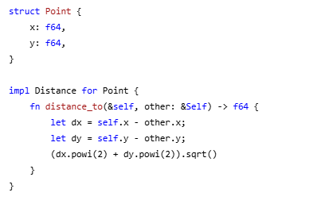
Custom Trait (1/2)
To define a custom trait :
To implement it :

Slide 30
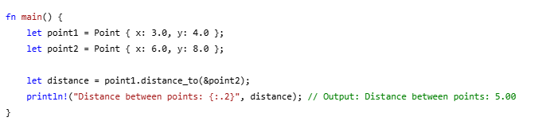
Custom Trait (2/2)
Two Point instances, point1 and point2, are created.
The distance_to method is called on point1 with point2 as the argument.
The result is printed with two decimal places for clarity.

Slide 31

Generic Type
Generic types allow you to write flexible and reusable functions, structs, enums, and traits that can operate on multiple types without duplicating code.
They provide a way to abstract over types while maintaining type safety and performance.
<T> declares a generic type parameter T for the Point struct.
The fields x and y are of type T.
When creating an instance of Point, T will be substituted with a concrete type.

Slide 32
Core data structure & complexity
Core data structures

Slide 33
Vector
Method Name | Definition
new | Creates an empty Vector.
with_capacity | Creates an empty Vector with a specified capacity.
push | Adds an element to the end of the vector.
pop | Removes and returns the last element of the vector.
insert | Inserts an element at a given index.
remove | Removes and returns the element at a given index.
len | Returns the number of elements in the vector.
is_empty | Checks if the vector is empty.
get | Returns a reference to the element at a given index.
iter | Returns an iterator over the elements.
iter_mut | Returns a mutable iterator over the elements.
sort | Sorts the elements of the vector in place.
dedup | Removes consecutive duplicate elements.
retain | Retains only the elements specified by a predicate.
extend | Extends the vector with the elements of an iterator.
clear | Removes all elements from the vector.
capacity | Returns the total capacity of the vector.
reserve | Reserves capacity for additional elements.
truncate | Shortens the vector to a specified length.
split_off | Splits the vector at a given index and returns the remaining elements.
A growable array type, stored on the heap.
Vectors provide dynamic resizing and efficient random access to elements.
When to Use It
Use when you need a resizable array with efficient insertion and deletion at the end.
Time Complexity:
  Insertion/Deletion at end: O(1)
  Insertion/Deletion in the middle: O(n)
  Access: O(1)
  Search: O(n)
Use Case
Storing a list of elements where the size may change dynamically.
Implementing stacks, queues (with appropriate methods), or other linear data structures.
Situations where random access and iteration are frequently needed.

Slide 34
LinkedList
A doubly-linked list with heap-allocated nodes.
Each node contains an element and pointers to the next and previous nodes.
When to Use It
Use when frequent insertions and deletions at both ends or in the middle are required.
Time Complexity:
Insertion/Deletion at ends: O(1)
Insertion/Deletion in the middle: O(n)
Access: O(n)
Use Case
Implementing queues, stacks, or other structures where dynamic insertion/deletion is needed.
Situations where cache locality is not critical.
Method Name | Definition
new | Creates an empty LinkedList.
push_front | Adds an element to the front of the list.
push_back | Adds an element to the back of the list.
pop_front | Removes and returns the element from the front of the list.
pop_back | Removes and returns the element from the back of the list.
len | Returns the length of the list.
is_empty | Checks if the list is empty.
split_off | Splits the list at a given index.

Slide 35
VecDeque
A double-ended queue implemented as a growable ring buffer.
It allows efficient insertion and removal from both ends.
When to Use It
Use when you need a queue or a double-ended queue with efficient operations at both ends.
Time Complexity:
  Insertion/Deletion at ends: O(1)
  Insertion/Deletion in the middle: O(n)
  Access: O(1)
Use Case
Task scheduling (FIFO or LIFO).
Breadth-first search (BFS) where elements are added to the back and removed from the front.
Method Name | Definition
new | Creates an empty VecDeque.
push_front | Adds an element to the front of the queue.
push_back | Adds an element to the back of the queue.
pop_front | Removes and returns the element from the front of the queue.
pop_back | Removes and returns the element from the back of the queue.
len | Returns the length of the queue.
is_empty | Checks if the queue is empty.
get | Returns a reference to the element at a given index.
as_slices | Returns two slices that contain the elements of the queue.

Slide 36
BinaryHeap
A priority queue implemented as a binary heap.
Elements are ordered such that the maximum value is always at the front.
When to Use It
Use when you need to frequently access the maximum (or minimum) element.
Time Complexity:
  Insertion: O(log n)
  Access max: O(1)
  Remove max: O(log n)
Use Case
Scheduling tasks by priority.
Dijkstra's algorithm for finding the shortest path.
Method Name | Definition
new | Creates an empty BinaryHeap.
push | Adds an element to the heap.
pop | Removes and returns the maximum element from the heap.
peek | Returns a reference to the maximum element without removing it.
len | Returns the number of elements in the heap.
is_empty | Checks if the heap is empty.
into_sorted_vec | Consumes the heap and returns a sorted vector.

Slide 37
HashMap
A hash table implementation that stores key-value pairs.
It uses a hash function to compute an index into an array of buckets.
When to Use It
Use when you need fast key-value lookups, insertions, and deletions.
Time Complexity:
  Insertion: O(1)
  Lookup: O(1)
  Deletion: O(1)
Use Case
Caching data for quick access.
Counting occurrences of elements (e.g., word frequency).
Method Name | Definition
new | Creates an empty HashMap.
insert | Inserts a key-value pair into the map.
get | Returns a reference to the value corresponding to the key.
remove | Removes a key-value pair from the map.
contains_key | Checks if the map contains a given key.
len | Returns the number of elements in the map.
is_empty | Checks if the map is empty.
iter | Returns an iterator over the key-value pairs.

Slide 38
HashSet
A hash set implementation that stores unique elements.
It uses a hash function to compute an index into an array of buckets.
When to Use It
Use when you need to store unique elements and check for membership efficiently.
Time Complexity:
  Insertion: O(1)
  Lookup: O(1)
  Deletion: O(1)
Use Case
Removing duplicates from a collection.
Tracking a set of unique items (e.g., visited nodes in a graph).
Method Name | Definition
new | Creates an empty HashSet.
insert | Adds an element to the set.
contains | Checks if the set contains a given element.
remove | Removes an element from the set.
len | Returns the number of elements in the set.
is_empty | Checks if the set is empty.
iter | Returns an iterator over the elements.

Slide 39
BTreeMap
A map implemented as a B-tree. It stores key-value pairs and maintains keys in sorted order.
When to Use It
Use when you need a map with sorted keys or range queries.
Time Complexity:
  Insertion: O(log n)
  Lookup: O(log n)
  Deletion: O(log n)
  Range queries: O(log n + m), where m is the number of elements in the range.
Use Case
Implementing ordered dictionaries.
Databases and filesystems where sorted data is required.
Method Name | Definition
new | Creates an empty BTreeMap.
insert | Inserts a key-value pair into the map.
get | Returns a reference to the value corresponding to the key.
remove | Removes a key-value pair from the map.
contains_key | Checks if the map contains a given key.
len | Returns the number of elements in the map.
is_empty | Checks if the map is empty.
range | Returns an iterator over a range of key-value pairs.

Slide 40
BTreeSet
A set implemented as a B-tree. It stores unique elements and maintains them in sorted order.
When to Use It
Use when you need a set with sorted elements or range queries.
Time Complexity:
  Insertion: O(log n)
  Lookup: O(log n)
  Deletion: O(log n)
  Range queries: O(log n + m), where m is the number of elements in the range.
Use Case
Maintaining a sorted list of unique elements.
Implementing ordered sets.
Method Name | Definition
new | Creates an empty BTreeSet.
insert | Adds an element to the set.
contains | Checks if the set contains a given element.
remove | Removes an element from the set.
len | Returns the number of elements in the set.
is_empty | Checks if the set is empty.
iter | Returns an iterator over the elements.
range | Returns an iterator over a range of elements.

Slide 41
Questions ?
Ask them all !

