Slide 1


Smart Grid Optimization
for Electric Mobility
Intelligent Energy Distribution & Management Network
Student
Supervisor
Year
Ibtissam Rharib
Dr. EL MKHALET MOUNA
2025 – 2026
Notes:
Welcome. Introduce yourself and the project topic. Mention the link to Morocco's National Electromobility Strategy.

Slide 2
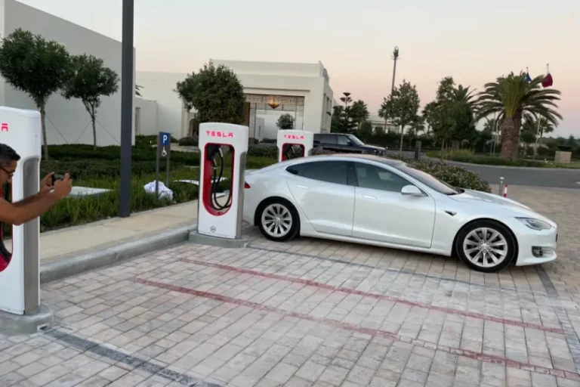
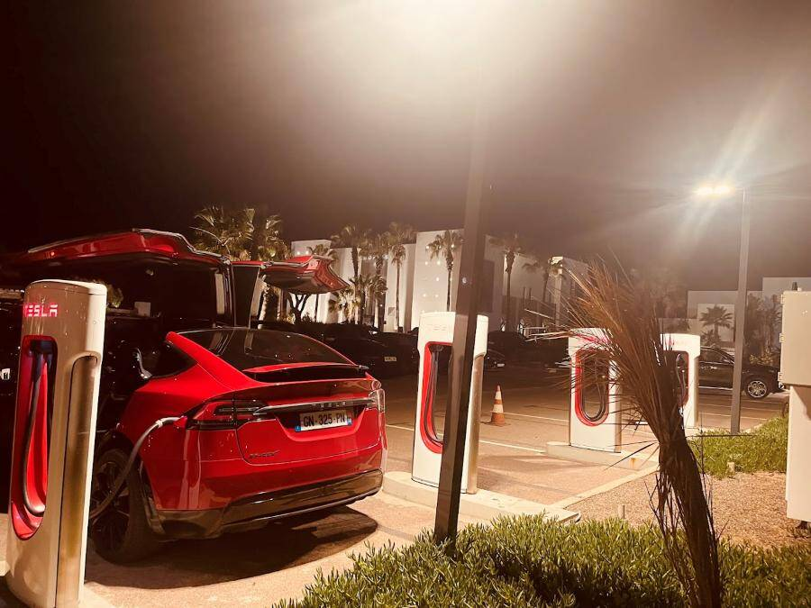
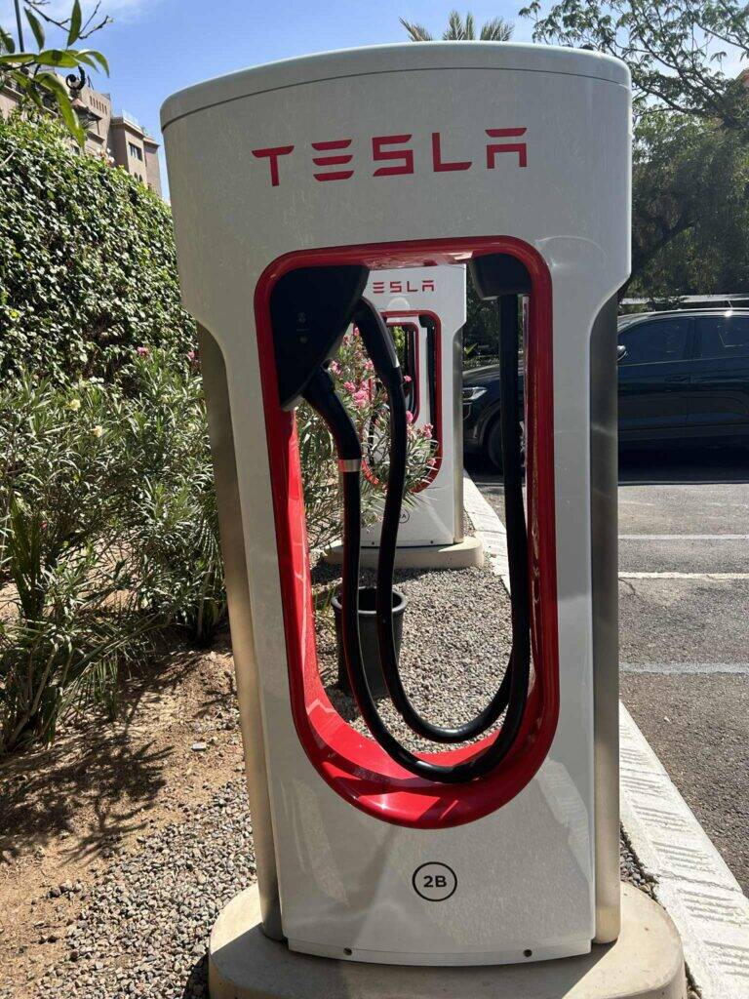
Why Does This Matter?
~2,500
The Problem
EVs in Morocco (2024)
Morocco's electric vehicle fleet is growing rapidly. Traditional power grids were not designed for the sudden, simultaneous charging demand this creates. Without intelligent optimization, the result is:
• Grid overload during peak hours
• High infrastructure costs
• Unequal energy distribution
• Bottlenecks in key urban zones
50,000
Projected EVs by 2030
52%
Renewable target by 2030
Tesla Model X in Agadir at the Supercharger
Tesla supercharger in Marrakech
Tesla supercharger in Tangier
Notes:
Highlight the scale of the challenge. Morocco is investing heavily in renewables (Noor Ouarzazate, Jbel Khalladi wind farm) — the grid must evolve too.

Slide 3
Our Approach: Modeling the Grid as a Graph
We represent the entire energy network as a weighted graph G = (V, E, W), where each component becomes a node and each power line becomes an edge.
⚡
🔄
🔌
🏙️
Energy Sources
Substations
Charging Stations
Demand Zones
Solar, wind, national grid
HV / MV / LV transformers
Fast & semi-fast chargers
Residential & commercial areas
Notes:
Explain that once the network is a graph, all the power of Operations Research applies directly — distances become costs, lines become edges with capacities.

Slide 4
Graph Algorithms in Action
Welsh-Powell
Kruskal
Dijkstra
Charging Slot Planning
Minimum Cost Network
Cheapest Energy Path
Colors conflicting stations into non-overlapping time slots to avoid substation overload.
Builds the minimum spanning tree — connects all nodes with the lowest possible cabling cost.
Finds the least-cost route from each energy source to every charging station.
Bellman-Ford
Ford-Fulkerson
Variable Cost Networks
Maximum Power Flow
Handles subsidized tariffs and detects negative-cost cycles in the energy network.
Calculates the maximum power that can flow from sources to all chargers simultaneously.
Notes:
Briefly explain each algorithm. Focus on WHY each one is relevant to electric grids specifically — not just abstract theory.

Slide 5
From Routing to Optimization
Transport algorithms and linear programming complete the optimization pipeline.
STEP 1
STEP 2
STEP 3
North-West
Method
Least Cost
Method
Simplex
Method
Initial feasible allocation of energy flows from sources to substations
→
Improved starting solution — assigns flows to cheapest routes first
→
Global optimal solution under all capacity and demand constraints
Result: The Simplex method converges in 8 iterations to an optimal cost Z* = 1,247 units — a 14% reduction compared to the North-West initial solution.
Notes:
Explain the pipeline: we start with a rough solution (NW), improve it (Least Cost), then optimize globally (Simplex). This mirrors real-world energy dispatching practices.

Slide 6
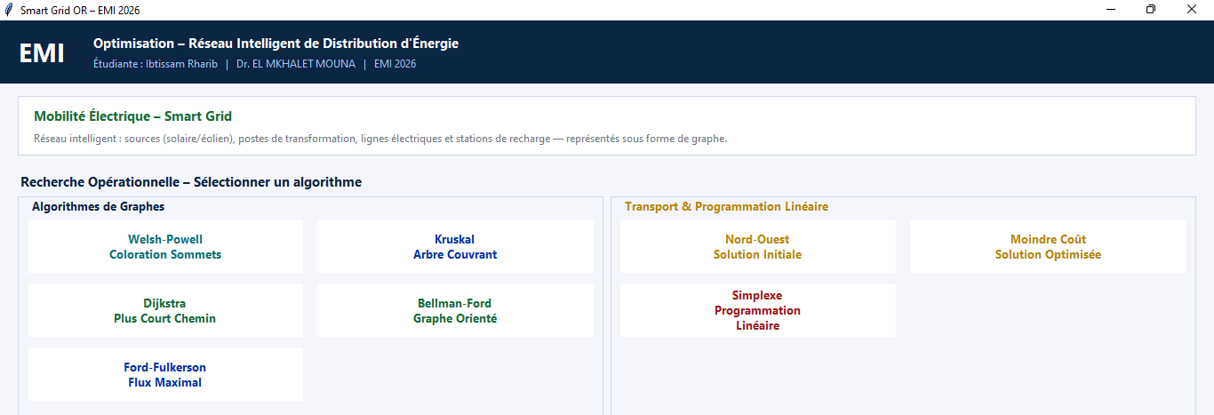
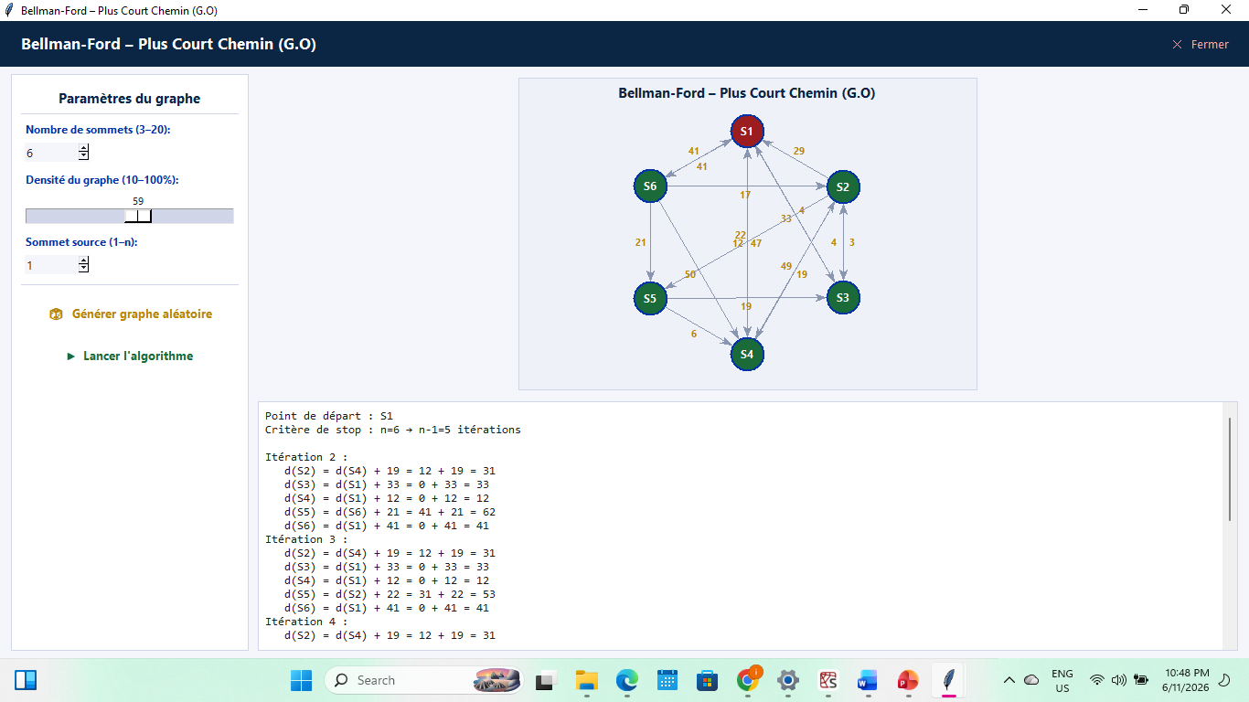
Desktop Application — Built in Python (Tkinter)
🎲
Random Graph Generation
📊
Live Graph Visualization
Configurable: 3 nodes, 10–100% density
Canvas-rendered with color-coded paths & weights
⚙️
🖥️
8 Algorithms Integrated
Executable (.exe)
All OR methods with step-by-step output
Compiled desktop app, no Python install needed
Notes:
Show the app live if possible. Highlight that data is fully random — the user sets the number of nodes and density, and the app generates and solves automatically.

Slide 7
Key Takeaways
Graph modeling enables rigorous OR methods on complex real-world networks
Future Work
• Real-time SCADA data integration
31% infrastructure savings achieved through Kruskal's MST on the Casablanca network
• Dynamic pricing (time-of-use tariffs)
14% operational cost reduction via Simplex linear programming
• Genetic algorithms for larger networks
Ford-Fulkerson identified the critical bottleneck limiting city-wide EV charging capacity
• Extension to national ONEE grid
• V2G (vehicle-to-grid) modeling
The integrated desktop application makes these tools accessible and demonstrable
Thank you for your attention.
Notes:
Summarize: the project proves that Operations Research is not just theory — it delivers measurable gains on real infrastructure. Open for questions.

