Slide 1
web
Ibtissem mekrazi

Slide 2
What Does Web Mean?
The Web is the common name for the World Wide Web, a subset of the Internet consisting of the pages that can be accessed by a Web browser.
Many people assume that the Web is the same as the Internet, and use these terms interchangeably. However, the term Internet actually refers to the global network of servers that makes the information sharing that happens over the Web possible. So, although the Web does make up a large portion of the Internet, but they are not one and same.

Slide 3
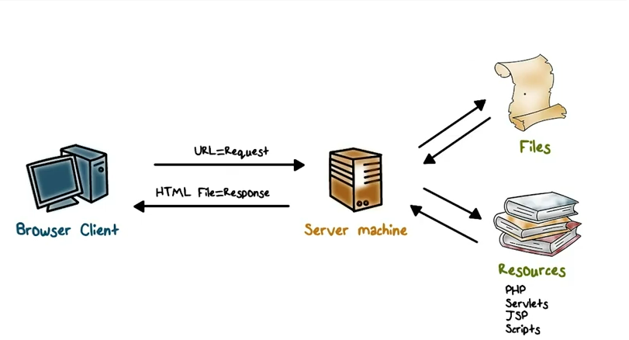
How does the Web work?

Slide 4
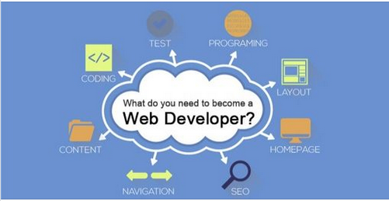

Slide 5
Why did you choose to learn web development?
Nowadays web development is very necessary. Because there are lot of business running through websites which needs web developers and designers. Websites runs in every Application so it Increase the need of web development,

