Slide 1
DSA 2040A Group Project Presentation Olist E-Commerce Data Mining
A Data-Driven Exploration of Customer Engagement and Sales Performance
Presented by: Group 6 – Fall 2025

Slide 2
Objective: Analyze Olist’s e-commerce dataset to uncover meaningful trends using:
ETL (Extract, Transform, Load)
Exploratory Data Analysis (EDA)
Feature Engineering
Predictive Modeling
Focus: Support business decisions on logistics, marketing, and customer engagement.

Slide 3
Team Structure & Roles
Team Member | Role Summary
Hana Gashhaw | Led ETL, Co-developed dashboards, Co-led modeling
Tizzah Nzioka | Co-led EDA, Feature engineering
Ted Korir | Co-led EDA, Modeling support
Selimah Tzindori | Dashboard design, Co-led clustering
Levvin Ekxam | Documentation, Visual storytelling
Angela Fungu | Documentation, Final edits and presentation support

Slide 4
Dataset Overview
Source: Olist public dataset
Size: 1.7M+ records across 9 CSV files
Period: Last 3 months of transaction data
Key joins: customer_id, order_id, product_id

Slide 5
ETL & Data Preparation
Handled missing data and outliers
Renamed and standardized columns
Merged data tables using keys
Filtered dataset to focus on recent 3 months

Slide 6
Exploratory Data Analysis (EDA)
Total Orders: 10,090
Revenue: 1.64M BRL
On-time Delivery: 91.02%
Customer Location: Mostly São Paulo
Preferred Payment: Credit card (73.5%)

Slide 7
Feature Engineering
Derived variables:
delivery_delay, price_per_gram, purchase_hour
Created categorical & time-based features
Applied log transformation to reduce skewness

Slide 8
Modeling & Segmentation
Clustering (K-Means):
High-frequency buyers
High-value customers
Budget shoppers
Regression: Delivery time prediction
Classification: Review score prediction

Slide 9
Visual Insights
Boxplots: Price variance by product
Heatmaps: Price, freight, and payment correlations
Scatterplots: Price vs Freight
Maps: Orders by Brazilian regions

Slide 10
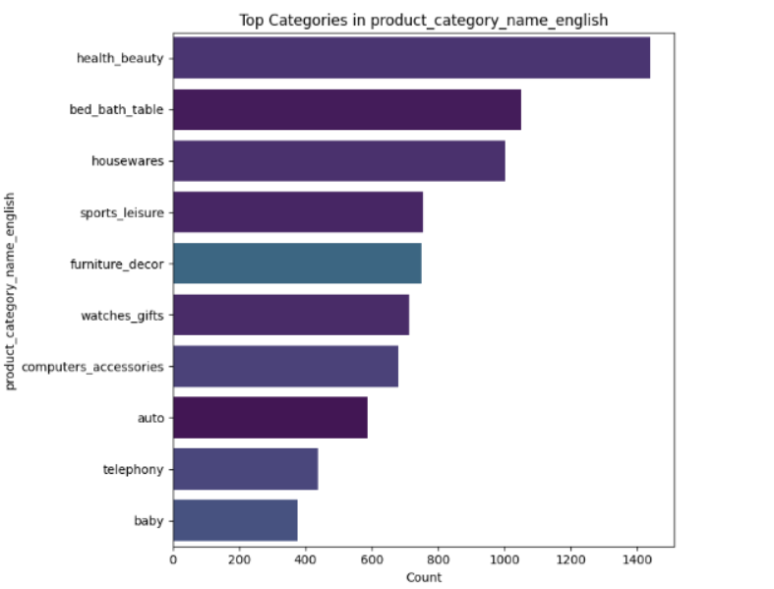
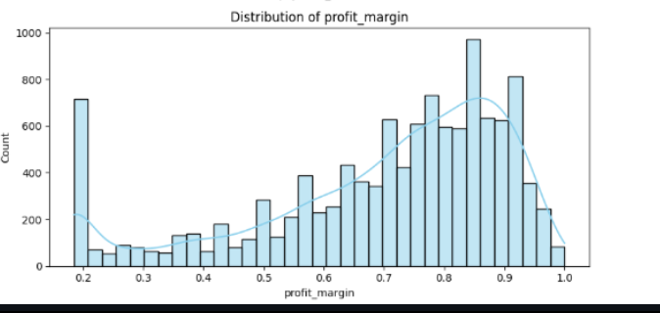
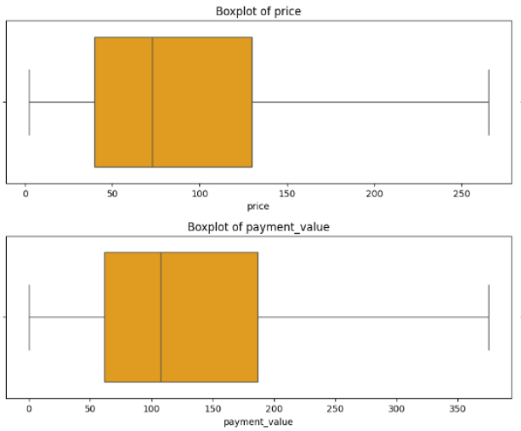

Slide 11
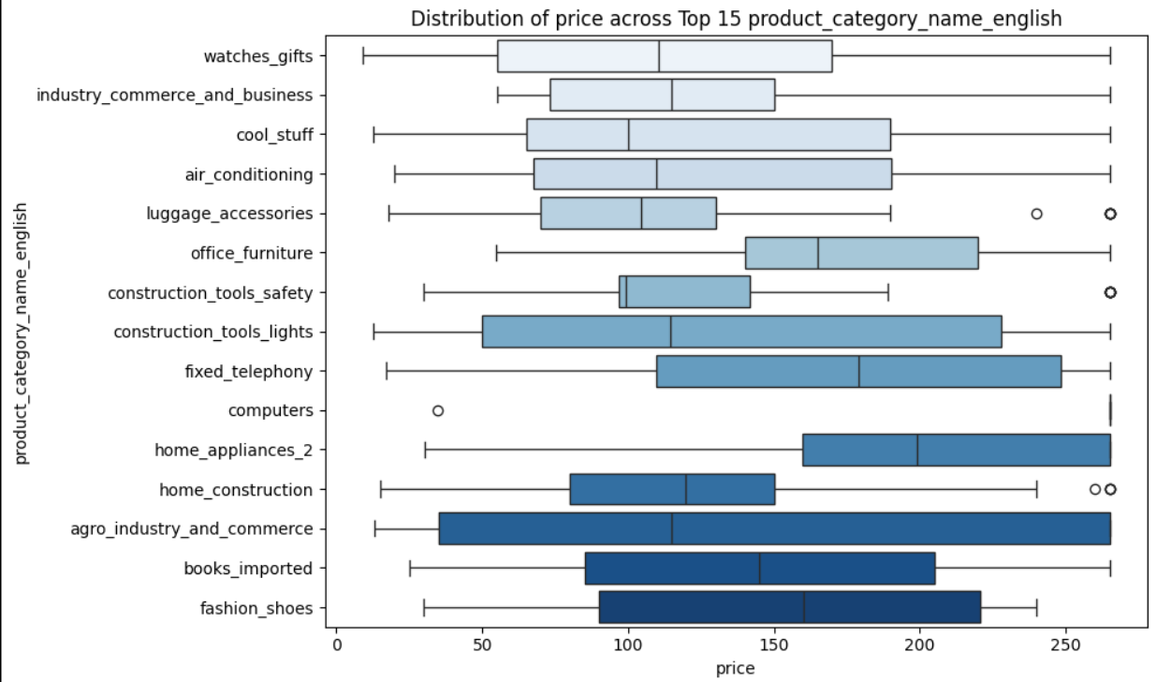

Slide 12
Business Implications
Improve delivery logistics in slower regions
Use segments to personalize marketing
Align inventory with regional demand
Encourage repeat purchases
Monitor low-rated products for quality issues

Slide 13
Conclusion
Comprehensive insights from sales, product, and customer data
Actionable strategies to improve performance and engagement
Demonstrated real-world data mining workflow

Slide 14


