Slide 1
MONEY??
LIBRARIES??
Felix Kabo, M.Arch, Ph.D.

Slide 2
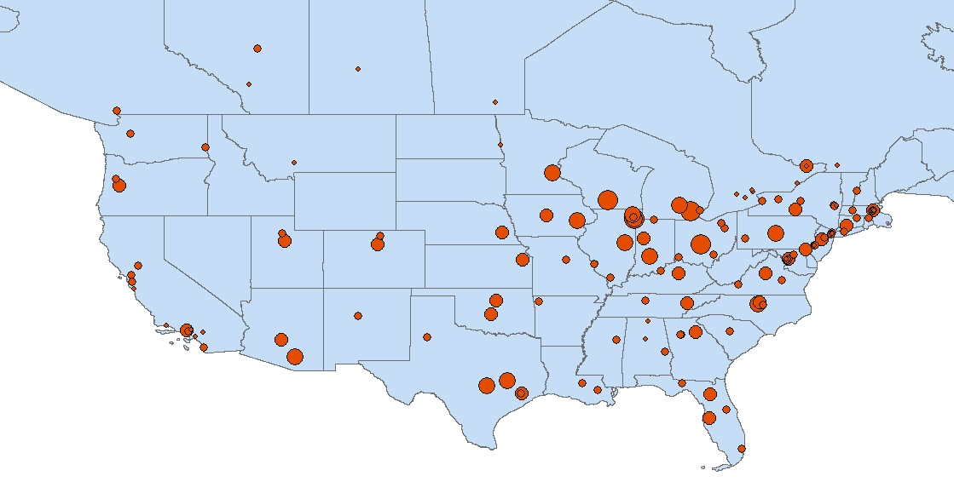
LIBRARIES$∝$ NATIONAL INSTITUTES OF HEALTH FUNDING

Slide 3
use bdc2014
create table ill_institutions
(
Institution varchar(255),
City varchar(125),
State varchar(50),
Zipcode varchar(9),
RU_VH varchar(1),
ARL varchar(1),
ACAD_RES varchar(1),
Public_100K varchar(1),
Public_CA varchar(1),
latitude float,
longitude float
);
bulk insert ill_institutions
from 'C:\Users\Felix Kabo\Desktop\BDC Knowledge Institutions.txt'
with (firstrow=2);
--406 rows

Slide 4
create table nihgrants2013
(
ORGANIZATION varchar(255),
AWARDS int,
FUNDING int,
CITY varchar(125),
STATE varchar(2)
);
bulk insert nihgrants2013
from 'C:\Users\Felix Kabo\Desktop\NIH Funding FY2013.txt'
with (firstrow=2);
--2292 rows

Slide 5
select sum(FUNDING) as moneyflows, upper(CITY) as city, upper(STATE) as state
into moneysum
from nihgrants2013
group by CITY, STATE
order by moneyflows
--813 rows
select * into knowledge_houses
from ill_institutions
left join states_abbreviations
on ill_institutions.State = states_abbreviations.ST
--406 rows

Slide 6
select COUNT(Institution) as knowledge_counts, upper(City) as cities, ABBR as states
from knowledge_houses
group by City, ABBR
order by knowledge_counts
--318 rows
select COUNT(Institution) as knowledge_counts, upper(City) as cities, ABBR as states
from knowledge_houses
where ABBR!='NULL'
group by City, ABBR
order by knowledge_counts
--279 rows

Slide 7
select COUNT(Institution) as knowledge_counts, upper(City) as cities, ABBR as states
into total_knowledge
from knowledge_houses
where ABBR!='NULL'
group by City, ABBR
order by knowledge_counts
--279 rows
select * into money_knowledge
from moneysum
left join total_knowledge
on moneysum.city = total_knowledge.cities
and moneysum.state = total_knowledge.states
--813 rows

Slide 8
select * from money_knowledge
where states!='NULL'
order by moneyflows
--194 rows
select * from money_knowledge
where knowledge_counts>0
order by moneyflows
--194 rows

Slide 9
--Finally, take easy route and calculate correlations in Stata...or do it in SQL
alter table money_knowledge
alter column moneyflows bigint
declare @mean1 decimal(20,6)
declare @mean2 decimal(20,6)
select @mean1=AVG(moneyflows*1.0)
,@mean2=AVG(knowledge_counts*1.0)
from money_knowledge
where knowledge_counts>0;
select (SUM((moneyflows*1.0-@mean1)*(knowledge_counts*1.0-@mean2))/COUNT(*))
/((STDEVP(moneyflows*1.0)*STDEVP(knowledge_counts*1.0))) as correlation
from money_knowledge
where knowledge_counts>0;
--0.554758521032079 Is it elegant? Maybe not...but you get the picture

Slide 10
MORE LIBRARIES = MORE MONEY!!
♫

