Slide 1
From Twitter API to Social Science Paper
Presentation for the ICOS Big Data Boot Camp
Todd Schifeling
5/22/14

Slide 2
Outline
Collecting Twitter Data with a Snowball
Motivation for Collecting the Data
Big Data-Social Science Divide
Possible Solutions

Slide 3
Snowballing Twitter Data
NOTES ON SNOWBALLING TWITTER DATA
Procedure:
starting point
network search
selection principle
Notes:
-akin to Google spidering, six degrees of Kevin Bacon; network search depends on type of group your snowballing (and the term snowballing shows disconnect between sociology and big data); content id depends on discriminating terminology – ex. of words mobile or trailer; !launch program!

Slide 4
Snowballing Twitter Data
NOTES ON SNOWBALLING TWITTER DATA
Procedure:
starting point: Scratchtruck
network search: friends
selection principle: self-description matches 2 dictionaries
Notes:
two dictionaries: one to id food-related, the other to id mobile-delivery system. Food words were scraped from online food encyclopedia

Slide 5
Twitter Data Calls
NOTES ON SNOWBALLING TWITTER DATA
friends.ids returns friendship ties (from, to)
5000 per call at one minute per call = 5000 friendship ties per minute (but only one user per minute)
users.lookup returns user info (name, description, location, last tweet, etc.)
100 per call at six seconds per call = 1000 users per minute
more info at https://dev.twitter.com/docs/api/1.1
Notes:
Go to website, show friends/ids; Go to program show twfriends4.py

Slide 6
Snowballing Twitter Data
NOTES ON SNOWBALLING TWITTER DATA
Results:
Steps | Time | Possible | Already Done | Selected | Collected | Friends
1 | 1 min | 1 | 0 | 1 | 1 | 3002
2 | 1 hr 42 mins | 3002 | 0 | 91 | 88 | 106769
3 | 3 dys 4 hrs 24 mins | 67764 | 2383 | 4359 | 4324 | 2511143
Notes:
-discuss size of network, diminishing returns, etc.; actual results
-possible users are much less because many friends are redundant (e.g., A-C and B-C become C and 2 becomes 1)

Slide 7
Workflow for Food Trucks Paper
NOTES ON SNOWBALLING TWITTER DATA
Get Twitter data on possible trucks
Identify trucks
Get idiosyncratic trucks from Twitter via in-degree
Match trucks to cities
Get additional data (demographics, chains, microbreweries, weather, etc.)
Regressions!
Co-author: Daphne Demetry, Northwestern University

Slide 8
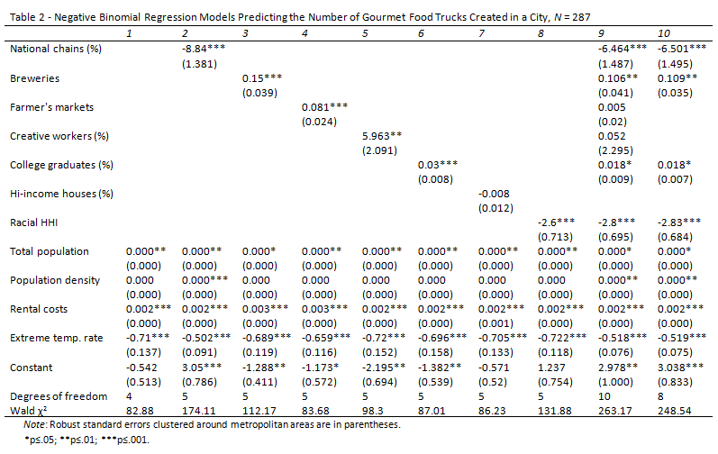
Now We’re Doing Social Science!
NOTES ON SNOWBALLING TWITTER DATA

Slide 9
But Why Collect Twitter Data on Gourmet Food trucks?

Slide 10
How Well Do They Mesh?
SURVEYING THE DIVIDE
 | Social Science |  | Big Data
Measurement | fidelity |  | large unobtrusive N
Notes:
other issues include longitudinal vs. cross-sectional data. Sampling problems are well known. Theoretical dispositions clash because social science is focused on identifying underlying causes and mechanisms, and big data is focused on identifying patterns and correlations. Attempts to translate the two are often clumsy because digital phenomena lack substantiation in the ‘real world,’ and so you get deep causal accounts based in shallow online data resting on problematic assumption of transferability (e.g., understand influence or innovation by studying Twitter data; similar to experiments but without controls). Analogy to early corporate networks research where skeptics said ‘so what?’

Slide 11
How Well Do They Mesh?
SURVEYING THE DIVIDE
 | Social Science |  | Big Data
Measurement | fidelity | IDEAL | large unobtrusive N
Notes:
other issues include longitudinal vs. cross-sectional data. Sampling problems are well known. Theoretical dispositions clash because social science is focused on identifying underlying causes and mechanisms, and big data is focused on identifying patterns and correlations. Attempts to translate the two are often clumsy because digital phenomena lack substantiation in the ‘real world,’ and so you get deep causal accounts based in shallow online data resting on problematic assumption of transferability (e.g., understand influence or innovation by studying Twitter data; similar to experiments but without controls). Analogy to early corporate networks research where skeptics said ‘so what?’

Slide 12
How Well Do They Mesh?
SURVEYING THE DIVIDE
 | Social Science |  | Big Data
Measurement | fidelity | IDEAL | large unobtrusive N
Sampling | random |  | digital breadcrumbs
Notes:
other issues include longitudinal vs. cross-sectional data. Sampling problems are well known. Theoretical dispositions clash because social science is focused on identifying underlying causes and mechanisms, and big data is focused on identifying patterns and correlations. Attempts to translate the two are often clumsy because digital phenomena lack substantiation in the ‘real world,’ and so you get deep causal accounts based in shallow online data resting on problematic assumption of transferability (e.g., understand influence or innovation by studying Twitter data; similar to experiments but without controls). Analogy to early corporate networks research where skeptics said ‘so what?’

Slide 13
How Well Do They Mesh?
SURVEYING THE DIVIDE
 | Social Science |  | Big Data
Measurement | fidelity | IDEAL | large unobtrusive N
Sampling | random | CHASM | digital breadcrumbs
Notes:
other issues include longitudinal vs. cross-sectional data. Sampling problems are well known. Theoretical dispositions clash because social science is focused on identifying underlying causes and mechanisms, and big data is focused on identifying patterns and correlations. Attempts to translate the two are often clumsy because digital phenomena lack substantiation in the ‘real world,’ and so you get deep causal accounts based in shallow online data resting on problematic assumption of transferability (e.g., understand influence or innovation by studying Twitter data; similar to experiments but without controls). Analogy to early corporate networks research where skeptics said ‘so what?’

Slide 14
How Well Do They Mesh?
SURVEYING THE DIVIDE
 | Social Science |  | Big Data
Measurement | fidelity | IDEAL | large unobtrusive N
Sampling | random | CHASM | digital breadcrumbs
Causality | realism |  | description
Notes:
other issues include longitudinal vs. cross-sectional data. Sampling problems are well known. Theoretical dispositions clash because social science is focused on identifying underlying causes and mechanisms, and big data is focused on identifying patterns and correlations. Attempts to translate the two are often clumsy because digital phenomena lack substantiation in the ‘real world,’ and so you get deep causal accounts based in shallow online data resting on problematic assumption of transferability (e.g., understand influence or innovation by studying Twitter data; similar to experiments but without controls). Analogy to early corporate networks research where skeptics said ‘so what?’

Slide 15
How Well Do They Mesh?
SURVEYING THE DIVIDE
 | Social Science |  | Big Data
Measurement | fidelity | IDEAL | large unobtrusive N
Sampling | random | CHASM | digital breadcrumbs
Causality | realism | CHASM | description
Notes:
other issues include longitudinal vs. cross-sectional data. Sampling problems are well known. Theoretical dispositions clash because social science is focused on identifying underlying causes and mechanisms, and big data is focused on identifying patterns and correlations. Attempts to translate the two are often clumsy because digital phenomena lack substantiation in the ‘real world,’ and so you get deep causal accounts based in shallow online data resting on problematic assumption of transferability (e.g., understand influence or innovation by studying Twitter data; similar to experiments but without controls). Analogy to early corporate networks research where skeptics said ‘so what?’

Slide 16

The Fallout
SURVEYING THE DIVIDE
Notes:
Big data is marginalized in sociology.

Slide 17

A Possible Way Forward
POSSIBLE SOLUTIONS
Identify populations that simultaneously inhabit both offline and online worlds…
…which links sampling frames to available breadcrumbs, and ‘real’ to digital phenomena
Notes:
now the sample and the behaviors are identical to the population and phenomena of interest

Slide 18
A Typology of Examples that Cross the Offline/Online Divide
POSSIBLE SOLUTIONS
1. Offline activities that are more common online or are difficult to observe offline:
rare or deviant subcultures
bullying, deception, and other bad behaviors
Notes:
now the sample and the behaviors are identical to the population and phenomena of interest

Slide 19
A Typology of Examples that Cross the Offline/Online Divide
POSSIBLE SOLUTIONS
2. Offline activities with a significant online share:
dating markets
reviews of restaurants, books, movies, consumer goods, etc.
neighborhood activism
Notes:
now the sample and the behaviors are identical to the population and phenomena of interest

Slide 20
A Typology of Examples that Cross the Offline/Online Divide
POSSIBLE SOLUTIONS
3. Offline activities that are also born online:
crowdsourcing projects
modern political ads
start-ups
Notes:
now the sample and the behaviors are identical to the population and phenomena of interest

Slide 21
Why the Case of Gourmet Food Trucks Bridges Offline and Online
POSSIBLE SOLUTIONS
A new organizational form
Twitter is crucial to the operations of the trucks
Golden breadcrumbs get left behind
Notes:
now the sample and the behaviors are identical to the population and phenomena of interest

Slide 22
Comparison of Twitter Data to Standard Organizational Data
POSSIBLE SOLUTIONS
Advantages: user-generated data, unfiltered by mediating data collector, digital breadcrumbs tracks organizational activity, relational data
Disadvantages: less systematic comparison across organizations, have to clean and validate data yourself

